Slide 3
TODAY’S MESSAGE
Matthew 1 Pt 1
Messiah’s Bloodline

Slide 4
Please subscribe for updates on our website,
Watch us on YouTube
follow us on Facebook and the other social media networks.
Please like and share our videos and posts

Slide 5
At the end of today’s teaching you will be able to 1. Ask Questions 2. Receive Prayer and 3. Give your Tithes, Offerings

Slide 6
The Vision of House of Israel is to be; 1. A Worshipping People (Jn 4:23,24) 2. An Evangelistic Community (Acts 2:42-47)

Slide 7
3. A Discipleship Center (Matt 28:19) 4. An Equipping Network (Eph 4:12) 5. And a Worldwide Witness for Yeshua The Messiah
(ACTS 1:8)

Slide 9
Worship in Prayer

Slide 10
TODAY’S MESSAGE
Matthew 1 Pt 1
Messiah’s Bloodline

Slide 11
^{Mt 1:1} The book of the generation of Yeshua Messiah, the son of David, the son of Abraham.

Slide 12
^{Mt 1:1} The book of the generation of Yeshua Messiah, the son of David, the son of Abraham.

Slide 13
The genealogy of Yeshua is vital prophetically in determining if Yeshua is in fact the prophesied Messiah.
Matthew traces Yeshua’s bloodline back through Perez, the son of Tamar and Judah to Israel, to Isaac the son of Abraham the father of us all who live by faith.

Slide 14
In this genealogical trace, Matthews’s efforts were to demonstrate to his readers that Yeshua was the prophesied Messiah with royal bloodline and that faith in Him was crucial to the restoration of the kingdom of Israel as king, and salvation for the nations of the world.

Slide 15
The genealogy or bloodline of Yeshua reveals that Yeshua’s ancestors were a mixture of Israelites, Canaanites and Moabites.
Matthew traces Yeshua’s genealogy back to Abraham through David.

Slide 16
^{Mt 1:2} Abraham begat Isaac; and Isaac begat Jacob/Israel; and Jacob/Israel begat Judas and his brethren;

Slide 17
YeHoVaH changed Jacob’s name to Israel but he is not once referenced as the man Israel or Israel the father in the New Testament.

Slide 18
The name Israel, is used in reference as:
The people of Israel
The land of Israel
The house of Israel
The tribes of Israel
The children of Israel
The king of Israel

Slide 19
The name Israel is not once used in reference to the man named Israel.
A person could read the entire New Testament and never know there was a man named Israel.

Slide 20
They would not know that the people of Israel came from a man named Israel.
They would not know that the 12 tribes of Israel were from the 12 sons of the man Israel

Slide 21
They would not know that the land of Israel was named after the man Israel
They would not know that the children of Israel was in reference to man Israel and instead connect the children to the land of Israel which is named after the man Israel

Slide 22
Israel is called Jacob throughout the New Testament, never Israel, as if YeHoVaH NEVER changed his name.

Slide 23
In many references in the New Testament the name Jacob is used after YeHoVaH changed his name to Israel.

Slide 24
This could be the main reason why New Testament people refer to the God of Abraham, Isaac and Jacob because they are trained to remember the man Jacob and NOT the man Israel.

Slide 25
Therefore most people connect the name Israel to the land, the tribe, the people, the nation and the kingdom, NOT the man.

Slide 26
^{Mt 1:3} And Judas/Judah begat Phares and Zara of Thamar; and Phares begat Esrom; and Esrom begat Aram;

Slide 27
By tracing Yeshua’s genealogy to Judas/Judah, Matthew identifies Yeshua as from the tribe of Judas/Judah and connects Yeshua to the prophecy given to Israel when he spoke

Slide 28
^{Ge 49:10} The sceptre shall not depart from Judah, nor a lawgiver from between his feet, until Shiloh come; and unto him shall the gathering of the people be.

Slide 29
Thamar/Tamar, a woman of Canaan, a Canaanite.

Slide 30
^{Mt 1:4} And Aram begat Aminadab; and Aminadab begat Naasson; and Naasson begat Salmon;
^{Mt 1:5} And Salmon begat Booz of Rachab; and Booz begat Obed of Ruth; and Obed begat Jesse;

Slide 31
Rehab, a harlot of Jericho in Canaan, a Canaanite
Ruth a Moabite

Slide 32
By connecting the bloodline of Yeshua to David, the king of Israel chosen by YeHoVaH when He prophetically spoke through Israel that the scepter would always remain in the house of Judah, Matthew reveals Yeshua as King and royal lineage to the house of David.

Slide 33
Luke shares with us the words spoken to Mary:
^{Lk 1:31} And, behold, thou shalt conceive in thy womb, and bring forth a son, and shalt call his name YESHUA.

Slide 34
^{Lk 1:32} He shall be great, and shall be called the Son of the Highest: and the Lord God shall give unto him the throne of his father David:
^{Lk 1:33} And he shall reign over the house of Jacob for ever; and of his kingdom there shall be no end.

Slide 35
Matthew Identifies David’s sin with the murder of Uriah and the marriage of his wife Bathsheba

Slide 36
^{Mt 1:6} And Jesse begat David the king; and David the king begat Solomon of her that had been the wife of Urias;

Slide 37
01339 בַּת־שֶׁבַע Bath-Sheba` {bath-sheh'-bah} Meaning: Bath-sheba = "daughter of an oath" 1) the wife of Uriah whom David had murdered, having had adulterous relations with her; subsequently wife of David and mother of Solomon, Shimea, Shobab, and Nathan. Usage: AV - Bathsheba 11; 11

Slide 38
The sons of David born to him from Bathsheba
And these were born unto him in Jerusalem; Shimea, and Shobab, and Nathan, and Solomon, four, of Bathshua the daughter of Ammiel: (1Ch 3:5 KJV)

Slide 39
^{Mt 1:7} And Solomon begat Roboam; and Roboam begat Abia; and Abia begat Asa;

Slide 40
Matthew follow David’s bloodline through his son Solomon, through Solomon's son Rehoboam the 1st king of the Southern Kingdom not Jeroboam the 1st king of the Northern Kingdom after the death of Solomon when the kingdoms split.

Slide 41
^{Mt 1:8} And Asa begat Josaphat; and Josaphat begat Joram; and Joram begat Ozias;
^{Mt 1:9} And Ozias begat Joatham; and Joatham begat Achaz; and Achaz begat Ezekias;

Slide 42
^{Mt 1:10} And Ezekias begat Manasses; and Manasses begat Amon; and Amon begat Josias;
^{Mt 1:11} And Josias begat Jechonias and his brethren, about the time they were carried away to Babylon:

Slide 43
Matthew includes the rebellion of the house of Judah that led to the Babylonian captivity and afterwards when some of the people of Judah returned to the land to rebuild after the Babylonian captivity.

Slide 44
^{Mt 1:12} And after they were brought to Babylon, Jechonias begat Salathiel; and Salathiel begat Zorobabel;
^{Mt 1:13} And Zorobabel begat Abiud; and Abiud begat Eliakim; and Eliakim begat Azor;
^{Mt 1:14} And Azor begat Sadoc; and Sadoc begat Achim; and Achim begat Eliud;

Slide 45
^{Mt 1:15} And Eliud begat Eleazar; and Eleazar begat Matthan; and Matthan begat Jacob;
^{Mt 1:16} And Jacob begat Joseph the husband of Mary, of whom was born Yeshua, who is called Messiah.

Slide 46
Joseph was the legal father of Yeshua by marriage as the husband of Mary the mother of Messiah Yeshua. Thus Matthew traces Joseph lineage.

Slide 47
Joseph Genealogy comes through Solomon
Luke traces another lineage, seemingly the lineage of Mary through David’s son Nathan, the brother of Solomon and another son of Bathsheba

Slide 48
01339 בַּת־שֶׁבַע Bath-Sheba` {bath-sheh'-bah} Meaning: Bath-sheba = "daughter of an oath" 1) the wife of Uriah whom David had murdered, having had adulterous relations with her; subsequently wife of David and mother of Solomon, Shimea, Shobab, and Nathan. Usage: AV - Bathsheba 11; 11

Slide 49
The sons of David born to him from Bathsheba
And these were born unto him in Jerusalem; Shimea, and Shobab, and Nathan, and Solomon, four, of Bathshua the daughter of Ammiel: (1Ch 3:5 KJV)

Slide 50
^{Lk 3:23} And Yeshua himself began to be about thirty years of age, being (as was supposed) the son of Joseph, which was the son of Heli,
^{Lk 3:31} Which was the son of Melea, which was the son of Menan, which was the son of Mattatha, which was the son of Nathan, which was the son of David,

Slide 51
^{Mt 1:17} So all the generations from Abraham to David are fourteen generations; and from David until the carrying away into Babylon are fourteen generations; and from the carrying away into Babylon unto Messiah are fourteen generations.

Slide 53
Your support is greatly appreciated and needed

Slide 54
Mail in your support by check or money order.
Our Mailing Address:
P O Box 1182
Fort Mill, SC 29716

Slide 55
New Donation Opportunities
CashAPP
Canada Registered Charity

Slide 57
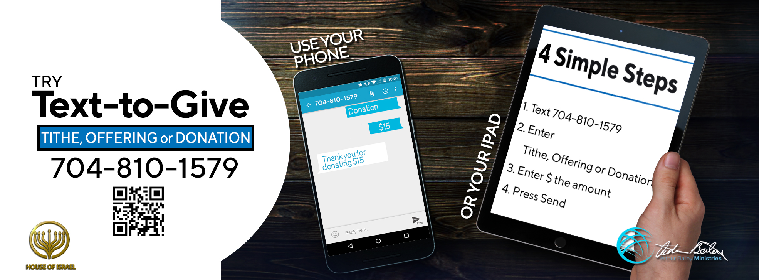

Slide 58
You can give by
Texting
Donate – Tithe - Offering
to
704-810-1579

