Slide 3
TODAY’S MESSAGE
Matthew 2:1-12
The King is Born

Slide 4
Please subscribe for updates on our website,
Watch us on YouTube
follow us on Facebook and the other social media networks.
Please like and share our videos and posts

Slide 5
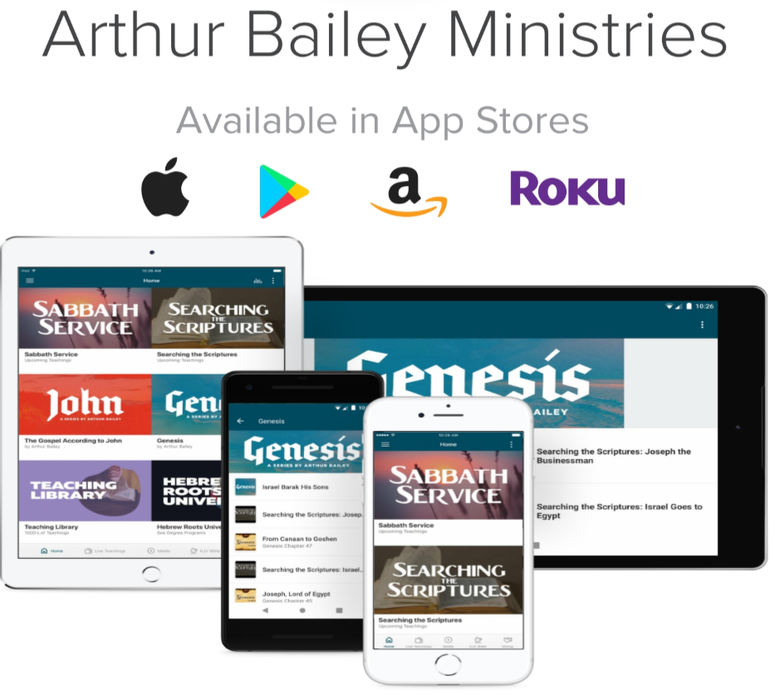

Slide 6
At the end of today’s teaching you will be able to 1. Ask Questions 2. Receive Prayer and 3. Give your Tithes, Offerings

Slide 7
The Vision of House of Israel is to be; 1. A Worshipping People (Jn 4:23,24) 2. An Evangelistic Community (Acts 2:42-47)

Slide 8
3. A Discipleship Center (Matt 28:19) 4. An Equipping Network (Eph 4:12) 5. And a Worldwide Witness for Yeshua The Messiah
(ACTS 1:8)

Slide 10
Worship in Prayer

Slide 11
TODAY’S MESSAGE
Matthew 2:1-12
The King is Born

Slide 12
The circumstances and events surrounding the conception and birth of Yeshua, the Messiah, are extraordinary in that they have occurred only once in all of human history. Messiah’s birth took place in a known town, but it was in a private, isolated, obscure, and somewhat secretive place with minimal witnesses.

Slide 13
However, it is recorded for the entire world to see. Many fulfillments of prophecies converge and culminate in the birth of the Messiah, King of the Jews, King of kings and Savior of the world.
In Sabbath Service today , we will take an
in-depth look at the circumstances and events surrounding the birth of The King in a land that already had a king.

Slide 14
^{Mt 2:1} Now when Yeshua was born in Bethlehem of Judaea in the days of Herod the king, behold, there came wise men from the east to Jerusalem,
^{Mt 2:2} Saying, Where is he that is born King of the Jews? for we have seen his star in the east, and are come to worship him.

Slide 15
How many wise men were there?

Slide 16
Where did they come from?
How would these men know about a Hebrew king and be interested in traveling such a great distance to find and worship him presenting Him with gifts?

Slide 17
For these men in a foreign country to know about the Messiah, Anointed, King someone had to have taught them about Him

Slide 18
Wise men or Magi’s Were known in Babylon as: teachers, seers, priests as well as sorcerers, astrologers, wise men etc.

Slide 19
Wise men – 3097 μάγος magos {mag'-os} Meaning: 1) a magus 1a) the name given by the Babylonians (Chaldeans), Medes, Persians, and others, to the wise men, teachers, priests, physicians, astrologers, seers, interpreters of dreams, augers, soothsayers, sorcerers etc. 1c) a false prophet and sorcerer

Slide 20
Origin: of foreign origin 07248; TDNT - 4:356,547; n m
Usage: AV - wise man 4, sorcerer 2; 6

Slide 21
This word magos/magus is used two other times in the New Testament in reference to a Jewish sorcerer and false prophet called Bar-yeshua (son of Jesus) but interpreted in that region of Cyprus as Elymas

Slide 22
^{Ac 13:6} And when they had gone through the isle unto Paphos, they found a certain sorcerer, a false prophet, a Jew, whose name was Bar-jesus:
^{Ac 13:8} But Elymas the sorcerer (for so is his name by interpretation) withstood them, seeking to turn away the deputy from the faith.

Slide 23
The origin of magos is found in Jeremiah

Slide 24
^{Jer 39:11} Now Nebuchadrezzar king of Babylon gave charge concerning Jeremiah to Nebuzar-adan the captain of the guard, saying,
^{Jer 39:12} Take him, and look well to him, and do him no harm; but do unto him even as he shall say unto thee.

Slide 25
^{Jer 39:13} So Nebuzar-adan the captain of the guard sent, and Nebushasban, Rabsaris, and Nergal-sharezer, Rab-mag, and all the king of Babylon's princes; ^{Jer 39:14} Even they sent, and took Jeremiah out of the court of the prison, and committed him unto Gedaliah the son of Ahikam the son of Shaphan, that he should carry him home: so he dwelt among the people.

Slide 26
07248 רַב־מָג Rab-Mag {rab-mawg'}
Meaning: 1) soothsayer, magician, chief soothsayer 1a) Rab-mag, chief soothsayer, or chief of princes, an official of Babylonia

Slide 27
Origin: from 07227 and a foreign word for a Magian; TWOT - 1143; n m
Usage: AV - Rabmag 2; 2
The root of Rab-Mag is Rab.

Slide 28
07227 רַב rab {rab} Meaning: adj 1) much, many, great 1a) much 1b) many 1c) abounding in 1d) more numerous than 1e) abundant, enough 1f) great 1g) strong 1h) greater than adv 1i) much, exceedingly n m 2) captain, chief Usage: AV - many 190, great 118, much 36, captain 24, more 12, long 10, enough 9, multitude 7, mighty 5, greater 4, greatly 3, misc 40; 458

Slide 29
Rab is a root word for Rabbi.
Rabbi is straight out of Babylon.
There were no Rabbi’s before the Babylonian captivity

Slide 30
Daniel and the 3 Hebrew boys were well known in Babylon for their faith and refusal to worship other gods.

Slide 31
^{Da 1:7} Unto whom the prince of the eunuchs gave names: for he gave unto Daniel the name of Belteshazzar; and to Hananiah, of Shadrach; and to Mishael, of Meshach; and to Azariah, of
Abed-nego.

Slide 32
^{Da 3:1} Nebuchadnezzar the king made an image of gold, whose height was threescore cubits, and the breadth thereof six cubits (ninety feet tall and nine feet wide): he set it up in the plain of Dura, in the province of Babylon.

Slide 33
When they refused to bow down they were thrown into a fiery furnace, YeHoVaH protected them and Nebuchadnezzar issued another decree.

Slide 34
^{Da 3:28} Then Nebuchadnezzar spake, and said, Blessed be the God of Shadrach, Meshach, and Abed-nego, who hath sent his angel, and delivered his servants that trusted in him, and have changed the king's word, and yielded their bodies, that they might not serve nor worship any god, except their own God.

Slide 35
^{Da 3:29} Therefore I make a decree, That every people, nation, and language, which speak any thing amiss against the God of Shadrach, Meshach, and Abed-nego, shall be cut in pieces, and their houses shall be made a dunghill: because there is no other God that can deliver after this sort.

Slide 36
^{Da 3:30} Then the king promoted Shadrach, Meshach, and Abed-nego, in the province of Babylon.

Slide 37
These men more than likely stood for, talked about and shared their faith while living in Babylon. It is believed that the Hebrew God was worshipped in Babylon after the decree was issued and the knowledge of the Hebrew God was known throughout the land.

Slide 38
^{Mt 2:3} When Herod the king had heard these things, he was troubled, and all Jerusalem with him.

Slide 39
Why was Herod troubled and all Jerusalem with him. The knowledge of this prophecy was known but Herod did not know where the child would be born although it was written in the prophet Micah 5.

Slide 40
^{Mt 2:4} And when he had gathered all the chief priests and scribes of the people together, he demanded of them where Christ should be born. ^{Mt 2:5} And they said unto him, In Bethlehem of Judaea: for thus it is written by the prophet, ^{Mt 2:6} And thou Bethlehem, in the land of Judah, art not the least among the princes of Judah: for out of thee shall come a Governor, that shall rule my people Israel.

Slide 41
^{Mic 5:2} But thou, Bethlehem Ephratah, though thou be little among the thousands of Judah, yet out of thee shall he come forth unto me that is to be ruler in Israel; whose goings forth have been from of old, from everlasting.

Slide 42
^{Mt 2:7} Then Herod, when he had privily called the wise men, inquired of them diligently what time the star appeared.
Why would Herod be interested in when the star appeared? It would give him a possible timeline of of how old the child would be according to verse 16

Slide 43
^{Mt 2:16} Then Herod, when he saw that he was mocked of the wise men, was exceeding wroth, and sent forth, and slew all the children that were in Bethlehem, and in all the coasts thereof, from two years old and under, according to the time which he had diligently inquired of the wise men.

Slide 44
^{Mt 2:8} And he sent them to Bethlehem, and said, Go and search diligently for the young child; and when ye have found him, bring me word again, that I may come and worship him also.

Slide 45
What he said is he wanted to worship Him. What he meant is he wanted to kill Him.

Slide 46
Herod was a murderer and at the time had murdered many:
King Herod. Herod the Great (37-4 B.C.), to be distinguished from the other Herods in the Bible (see chart on "House of Herod," Matthew 2:1). Herod was a non-Jew, an Idumean, who was appointed king of Judea by the Roman Senate in 40 B.C. and gained control in 37.

Slide 47
Idumean were descendants of Esau/Edom/Edomites - 0123 אֱדֹם 'Edom {ed-ome'} or (fully) אֱדוֹם 'Edowm {ed-ome'}
Meaning: Edom = "red" 1) Edom 2) Edomite, Idumean - descendants of Esau 3) land of Edom, Idumea - land south and south east of Palestine
Usage: AV - Edom 87, Edomites 9, Idumea 4; 100

Slide 48
Like most rulers of the day, he was ruthless, murdering his wife, his three sons, mother-in-law, brother-in-law, uncle and many others--not to mention the babies in Bethlehem (v. 16). His reign was also noted for splendor, as seen in the many theaters, amphitheaters, monuments, pagan altars, fortresses and other buildings he erected or refurbished--including the greatest work of all, the rebuilding of the temple in Jerusalem, begun in 20 B.C. and finished 68 years after his death.

Slide 49
^{Mt 2:9} When they had heard the king, they departed; and, lo, the star, which they saw in the east, went before them, till it came and stood over where the young child was.

Slide 50
Where Herod sent them and where the star took them were two different places. Herod sent them to Bethlehem in Judea but the star took them to Nazareth of Galilee.

Slide 51
^{Mt 2:10} When they saw the star, they rejoiced with exceeding great joy.
^{Mt 2:11} And when they were come into the house, they saw the young child with Mary his mother, and fell down, and worshipped him: and when they had opened their treasures, they presented unto him gifts; gold, and frankincense, and myrrh.

Slide 52
They went into a house. When Yeshua was born Joseph and Mary had travelled to Bethlehem where they remained until the birth of Yeshua and after Mary’s forty days of purification before returning to Nazareth.

Slide 53
Luke covers the birth, the angelic announcement, the shepherds, the eighth day circumcision, the 40 days of purification, the presenting of Messiah in the temple, Simeon the old man who had been promised by YeHoVaH that he would see the Messiah before he died, Anna the prophetess, the daughter of Phanuel, of the tribe of Asher’s prophecy and the family’s return to Nazareth where Yeshua grew up.

Slide 54
^{Lk 2:39} When Joseph and Mary had done everything required by the Law of the Lord, they returned to Galilee to their own town of Nazareth.

Slide 55
^{Lk 2:40} And the child grew and became strong; he was filled with wisdom, and the grace of God was upon him.

Slide 56
Luke does not cover the Magi’s visit, their encounter with Herod, the Joseph, Mary and Yeshua’s flight to Egypt to escape Herod’s death decree, the death of Herod and Joseph, Mary and Yeshua’s return to Nazareth.

Slide 57
^{Lev 12:2} Speak unto the children of Israel, saying, If a woman have conceived seed, and born a man child: then she shall be unclean seven days; according to the days of the separation for her infirmity shall she be unclean.
^{Lev 12:3} And in the eighth day the flesh of his foreskin shall be circumcised.

Slide 58
^{Lev 12:4} And she shall then continue in the blood of her purifying three and thirty days; she shall touch no hallowed thing, nor come into the sanctuary, until the days of her purifying be fulfilled.

Slide 59
^{Mt 2:12} And being warned of God in a dream that they should not return to Herod, they departed into their own country another way.

Slide 60
YeHovaH speaks to these Magi’s in a dream as He had spoken to Joseph in a dream.
YeHoVaH sent the angel Gabriel to speak to Mary

Slide 61
Your support is greatly appreciated and needed

Slide 62
New Donation Opportunities
Our Preferred Method
CashAPP

Slide 64
Mail in your support by check or money order.
Our Mailing Address:
P O Box 1182
Fort Mill, SC 29716

Slide 65
New Canadian
Donation Opportunity
Arthur Bailey Ministries is a
Registered Charity in Canada

Slide 67
You can give by
Texting
Donate – Tithe - Offering
to
704-810-1579

