Slide 3
TODAY’S MESSAGE
Matthew 6:1-18
Charity, Prayer, Forgiving and Fasting

Slide 4
Please subscribe for updates on our website,
Watch us on YouTube
follow us on Facebook and the other social media networks.
Please like and share our videos and posts

Slide 6
At the end of today’s teaching you will be able to 1. Ask Questions 2. Receive Prayer and 3. Give your Tithes, Offerings

Slide 7
The Vision of House of Israel is to be; 1. A Worshipping People (Jn 4:23,24) 2. An Evangelistic Community (Acts 2:42-47)

Slide 8
3. A Discipleship Center (Matt 28:19) 4. An Equipping Network (Eph 4:12) 5. And a Worldwide Witness for Yeshua The Messiah
(ACTS 1:8)

Slide 10
Ministry of Prayer

Slide 11
Ministry of The Word

Slide 12
TODAY’S MESSAGE
Matthew 6:1-18
Charity, Prayer, Forgiving and Fasting

Slide 13
^{Mt 6:1} Take heed that ye do not your alms before men, to be seen of them: otherwise ye have no reward of your Father which is in heaven. ^{Mt 6:2} Therefore when thou doest thine alms, do not sound a trumpet before thee, as the hypocrites do in the synagogues and in the streets, that they may have glory of men. Verily I say unto you, They have their reward.

Slide 14
Alms – 1654 ἐλεημοσύνη eleemosune {el-eh-ay-mos-oo'-nay}
Meaning: 1) mercy, pity 1a) esp. as exhibited in giving alms, charity 2) the benefaction itself, a donation to the poor, alms
Usage: AV - alms 13, almsdeeds 1; 14

Slide 15
^{Mt 6:3} But when thou doest alms, let not thy left hand know what thy right hand doeth:
^{Mt 6:4} That thine alms may be in secret: and thy Father which seeth in secret himself shall reward thee openly.

Slide 16
There is a very thin line between highlighting the works or accomplishments of your ministry and bragging about what you and your ministry is doing.
There is a thin line between men seeing your good works and you wanting men to see your good works.

Slide 17
These are matters or the heart that points to your motives or what is motivating you to do what your are doing. Is your motives and work being done to draw attention to you or to the work being done?
Are you doing what you are doing for likes, to be seen of men or to encourage others to get involved and join the efforts you are highlighting or bringing attention to?

Slide 18
It is difficult to draw attention to a cause that need to be addressed without drawing attention to the one drawing attention to the cause.
Yeshua was not trying to make a name for Himself but by preaching and teaching the gospel of the kingdom the way it should have been taught drew attention to Him and made Him known.

Slide 19
It is almost impossible to do charity work without it being known just make sure the motive is not to be made known or to be seen of men because them seeing you and patting you on the back piling accolades on you for what you have done is your reward.

Slide 20
For years we worked on the front lines in addressing community issues with any plaques, accolades, or honors at MLK banquets or other gatherings or honors where community leaders were acknowledged for their works and for a long time it bothered me that we never received an award for our work.

Slide 21
But Father saw our work and He has rewarded me giving me a place of honor in His Kingdom work. I am no longer in worldly kingdom work I am now totally focused on the work of the Kingdom of Heaven/YeHoVaH

Slide 22
When you give into the work of the kingdom in a place where kingdom work is being done let that be enough and Father who see it will reward you.

Slide 23
People have asked me if it is ok to give to charities, my response, only if they are advancing the Gospel of the Kingdom of YeHoVaH. What about Jewish causes or food banks and other worthwhile charities, my response is the same, only if they are advancing the Gospel of the Kingdom of YeHoVaH.

Slide 24
Personal prayer
^{Mt 6:5} And when thou prayest, thou shalt not be as the hypocrites are: for they love to pray standing in the synagogues and in the corners of the streets, that they may be seen of men. Verily I say unto you, They have their reward.

Slide 25
^{Mt 6:6} But thou, when thou prayest, enter into thy closet, and when thou hast shut thy door, pray to thy Father which is in secret; and thy Father which seeth in secret shall reward thee openly.

Slide 26
Personal prayer is done without fanfare or openly. Personal prayer is time between you and YeHoVaH.

Slide 27
^{Mt 6:7} But when ye pray, use not vain repetitions, as the heathen do: for they think that they shall be heard for their much speaking.
^{Mt 6:8} Be not ye therefore like unto them: for your Father knoweth what things ye have need of, before ye ask him.

Slide 28
Personal prayer from the heart and to the point is preferable, for Father already know what you need. No point dragging out prayer trying to impress Him.

Slide 29
^{Mt 6:9} After this manner therefore pray ye: Our Father which art in heaven, Hallowed be thy name.

Slide 30
This is a way to pray
Approach YeHoVaH as the one who is in heaven and whose Name is Holy

Slide 31
^{Mt 6:10} Thy kingdom come. Thy will be done in earth, as it is in heaven.
Pray for Father’s kingdom and will to be done on earth as it is in Heaven where He reign supreme.

Slide 32
^{Mt 6:11} Give us this day our daily bread.
Father is our provider

Slide 33
Forgive debt
There is a difference between forgiving debt and forgiving trespasses.
I asked a Karaite Jewish scholar once if this passage was connected to the year of release and he told me no it had to do with sin. Sin is referred to as trespasses and transgressions

Slide 34
Forgiving debt is in Torah and forgiving trespasses are also in Torah as we will see.
Forgiving Debts Deut. 15:1-4
Forgiving a Trespass Genesis 50:17

Slide 35
The principle of sowing and reaping, doing unto others as you will have men do unto you.

Slide 36
^{Mt 6:12} And forgive us our debts, as we forgive our debtors.

Slide 37
Forgive
Debt – 3783 ὀφείλημα opheilema {of-i'-lay-mah}
Meaning: 1) that which is owed 1a) that which is justly or legally due, a debt 2) metaph. offence, sin
Origin: from (the alternate of) 3784; TDNT - 5:565,746; n n
Usage: AV - debt 2; 2

Slide 38
Debtors – 3781 ὀφειλέτης opheiletes {of-i-let'-ace} Meaning: 1) one who owes another, a debtor 1a) one held by some obligation, bound by some duty 1b) one who has not yet made amends to whom he has injured: 1b1) one who owes God penalty or whom God can demand punishment as something due, i.e. a sinner Origin: from 3784 – ὀφείλω opheilo; TDNT - 5:565,746; n m
Usage: AV - debtor 5, sinner 1, which owed 1; 7

Slide 39
Luke puts this portion of Yeshua’s teaching on prayer in proper perspective

Slide 40
^{Lk 11:4} And forgive us our sins; for we also forgive every one that is indebted to us. And lead us not into temptation; but deliver us from evil.

Slide 41
Indebted – 3784 ὀφείλω opheilo {of-i'-lo}
Meaning: 1) to owe 1a) to owe money, be in debt for 1a1) that which is due, the debt 2) metaph. the goodwill due
Usage: AV - ought 15, owe 7, be bound 2, be (one's) duty 2, be a debtor 1, be guilty 1, be indebted 1, misc 7; 36

Slide 42
A lesson from Torah on forgiving debt:
^{Dt 15:1} At the end of every seven years thou shalt make a release.

Slide 43
^{Dt 15:2} And this is the manner of the release: Every creditor that lendeth aught unto his neighbour shall release it; he shall not exact it of his neighbour, or of his brother; because it is called the LORD'S release.
^{Dt 15:3} Of a foreigner thou mayest exact it again: but that which is thine with thy brother thine hand shall release;

Slide 44
^{Dt 15:4} Save when there shall be no poor among you; for the LORD shall greatly bless thee in the land which the LORD thy God giveth thee for an inheritance to possess it:
^{Dt 15:5} Only if thou carefully hearken unto the voice of the LORD thy God, to observe to do all these commandments which I command thee this day.

Slide 45
^{Dt 15:6} For the LORD thy God blesseth thee, as he promised thee: and thou shalt lend unto many nations, but thou shalt not borrow; and thou shalt reign over many nations, but they shall not reign over thee.
^{Dt 15:7} If there be among you a poor man of one of thy brethren within any of thy gates in thy land which the LORD thy God giveth thee, thou shalt not harden thine heart, nor shut thine hand from thy poor brother:

Slide 46
^{Dt 15:8} But thou shalt open thine hand wide unto him, and shalt surely lend him sufficient for his need, in that which he wanteth.
^{Dt 15:9} Beware that there be not a thought in thy wicked heart, saying, The seventh year, the year of release, is at hand; and thine eye be evil against thy poor brother, and thou givest him nought; and he cry unto the LORD against thee, and it be sin unto thee.

Slide 47
^{Dt 15:10} Thou shalt surely give him, and thine heart shall not be grieved when thou givest unto him: because that for this thing the LORD thy God shall bless thee in all thy works, and in all that thou puttest thine hand unto.

Slide 48
A kingdom lesson on forgiving debt:
Mat 18:23 Therefore is the kingdom of heaven likened unto a certain king, which would take account of his servants.
²⁴ And when he had begun to reckon, one was brought unto him, which owed him ten thousand talents.

Slide 49
²⁵ But forasmuch as he had not to pay, his lord commanded him to be sold, and his wife, and children, and all that he had, and payment to be made.
²⁶ The servant therefore fell down, and worshipped him, saying, Lord, have patience with me, and I will pay thee all.

Slide 50
²⁷ Then the lord of that servant was moved with compassion, and loosed him, and forgave him the debt.
²⁸ But the same servant went out, and found one of his fellowservants, which owed him an hundred pence: and he laid hands on him, and took him by the throat, saying, Pay me that thou owest.

Slide 51
²⁹ And his fellowservant fell down at his feet, and besought him, saying, Have patience with me, and I will pay thee all.
³⁰ And he would not: but went and cast him into prison, till he should pay the debt.
³¹ So when his fellowservants saw what was done, they were very sorry, and came and told unto their lord all that was done.

Slide 52
³² Then his lord, after that he had called him, said unto him, O thou wicked servant, I forgave thee all that debt, because thou desiredst me:
³³ Shouldest not thou also have had compassion on thy fellowservant, even as I had pity on thee?

Slide 53
³⁴ And his lord was wroth, and delivered him to the tormentors, till he should pay all that was due unto him.
³⁵ So likewise shall my heavenly Father do also unto you, if ye from your hearts forgive not every one his brother their trespasses. (Mat 18:23-35 KJV)

Slide 54
^{Mt 6:13} And lead us not into temptation, but deliver us from evil: For thine is the kingdom, and the power, and the glory, for ever. Amen.

Slide 55
Lead us not into trials deliver us from allowing evil or wickedness to enter our hearts for we are your servants in your kingdom where you have all power, glory be thy Name!

Slide 56
^{Mt 6:14} For if ye forgive men their trespasses, your heavenly Father will also forgive you:
^{Mt 6:15} But if ye forgive not men their trespasses, neither will your Father forgive your trespasses.

Slide 57
Forgiving trespasses/sins
The principle of sowing and reaping, doing unto others as you will have Father do unto you.

Slide 58
A Torah example of forgiving trespass
Forgiving a Trespass Genesis 50:17

Slide 59
^{Ge 50:17} So shall ye say unto Joseph, Forgive, I pray thee now, the trespass of thy brethren, and their sin; for they did unto thee evil: and now, we pray thee, forgive the trespass of the servants of the God of thy father. And Joseph wept when they spake unto him.

Slide 60
Is Yeshua saying this is the only way to pray? No. See how Yeshua prayed in John 17

Slide 61
It appears fasting was not done while Messiah was with His disciples but they would fast when He was no longer with them.

Slide 62
^{Mk 2:18} And the disciples of John and of the Pharisees used to fast: and they come and say unto him, Why do the disciples of John and of the Pharisees fast, but thy disciples fast not? ^{Mk 2:19} And Jesus said unto them, Can the children of the bridechamber fast, while the bridegroom is with them? as long as they have the bridegroom with them, they cannot fast.

Slide 63
^{Mk 2:20} But the days will come, when the bridegroom shall be taken away from them, and then shall they fast in those days.

Slide 64
Yeshua instructs them on how to fast unto Father in the way that pleased YeHoVaH and moved Him to reward them for their fast

Slide 65
^{Mt 6:16} Moreover when ye fast, be not, as the hypocrites, of a sad countenance: for they disfigure their faces, that they may appear unto men to fast. Verily I say unto you, They have their reward.

Slide 66
Fast – 3522 νηστεύω nesteuo {nace-tyoo'-o}
Meaning: 1) to abstain as a religious exercise from food and drink: either entirely, if the fast lasted but a single day, or from customary and choice nourishment, if it continued several days
Origin: from 3523; TDNT - 4:924,632; v
Usage: AV - fast 21; 21

Slide 67
^{Mt 6:17} But thou, when thou fastest, anoint thine head, and wash thy face;
^{Mt 6:18} That thou appear not unto men to fast, but unto thy Father which is in secret: and thy Father, which seeth in secret, shall reward thee openly.
Our fasting is to be done unto YeHoVaH Not unto men.

Slide 68
An example from the disciples of corporate prayer and fasting:
^{Ac 13:1} Now there were in the church that was at Antioch certain prophets and teachers; as Barnabas, and Simeon that was called Niger, and Lucius of Cyrene, and Manaen, which had been brought up with Herod the tetrarch, and Saul.

Slide 69
^{Ac 13:2} As they ministered to the Lord, and fasted, the Holy Ghost said, Separate me Barnabas and Saul for the work whereunto I have called them.
^{Ac 13:3} And when they had fasted and prayed, and laid their hands on them, they sent them away.

Slide 70
As we do Charity, Prayer, Forgiving and Fasting let us make sure we do what we do unto and in obedience to YeHoVaH as taught by Messiah.

Slide 71
Many are familiar with church and denominational sayings and are doing what the church and denominations say. Let us familiarize ourselves with and do what the Word say do!

Slide 72
Corporate prayer

Slide 73
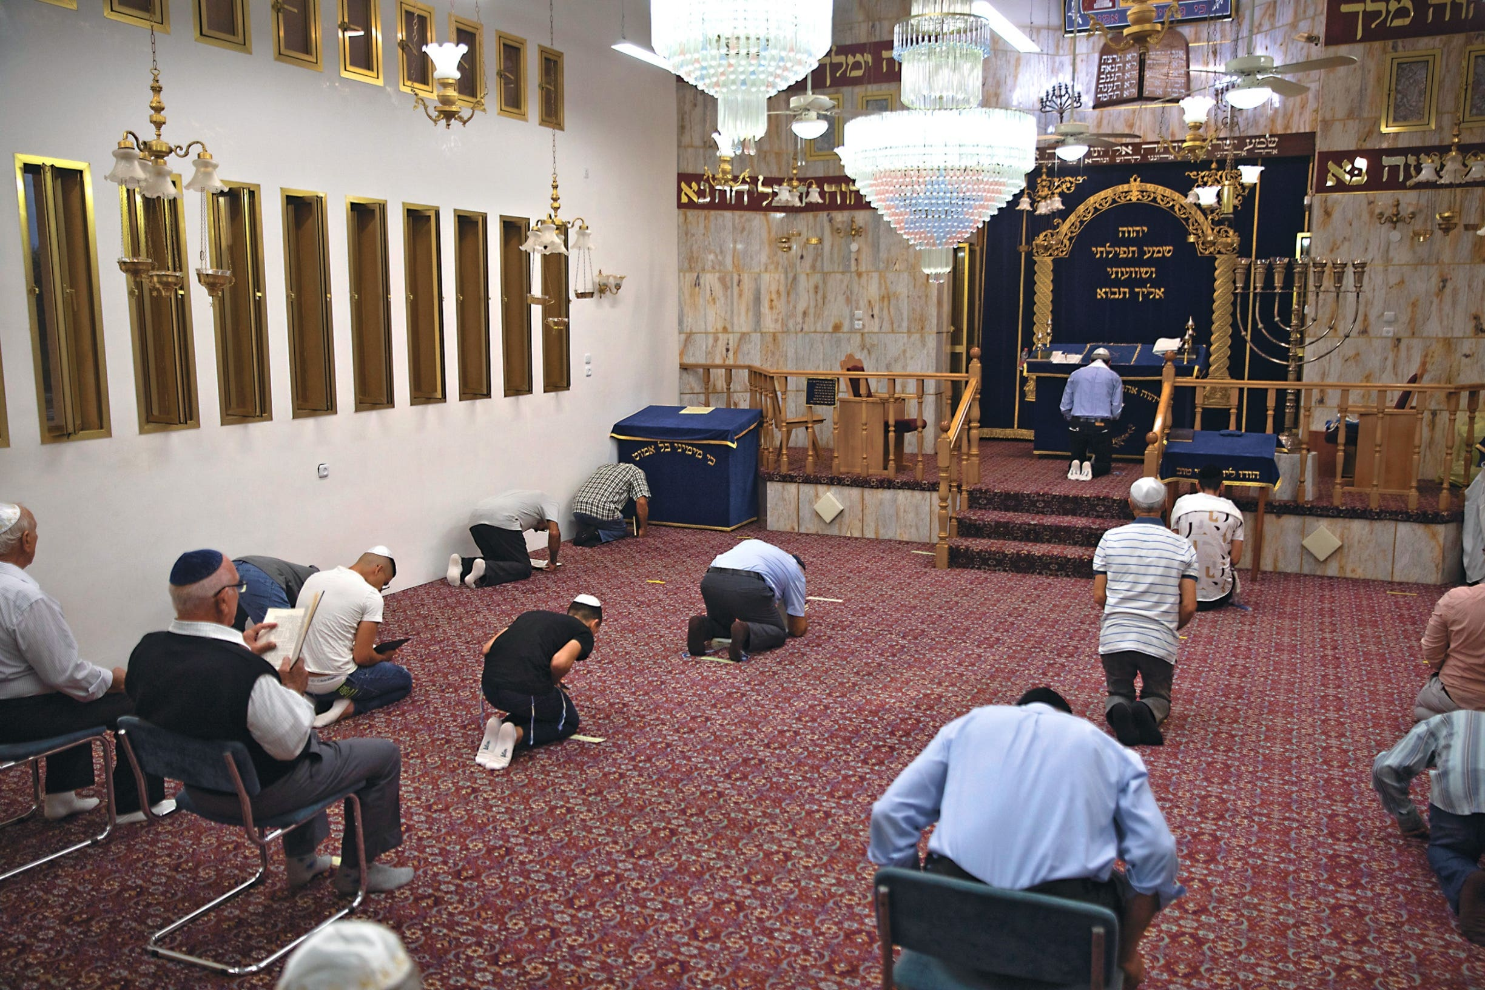
These are not muslims praying

Slide 74
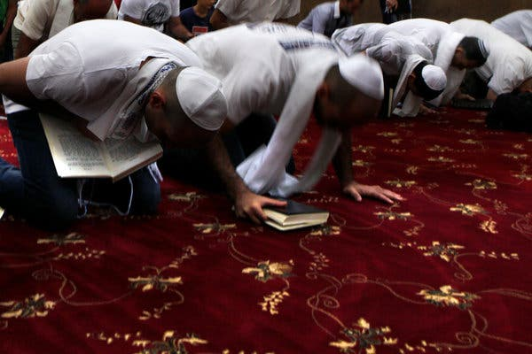
These are not muslims praying

Slide 75
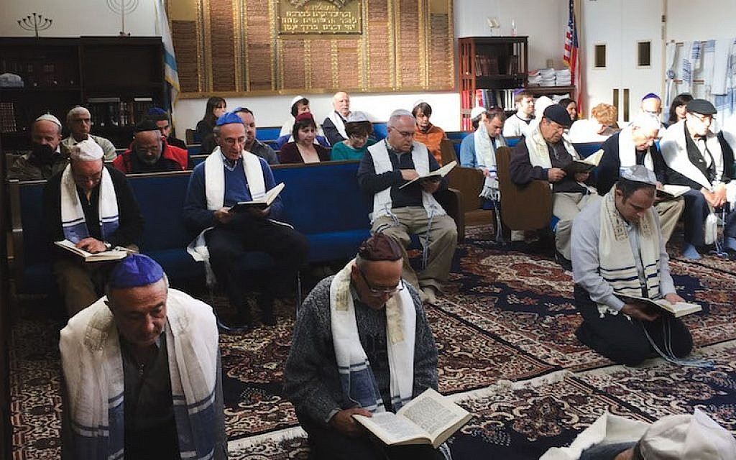
These are not muslims praying

Slide 77
Your support is greatly appreciated and needed

Slide 78
New Donation Opportunities
Our Preferred Method
CashAPP

Slide 80
Mail in your support by check or money order.
Our Mailing Address:
P O Box 1182
Fort Mill, SC 29716

Slide 81
New Canadian
Donation Opportunity
Arthur Bailey Ministries is a
Registered Charity in Canada

Slide 82
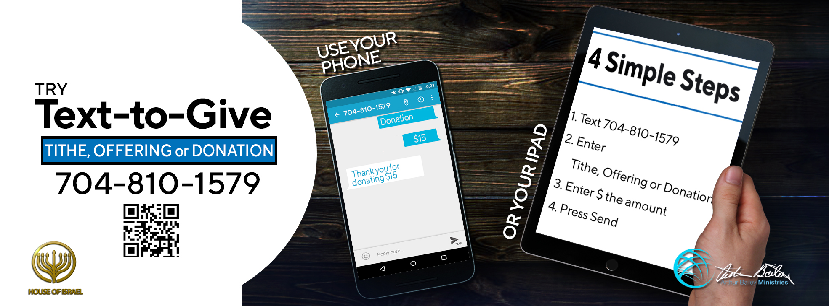

Slide 83
You can give by
Texting
Donate – Tithe - Offering
to
704-810-1579

