Slide 3
TODAY’S MESSAGE
Religion and The Feast of Trumpets
The Feast of Trumpets 2020

Slide 4
Please subscribe for updates on our website,
Watch us on YouTube
follow us on Facebook and the other social media networks.
Please like and share our videos and posts

Slide 5
At the end of today’s teaching you will be able to 1. Ask Questions 2. Receive Prayer and 3. Give your Tithes, Offerings

Slide 6
The Vision of House of Israel is to be; 1. A Worshipping People (Jn 4:23,24) 2. An Evangelistic Community (Acts 2:42-47)

Slide 7
3. A Discipleship Center (Matt 28:19) 4. An Equipping Network (Eph 4:12) 5. And a Worldwide Witness for Yeshua The Messiah
(ACTS 1:8)

Slide 9
Worship in Prayer

Slide 10
TODAY’S MESSAGE
Religion and The Feast of Trumpets
The Feast of Trumpets 2020

Slide 11
^{Lev 23:23} And the LORD spake unto Moses, saying, ^{Lev 23:24} Speak unto the children of Israel, saying, In the seventh month, in the first day of the month, shall ye have a sabbath, a memorial of blowing of trumpets, an holy convocation. ^{Lev 23:25} Ye shall do no servile work therein: but ye shall offer an offering made by fire unto the LORD.

Slide 12
A memorial of blowing the trumpets keyword Memorial.
The first time the word memorial was used it was to remember YeHoVaH’s Name.

Slide 13
^{Ex 3:15} And God said moreover unto Moses, Thus shalt thou say unto the children of Israel, The LORD God of your fathers, the God of Abraham, the God of Isaac, and the God of Jacob, hath sent me unto you: this is my name for ever, and this is my memorial unto all generations.

Slide 14
02143 זֵכֶר zeker {zay'-ker} or זֶכֶר zeker {zeh'-ker}
Meaning: 1) memorial, remembrance 1a) remembrance, memory 1b) memorial
Origin: from 02142; TWOT - 551a; n m
Usage: AV - remembrance 11, memorial 5, memory 5, remembered 1, scent 1; 23

Slide 15
The second time memorial was used to remember YeHoVaH’s Passover.
^{Ex 12:14} And this day shall be unto you for a memorial; and ye shall keep it a feast to the LORD throughout your generations; ye shall keep it a feast by an ordinance for ever.

Slide 16
The third time the word memorial was used to remember YeHoVaH’s Feast of Unleavened Bread. YeHoVaH’s deliverance from the bondage in Egypt
^{Ex 13:9} And it shall be for a sign unto thee upon thine hand, and for a memorial between thine eyes, that the LORD'S law may be in thy mouth: for with a strong hand hath the LORD brought thee out of Egypt.

Slide 17
The Biblical Israel associated Tumpets with Sinai
The first, second, third and fourth time trumpets was used was at Sinai in association with the giving of the Law of the Kingdom of Israel.

Slide 18
^{Ex 19:13} There shall not an hand touch it, but he shall surely be stoned, or shot through; whether it be beast or man, it shall not live: when the trumpet soundeth long, they shall come up to the mount.

Slide 19
^{Ex 19:16} And it came to pass on the third day in the morning, that there were thunders and lightnings, and a thick cloud upon the mount, and the voice of the trumpet exceeding loud; so that all the people that was in the camp trembled.

Slide 20
^{Ex 19:19} And when the voice of the trumpet sounded long, and waxed louder and louder, Moses spake, and God answered him by a voice.
^{Ex 20:18} And all the people saw the thunderings, and the lightnings, and the noise of the trumpet, and the mountain smoking: and when the people saw it, they removed, and stood afar off.

Slide 21
When we blow the trumpets it is to remember YeHoVaH: His Name, His deliverance, His Law

Slide 22
^{Nu 10:7} But when the congregation is to be gathered together, ye shall blow, but ye shall not sound an alarm.
^{Nu 10:8} And the sons of Aaron, the priests, shall blow with the trumpets; and they shall be to you for an ordinance for ever throughout your generations.

Slide 23
When we blow the trumpets in accordance to His instructions He will remember us.
^{Nu 10:9} And if ye go to war in your land against the enemy that oppresseth you, then ye shall blow an alarm with the trumpets; and ye shall be remembered before the LORD your God, and ye shall be saved from your enemies.

Slide 24
^{Nu 10:10} Also in the day of your gladness, and in your solemn days, and in the beginnings of your months, ye shall blow with the trumpets over your burnt offerings, and over the sacrifices of your peace offerings; that they may be to you for a memorial before your God: I am the LORD your God.

Slide 25
We are not to add to or diminish from YeHoVaH’s Law

Slide 26
^{Dt 4:1} Now therefore hearken, O Israel, unto the statutes and unto the judgments, which I teach you, for to do them, that ye may live, and go in and possess the land which the LORD God of your fathers giveth you. ^{Dt 4:2} Ye shall not add unto the word which I command you, neither shall ye diminish aught from it, that ye may keep the commandments of the LORD your God which I command you.

Slide 27
The Feast of Trumpets is not about looking ahead but looking back
The Feast of Trumpets is not about the future it’s about the past
The Feast of Trumpets is not about religion it’s about remembrance

Slide 28
Religion has caused the saints to forget the meaning of Trumpets by adding other meanings

Slide 29
When people add to the meaning of the feast and incorporating prophecy, Prophetic fulfillments, days of judgment and things to come instead of looking back, looking ahead instead of remembering. They have forgotten and given the feast of trumpets a new meaning

Slide 30
Religious Jews in Judaism and secular Jews around the world identify Yom Teruah / The Day of Trumpets as Rosh Hashanah and changed the memorial to the Jewish new year for religious Jews and secular Jews alike. In addition has associated the 10 days from Yom Teruah to Yom Kippur as the 10 days of awe and repentance.

Slide 31
The Christians look at the Day of Trumpets as it relates to the second coming of Jesus.

Slide 32
Messianic and Hebrew Roots Assembly combines Judaism and Christianity by not only looking at The Day of Trumpets as the beginning of the fall feast season, the Jewish new year and the fulfillment of future prophecy incorporating the return of the Messiah,

Slide 33
Judaism‘s influence on the feast of the Lord
Spring and Fall Feasts.
Today Trumpets is referred to by many as the beginning of the fall feast but the fall has not yet come.
Tuesday, September 22, 2020

Slide 34
The Bible teach that we are not to add or diminish from the law God‘s instructions. When religious people introduce traditions and begin to practice and teach those traditions as if they are commandments, establish prayers and orders of service, liturgy’s,

Slide 35
and within those liturgy‘s and prayers are terminologies referring to Rosh Hashanah the Jewish new year, celebrating it as if it’s actually the new year, it cause confusion for many who are now going around saying happy new year.

Slide 36
Israel recently went on lockdown and it made Rabbi resign from the council in protest to the lockdown saying the lockdown 1. was too late and 2. it would prevent many Jews from celebrating their religious festivals of Rosh Hashanah and Yom Kippur the holiest day of the Jewish calendar.

Slide 37
Blending Judaism and it’s feast with Christianity and there prophetic ideaology have led many to conclude that the early feasts (referring to them as the spring feasts) have been fulfilled and the latter feast (referred to as the fall feast) are yet to be fulfilled awaiting the return of Jewish Jesus or Yeshua.

Slide 38
We all know that Judaism and religious Jews do not subscribe to Pentecost or see Messiah in the feasts as Christians as Messianic‘s who associate the fees with Jesus/Yeshua. We all have to admit since Judaism rejects Jesus/Yeshua as Messiah therefore the prophetic shadow pictures are strictly Messianic and Christian blends isolated from Judaism.

Slide 39
A story from my class.
Don’t over think.
Never Forget
Remember Trumpets is about remembering
The memorial of blowing the trumpets

Slide 40
See Website for dates for:
Yom Kippur
Feast of Tabernacles
The Eighth Day

Slide 42
Your support is greatly appreciated and needed

Slide 43
Mail in your support by check or money order.
Our Mailing Address:
P O Box 1182
Fort Mill, SC 29716

Slide 44
New Donation Opportunities
CashAPP
Canada Registered Charity

Slide 46
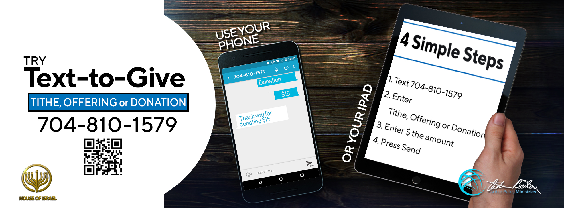

Slide 47
You can give by
Texting
Donate – Tithe - Offering
to
704-810-1579

