Slide 3
Today’s Teaching
“Remove the Leaven”
www.ArthurBaileyMinistries.com

Slide 4
Some quick Announcements.
I was informed via phone call our application for Accreditation has been approved. Therefore, we move from Candidate status to Accredited status with our Certificate of Accreditation being mailed out this week.

Slide 5
I went to Washington, D.C. on Tuesday and applied for a Visa and completed the biometrics that required fingerprints and a photo for the
Nigerian Missionary Trip May 1-5.
The process took less than 30 minutes. I am waiting on the results and the Visa along with my Passport in the mail.

Slide 6
Please subscribe for updates on our Website.
Watch us on YouTube.
Follow us on Facebook and the other Social Media networks.
Please Like and Share our videos and posts.

Slide 7
At the end of today’s Teaching, you will be able to 1. Ask Questions 2. Receive Prayer and 3. Give your Tithes and Offerings

Slide 8
The Vision of House of Israel is to be: 1. A Worshipping People (John 4:23-24) 2. An Evangelistic Community (Acts 2:42-47)

Slide 9
3. A Discipleship Center (Matthew 28:19) 4. An Equipping Network (Ephesians 4:12) 5. And a Worldwide Witness for Yeshua The Messiah
(Acts 1:8)

Slide 11
Prayer

Slide 12
TODAY’S MESSAGE
“Remove the Leaven”

Slide 13
In this Teaching, we will focus on two types of leaven that we received instructions on from YeHoVaH and Yeshua.

Slide 14
Leaven – in Food
Leaven – in Teachings

Slide 15
LEAVEN (leeaw’ vehn) A small portion of fermented dough used to ferment other dough—Holman Bible Dictionary.

Slide 16
Leaven is dough that has been allowed to rise.
The leaven in food is sometimes easier to detect than leaven in teachings.

Slide 17
Exodus 12:19 (KJV) 19 Seven days shall there be no leaven found in your houses: for whosoever eateth that which is leavened, even that soul shall be cut off from the congregation of Israel, whether he be a stranger, or born in the land.

Slide 18
Exodus 13:7 (KJV) 7 Unleavened bread shall be eaten seven days; and there shall no leavened bread be seen with thee, neither shall there be leaven seen with thee in all thy quarters.

Slide 19
The more we search the Scriptures, grow in the grace and knowledge of our Master and Savior Messiah Yeshua, the more we must come to grips with the leaven and see the exposure of teachings and traditions that have developed and shaped our belief systems and impacted our practices and decision making.

Slide 20
Faith cometh by hearing …
What you hear and receive produces faith in what you believe.

Slide 21
What is the big deal about leaven?

Slide 22
YeHoVaH Commanded His people to…

Slide 23
Remove leaven from our homes for seven days.
Eat nothing with leaven in it for seven days.
Eat unleavened bread for seven days.

Slide 24
Remove leaven from our homes for seven days.

Slide 25
Seven days shall ye eat unleavened bread; even the first day ye shall put away leaven out of your houses: for whosoever eateth leavened bread from the first day until the seventh day, that soul shall be cut off from Israel.
(Exo 12:15 KJV)

Slide 26
Eat nothing with leaven in it for seven days.

Slide 27
Seven days shall there be no leaven found in your houses: for whosoever eateth that which is leavened, even that soul shall be cut off from the congregation of Israel, whether he be a stranger, or born in the land. (Exo 12:19 KJV)

Slide 28
Why remove leavened products, or products with leaven in them, from our home?

Slide 29
Eat unleavened bread for seven days.

Slide 30
Ye shall eat nothing leavened; in all your habitations shall ye eat unleavened bread. (Exo 12:20 KJV)

Slide 31
For some people the seven days of unleavened bread will be a breeze, for others it will be a trial. So many processed foods have leaven in them. If you have leavened products in your home, the potential of inadvertently eating some during this period increases.

Slide 32
If you remove the leavened products from your home, the chances of eating leavened products decrease dramatically.

Slide 33
Eating out at someone’s home increases the chances of eating leavened products.
Eating in a restaurant increases the chances of eating leavened products.

Slide 34
For those of you who work outside the home, you should consider taking your lunch and snack foods to work with you to ensure you are not eating leavened products.

Slide 35
Why would someone not take the necessary precautions to avoid eating leavened foods?

Slide 36
They don’t care
They don’t believe the Command applies to them.
They don’t believe it takes all those necessary precautions.
Beliefs, teachings, doctrines, aka leaven of the Pharisees, Sadducees, Herod.

Slide 37
Yeshua warned us to beware of the leaven or teachings that came from:
Pharisees
Sadducees
Herod

Slide 38
Leaven – in Teachings

Slide 39
Then Jesus said unto them, Take heed and beware of the leaven of the Pharisees and of the Sadducees. (Mat 16:6 KJV)

Slide 40
How is it that ye do not understand that I spake it not to you concerning bread, that ye should beware of the leaven of the Pharisees and of the Sadducees?
Then understood they how that he bade them not beware of the leaven of bread, but of the doctrine of the Pharisees and of the Sadducees. (Mat 16:11-12 KJV)

Slide 41
And he charged them, saying, Take heed, beware of the leaven of the Pharisees, and of the leaven of Herod. (Mar 8:15 KJV)

Slide 42
In the mean time, when there were gathered together an innumerable multitude of people, insomuch that they trode one upon another, he began to say unto his disciples first of all, Beware ye of the leaven of the Pharisees, which is hypocrisy.
(Luk 12:1 KJV)

Slide 43
Preparation H2 O
Preparing our Heart For Passover
Preparing our Home For Passover
Preparing our Offering For Passover

Slide 44
Preparing our Heart For Passover
What does preparing your heart require?

Slide 45
You determine in your heart that you are going to celebrate the Passover.
You will look forward to the coming of Passover, even by looking for news about the sighting of the New Moon and the Aviv Barley in Israel.

Slide 46
You will take the necessary time off from work.
You will begin saving your money so that you will be prepared financially when Passover comes around.

Slide 47
You will be ready to celebrate when the Passover is celebrated

Slide 48
When YeHoVaH appeared to the Israelites and gave them the instructions for Passover, they had to mentally, emotionally, and physically prepare for the Exodus and to leave a life they had known for 400 years.

Slide 49
Preparing our Home For Passover
Remove All Leaven from your home

Slide 50
How do I prepare my home for Passover?

Slide 51
Inform family members to be on the lookout for leaven
Foods with leaven can be prepared for consumption weeks prior to Passover

Slide 52
Remember breaded foods have leaven. Look in the freezer for these items.

Slide 53
Places to look for Leaven
Pantry
Refrigerator
Freezer
Garage and storage rooms

Slide 54
Preparing our Offering For Passover
Every Feast required an Offering

Slide 55
^{Ex 23:14} Three times thou shalt keep a feast unto me in the year.

Slide 56
^{Ex 23:15} Thou shalt keep the feast of unleavened bread: (thou shalt eat unleavened bread seven days, as I commanded thee, in the time appointed of the month Abib; for in it thou camest out from Egypt: and none shall appear before me empty (handed):)

Slide 57
^{Ex 23:16} And the feast of harvest, the firstfruits of thy labours, which thou hast sown in the field: and the feast of ingathering, which is in the end of the year, when thou hast gathered in thy labours out of the field.

Slide 58
^{Ex 23:17} Three times in the year all thy males shall appear before YeHoVaH GOD.
^{Ex 23:18} Thou shalt not offer the blood of my sacrifice with leavened bread; neither shall the fat of my sacrifice remain until the morning.

Slide 59
^{Ex 23:19} The first of the firstfruits of thy land thou shalt bring into the house of YeHoVaH thy God…

Slide 60
^{Dt 16:16} Three times in a year shall all thy males appear before YeHoVaH thy God in the place which he shall choose; in the feast of unleavened bread, and in the feast of weeks, and in the feast of tabernacles: and they shall not appear before YeHoVaH empty (handed):

Slide 61
^{Pr 3:9} Honour YeHoVaH with thy substance, and with the firstfruits of all thine increase:

Slide 62
Question and Answer
Period

Slide 63
Prayer and Blessing

Slide 64
Your support is greatly appreciated and needed.

Slide 65
Our Preferred Donation Method
CashAPP
$ABMHOI

Slide 67
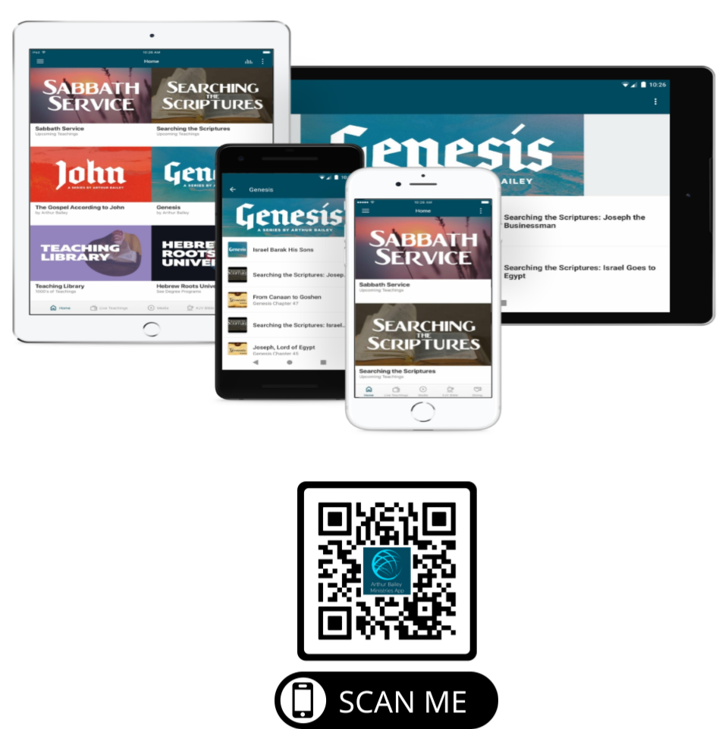

Slide 69
New Donation Opportunities
Canada Registered Charity

Slide 70
Mail in your support by check or money order.
Our Mailing Address:
P O Box 1182
Fort Mill, SC 29716

Slide 72
You can give by
Texting
Donate – Tithe - Offering
to
704-810-1579

