Slide 3
Welcome to
Searching the Scriptures

Slide 4
TODAY’S MESSAGE
Leviticus 19:19-37
Laws for Holy Living Pt. 2

Slide 5
Please Subscribe for Updates on our Website.
Watch us on YouTube.
Follow us on Facebook and the
other Social Media Networks.
Please Like and Share our Videos
and Posts.

Slide 6
At the end of today’s Teaching, you will be able to 1. Ask Questions 2. Receive Prayer 3. Give your Tithes and Offerings

Slide 7
The Vision of House of Israel is to be: 1. A Worshipping People (John 4:23-24) 2. An Evangelistic Community (Acts 2:42-47)

Slide 8
3. A Discipleship Center (Matthew 28:19) 4. An Equipping Network (Ephesians 4:12) 5. And a Worldwide Witness for Yeshua The Messiah
(Acts 1:8)

Slide 10
Prayer

Slide 11
TODAY’S MESSAGE
Leviticus 19:19-37
Laws for Holy Living Pt. 2

Slide 12
In Leviticus 19, YeHoVaH gave Moses several Instructions, on a variety of topics, to speak to the Children of Israel concerning how they were to conduct themselves in the Land of Israel and wherever they were. The Laws they were given were for His Holy, set apart people to live Holy unto YeHoVaH!

Slide 13
Leviticus 19 opens with YeHoVaH speaking to Moses to inform His people that they are to be Holy.

Slide 14
^{Lev 19:1} And the LORD spake unto Moses, saying,
^{Lev 19:2} Speak unto all the congregation of the children of Israel, and say unto them, Ye shall be holy: for I the LORD your God am holy.

Slide 15
Spake – 01696 דִּבֵּר dabar {daw-bar'} Meaning: 1) to speak, declare, converse, command, promise, warn, threaten, sing 1a) (Qal) to speak 1b) (Niphal) to speak with one another, talk 1c) (Piel) 1c1) to speak 1c2) to promise 1d) (Pual) to be spoken 1e) (Hithpael) to speak 1f) (Hiphil) to lead away, put to flight Usage: AV - speak 840, say 118, talk 46, promise 31, tell 25, commune 20, pronounce 14, utter 7, command 4 misc 38; 1143

Slide 16
^{Lev 19:2} Speak unto all the congregation of the children of Israel, and say unto them, Ye shall be holy: for I the LORD your God am holy.

Slide 17
Speak – 01696 דִּבֵּר dabar {daw-bar'} Meaning: 1) to speak, declare, converse, command, promise, warn, threaten, sing 1a) (Qal) to speak 1b) (Niphal) to speak with one another, talk 1c) (Piel) 1c1) to speak 1c2) to promise 1d) (Pual) to be spoken 1e) (Hithpael) to speak 1f) (Hiphil) to lead away, put to flight Usage: AV - speak 840, say 118, talk 46, promise 31, tell 25, commune 20, pronounce 14, utter 7, command 4 misc 38; 1143

Slide 18
Holy – 06918 קָדוֹשׁ qadowsh {kaw-doshe'} or קָדֹשׁ qadosh {kaw-doshe'}
Meaning: 1) sacred, holy, Holy One, saint, set apart
Usage: AV - holy 65, Holy One 39, saint 12; 116

Slide 19
^{Lev 19:19} Ye shall keep my statutes. Thou shalt not let thy cattle gender with a diverse kind: thou shalt not sow thy field with mingled seed: neither shall a garment mingled of linen and woollen come upon thee.

Slide 20
Statutes – 02708 חֻקָּה chuqqah {khook-kaw'}
Meaning: 1) statute, ordinance, limit, enactment, something prescribed 1a) statute
Usage: AV - statute 77, ordinance 22, custom 2, appointed 1, manners 1, rites 1; 104

Slide 21
YeHoVaH established the Statutes for His people.
The first use of this word is connected to Abraham as Father spoke to Isaac during a famine in Genesis 26.

Slide 22
^{Ge 26:1} And there was a famine in the land, beside the first famine that was in the days of Abraham. And Isaac went unto Abimelech king of the Philistines unto Gerar.
^{Ge 26:2} And the LORD appeared unto him, and said, Go not down into Egypt; dwell in the land which I shall tell thee of:

Slide 23
^{Ge 26:3} Sojourn in this land, and I will be with thee, and will bless thee; for unto thee, and unto thy seed, I will give all these countries, and I will perform the oath which I sware unto Abraham thy father;
^{Ge 26:4} And I will make thy seed to multiply as the stars of heaven, and will give unto thy seed all these countries; and in thy seed shall all the nations of the earth be blessed;

Slide 24
^{Ge 26:5} Because that Abraham obeyed my voice, and kept my charge, my commandments, my statutes, and my laws.

Slide 25
The Commands
No cross breeding of animals
No mingling or mixing of seed together
No mingling of linen and wool

Slide 26
^{Lev 19:20} And whosoever lieth carnally with a woman, that is a bondmaid, betrothed to an husband, and not at all redeemed, nor freedom given her; she shall be scourged; they shall not be put to death, because she was not free.

Slide 27
Scourged – 01244 בִּקֹּרֶת biqqoreth {bik-ko-reth}
Meaning: 1) punishment (after judicial enquiry), compensation
Usage: AV - scourged 1; 1

Slide 28
There was to be no sexual relationship with a betrothed bondwoman.
First, there is an investigation into the matter to determine the verdict.

Slide 29
The Hebrew word for scourge indicates she shall be punished or compensated.
The man who sinned must bring and offering for an atonement for his sin.

Slide 30
^{Lev 19:21} And he shall bring his trespass offering unto the LORD, unto the door of the tabernacle of the congregation, even a ram for a trespass offering.
^{Lev 19:22} And the priest shall make an atonement for him with the ram of the trespass offering before the LORD for his sin which he hath done: and the sin which he hath done shall be forgiven him.

Slide 31
^{Lev 19:23} And when ye shall come into the land, and shall have planted all manner of trees for food, then ye shall count the fruit thereof as uncircumcised: three years shall it be as uncircumcised unto you: it shall not be eaten of.

Slide 32
^{Lev 19:24} But in the fourth year all the fruit thereof shall be holy to praise the LORD withal.
^{Lev 19:25} And in the fifth year shall ye eat of the fruit thereof, that it may yield unto you the increase thereof: I am the LORD your God.

Slide 33
The age of the tree does not determine when the count begins. The count begins when the tree first produces fruit.

Slide 34
^{Lev 19:26} Ye shall not eat any thing with the blood: neither shall ye use enchantment, nor observe times.

Slide 35
The blood of the animal had to be properly disposed of and not visible while eating the beast that was killed.

Slide 36
^{Dt 12:22} Even as the roebuck and the hart is eaten, so thou shalt eat them: the unclean and the clean shall eat of them alike.
^{Dt 12:23} Only be sure that thou eat not the blood: for the blood is the life; and thou mayest not eat the life with the flesh.

Slide 37
^{Dt 12:24} Thou shalt not eat it; thou shalt pour it upon the earth as water.
^{Dt 12:25} Thou shalt not eat it; that it may go well with thee, and with thy children after thee, when thou shalt do that which is right in the sight of the LORD.

Slide 38
^{Lev 19:27} Ye shall not round the corners of your heads, neither shalt thou mar the corners of thy beard.

Slide 39
^{Lev 19:27} “ ‘Do not cut the hair at the sides of your head or clip off the edges of your beard. HNV
^{Lev 19:27} You shall not round the corners of the hair of your heads nor trim the corners of your beard [as some idolaters do]. AMP
^{LEV 19:27} ‘ You shall not round off the side-growth of your heads nor harm the edges of your beard. NASV

Slide 40
^{Lev 19:27} —Ye shall not shave the corners of your head round, neither shalt thou mutilate the corners of thy beard. Darby
^{Lev 19:27} “Do not trim off the hair on your temples or clip the edges of your beards. NLT
²⁷ You shall not round off the hair on your temples or mar the edges of your beard. NRSV

Slide 41
^{Lev 19:27} Ye shall not round the corners of your heads, neither shalt thou mar the corners of thy beard. KJV

Slide 42
Round – 05362 נָקַף naqaph {naw-kaf'}
Meaning: 1) to strike, strike off 1a) (Piel) to strike off skin 2) to go around, compass, round 2a) (Qal) to go around 2b) (Hiphil) 2b1) to go around, surround, encompass, enclose 2b2) to make the round, complete the circuit 2b3) to make round, round off

Slide 43
Usage: AV - compass 7, go round about 3, go about 2, compass about 2, destroy 1, down 1, inclosed 1, kill 1, round 1; 19

Slide 44
Mar – 07843 שָׁחַת shachath {shaw-khath'}
Meaning: 1) to destroy, corrupt, go to ruin, decay 1a) (Niphal) to be marred, be spoiled, be corrupted, be corrupt, be injured, be ruined, be rotted 1b) (Piel) 1b1) to spoil, ruin 1b2) to pervert, corrupt, deal corruptly (morally) 1c) (Hiphil) 1c1) to spoil, ruin, destroy 1c2) to pervert, corrupt (morally) 1c3) destroyer (participle) 1d) (Hophal) spoiled, ruined (participle)

Slide 45
Usage: AV - destroy 96, corrupt 22, mar 7, destroyer 3, corrupters 2, waster 2, spoilers 2, battered 1, corruptly 1, misc 11; 147

Slide 46
Rounding or marring has nothing to do with cutting or shaving one’s head or beard.

Slide 47
^{Lev 19:28} Ye shall not make any cuttings in your flesh for the dead, nor print any marks upon you: I am the LORD.

Slide 48
Marks – 07085 קַעֲקַע qa`aqa` {kah-ak-ah'}
Meaning: 1) incision, imprintment, tattoo, mark
Usage: AV - marks 1; 1

Slide 49
^{Lev 19:29} Do not prostitute thy daughter, to cause her to be a whore; lest the land fall to whoredom, and the land become full of wickedness.

Slide 50
Don’t prostitute a daughter for whatever reason.

Slide 51
^{Lev 19:30} Ye shall keep my sabbaths, and reverence my sanctuary: I am the LORD.

Slide 52
The Sabbath was and is to be kept Holy.
The Sanctuary was the Tabernacle/Temple where the Priests did their service unto YeHoVaH, not the inner sanctum of where congregations gather for their services.

Slide 53
^{Lev 19:31} Regard not them that have familiar spirits, neither seek after wizards, to be defiled by them: I am the LORD your God.

Slide 54
Familiar spirits – 0178 אוֹב 'owb {obe}
Meaning: 1) water skin bottle 2) necromancer 1b) necromancer, one who evokes the dead 1c) ghost, spirit of a dead one 1d) practice of necromancy 3) one that has a familiar spirit
Usage: AV - familiar spirit(s) 16, bottles 1; 17

Slide 55
Don’t seek counsel from the dead, from the ancient ones, or spiritual guidance from ancestors.
Don’t go to witches, palm readers, tarot card readers, or anyone to tell you your future.

Slide 56
^{Lev 19:32} Thou shalt rise up before the hoary head, and honour the face of the old man, and fear thy God: I am the LORD.

Slide 57
Hoary head – 07872 שֵׂיבָה seybah {say-baw'}
Meaning: 1) age, gray hair, hoary head, old age 1a) gray hair, hoary head 1b) old age
Usage: AV - old age 6, gray hairs 6, hoar head 3, hoary head 2, grayheaded 1, hoary 1; 19

Slide 58
Rising for the hoary head is showing respect for our aged ones.

Slide 59
^{Lev 19:33} And if a stranger sojourn with thee in your land, ye shall not vex him.

Slide 60
Sojourn – 01481 גּוּר guwr {goor}
Meaning: 1) to sojourn, abide, dwell in, dwell with, remain, inhabit, be a stranger, be continuing, surely 1a) (Qal) 1a1) to sojourn, dwell for a time 1a2) to abide, stay, temporarily dwell 1b) (Hithpolel) 1b1) to seek hospitality with 1b2) to assemble oneself

Slide 61
Usage: AV - sojourn 58, dwell 12, afraid 6, stranger 6, gather together 4, fear 3, abide 2, assemble 1, stand in awe 1, gathered 1, inhabitant 1, remain 1, sojourners 1, surely 1; 98

Slide 62
^{Lev 19:34} But the stranger that dwelleth with you shall be unto you as one born among you, and thou shalt love him as thyself; for ye were strangers in the land of Egypt: I am the LORD your God.

Slide 63
Dwelleth – 01481 גּוּר guwr {goor}
Meaning: 1) to sojourn, abide, dwell in, dwell with, remain, inhabit, be a stranger, be continuing, surely 1a) (Qal) 1a1) to sojourn, dwell for a time 1a2) to abide, stay, temporarily dwell 1b) (Hithpolel) 1b1) to seek hospitality with 1b2) to assemble oneself

Slide 64
Usage: AV - sojourn 58, dwell 12, afraid 6, stranger 6, gather together 4, fear 3, abide 2, assemble

Slide 65
^{Lev 19:35} Ye shall do no unrighteousness in judgment, in meteyard, in weight, or in measure.
^{Lev 19:36} Just balances, just weights, a just ephah, and a just hin, shall ye have: I am the LORD your God, which brought you out of the land of Egypt.

Slide 66
^{Lev 19:37} Therefore shall ye observe all my statutes, and all my judgments, and do them: I am the LORD.

Slide 67
Statutes – 02708 חֻקָּה chuqqah {khook-kaw'}
Meaning: 1) statute, ordinance, limit, enactment, something prescribed 1a) statute
Usage: AV - statute 77, ordinance 22, custom 2, appointed 1, manners 1, rites 1; 104

Slide 68
Judgments – 04941 מִשְׁפָּט mishpat {mish-pawt'}
Meaning: 1) judgment, justice, ordinance 1a) judgment 1a1) act of deciding a case 1a2) place, court, seat of judgment 1a3) process, procedure, litigation (before judges) 1a4) case, cause (presented for judgment)

Slide 69
1a5) sentence, decision (of judgment) 1a6) execution (of judgment) 1a7) time (of judgment) 1b) justice, right, rectitude (attributes of God or man) 1c) ordinance 1d) decision (in law) 1e) right, privilege, due (legal) 1f) proper, fitting, measure, fitness, custom, manner, plan

Slide 70
Usage: AV - judgment 296, manner 38, right 18, cause 12, ordinance 11, lawful 7, order 5, worthy 3, fashion 3, custom 2, discretion 2, law 2, measure 2, sentence 2, misc 18; 421

Slide 71
YeHoVaH presented these somewhat random Commandments for Israel to conduct themselves in a Holy manner, in community, in His Presence.

Slide 72
Your support is greatly appreciated and needed.

Slide 74
Our Preferred
Donation Methods:

Slide 75
CashApp – $ABMHOI
Venmo – @Arthur-Bailey-10
Zelle – apostlea@gmail.com

Slide 76
Question and Answer
Period

Slide 77
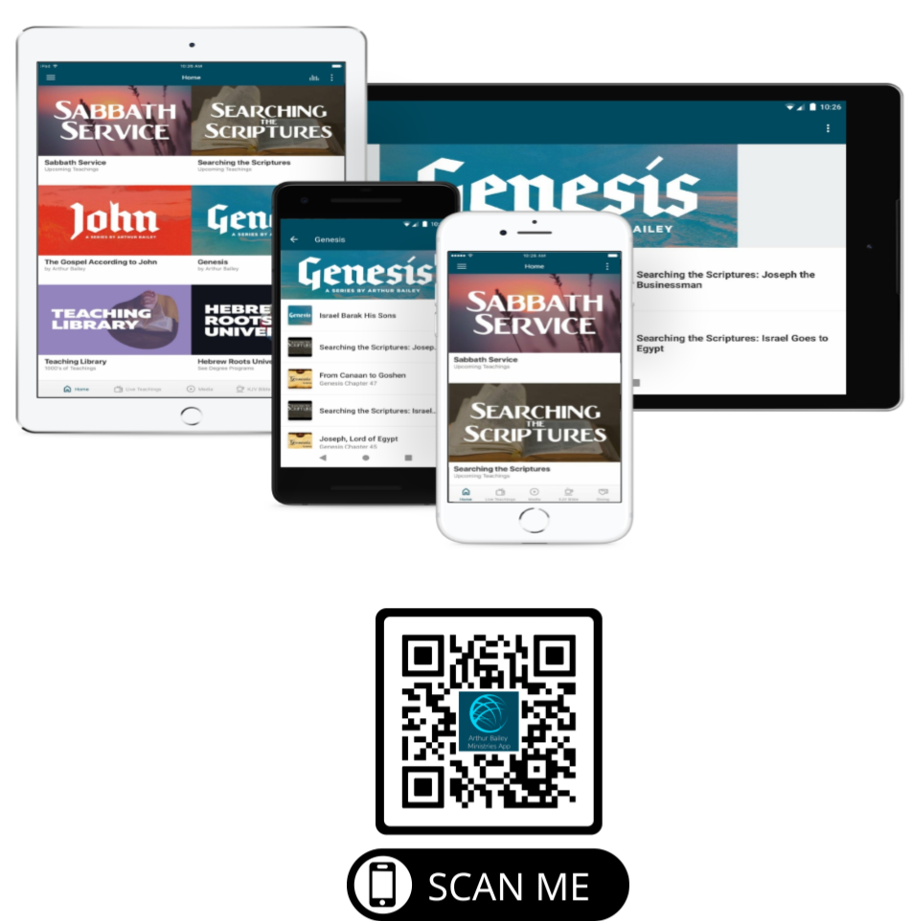

Slide 78
Mail in your support by check or money order.
Our Mailing Address:
P O Box 1182
Fort Mill, SC 29716

Slide 79
You can give by
Texting
Donate – Tithe - Offering
to
704-810-1579

Slide 80
