Slide 3
TODAY’S MESSAGE
Luke 13:22-35
Workers of Iniquity

Slide 4
Please Subscribe for Updates on our Website.
Watch us on YouTube.
Follow us on Facebook and the
other Social Media Networks.
Please Like and Share our Videos
and Posts.

Slide 5
At the end of today’s Teaching, you will be able to 1. Ask Questions 2. Receive Prayer 3. Give your Tithes and Offerings

Slide 6
The Vision of House of Israel is to be: 1. A Worshipping People (John 4:23-24) 2. An Evangelistic Community (Acts 2:42-47)

Slide 7
3. A Discipleship Center (Matthew 28:19) 4. An Equipping Network (Ephesians 4:12) 5. And a Worldwide Witness for Yeshua The Messiah
(Acts 1:8)

Slide 9
Prayer

Slide 10
TODAY’S MESSAGE
Luke 13:22-35
Workers of Iniquity

Slide 11
Yeshua’s life, lifestyle, and Ministry provoked opposition from a variety of people from the king to the common man. From the news of Messiah’s birth, the visit by the Magi and the killing of the males two years and younger, to the cries for His crucifixion by the religious leaders and the people, and the plotting of Messiah’s death, cast an ominous shadow over the people He came to save.

Slide 12
In this portion of Luke, Yeshua is asked a question on a few being saved and then warned about a plot against His life. Yeshua’s response leaves much to seriously consider for all who heard and read Yeshua’s words.

Slide 13
^{Lk 13:22} And he went through the cities and villages, teaching, and journeying toward Jerusalem.
^{Lk 13:23} Then said one unto him, Lord, are there few that be saved? And he said unto them,

Slide 14
Question: Are there few that be saved?

Slide 15
Saved – 4982 σῴζω sozo {sode'-zo}
Meaning: 1) to save, keep safe and sound, to rescue from danger or destruction 1a) one (from injury or peril) 1a1) to save a suffering one (from perishing), i.e. one suffering from disease, to make well, heal, restore to health 1b1) to preserve one who is in danger of destruction, to save or rescue

Slide 16
1b) to save in the technical biblical sense 1b1) negatively 1b1a) to deliver from the penalties of the Messianic judgment 1b1b) to save from the evils which obstruct the reception of the Messianic deliverance
Usage: AV - save 93, make whole 9, heal 3, be whole 2, misc 3; 110

Slide 17
Yeshua does not answer the question but encouraged the hearers of His response to strive to enter at the strait gate.
^{Lk 13:24} Strive to enter in at the strait gate: for many, I say unto you, will seek to enter in, and shall not be able.

Slide 18
Strive – 75 ἀγωνίζομαι agonizomai {ag-o-nid'-zom-ahee} Meaning: 1) to enter a contest: contend in the gymnastic games 2) to contend with adversaries, fight 3) metaph. to contend, struggle, with difficulties and dangers 4) to endeavour with strenuous zeal, strive: to obtain something
Usage: AV - strive 3, fight 3, labour fervently 1; 7

Slide 19
Strait – 4728 στενός stenos {sten-os'}
Meaning: 1) narrow, strait
Usage: AV - strait 3; 3

Slide 20
Yeshua said in Matthew:
^{Mt 7:13} Enter ye in at the strait gate: for wide is the gate, and broad is the way, that leadeth to destruction, and many there be which go in thereat:
^{Mt 7:14} Because strait is the gate, and narrow is the way, which leadeth unto life, and few there be that find it.

Slide 21
Why won’t they be able to enter in?
^{Lk 13:25} When once the master of the house is risen up, and hath shut to the door, and ye begin to stand without, and to knock at the door, saying, Lord, Lord, open unto us; and he shall answer and say unto you, I know you not whence ye are:

Slide 22
Grace expires.
The grace period expires.
The Dispensationalists even teach the age of grace, or the age of the church expires with the rapture.

Slide 23
^{Lk 13:26} Then shall ye begin to say, We have eaten and drunk in thy presence, and thou hast taught in our streets.
^{Lk 13:27} But he shall say, I tell you, I know you not whence ye are; depart from me, all ye workers of iniquity.

Slide 24
Workers – 2040 ἐργάτης ergates {er-gat'-ace}
Meaning: 1) a workman, a labourer 1a) usually one who works for hire esp. an agricultural worker 2) one who does, a worker, perpetrator
Usage: AV - labourer 10, workman 3, worker 3; 16

Slide 25
There are three Greek words for iniquity in the New Testament writings.

Slide 26
Iniquity – 93 ἀδικία adikia {ad-ee-kee'-ah}
Meaning: 1) injustice, of a judge 2) unrighteousness of heart and life 3) a deed violating law and justice, act of unrighteousness
Usage: AV - unrighteousness 16, iniquity 6, unjust 2, wrong 1; 25

Slide 27
^{2Pe 2:15} Which have forsaken the right way, and are gone astray, following the way of Balaam the son of Bosor, who loved the wages of unrighteousness;
^{2Pe 2:16} But was rebuked for his iniquity: the dumb ass speaking with man's voice forbad the madness of the prophet.

Slide 28
Iniquity – 3892 παρανομία paranomia {par-an-om-ee'-ah}
Meaning: 1) breach of law, transgression, wickedness
Usage: AV - iniquity 1; 1

Slide 29
The most quoted by Messianics:
^{Mt 7:23} And then will I profess unto them, I never knew you: depart from me, ye that work iniquity.
^{Mt 13:41} The Son of man shall send forth his angels, and they shall gather out of his kingdom all things that offend, and them which do iniquity;

Slide 30
^{Mt 23:28} Even so ye also outwardly appear righteous unto men, but within ye are full of hypocrisy and iniquity.
^{Mt 24:12} And because iniquity shall abound, the love of many shall wax cold.

Slide 31
Iniquity – 458 ἀνομία anomia {an-om-ee'-ah}
Meaning: 1) the condition of without law 1a) because ignorant of it 1b) because of violating it 2) contempt and violation of law, iniquity, wickedness
Usage: AV - iniquity 12, unrighteousness 1, transgress the law + 4060 1, transgression of the law 1; 15

Slide 32
Not knowing the Law
Refusing to obey the Law
Rejection of the Law altogether
Anomia would seemingly fall into the category of Hosea 4:6.

Slide 33
^{Hos 4:6} My people are destroyed for lack of knowledge: because thou hast rejected knowledge, I will also reject thee, that thou shalt be no priest to me: seeing thou hast forgotten the law of thy God, I will also forget thy children.

Slide 34
^{1Jn 3:2} Beloved, now are we the sons of God, and it doth not yet appear what we shall be: but we know that, when he shall appear, we shall be like him; for we shall see him as he is. ^{1Jn 3:3} And every man that hath this hope in him purifieth himself, even as he is pure.
^{1Jn 3:4} Whosoever committeth sin transgresseth also the law: for sin is the transgression of the law.

Slide 35
^{Lk 13:28} There shall be weeping and gnashing of teeth, when ye shall see Abraham, and Isaac, and Jacob, and all the prophets, in the kingdom of God, and you yourselves thrust out. ^{Lk 13:29} And they shall come from the east, and from the west, and from the north, and from the south, and shall sit down in the kingdom of God. ^{Lk 13:30} And, behold, there are last which shall be first, and there are first which shall be last.

Slide 36
Certain Pharisees, aware of Herod’s plan, warned Yeshua to leave the area He was in because of Herod.
^{Lk 13:31} The same day there came certain of the Pharisees, saying unto him, Get thee out, and depart hence: for Herod will kill thee.

Slide 37
Herod, in the days of Yeshua’s Ministry was tetrarch of Galilee and Perea. He had John the Baptist beheaded. Back in Luke 9, he heard that John had been resurrected from the dead.

Slide 38
Herod had no jurisdiction in Jerusalem for it was under the authority of Pontius Pilate. Some believe the Pharisees were trying to hasten His journey to Jerusalem, out of reach of Herod, but well within the reach of the religious leaders who would ultimately pressure Pilate to crucify Yeshua.

Slide 39
^{Lk 9:7} Now Herod the tetrarch heard of all that was done by him: and he was perplexed, because that it was said of some, that John was risen from the dead; ^{Lk 9:8} And of some, that Elias had appeared; and of others, that one of the old prophets was risen again. ^{Lk 9:9} And Herod said, John have I beheaded: but who is this, of whom I hear such things? And he desired to see him.

Slide 40
Yeshua was not afraid of Herod, and continued to focus on His Ministry and mission.

Slide 41
^{Lk 13:32} And he said unto them, Go ye, and tell that fox, Behold, I cast out devils, and I do cures today and tomorrow, and the third day I shall be perfected.
^{Lk 13:33} Nevertheless I must walk today, and tomorrow, and the day following: for it cannot be that a prophet perish out of Jerusalem.

Slide 42
^{Lk 13:34} O Jerusalem, Jerusalem, which killest the prophets, and stonest them that are sent unto thee; how often would I have gathered thy children together, as a hen doth gather her brood under her wings, and ye would not!

Slide 43
Jerusalem, in this passage, is referring to the religious center, which was inclusive of all religious activity and the focal point of the Temple services where all of Israel were to gather three times a year.

Slide 44
^{Lk 13:35} Behold, your house is left unto you desolate: and verily I say unto you, Ye shall not see me, until the time come when ye shall say, Blessed is he that cometh in the name of the Lord.

Slide 45
House – 3624 οἶκος oikos {oy'-kos}
Meaning: 1) a house 1a) an inhabited house, home 1b) any building whatever 1b1) of a palace 1b2) the house of God, the tabernacle 1c) any dwelling place 1c1) of the human body as the abode of demons that possess it 1c2) of tents, and huts, and later, of the nests, stalls, lairs, of animals

Slide 46
1c3) the place where one has fixed his residence, one's settled abode, domicile 2) the inmates of a house, all the persons forming one family, a household 2a) the family of God, of the Christian Church, of the church of the Old and New Testaments 3) stock, race, descendants of one
Usage: AV - house 104, household 3, home + 1519 2, at home + 1722 2, misc 3; 114

Slide 47
Desolate – 2048 ἔρημος eremos {er'-ay-mos} Meaning: 1) solitary, lonely, desolate, uninhabited 1a) used of places 1a1) a desert, wilderness 1a2) deserted places, lonely regions 1a3) an uncultivated region fit for pasturage 1b) used of persons 1b1) deserted by others 1b2) deprived of the aid and protection of others, especially of friends, acquaintances, kindred

Slide 48
1b3) bereft 1b3a) of a flock deserted by the shepherd 1b3b) of a women neglected by her husband, from whom the husband withholds himself
Usage: AV - wilderness 32, desert 13, desolate 4, solitary 1; 50
The prophet Malachi prophesied by the Spirit of YeHoVaH in his final verse of Chapter 4.

Slide 49
^{Mal 4:5} Behold, I will send you Elijah the prophet before the coming of the great and dreadful day of the LORD:
^{Mal 4:6} And he shall turn the heart of the fathers to the children, and the heart of the children to their fathers, lest I come and smite the earth with a curse.

Slide 50
Not many years after the ascension of Messiah Yeshua, persecution began amongst the followers of Messiah. The Saints were scattered in Acts 8.

Slide 51
^{Ac 8:1} And Saul was consenting unto his death. And at that time there was a great persecution against the church which was at Jerusalem; and they were all scattered abroad throughout the regions of Judaea and Samaria, except the apostles.

Slide 52
James, the brother of John, was killed by Herod.

Slide 53
^{Ac 12:1} Now about that time Herod the king stretched forth his hands to vex certain of the church.
^{Ac 12:2} And he killed James the brother of John with the sword.

Slide 54
The Temple was destroyed around 70 AD and religious life in Israel was forever changed.

Slide 55
Today, we await our Messiah’s return.

Slide 56
Your support is greatly appreciated and needed.

Slide 58
Our Preferred
Donation Methods:

Slide 59
CashApp – $ABMHOI
Venmo – @Arthur-Bailey-10
Zelle – apostlea@gmail.com

Slide 60
Question and Answer
Period

Slide 61
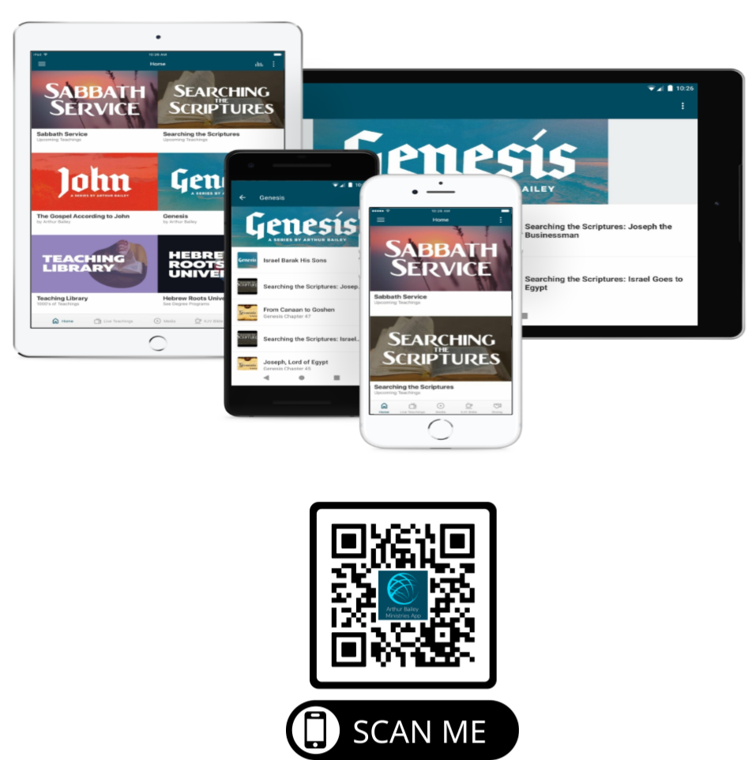

Slide 62
Mail in your support by check or money order.
Our Mailing Address:
P O Box 1182
Fort Mill, SC 29716

Slide 63
You can give by
Texting
Donate – Tithe - Offering
to
704-810-1579

