Slide 3
TODAY’S MESSAGE
The Eighth Day 2022
A Time for Reflection

Slide 4
Please Subscribe for Updates on our Website.
Watch us on YouTube.
Follow us on Facebook and the
other Social Media Networks.
Please Like and Share our Videos
and Posts.

Slide 5
At the end of today’s Teaching, you will be able to 1. Ask Questions 2. Receive Prayer 3. Give your Tithes and Offerings

Slide 6
The Vision of House of Israel is to be: 1. A Worshipping People (John 4:23-24) 2. An Evangelistic Community (Acts 2:42-47)

Slide 7
3. A Discipleship Center (Matthew 28:19) 4. An Equipping Network (Ephesians 4:12) 5. And a Worldwide Witness for Yeshua The Messiah
(Acts 1:8)

Slide 9
Worship in Prayer

Slide 10
TODAY’S MESSAGE
The Eighth Day 2022
A Time for Reflection

Slide 11
As a people who celebrate the Feasts of YeHoVaH, we must remember why we are celebrating His Feasts. Too often, the focus of why we are keeping the Feasts gets lost in the celebrations, and the reasons why are forgotten.

Slide 12
The Feasts required reflection and remembrance of YeHoVaH's Instructions, and celebration of YeHoVaH who made Covenant and kept Covenant despite the peoples’ behavior towards Him.

Slide 13
Before YeHoVaH made man, He established the appointed times (Feasts).
Man was made on the sixth day of Creation; the appointed times were established on the fourth day of Creation.

Slide 14
^{Ge 1:14} And God said, Let there be lights in the firmament of the heaven to divide the day from the night; and let them be for signs, and for seasons, and for days, and years:

Slide 15
Seasons – 04150 מוֹעֵד mow`ed {mo-ade'} or מֹעֵד mo`ed {mo-ade'} or )fem.( מוֹעָדָה mow`adah )2 Chr 8:13( {mo-aw-daw'}
Meaning: 1) appointed place, appointed time, meeting 1a) appointed time 1a1) appointed time (general) 1a2) sacred season, set feast, appointed season 1b) appointed meeting 1c) appointed place 1d) appointed sign or signal 1e) tent of meeting

Slide 16
Usage: AV - congregation 150, feast 23, season 13, appointed 12, time 12, assembly 4, solemnity 4, solemn 2, days 1, sign 1, synagogues 1; 223

Slide 17
The first set Feast that YeHoVaH established was the Sabbath Day.
YeHoVaH made the Seventh day. Although it is not called the Sabbath, we all know that it is the Sabbath Day.

Slide 18
^{Ge 2:1} Thus the heavens and the earth were finished, and all the host of them.
^{Ge 2:2} And on the seventh day God ended his work which he had made; and he rested on the seventh day from all his work which he had made.

Slide 19
^{Ge 2:3} And God blessed the seventh day, and sanctified it: because that in it he had rested from all his work which God created and made.

Slide 20
YeHoVaH made the Sabbath for man as Yeshua so boldly declared in Mark.
Mark 2: 27 ¶ And he said unto them, The sabbath was made for man, and not man for the sabbath:

Slide 21
After YeHoVaH delivered His people from bondage in Egypt, He instructed them concerning His appointed times that were to be observed when they entered The Land.

Slide 22
^{Lev 23:1} And the LORD spake unto Moses, saying,
^{Lev 23:2} Speak unto the children of Israel, and say unto them, Concerning the feasts of the LORD, which ye shall proclaim to be holy convocations, even these are my feasts.

Slide 23
^{Lev 23:3} Six days shall work be done: but the seventh day is the sabbath of rest, an holy convocation; ye shall do no work therein: it is the sabbath of the LORD in all your dwellings.
^{Lev 23:4} These are the feasts of the LORD, even holy convocations, which ye shall proclaim in their seasons.

Slide 24
^{Lev 23:37} These are the feasts of the LORD, which ye shall proclaim to be holy convocations, to offer an offering made by fire unto the LORD, a burnt offering, and a meat offering, a sacrifice, and drink offerings, every thing upon his day:
^{Lev 23:38} Beside the sabbaths of the LORD, and beside your gifts, and beside all your vows, and beside all your freewill offerings, which ye give unto the LORD.

Slide 25
These Feasts are YeHoVaH’s Feasts, NOT ours. We celebrate Him, NOT ourselves.
Underlined = Pilgrimage Feasts.

Slide 26
Passover
Unleavened Bread
Firstfruits
Day of Pentecost
Day of Trumpets
Day of Atonement
Tabernacles
Eighth Day

Slide 27
The Eighth Day is the closing Assembly where people reflect, remember, recommit, and rededicate themselves to YeHoVaH and to serve YeHoVaH and Him alone!

Slide 28
The wandering in the wilderness, the Babylonian captivity, and the destruction and dispersing of Israel from the Holy Land after the ascension of Messiah, can all be traced back to the failure to Obey YeHoVaH.

Slide 29
For the purpose of this study, I want to focus on the remnant of Israel in Nehemiah’s day that returned to the Land of Israel from Babylon and their discovery of the Book of the Law.

Slide 30
^{Ne 8:13} And on the second day were gathered together the chief of the fathers of all the people, the priests, and the Levites, unto Ezra the scribe, even to understand the words of the law.
^{Ne 8:14} And they found written in the law which the LORD had commanded by Moses, that the children of Israel should dwell in booths in the feast of the seventh month:

Slide 31
^{Ne 8:15} And that they should publish and proclaim in all their cities, and in Jerusalem, saying, Go forth unto the mount, and fetch olive branches, and pine branches, and myrtle branches, and palm branches, and branches of thick trees, to make booths, as it is written.

Slide 32
^{Ne 8:16} So the people went forth, and brought them, and made themselves booths, every one upon the roof of his house, and in their courts, and in the courts of the house of God, and in the street of the water gate, and in the street of the gate of Ephraim.

Slide 33
^{Ne 8:17} And all the congregation of them that were come again out of the captivity made booths, and sat under the booths: for since the days of Jeshua the son of Nun unto that day had not the children of Israel done so. And there was very great gladness.

Slide 34
^{Ne 8:18} Also day by day, from the first day unto the last day, he read in the book of the law of God. And they kept the feast seven days; and on the eighth day was a solemn assembly, according unto the manner.

Slide 35
The people were excited to be delivered and back in The Land, to rediscover the Law of YeHoVaH, and to have the freedom to celebrate and worship YeHoVaH. And then reality sets in.
The rest of the Story …

Slide 36
After the Eighth Day, on the twenty fourth day, we see the response of the people after they understood what YeHoVaH’s intent was for giving
The Eighth Day Solemn Assembly.

Slide 37
^{Ne 9:1} Now in the twenty and fourth day of this month the children of Israel were assembled with fasting, and with sackclothes, and earth upon them.

Slide 38
After the completion of the Eighth Day Assembly and after reflecting on the rebellion of their fathers, the Israelites who returned to the land fasted, repented, recommitted, and rededicated themselves to obeying YeHoVaH’s Law and worshipped Him.

Slide 39
^{Ne 9:2} And the seed of Israel separated themselves from all strangers, and stood and confessed their sins, and the iniquities of their fathers.
^{Ne 9:3} And they stood up in their place, and read in the book of the law of the LORD their God one fourth part of the day; and another fourth part they confessed, and worshipped the LORD their God.

Slide 40
^{Ne 9:4} Then stood up upon the stairs, of the Levites, Jeshua, and Bani, Kadmiel, Shebaniah, Bunni, Sherebiah, Bani, and Chenani, and cried with a loud voice unto the LORD their God.
^{Ne 9:5} Then the Levites, Jeshua, and Kadmiel, Bani, Hashabniah, Sherebiah, Hodijah, Shebaniah, and Pethahiah, said, Stand up and bless the LORD your God for ever and ever: and blessed be thy glorious name, which is exalted above all blessing and praise.

Slide 41
^{Ne 9:6} Thou, even thou, art LORD alone; thou hast made heaven, the heaven of heavens, with all their host, the earth, and all things that are therein, the seas, and all that is therein, and thou preservest them all; and the host of heaven worshippeth thee. ^{Ne 9:7} Thou art the LORD the God, who didst choose Abram, and broughtest him forth out of Ur of the Chaldees, and gavest him the name of Abraham;

Slide 42
^{Ne 9:8} And foundest his heart faithful before thee, and madest a covenant with him to give the land of the Canaanites, the Hittites, the Amorites, and the Perizzites, and the Jebusites, and the Girgashites, to give it, I say, to his seed, and hast performed thy words; for thou art righteous: ^{Ne 9:9} And didst see the affliction of our fathers in Egypt, and heardest their cry by the Red sea;

Slide 43
^{Ne 9:10} And showedst signs and wonders upon Pharaoh, and on all his servants, and on all the people of his land: for thou knewest that they dealt proudly against them. So didst thou get thee a name, as it is this day. ^{Ne 9:11} And thou didst divide the sea before them, so that they went through the midst of the sea on the dry land; and their persecutors thou threwest into the deeps, as a stone into the mighty waters.

Slide 44
^{Ne 9:12} Moreover thou leddest them in the day by a cloudy pillar; and in the night by a pillar of fire, to give them light in the way wherein they should go.
^{Ne 9:13} Thou camest down also upon mount Sinai, and spakest with them from heaven, and gavest them right judgments, and true laws, good statutes and commandments:

Slide 45
^{Ne 9:14} And madest known unto them thy holy sabbath, and commandedst them precepts, statutes, and laws, by the hand of Moses thy servant: ^{Ne 9:15} And gavest them bread from heaven for their hunger, and broughtest forth water for them out of the rock for their thirst, and promisedst them that they should go in to possess the land which thou hadst sworn to give them.

Slide 46
^{Ne 9:16} But they and our fathers dealt proudly, and hardened their necks, and hearkened not to thy commandments, ^{Ne 9:17} And refused to obey, neither were mindful of thy wonders that thou didst among them; but hardened their necks, and in their rebellion appointed a captain to return to their bondage: but thou art a God ready to pardon, gracious and merciful, slow to anger, and of great kindness, and forsookest them not.

Slide 47
^{Ne 9:18} Yea, when they had made them a molten calf, and said, This is thy God that brought thee up out of Egypt, and had wrought great provocations; ^{Ne 9:19} Yet thou in thy manifold mercies forsookest them not in the wilderness: the pillar of the cloud departed not from them by day, to lead them in the way; neither the pillar of fire by night, to show them light, and the way wherein they should go.

Slide 48
^{Ne 9:20} Thou gavest also thy good spirit to instruct them, and withheldest not thy manna from their mouth, and gavest them water for their thirst.
^{Ne 9:21} Yea, forty years didst thou sustain them in the wilderness, so that they lacked nothing; their clothes waxed not old, and their feet swelled not.

Slide 49
^{Ne 9:22} Moreover thou gavest them kingdoms and nations, and didst divide them into corners: so they possessed the land of Sihon, and the land of the king of Heshbon, and the land of Og king of Bashan. ^{Ne 9:23} Their children also multipliedst thou as the stars of heaven, and broughtest them into the land, concerning which thou hadst promised to their fathers, that they should go in to possess it.

Slide 50
^{Ne 9:24} So the children went in and possessed the land, and thou subduedst before them the inhabitants of the land, the Canaanites, and gavest them into their hands, with their kings, and the people of the land, that they might do with them as they would. ^{Ne 9:25} And they took strong cities, and a fat land, and possessed houses full of all goods, wells digged, vineyards, and oliveyards, and fruit trees in abundance: so they did eat, and were filled, and became fat, and delighted themselves in thy great goodness.

Slide 51
^{Ne 9:26} Nevertheless they were disobedient, and rebelled against thee, and cast thy law behind their backs, and slew thy prophets which testified against them to turn them to thee, and they wrought great provocations. ^{Ne 9:27} Therefore thou deliveredst them into the hand of their enemies, who vexed them: and in the time of their trouble, when they cried unto thee, thou heardest them from heaven; and according to thy manifold mercies thou gavest them saviours, who saved them out of the hand of their enemies.

Slide 52
^{Ne 9:28} But after they had rest, they did evil again before thee: therefore leftest thou them in the hand of their enemies, so that they had the dominion over them: yet when they returned, and cried unto thee, thou heardest them from heaven; and many times didst thou deliver them according to thy mercies;

Slide 53
^{Ne 9:29} And testifiedst against them, that thou mightest bring them again unto thy law: yet they dealt proudly, and hearkened not unto thy commandments, but sinned against thy judgments, (which if a man do, he shall live in them;) and withdrew the shoulder, and hardened their neck, and would not hear. ^{Ne 9:30} Yet many years didst thou forbear them, and testifiedst against them by thy spirit in thy prophets: yet would they not give ear: therefore gavest thou them into the hand of the people of the lands.

Slide 54
^{Ne 9:31} Nevertheless for thy great mercies' sake thou didst not utterly consume them, nor forsake them; for thou art a gracious and merciful God.

Slide 55
^{Ne 9:32} Now therefore, our God, the great, the mighty, and the terrible God, who keepest covenant and mercy, let not all the trouble seem little before thee, that hath come upon us, on our kings, on our princes, and on our priests, and on our prophets, and on our fathers, and on all thy people, since the time of the kings of Assyria unto this day.

Slide 56
^{Ne 9:33} Howbeit thou art just in all that is brought upon us; for thou hast done right, but we have done wickedly: ^{Ne 9:34} Neither have our kings, our princes, our priests, nor our fathers, kept thy law, nor hearkened unto thy commandments and thy testimonies, wherewith thou didst testify against them.

Slide 57
^{Ne 9:35} For they have not served thee in their kingdom, and in thy great goodness that thou gavest them, and in the large and fat land which thou gavest before them, neither turned they from their wicked works. ^{Ne 9:36} Behold, we are servants this day, and for the land that thou gavest unto our fathers to eat the fruit thereof and the good thereof, behold, we are servants in it:

Slide 58
^{Ne 9:37} And it yieldeth much increase unto the kings whom thou hast set over us because of our sins: also they have dominion over our bodies, and over our cattle, at their pleasure, and we are in great distress. ^{Ne 9:38} And because of all this we make a sure covenant, and write it; and our princes, Levites, and priests, seal unto it.

Slide 59
The people made a Covenant.
^{Ne 10:28} And the rest of the people, the priests, the Levites, the porters, the singers, the Nethinims, and all they that had separated themselves from the people of the lands unto the law of God, their wives, their sons, and their daughters, every one having knowledge, and having understanding;

Slide 60
^{Ne 10:29} They clave to their brethren, their nobles, and entered into a curse, and into an oath, to walk in God's law, which was given by Moses the servant of God, and to observe and do all the commandments of the LORD our Lord, and his judgments and his statutes;

Slide 61
If we properly reflect and celebrate YeHoVaH, we will realize we’re not simply returning to the way things were, or to our former lives.
We will resolve in our hearts and minds to do better going forth.

Slide 62
Reflect and Review Your Response to YeHoVaH's Laws
Have I been obedient to His Instructions?
Have I been faithful to what He has called me to do?
Have I been hot, cold, lukewarm?

Slide 63
Repent And Repair
What changes do I need to make?
What issues do I need to address?
What damage have I done and where do I need to make things right?

Slide 64
Restore and Renew Your Commitment to YeHoVaH
What will I do better? What improvements am I going to make going forward?
What boundaries will I set to keep me in line with His Word?
What or who do I need to cut off and what do I need to add to my faith?

Slide 65
Restore and Renew Your Commitment to YeHoVaH (cont.)
What have I learned about myself that gets in the way and needs Correcting?
What do I need to do to Restore my relationship With YeHoVaH?
Am I going to keep the Sabbath Holy?

Slide 66
Restore and Renew Your Commitment to YeHoVaH (cont.)
Am I going to obey His Commandments?
Am I going to prepare for (2nd Tithes) and celebrate the Feasts of YeHoVaH?
Will I wear my Tzitzits to be reminded to keep His Commandments?

Slide 67
Prayer of Repentance
Prayer of Renewal
Prayer of Rededication
Prayer for Healing
Prayer of Commitment and Strength to walk in Divine Purpose and Calling

Slide 68
Next year we get to do it all over again!
Let's do better going forward!

Slide 70
Your support is greatly appreciated and needed.

Slide 72
Our Preferred
Donation Methods:

Slide 73
CashApp – $ABMHOI
Venmo – @Arthur-Bailey-10
Zelle – apostlea@gmail.com

Slide 74
Question and Answer
Period

Slide 75
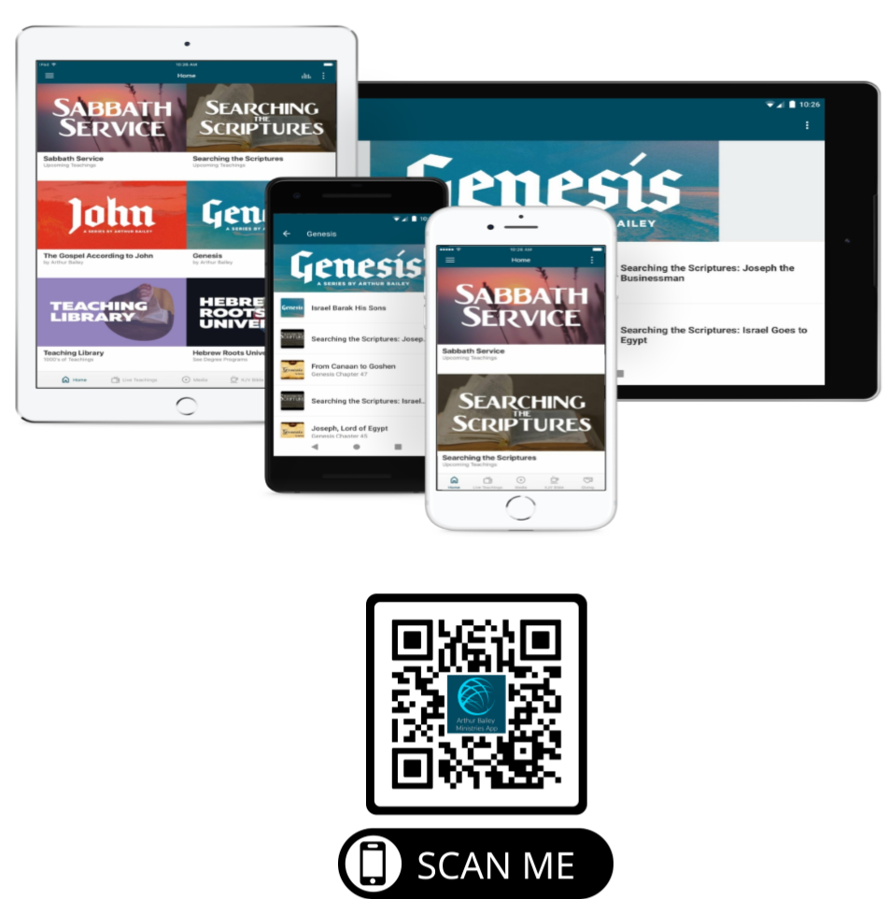

Slide 76
Mail in your support by check or money order.
Our Mailing Address:
P O Box 1182
Fort Mill, SC 29716

Slide 77
You can give by
Texting
Donate – Tithe - Offering
to
704-810-1579

