Slide 3
Welcome to
Searching the Scriptures

Slide 4
TODAY’S MESSAGE
Exodus 28:1-43
The Priestly Garments Pt 1

Slide 5
arthurbaileyministries.com/podcasts

Slide 6
Please subscribe for updates on our Website.
Watch us on YouTube.
Follow us on Facebook and the other Social Media networks.
Please Like and Share our videos and posts.

Slide 7
At the end of today’s Teaching, you will be able to 1. Ask Questions 2. Receive Prayer 3. Give your Tithes and Offerings

Slide 8
The Vision of House of Israel is to be: 1. A Worshipping People (John 4:23-24) 2. An Evangelistic Community (Acts 2:42-47)

Slide 9
3. A Discipleship Center (Matthew 28:19) 4. An Equipping Network (Ephesians 4:12) 5. And a Worldwide Witness for Yeshua The Messiah
(Acts 1:8)

Slide 11
Prayer

Slide 12
TODAY’S MESSAGE
Exodus 28:1-43
The Priestly Garments Pt 1

Slide 13
YeHoVaH gave Moses the pattern of the Tabernacle and its dimensions after informing Moses what items would be needed to complete the task. Before completing the list of all of the items that would go into the Tabernacle, YeHoVaH transitions to the items the Priests would need to wear in order to carry out their services unto YeHoVaH in the Tabernacle.

Slide 14
These garments were to be worn while the High Priest and Priests were serving in the Tabernacle unto YeHoVaH and while carrying out their duties among the Israelites. YeHoVaH gave Moses an elaborate set of intricate garment designs for Aaron the High Priest and the sons of Aaron who would serve with him as Priests. Skilled craftsmen would be designated to create the priestly garments that would bring dignity and honor to those who would serve in the priestly roles.

Slide 15
In this portion of Exodus, we will discuss the instructions given to Moses for the priestly garments, their parts, and purposes.

Slide 16
^{Ex 28:1} And take thou unto thee Aaron thy brother, and his sons with him, from among the children of Israel, that he may minister unto me in the priest's office, even Aaron, Nadab and Abihu, Eleazar and Ithamar, Aaron's sons.

Slide 17
Aaron and his 4 sons, Nadab, Abihu, Eleazar, and Ithamar, were the first priests serving in the Tabernacle with Aaron as the High Priest.

Slide 18
^{Ex 28:2} And thou shalt make holy garments for Aaron thy brother for glory and for beauty.

Slide 19
The priests' garments displayed honor, glory, splendor, riches, dignity, reverence…

Slide 20
Glory – 03519 כָּבוֹד k abowd {kaw-bode'} rarely כָּבֹד kabod {kaw-bode'}
Meaning: 1) glory, honour, glorious, abundance 1a) abundance, riches 1b) honour, splendour, glory 1c) honour, dignity 1d) honour, reputation 1e) honour, reverence, glory 1f) glory
Usage: AV - glory 156, honour 32, glorious 10, gloriously 1, honourable 1; 200

Slide 21
This glory was for both the person wearing the garment and for the person that saw it on the person wearing the garment.
The wearer was to wear it with dignity and honor and the person who saw the garment worn should honor the one wearing it with dignity, honor, and reverence.

Slide 22
Beauty – 08597 תִּפְאָרָה tiph'arah {tif-aw-raw'} or תִּפְאֶרֶת tiph'ereth {tif-eh'-reth}
Meaning: 1) beauty, splendour, glory 1a) beauty, finery (of garments, jewels) 1b) glory 1b1) of rank, renown 1b2) as attribute of God 1c) honour (or nation Israel) 1d) glorying, boasting (of individual)
Usage: AV - glory 22, beauty 10, beautiful 6, honour 4, fair 3, glorious 3, bravery 1, comely 1, excellent 1; 51

Slide 23
The priestly garments were also garments of rank.
The High Priest’s garment (Aaron) was of a higher rank than the priests’ (Aaron sons) garments.

Slide 24
^{Ex 28:3} And thou shalt speak unto all that are wisehearted (skill minded), whom I have filled with the spirit of wisdom, that they may make Aaron's garments to consecrate him, that he may minister unto me in the priest's office.

Slide 25
The wise-hearted men had been endowed by YeHoVaH with the skills they have mastered and given the wisdom of YeHoVaH to make the items YeHoVaH gave Moses the instructions to make.
Moses did not have to know everything or do everything. YeHoVaH had placed in Moses' midst those whom He had filled with His spirit of wisdom.

Slide 26
In Exodus 31, YeHoVaH reveals who these men are that He has chosen.
^{Ex 31:2} See, I have called by name Bezaleel the son of Uri, the son of Hur, of the tribe of Judah:

Slide 27
^{Ex 31:3} And I have filled him with the spirit of God, in wisdom, and in understanding, and in knowledge, and in all manner of workmanship,
^{Ex 31:4} To devise cunning works, to work in gold, and in silver, and in brass,

Slide 28
^{Ex 31:5} And in cutting of stones, to set them, and in carving of timber, to work in all manner of workmanship.
^{Ex 31:6} And I, behold, I have given with him Aholiab, the son of Ahisamach, of the tribe of Dan: and in the hearts of all that are wisehearted I have put wisdom, that they may make all that I have commanded thee;

Slide 29
^{Ex 28:4} And these are the garments which they shall make; a breastplate, and an ephod, and a robe, and a broidered coat, a mitre, and a girdle: and they shall make holy garments for Aaron thy brother, and his sons, that he may minister unto me in the priest's office.

Slide 30
The variety of visual images of what these garments looked like shows a difference in how these instructions have been interpreted down through the years. This makes it difficult to arrive at an exact replica of the priestly garments.

Slide 31
https://images.search.yahoo.com/search/images?p=THE+PRIESTLY+GARMENTS&fr=mcafee&type=E211US105G0&imgurl=https%3A%2F%2Fi.pinimg.com%2Foriginals%2F95%2F6f%2F26%2F956f2675204ca33a91e1a173c0ec9652.jpg#id=4&iurl=https%3A%2F%2Fcdn11.bigcommerce.com%2Fs-c8331u0%2Fimages%2Fstencil%2F1280x1280%2Fproducts%2F9763%2F11745%2F4059L__50863.1437071220.jpg%3Fc%3D2%26imbypass%3Don&action=click

Slide 32
The garments were holy because of the holy service that was to be performed in them.

Slide 33
^{Ex 28:5} And they shall take gold, and blue, and purple, and scarlet, and fine linen.
^{Ex 28:6} And they shall make the ephod of gold, of blue, and of purple, of scarlet, and fine twined linen, with cunning work.

Slide 34
^{Ex 28:7} It shall have the two shoulderpieces thereof joined at the two edges thereof; and so it shall be joined together.
^{Ex 28:8} And the curious girdle of the ephod, which is upon it, shall be of the same, according to the work thereof; even of gold, of blue, and purple, and scarlet, and fine twined linen.

Slide 35
^{Ex 28:9} And thou shalt take two onyx stones, and grave on them the names of the children of Israel:

Slide 36
Children in this passage is not speaking of all Israelites but specifically the sons of Israel.

Slide 37
Children – 01121 בֵּן ben {bane} Meaning: 1) son, grandson, child, member of a group 1a) son, male child 1b) grandson 1c) children (pl. - male and female) 1d) youth, young men
Usage: AV - son 2978, children 1568, old 135, first 51, man 20, young 18, young + 01241 17, child 10, stranger 10, people 5, misc 92; 4906

Slide 38
^{Ex 28:10} Six of their names on one stone, and the other six names of the rest on the other stone, according to their birth.

Slide 39
The verse indicates 12 names that would be engraved on the two stones.
Israel had 12 sons from his 2 wives and 2 handmaidens, Bilhah and Zilpah.

Slide 40
Ben is translated and used as – son 2978, children 1568, old 135, first 51, man 20, young 18, young + 01241 17, child 10, stranger 10, people 5, misc 92; 4906

Slide 41
Sons of Israel is most appropriate in this passage because Israel had a total of 15 children;
14 sons including Ephraim and Manasseh; and
1 daughter Dinah.

Slide 42
The list has 12 names
^{Ge 35:22} …Now the sons of Jacob were twelve:

Slide 43
The Sons of Leah
Reuben
Simeon
Levi
Judah
Issachar
Zebulun

Slide 44
Sons of Bilhah, Rachel’s handmaid
Dan
Naphtali
Sons of Zilpah, Leah’s handmaid
Gad
Asher

Slide 45
The Sons of Rachel
Joseph
Benjamin

Slide 46
2 sons from Joseph and his Egyptian wife, Asenath, named Ephraim and Manasseh, most likely would not have been included in this list of 12.

Slide 47
^{Ex 28:11} With the work of an engraver in stone, like the engravings of a signet, shalt thou engrave the two stones with the names of the children of Israel: thou shalt make them to be set in ouches of gold.

Slide 48
The engraver in stone, like everyone else that worked on the items that YeHoVaH gave instructions to Moses to make, was filled with the spirit of wisdom.

Slide 49
^{Ex 28:12} And thou shalt put the two stones upon the shoulders of the ephod for stones of memorial unto the children of Israel: and Aaron shall bear their names before the LORD upon his two shoulders for a memorial.

Slide 50
When Aaron went into the Tabernacle, he carried all the names of the sons of Israel into the Tabernacle. Therefore, all of the sons of Israel were represented on Aaron’s shoulders.

Slide 51
^{Ex 28:13} And thou shalt make ouches of gold;
^{Ex 28:14} And two chains of pure gold at the ends; of wreathen work shalt thou make them, and fasten the wreathen chains to the ouches.

Slide 52
Sabbath Teaching
Matthew 19:13-30
Eternal Life and the Law

Slide 53
Your support is greatly appreciated and needed.

Slide 54
Our Preferred Donation Method
CashAPP
$ABMHOI

Slide 56
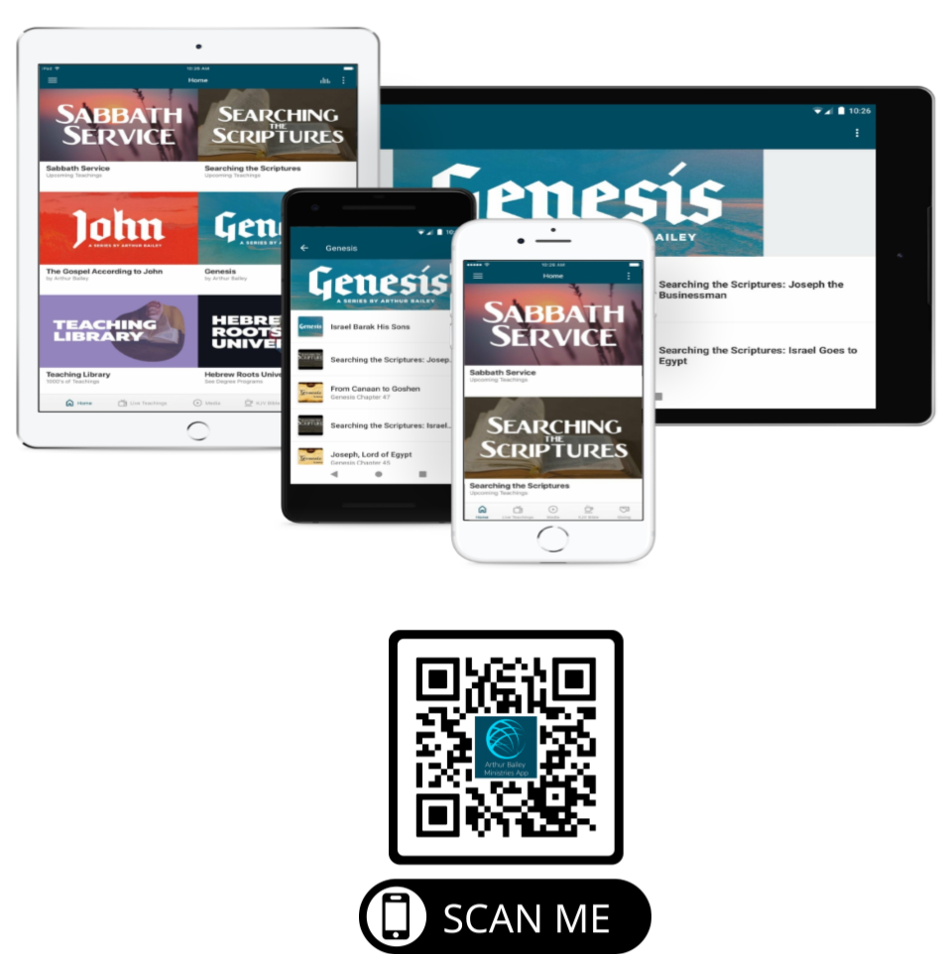

Slide 58
Mail in your support by check or money order.
Our Mailing Address:
P O Box 1182
Fort Mill, SC 29716

Slide 60
You can give by
Texting
Donate – Tithe - Offering
to
704-810-1579

