Slide 3
TODAY’S MESSAGE
Luke 14:25-35
The Disciple and The Cross

Slide 4
Please Subscribe for Updates on our Website.
Watch us on YouTube.
Follow us on Facebook and the
other Social Media Networks.
Please Like and Share our Videos
and Posts.

Slide 5
At the end of today’s Teaching, you will be able to 1. Ask Questions 2. Receive Prayer 3. Give your Tithes and Offerings

Slide 6
The Vision of House of Israel is to be: 1. A Worshipping People (John 4:23-24) 2. An Evangelistic Community (Acts 2:42-47)

Slide 7
3. A Discipleship Center (Matthew 28:19) 4. An Equipping Network (Ephesians 4:12) 5. And a Worldwide Witness for Yeshua The Messiah
(Acts 1:8)

Slide 9
Prayer

Slide 10
TODAY’S MESSAGE
Luke 14:25-35
The Disciple and The Cross

Slide 11
Yeshua made it clear, on several occasions, the cost of being His Disciple in the service of YeHoVaH. In this portion of Luke, He makes it even clearer the price every Disciple must be willing to pay by choosing to follow Him.
Are you willing to pay the price for being a Disciple of Yeshua?

Slide 12
One of the most challenging teachings Yeshua taught, and most likely one of the most difficult and controversial teachings to hear, was the teaching on making a deciding choice between Yeshua and one’s family.
Yeshua’s teaching in this passage could easily be put in the cult status and would very possibly be considered hate speech in our day.

Slide 13
^{Lk 14:25} And there went great multitudes with him: and he turned, and said unto them,

Slide 14
At times it seems, that Yeshua is trying to dissuade people from following Him. A great multitude of people are following Him, and He tells them they have to make a choice between Him and their immediate family.

Slide 15
^{Lk 14:26} If any man come to me, and hate not his father, and mother, and wife, and children, and brethren, and sisters, yea, and his own life also, he cannot be my disciple.

Slide 16
Hate – 3404 μισέω miseo {mis-eh'-o}
Meaning: 1) to hate, pursue with hatred, detest 2) to be hated, detested
Origin: from a primary misos (hatred); TDNT - 4:683,597; v
Usage: AV - hate 41, hateful 1; 42

Slide 17
The word choice Yeshua used was first used by Luke in reference to Zachariah’s prophecy to describe YeHoVaH’s deliverance of Israel from their enemies and those who hated the Israelites.

Slide 18
^{Lk 1:67} And his father Zacharias was filled with the Holy Ghost, and prophesied, saying, ^{Lk 1:68} Blessed be the Lord God of Israel; for he hath visited and redeemed his people,
^{Lk 1:69} And hath raised up an horn of salvation for us in the house of his servant David;

Slide 19
^{Lk 1:70} As he spake by the mouth of his holy prophets, which have been since the world began:
^{Lk 1:71} That we should be saved from our enemies, and from the hand of all that hate us:

Slide 20
Yeshua expounds on the teaching He had done earlier in Luke 9 where He stated,
^{Lk 9:23} And he said to them all, If any man will come after me, let him deny himself, and take up his cross daily, and follow me.
^{Lk 9:24} For whosoever will save his life shall lose it: but whosoever will lose his life for my sake, the same shall save it.

Slide 21
^{Lk 9:25} For what is a man advantaged, if he gain the whole world, and lose himself, or be cast away?
^{Lk 9:26} For whosoever shall be ashamed of me and of my words, of him shall the Son of man be ashamed, when he shall come in his own glory, and in his Father's, and of the holy angels.

Slide 22
^{Lk 14:27} And whosoever doth not bear his cross, and come after me, cannot be my disciple.

Slide 23
The way salvation and being saved have been taught in the Christian church is simply not fair to the listener who responds at an altar call without understanding the full weight and measure of what it means to be a Disciple of Messiah.

Slide 24
The cost or price one must pay to be a Disciple or follower of Messiah cannot be fully comprehended without understanding what is required over a lifetime of endurance, persecution, rejection, etc.

Slide 25
The price one must be willing to pay for being a Disciple of Yeshua is addressed in all of the Gospel narratives.

Slide 26
Matthew
^{Mt 10:34} Think not that I am come to send peace on earth: I came not to send peace, but a sword.
^{Mt 10:35} For I am come to set a man at variance against his father, and the daughter against her mother, and the daughter-in-law against her mother-in-law.

Slide 27
^{Mt 10:36} And a man's foes shall be they of his own household. ^{Mt 10:37} He that loveth father or mother more than me is not worthy of me: and he that loveth son or daughter more than me is not worthy of me. ^{Mt 10:38} And he that taketh not his cross, and followeth after me, is not worthy of me. ^{Mt 10:39} He that findeth his life shall lose it: and he that loseth his life for my sake shall find it.

Slide 28
Mark
^{Mk 8:34} And when he had called the people unto him with his disciples also, he said unto them, Whosoever will come after me, let him deny himself, and take up his cross, and follow me. ^{Mk 8:35} For whosoever will save his life shall lose it; but whosoever shall lose his life for my sake and the gospel's, the same shall save it.

Slide 29
^{Mk 8:36} For what shall it profit a man, if he shall gain the whole world, and lose his own soul?
^{Mk 8:37} Or what shall a man give in exchange for his soul?

Slide 30
John
^{Jn 12:25} He that loveth his life shall lose it; and he that hateth his life in this world shall keep it unto life eternal.
^{Jn 12:26} If any man serve me, let him follow me; and where I am, there shall also my servant be: if any man serve me, him will my Father honour.

Slide 31
Making a decision to follow Yeshua can be made by anyone.
However, no one can come to the Son except the Father draws him.

Slide 32
^{Jn 6:44} No man can come to me, except the Father which hath sent me draw him: and I will raise him up at the last day.
^{Jn 6:45} It is written in the prophets, And they shall be all taught of God. Every man therefore that hath heard, and hath learned of the Father, cometh unto me.

Slide 33
Yeshua gives two earthly examples of counting the cost or considering the price one must be willing to pay.
Both examples are seemingly associated with warfare of some sort.
The first example has to do with building a fortified structure.

Slide 34
^{Lk 14:28} For which of you, intending to build a tower, sitteth not down first, and counteth the cost, whether he have sufficient to finish it?

Slide 35
Tower – 4444 πύργος purgos {poor'-gos}
Meaning: 1) a tower 2) a fortified structure rising to a considerable height, to repel a hostile attack or to enable a watchman to see in every direction
Usage: AV - tower 4; 4

Slide 36
^{Lk 14:29} Lest haply, after he hath laid the foundation, and is not able to finish it, all that behold it begin to mock him,
^{Lk 14:30} Saying, This man began to build, and was not able to finish.

Slide 37
The second example is determining whether to go to war or to seek peace.

Slide 38
^{Lk 14:31} Or what king, going to make war against another king, sitteth not down first, and consulteth whether he be able with ten thousand to meet him that cometh against him with twenty thousand?
^{Lk 14:32} Or else, while the other is yet a great way off, he sendeth an ambassage, and desireth conditions of peace.

Slide 39
The cross was an instrument of death and here it symbolizes the necessity of total commitment, even unto death, on the part of Yeshua’s Disciples.

Slide 40
To deny self means to cease to make self the center of one’s life and actions. The person who is carrying a cross is the picture of a man, already condemned, and is required to carry the beam of his own cross to the place of execution.

Slide 41
Bearing one’s cross is a willingness to suffer and die for Yeshua’s sake and being willing to suffer the most violent suffering unto death in Yeshua’s time.

Slide 42
Yeshua did not want a blind, naive commitment that expected only blessings. As a builder estimates costs or a king evaluates military strength, so a person must consider what Yeshua expects of His followers.
The cost, Yeshua warned, is complete surrender to him.

Slide 43
Yeshua is teaching being set apart, being separated. This is living a set apart life in a crowded world with all of its expectations and demands that life and the people we love try to put on us.

Slide 44
^{Lk 14:33} So likewise, whosoever he be of you that forsaketh not all that he hath, he cannot be my disciple.

Slide 45
Forsaketh – 657 ἀποτάσσομαι (ἀποτάσσω) apotassomai {ap-ot-as'-som-ahee}
Meaning: 1) to set apart, separate 1a) to separate one's self, withdraw one's self from anyone 1a1) to take leave of, bid farewell to 1b) to renounce, forsake
Usage: AV - bid farewell 2, take leave 2, send away 1, forsake 1; 6

Slide 46
Questions to Resolve
Are you willing to forsake your father and mother?

Slide 47
For some parents, exerting control over their offspring is their parental right. For something or someone to have greater control over their children than they have is a preverbal threat.

Slide 48
Your Wife?
The same for a wife concerning her husband.

Slide 49
Your Children?
For some people, they see Yeshua as a threat against them and their family.

Slide 50
Your Brothers and Sisters?
Anytime anyone puts their faith above their family, it is viewed as some form of cult or occultist behavior.

Slide 51
For some people, nothing and no one should come between, or be allowed to come between, them and family.
Yeshua was not only a threat to religious leaders and religion, but He was also a threat to families.

Slide 52
However, Yeshua is the answer to all manner of dysfunctions.
He is the answer to Life itself, for structure.

Slide 53
^{Lk 14:34} Salt is good: but if the salt have lost his savour, wherewith shall it be seasoned?
^{Lk 14:35} It is neither fit for the land, nor yet for the dunghill; but men cast it out. He that hath ears to hear, let him hear.

Slide 54
Your support is greatly appreciated and needed.

Slide 56
Our Preferred
Donation Methods:

Slide 57
CashApp – $ABMHOI
Venmo – @Arthur-Bailey-10
Zelle – apostlea@gmail.com

Slide 58
Question and Answer
Period

Slide 59
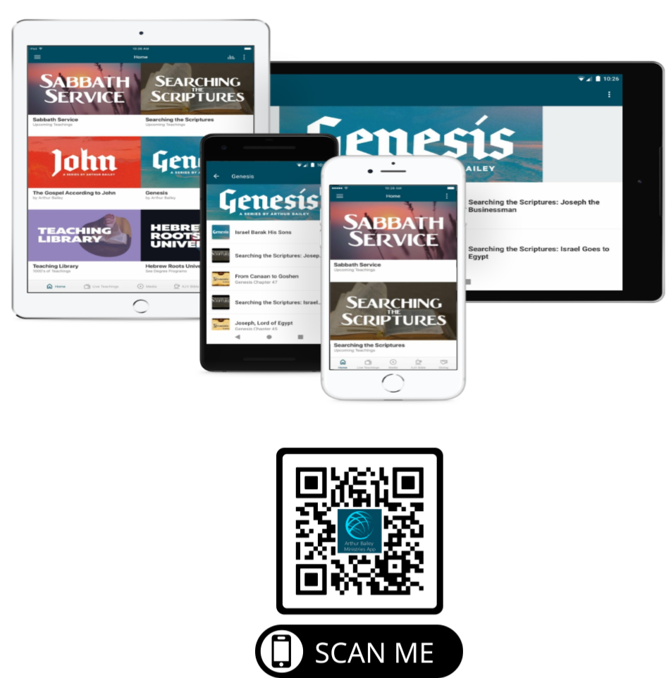

Slide 60
Mail in your support by check or money order.
Our Mailing Address:
P O Box 1182
Fort Mill, SC 29716

Slide 61
You can give by
Texting
Donate – Tithe - Offering
to
704-810-1579

