Slide 3
TODAY’S MESSAGE
“The Biblical New Year”

Slide 4
Please subscribe for updates on our Website.
Watch us on YouTube.
Follow us on Facebook and the other Social Media networks.
Please Like and Share our videos and posts.

Slide 5
At the end of today’s Teaching, you will be able to 1. Ask Questions 2. Receive Prayer 3. Give your Tithes and Offerings

Slide 6
The Vision of House of Israel is to be: 1. A Worshipping People (John 4:23-24) 2. An Evangelistic Community (Acts 2:42-47)

Slide 7
3. A Discipleship Center (Matthew 28:19) 4. An Equipping Network (Ephesians 4:12) 5. And a Worldwide Witness for Yeshua The Messiah
(Acts 1:8)

Slide 9
Prayer

Slide 10
TODAY’S MESSAGE
“The Biblical New Year”

Slide 11
America, and nations around the world, celebrate the New Year in the Winter at midnight on December 31st /January 1st .

Slide 12
The Jewish Community Celebrates the New Year in the Fall at sundown on Rosh Hashanah or Yom Teruah, The Feast of Trumpets. But the Jewish Community calls it the New Year although Yom Teruah is the 7th Month of the Jewish Calendar.

Slide 13
But when does The Creator of the Universe command us to observe the Beginning of Months, or the first month of the year (The New Year) and how did we get so far off from His Calendar?

Slide 14
Exodus 12:1 And the LORD spake unto Moses and Aaron in the land of Egypt saying, 12:2 This month shall be unto you the beginning of months: it shall be the first month of the year to you.

Slide 15
By reading a little further, we conclude the first month of the Year is the Month of The Aviv, also called Nisan, which is the month of the Passover commemorating the Exodus from Egypt.

Slide 16
^{Ex 12:3} Speak ye unto all the congregation of Israel, saying, In the tenth day of this month they shall take to them every man a lamb, according to the house of their fathers, a lamb for an house:

Slide 17
^{Ex 12:4} And if the household be too little for the lamb, let him and his neighbour next unto his house take it according to the number of the souls; every man according to his eating shall make your count for the lamb.

Slide 18
^{Ex 12:5} Your lamb shall be without blemish, a male of the first year: ye shall take it out from the sheep, or from the goats:
^{Ex 12:6} And ye shall keep it up until the fourteenth day of the same month: and the whole assembly of the congregation of Israel shall kill it in the evening.

Slide 19
^{Ex 12:7} And they shall take of the blood, and strike it on the two side posts and on the upper door post of the houses, wherein they shall eat it.
^{Ex 12:8} And they shall eat the flesh in that night, roast with fire, and unleavened bread; and with bitter herbs they shall eat it.

Slide 20
^{Ex 12:9} Eat not of it raw, nor sodden at all with water, but roast with fire; his head with his legs, and with the purtenance thereof.
^{Ex 12:10} And ye shall let nothing of it remain until the morning; and that which remaineth of it until the morning ye shall burn with fire.

Slide 21
^{Ex 12:11} And thus shall ye eat it; with your loins girded, your shoes on your feet, and your staff in your hand; and ye shall eat it in haste: it is the LORD'S passover.
^{Ex 12:12} For I will pass through the land of Egypt this night, and will smite all the firstborn in the land of Egypt, both man and beast; and against all the gods of Egypt I will execute judgment: I am the LORD.

Slide 22
^{Ex 12:13} And the blood shall be to you for a token upon the houses where ye are: and when I see the blood, I will pass over you, and the plague shall not be upon you to destroy you, when I smite the land of Egypt.
^{Ex 12:14} And this day shall be unto you for a memorial; and ye shall keep it a feast to the LORD throughout your generations; ye shall keep it a feast by an ordinance for ever

Slide 23
^{Ex 12:15} Seven days shall ye eat unleavened bread; even the first day ye shall put away leaven out of your houses: for whosoever eateth leavened bread from the first day until the seventh day, that soul shall be cut off from Israel.

Slide 24
^{Ex 12:16} And in the first day there shall be an holy convocation, and in the seventh day there shall be an holy convocation to you; no manner of work shall be done in them, save that which every man must eat, that only may be done of you.

Slide 25
^{Ex 12:17} And ye shall observe the feast of unleavened bread; for in this selfsame day have I brought your armies out of the land of Egypt: therefore shall ye observe this day in your generations by an ordinance for ever.
^{Ex 12:18} In the first month, on the fourteenth day of the month at even, ye shall eat unleavened bread, until the one and twentieth day of the month at even.

Slide 26
ABIB (ay’ bib) The month of the Exodus deliverance from Egypt (Ex. 13:4) and thus of the Passover festival (Ex. 23:15; 34:18; Deut. 16:1). A harvest month covering parts of March and April, Abib means, “ears of grain.” Later the month was called Nisan (Esther 3:7).
—Holman Bible Dictionary

Slide 27
ABIB (Heb. aviv, an ear of corn). The preexilic name for the first month (March April) of the year (Exod 13:4; 23:15; 34:18)-called Nisan after the Exile.
NIV Compact Dictionary of the Bible

Slide 28
Biblical References to the Month Abib/Aviv

Slide 29
^{Ex 13:4} This day came ye out in the month Abib.

Slide 30
^{Ex 23:15} Thou shalt keep the feast of unleavened bread: (thou shalt eat unleavened bread seven days, as I commanded thee, in the time appointed of the month Abib; for in it thou camest out from Egypt: and none shall appear before me empty:)

Slide 31
^{Ex 34:18} The feast of unleavened bread shalt thou keep. Seven days thou shalt eat unleavened bread, as I commanded thee, in the time of the month Abib: for in the month Abib thou camest out from Egypt

Slide 32
^{Dt 16:1} Observe the month of Abib, and keep the passover unto the LORD thy God: for in the month of Abib the LORD thy God brought thee forth out of Egypt by night

Slide 33
{8104}— shamar, shaw-mar'; a primitive root; properly, to hedge about (as with thorns), i.e. guard; generally, to protect, attend to, etc.: — beward, be circumspect, take heed (to self), keep(-er, self), mark, look narrowly, observe, preserve, regard, reserve, save (self),
sure, (that lay) wait (for), watch(-man).

Slide 34
With all these instructions concerning the month Abib/Aviv,
why is the
New Year (Rosh Hashanah)
kept by those in
Judaism in the 7th month and by
Christians at the end of the 10th month?

Slide 35
New Year (Rosh Hashanah)
kept by those in
1. Judaism in the 7th month

Slide 36
^{Ex 23:14} Three times thou shalt keep a feast unto me in the year.
^{Ex 23:15} Thou shalt keep the feast of unleavened bread: (thou shalt eat unleavened bread seven days, as I commanded thee, in the time appointed of the month Abib; for in it thou camest out from Egypt: and none shall appear before me empty:)

Slide 37
^{Ex 23:16} And the feast of harvest, the firstfruits of thy labours, which thou hast sown in the field: and the feast of ingathering, which is in the end of the year, when thou hast gathered in thy labours out of the field.

Slide 38
ROSH (rohssh) Personal name meaning, “head” or “chief.”—Holman Bible Dictionary

Slide 39
Rosh Hashanah (Israeli Hebrew: רֹאשׁ הַשָּׁנָה‎, literally "head of the year") is the Jewish New Year. The Biblical name for this holiday is Yom Teruah (Israeli Hebrew: יוֹם
תְּרוּעָה‎,(h[;WrT])))) mwOy) literally "day
[of] shouting/raising a noise") or the Feast of Trumpets.
Wikipedia

Slide 40
From www.jewfaq.org/holiday2.htm
Those who Celebrate
Rosh Hashanah in the 7th month, as the New Year, are following Judaism.

Slide 41
Rosh Hashanah occurs on the first and second days of Tishri. In Hebrew, Rosh Hashanah means, literally, "head of the year" or "first of the year." Rosh Hashanah is commonly known as the Jewish New Year.

Slide 42
This name is somewhat deceptive, because there is little similarity between Rosh Hashanah, one of the holiest days of the year, and the American midnight drinking bash and daytime football games.

Slide 43
There is, however, one important similarity between the Jewish New Year and the American one: Many Americans use the New Year as a time to plan a better life, making “resolutions”.

Slide 44
Likewise, the Jewish New Year is a time to begin introspection, looking back at the mistakes of the past year and planning the changes to make in the new year. More on this concept at Days of Awe.

Slide 45
The name "Rosh Hashanah" is not used in the Bible to discuss this holiday. The Bible refers to the holiday as Yom Ha-Zikkaron (the day of remembrance) or Yom Teruah (the day of the sounding of the shofar). The holiday is instituted in Leviticus 23:24-25.

Slide 46
From www.jewfaq.org/holiday2.htm
Those who Celebrate
Rosh Hashanah in the 7th month as the New Year are following Judaism.

Slide 47
{8643} h[;WrT] — truw`ah, ter-oo-aw'; from 7321; clamor, i.e.
acclamation of joy or a battle-cry; especially clangor of trumpets,
as an alarum: — alarm, blow(- ing) (of, the) (trumpets), joy, jubile,
loud noise, rejoicing, shout(-ing), (high, joyful) sound(-ing).

Slide 48
New Year in the 1st Month of the Gregorian Calendar
2. Christians celebrate New Year at the end of the 10th month?

Slide 49
Origin of OCTOBER
Middle English Octobre, from Old English & Anglo-French; Old English October, from Latin, 8th month of the early Roman calendar, from octo; Anglo-French, from Latin October First Known Use: before 12th century

Slide 50
Origin of DECEMBER
Middle English Decembre, from Old English or Anglo-French, both from Latin December (tenth month), from decem ten —First Known Use: before 12th century

Slide 51
December comes from the Latin word for 'tenth.' So then, why is it our twelfth month?

Slide 52
Origin of JANUARY
Middle English Januarie, from Latin Januarius, 1st month of the ancient Roman year, from Janus First Known Use: 14th century

Slide 53
Julius Caesar in 46th BC moved the beginning of the Year to January, but the names of the months were already established.

Slide 54
When Yeshua was born, Rome was in power, Caesar was Emperor. It was in this period that the phrase “render unto Caesar that which is Caesar’s and unto God that which is God” was used by Yeshua.

Slide 55
^{Mt 22:17} Tell us therefore, What thinkest thou? Is it lawful to give tribute unto Caesar, or not?
^{Mt 22:18} But Jesus perceived their wickedness, and said, Why tempt ye me, ye hypocrites?

Slide 56
^{Mt 22:19} Show me the tribute money. And they brought unto him a penny.
^{Mt 22:20} And he saith unto them, Whose is this image and superscription?

Slide 57
^{Mt 22:21} They say unto him, Caesar's. Then saith he unto them, Render therefore unto Caesar the things which are Caesar's; and unto God the things that are God's.

Slide 58
Those who celebrate January 1st as the New Year are following that which was established by Caesar, not which is established by YeHoVaH!

Slide 59
^{Ex 23:16} And the feast of harvest, the firstfruits of thy labours, which thou hast sown in the field: and the feast of ingathering, which is in the end of the year, when thou hast gathered in thy labours out of the field.

Slide 60
{614}—aw-seef'; from 622; gathered, i.e. (abstractly) a gathering in of crops: — ingathering.

Slide 61
Notice the language or words used in this next Hebrew word to define and describe the ingathering.

Slide 62
{622}—aw-saf'; a primitive root; to gather for any purpose; hence, to receive, take away, i.e. remove (destroy, leave behind, put up, restore, etc.):

Slide 63
— assemble, bring, consume, destroy, felch, gather (in, together, up again), X generally, get (him), lose, put all together, receive, recover (another from leprosy), (be) rereward, X surely, take (away, into, up), X utterly,
withdraw.

Slide 64
It is from this word the doctrine of the rapture is derived.
But that is another story …

Slide 65
Israel's agricultural calendar began in the fall and dominated the nation's civil calendar. Both calendars (civil and religious) supposedly existed side by side until after the exile. Judaism today uses only the calendar that begins in the fall.

Slide 66
Here is what Wikipedia and others have to say –
ANCIENT NEW YEARS

Slide 67
The celebration of the new year is the oldest of all holidays. It was first observed in ancient Babylon about 4000 years ago. In the years around 2000 BC, the Babylonian New Year began with the first New Moon (actually the first visible crescent) after the Vernal Equinox (first day of spring).

Slide 68
The beginning of spring is a logical time to start a new year. After all, it is the season of rebirth, of planting new crops, and of blossoming. January 1, on the other hand, has no astronomical nor agricultural significance. It is purely arbitrary.

Slide 69
The Babylonian New Year celebration lasted for eleven days. Each day had its own particular mode of celebration, but it is safe to say that modern New Year's Eve festivities pale in comparison.

Slide 70
The Romans continued to observe the New Year in late March, but their calendar was continually tampered with by various emperors so that the calendar soon became out of synchronization with the sun.

Slide 71
In order to set the calendar right, the Roman senate, in 153 BC, declared January 1 to be the beginning of the New Year. But tampering continued until Julius Caesar, in 46 BC, established what has come to be known as the Julian Calendar.

Slide 72
The World Book Encyclopedia of 1984, volume 14, page 237 states: "The Roman ruler Julius Caesar established January 1 as New Year's Day in 46 BC. The Romans dedicated this day to Janus, the god of gates, doors, and beginnings.

Slide 73
The month of January was named after Janus, who had two faces - one looking forward and the other looking backward." This suggests that New Year's celebrations are founded on pagan traditions.

Slide 74
Most countries in Western Europe officially adopted January 1 as New Year's Day somewhat before they adopted the Gregorian calendar. In England, the Feast of the Annunciation on March 25, was the first day of the new year until the adoption of the Gregorian Calendar in 1752.

Slide 75
The March 25 date was known as Annunciation Style; the January 1 date was known as Circumcision Style, because this was the date of the Feast of the Circumcision, being the eighth day counting from December 25 when Christ was believed to be born.

Slide 76
(Everybody Knows that Christ (Messiah) was not born on December 25th so how could He be circumcised on January 1st? ANOTHER LIE)
This day was christened as the beginning of the New Year by Pope Gregory as he designed the Liturgical Calendar.

Slide 77
Israel is one country that uses the Gregorian calendar but does not formally celebrate the New Year's holiday — mainly due to objections by religious parties on the holiday's non-Jewish origins. However, there are Israeli Jews who partake in some sort of celebration.

Slide 78
The date of the Jewish new year is celebrated on Rosh Hashanah no matter where the location. The date of the Islamic New Year moves from year to year because the Islamic calendar is lunar.
Therefore, what should be the response of the followers of the true Messiah to the festivities of the Pagan New Year Celebrations?

Slide 79
The Prophet Daniel received the interpretation of a dream he had in Daniel 7:1-28 and shared that interpretation under the inspiration of the Holy Spirit (Ruach HaKodesh) that these times would come upon us.

Slide 80
We now know that Daniel was dreaming about the Man of Lawlessness the Anti-Christ (Messiah). Daniel revealed the following statement about the Anti-Messiah in Chapter 7:25:

Slide 81
“And he shall speak great words against the most High, and shall wear out the saints of the most High, and think to change times and laws: and they shall be given into his hand until a time and times and the dividing of time.”

Slide 82
By Following YeHoVaH’s reckoning of time, we do not fall prey to Judaism or Christianity’s reckoning of time and will be better prepared for the return of Messiah.

Slide 83
^{Mt 24:14} And this gospel of the kingdom shall be preached in all the world for a witness unto all nations; and then shall the end come.

Slide 84
^{Mt 24:15} When ye therefore shall see the abomination of desolation, spoken of by Daniel the prophet, stand in the holy place, (whoso readeth, let him understand:)
^{Mt 24:16} Then let them which be in Judaea flee into the mountains:

Slide 85
^{Mt 24:17} Let him which is on the housetop not come down to take any thing out of his house:
^{Mt 24:18} Neither let him which is in the field return back to take his clothes.
^{Mt 24:19} And woe unto them that are with child, and to them that give suck in those days!

Slide 86
^{Mt 24:20} But pray ye that your flight be not in the winter, neither on the sabbath day:
^{Mt 24:21} For then shall be great tribulation, such as was not since the beginning of the world to this time, no, nor ever shall be.

Slide 87
^{Mt 24:22} And except those days should be shortened, there should no flesh be saved: but for the elect's sake those days shall be shortened.

Slide 88
Our Preferred Donation Method
CashAPP
$ABMHOI

Slide 90
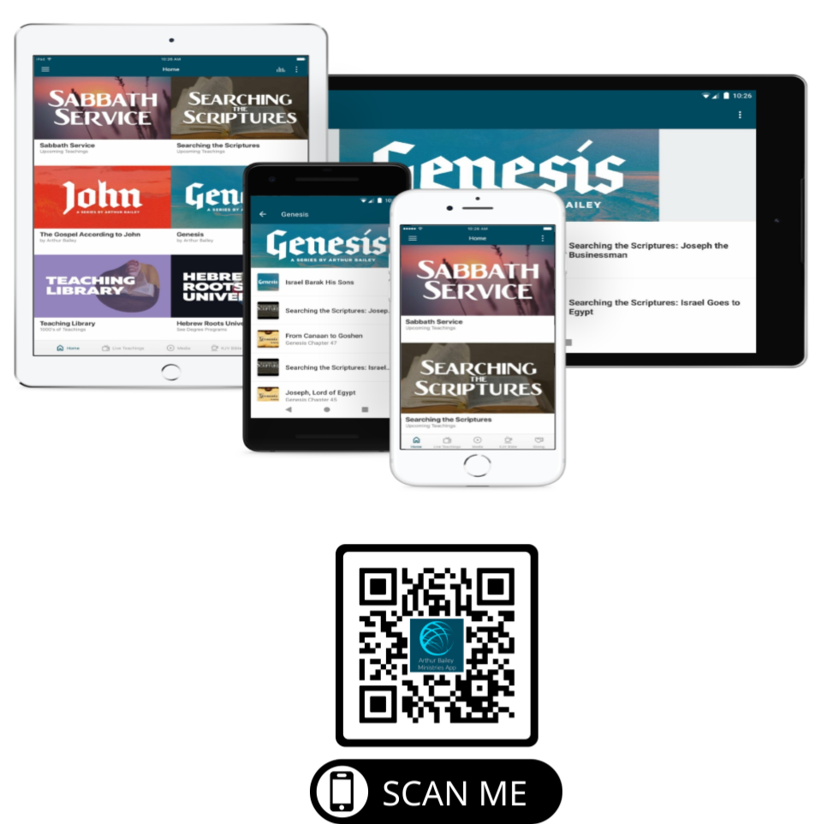

Slide 92
New Donation Opportunities
Canada Registered Charity

Slide 93
Mail in your support by check or money order.
Our Mailing Address:
P O Box 1182
Fort Mill, SC 29716

Slide 94
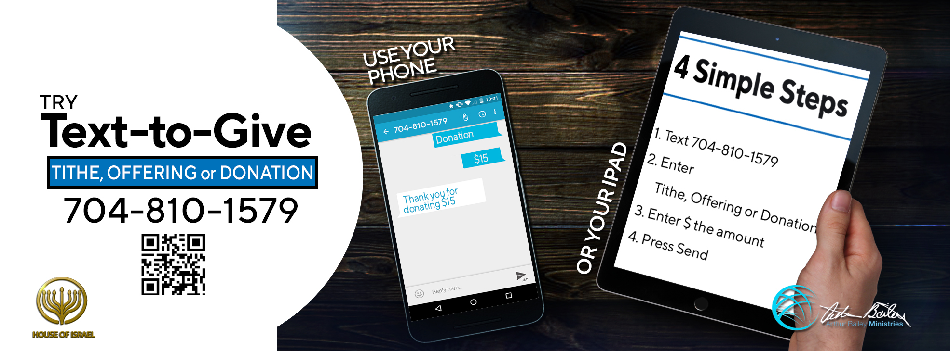

Slide 95
You can give by
Texting
Donate – Tithe - Offering
to
704-810-1579

