Slide 3
TODAY’S MESSAGE
Leviticus 26:21-46
Curses for Disobeying the Law
Pt 2

Slide 4
Please Subscribe for Updates on our Website.
Watch us on YouTube.
Follow us on Facebook and the
other Social Media Networks.
Please Like and Share our Videos
and Posts.

Slide 5
At the end of today’s Teaching, you will be able to 1. Ask Questions 2. Receive Prayer 3. Give your Tithes and Offerings

Slide 6
The Vision of House of Israel is to be: 1. A Worshipping People (John 4:23-24) 2. An Evangelistic Community (Acts 2:42-47)

Slide 7
3. A Discipleship Center (Matthew 28:19) 4. An Equipping Network (Ephesians 4:12) 5. And a Worldwide Witness for Yeshua The Messiah
(Acts 1:8)

Slide 9
Prayer

Slide 10
TODAY’S MESSAGE
Leviticus 26:21-46
Curses for Disobeying the Law
Pt 2

Slide 11
The Law of YeHoVaH is inclusive of blessings and curses, life and death. Those who obey YeHoVaH’s Law experience the life of YeHoVaH and the benefits, blessings, and privileges thereof. Disobeying the Law of YeHoVaH produces death and the curses associated with disobedience.

Slide 12
In the second portion of Leviticus 26, YeHoVaH instructs Moses to warn the Children of Israel, and those who joined themselves to the Commonwealth of Israel, of what they had to look forward to if they rejected His Law or failed to carry out all His Commands and violated His Covenant.

Slide 13
As stated in Part 1, there is a progression of curses after each failed opportunity to repent. Their lives would get worse, not better.

Slide 14
Several things will be covered in this portion.
Four times YeHoVaH mentions punishment seven times more in verses 18, 21, 24, and 28.
YeHoVaH would walk contrary to Israel as Israel walked contrary to Him.
YeHoVaH’s Covenant with Israel was conditional.
YeHoVaH would not forsake Israel.

Slide 15
If you believe in the blessings of God’s promises, remember the curses for disobedience are also promises.
Wisdom, even logic, should respond to YeHoVaH in obeying His Law when He makes it crystal clear what would happen if we do not.

Slide 16
One would think that it would be foolish, irresponsible, and reckless to go against His Instructions knowing the consequences of what would happen if we did not, unless we did not believe He would do what He said He would do.

Slide 17
Most Believers believe and confess that YeHoVaH is a Promise Keeper.
YeHoVaH’s threats and warnings are also promises!
If He tell us what He will do if we don’t do what He says, should we be surprised or mad at Him for doing what He said He would do if we don’t do what He said to do?

Slide 18
^{Lev 26:21} And if ye walk contrary unto me, and will not hearken unto me; I will bring seven times more plagues upon you according to your sins.
^{Lev 26:22} I will also send wild beasts among you, which shall rob you of your children, and destroy your cattle, and make you few in number; and your high ways shall be desolate.

Slide 19
Wild beasts will rob them of their children. Later in this Chapter, they will eat the flesh of their sons and daughters.
The wild animals will kill their children and cattle and their population will decrease.

Slide 20
^{Lev 26:23} And if ye will not be reformed by me by these things, but will walk contrary unto me;
If the people did not repent, YeHoVaH would walk in opposition to them and punish them seven times for their sins.

Slide 21
Contrary – 07147 קֶרִי qeriy
{ker-ee'}
Meaning: 1) opposition, contrariness, encounter, contrary or hostile encounter
Usage: AV - contrary 7; 7

Slide 22
^{Lev 26:24} Then will I also walk contrary unto you, and will punish you yet seven times for your sins.

Slide 23
In verse 18, YeHoVaH said He would bring seven times more plagues on Israel.
In verses 21 and 24, YeHoVaH will punish them seven times for their sin.
Later, He said He would chastise them seven times.

Slide 24
Punish – 05221 נָכָה nakah {naw-kaw'}
Meaning: 1) to strike, smite, hit, beat, slay, kill 1a) (Niphal) to be stricken or smitten 1b) (Pual) to be stricken or smitten 1c) (Hiphil) 1c1) to smite, strike, beat, scourge, clap, applaud, give a thrust 1c2) to smite, kill, slay (man or beast) 1c3) to smite, attack, attack and destroy, conquer, subjugate, ravage 1c4) to smite, chastise, send judgment upon, punish, destroy

Slide 25
1d) (Hophal) to be smitten 1d1) to receive a blow 1d2) to be wounded 1d3) to be beaten 1d4) to be (fatally) smitten, be killed, be slain 1d5) to be attacked and captured 1d6) to be smitten (with disease) 1d7) to be blighted (of plants)
Usage: AV - smite 348, slay 92, kill 20, beat 9, slaughter 5, stricken 3, given 3, wounded 3, strike 2, stripes 2, misc 13; 500

Slide 26
^{Lev 26:25} And I will bring a sword upon you, that shall avenge the quarrel of my covenant: and when ye are gathered together within your cities, I will send the pestilence among you; and ye shall be delivered into the hand of the enemy.

Slide 27
Quarrel – 05359 נָקָם naqam {naw-kawm'}
Meaning: 1) vengeance 1a) vengeance (by God, by Samson, by enemies of Judah)
Usage: AV - vengeance 15, quarrel 1, avenge 1; 17

Slide 28
^{Lev 26:26} And when I have broken the staff of your bread, ten women shall bake your bread in one oven, and they shall deliver you your bread again by weight: and ye shall eat, and not be satisfied.
This verse indicates that they would not have enough food.

Slide 29
^{Lev 26:26} When I break your staff of bread and cut off your supply of food, ten women shall bake your bread in one oven, and they shall ration your bread and deliver it again by weight; and you shall eat, and not be satisfied. [Hag. 1:6] AMP

Slide 30
^{Lev 26:26} I will completely destroy your food supply, so the bread from one oven will have to be stretched to feed ten families. They will ration your food by weight, and even if you have food to eat, you will not be satisfied. NLT

Slide 31
^{Lev 26:27} And if ye will not for all this hearken unto me, but walk contrary unto me;
^{Lev 26:28} Then I will walk contrary unto you also in fury; and I, even I, will chastise you seven times for your sins.

Slide 32
Chastise – 03256 יָסַר yacar {yaw-sar'}
Meaning: 1) to chasten, discipline, instruct, admonish 1a) (Qal) 1a1) to chasten, admonish 1a2) to instruct 1a3) to discipline 1b) (Niphal) to let oneself be chastened or corrected or admonished 1c) (Piel) 1c1) to discipline, correct 1c2) to chasten, chastise 1d) (Hiphil) to chasten 1e) (Nithpael) to teach
Usage: AV - chastise 21 instruct 8, correct 7, taught 2, bound 1, punish 1, reformed 1, reproveth 1, sore 1; 43

Slide 33
The people would resort to cannibalism.
The children that were not killed by wild beasts, as indicated in verse 22, would be subjected to being eaten.

Slide 34
^{Lev 26:29} And ye shall eat the flesh of your sons, and the flesh of your daughters shall ye eat.
^{Lev 26:30} And I will destroy your high places, and cut down your images, and cast your carcases upon the carcases of your idols, and my soul shall abhor you.

Slide 35
The people would establish high places and set up images against the Instructions of YeHoVaH, but He would destroy them.
Deuteronomy 28 states:

Slide 36
^{Dt 28:52} And he shall besiege thee in all thy gates, until thy high and fenced walls come down, wherein thou trustedst, throughout all thy land: and he shall besiege thee in all thy gates throughout all thy land, which the LORD thy God hath given thee. ^{Dt 28:53} And thou shalt eat the fruit of thine own body, the flesh of thy sons and of thy daughters, which the LORD thy God hath given thee, in the siege, and in the straitness, wherewith thine enemies shall distress thee:

Slide 37
^{Dt 28:54} So that the man that is tender among you, and very delicate, his eye shall be evil toward his brother, and toward the wife of his bosom, and toward the remnant of his children which he shall leave:

Slide 38
^{Lev 26:31} And I will make your cities waste, and bring your sanctuaries unto desolation, and I will not smell the savour of your sweet odours.

Slide 39
Sanctuaries – 04720 מִקְדָּשׁ miqdash {mik-dawsh'} or מִקְּדָּשׁ miqqedash )Ex. 15:17( {mik-ked-awsh'}
Meaning: 1) sacred place, sanctuary, holy place 1a) sanctuary 1a1) of the temple 1a2) of the tabernacle 1a3) of Ezekiel's temple 1a4) of Jehovah
Usage: AV - sanctuary 69, holy place 3, chapel 1, hallowed part 1; 74

Slide 40
The Offerings of the people would be rejected by YeHoVaH.

Slide 41
^{Lev 26:32} And I will bring the land into desolation: and your enemies which dwell therein shall be astonished at it.
^{Lev 26:33} And I will scatter you among the heathen, and will draw out a sword after you: and your land shall be desolate, and your cities waste.

Slide 42
^{Lev 26:34} Then shall the land enjoy her sabbaths, as long as it lieth desolate, and ye be in your enemies' land; even then shall the land rest, and enjoy her sabbaths.
^{Lev 26:35} As long as it lieth desolate it shall rest; because it did not rest in your sabbaths, when ye dwelt upon it.

Slide 43
^{Lev 26:36} And upon them that are left alive of you I will send a faintness into their hearts in the lands of their enemies; and the sound of a shaken leaf shall chase them; and they shall flee, as fleeing from a sword; and they shall fall when none pursueth.
^{Lev 26:37} And they shall fall one upon another, as it were before a sword, when none pursueth: and ye shall have no power to stand before your enemies.

Slide 44
^{Lev 26:38} And ye shall perish among the heathen, and the land of your enemies shall eat you up.
^{Lev 26:39} And they that are left of you shall pine away in their iniquity in your enemies' lands; and also in the iniquities of their fathers shall they pine away with them.

Slide 45
^{Lev 26:40} If they shall confess their iniquity, and the iniquity of their fathers, with their trespass which they trespassed against me, and that also they have walked contrary unto me;

Slide 46
Confess – 03034 יָדָה yadah {yaw-daw'}
Meaning: 1) to throw, shoot, cast 1a) (Qal) to shoot (arrows) 1b) (Piel) to cast, cast down, throw down 1c) (Hiphil) 1c1) to give thanks,, laud, praise 1c2) to confess, confess (the name of God) 1d) (Hithpael) 1d1) to confess (sin) 1d2) to give thanks
Usage: AV - praise 53, give thanks 32, confess 16, thank 5, make confession 2, thanksgiving 2, cast 1, cast out 1, shoot 1, thankful 1; 114

Slide 47
^{Lev 26:41} And that I also have walked contrary unto them, and have brought them into the land of their enemies; if then their uncircumcised hearts be humbled, and they then accept of the punishment of their iniquity:

Slide 48
YeHoVaH commanded Israel to circumcise their hearts:
^{Dt 10:16} Circumcise therefore the foreskin of your heart, and be no more stiffnecked.

Slide 49
YeHoVaH would also circumcise Israel’s heart.
^{Dt 30:6} The LORD your God will circumcise your hearts and the hearts of your descendants, so that you may love him with all your heart and with all your soul, and live.

Slide 50
The circumcised heart is the heart YeHoVaH put in us to Obey Him.
^{EZE 11:19} “And I will give them one heart, and put a new spirit within them. And I will take the heart of stone out of their flesh and give them a heart of flesh,
^{EZE 11:20} that they may walk in My statutes and keep My ordinances and do them. Then they will be My people, and I shall be their God.

Slide 51
A circumcised heart is a heart that keeps the righteousness of God's Law! Paul spoke of the circumcised heart in this manner:
^{Ro 2:25} For circumcision verily profiteth, if thou keep the law: but if thou be a breaker of the law, thy circumcision is made uncircumcision.

Slide 52
^{Ro 2:26} Therefore if the uncircumcision keep the righteousness of the law, shall not his uncircumcision be counted for circumcision?
^{Ro 2:27} And shall not uncircumcision which is by nature, if it fulfil the law, judge thee, who by the letter and circumcision dost transgress the law?

Slide 53
^{Ro 2:28} For he is not a Jew, which is one outwardly; neither is that circumcision, which is outward in the flesh:
^{Ro 2:29} But he is a Jew, which is one inwardly; and circumcision is that of the heart, in the spirit, and not in the letter; whose praise is not of men, but of God.

Slide 54
^{Lev 26:42} Then will I remember my covenant with Jacob, and also my covenant with Isaac, and also my covenant with Abraham will I remember; and I will remember the land.
The Land would have its Sabbaths.

Slide 55
^{Lev 26:43} The land also shall be left of them, and shall enjoy her sabbaths, while she lieth desolate without them: and they shall accept of the punishment of their iniquity: because, even because they despised my judgments, and because their soul abhorred my statutes.

Slide 56
^{Lev 26:44} And yet for all that, when they be in the land of their enemies, I will not cast them away, neither will I abhor them, to destroy them utterly, and to break my covenant with them: for I am the LORD their God.

Slide 57
Although YeHoVaH would carry them away into the land of their enemies:
In the multitude of Israel’s wickedness, He would not cast Israel away while they were in the land of their enemies.
YeHoVaH would not abhor them while they were captives in the land of their enemies, nor destroy them while they were in the land of their enemies.

Slide 58
YeHoVaH would not forsake Israel or break His Covenant, although Israel broke Covenant with Him.
^{Lev 26:45} But I will for their sakes remember the covenant of their ancestors, whom I brought forth out of the land of Egypt in the sight of the heathen, that I might be their God: I am the LORD.

Slide 59
YeHoVaH would remember His Covenant with Jacob/Israel, Isaac, and Abraham.
The Covenant YeHoVaH made with Israel at Sinai was repeatedly, over time, broken by Israel. And yet, Father never completely destroyed Israel because of the Covenant He made with Abraham, Isaac, and Israel.

Slide 60
While in exile in Babylon, YeHoVaH used Jeremiah to chasten Israel because they broke Covenant with Him. But YeHoVaH also promised that a New Covenant with them would be made.
^{Jer 31:31} Behold, the days come, saith the LORD, that I will make a new covenant with the house of Israel, and with the house of Judah:

Slide 61
^{Jer 31:32} Not according to the covenant that I made with their fathers in the day that I took them by the hand to bring them out of the land of Egypt; which my covenant they brake, although I was an husband unto them, saith the LORD:
^{Jer 31:33} But this shall be the covenant that I will make with the house of Israel; After those days, saith the LORD, I will put my law in their inward parts, and write it in their hearts; and will be their God, and they shall be my people.

Slide 62
Like the Old Covenant, the New Covenant would be conditional.
^{Heb 8:8} For finding fault with them, he saith, Behold, the days come, saith the Lord, when I will make a new covenant with the house of Israel and with the house of Judah:

Slide 63
^{Heb 8:9} Not according to the covenant that I made with their fathers in the day when I took them by the hand to lead them out of the land of Egypt; because they continued not in my covenant, and I regarded them not, saith the Lord.

Slide 64
^{Heb 8:10} For this is the covenant that I will make with the house of Israel after those days, saith the Lord; I will put my laws into their mind, and write them in their hearts: and I will be to them a God, and they shall be to me a people:

Slide 65
YeHoVaH will be a God to the people.
The people will be YeHoVaH’s people.

Slide 66
^{Lev 26:46} These are the statutes and judgments and laws, which the LORD made between him and the children of Israel in mount Sinai by the hand of Moses.

Slide 68
Your support is greatly appreciated and needed.

Slide 70
Our Preferred
Donation Methods:

Slide 71
CashApp – $ABMHOI
Venmo – @Arthur-Bailey-10
Zelle – apostlea@gmail.com

Slide 72
Question and Answer
Period

Slide 73
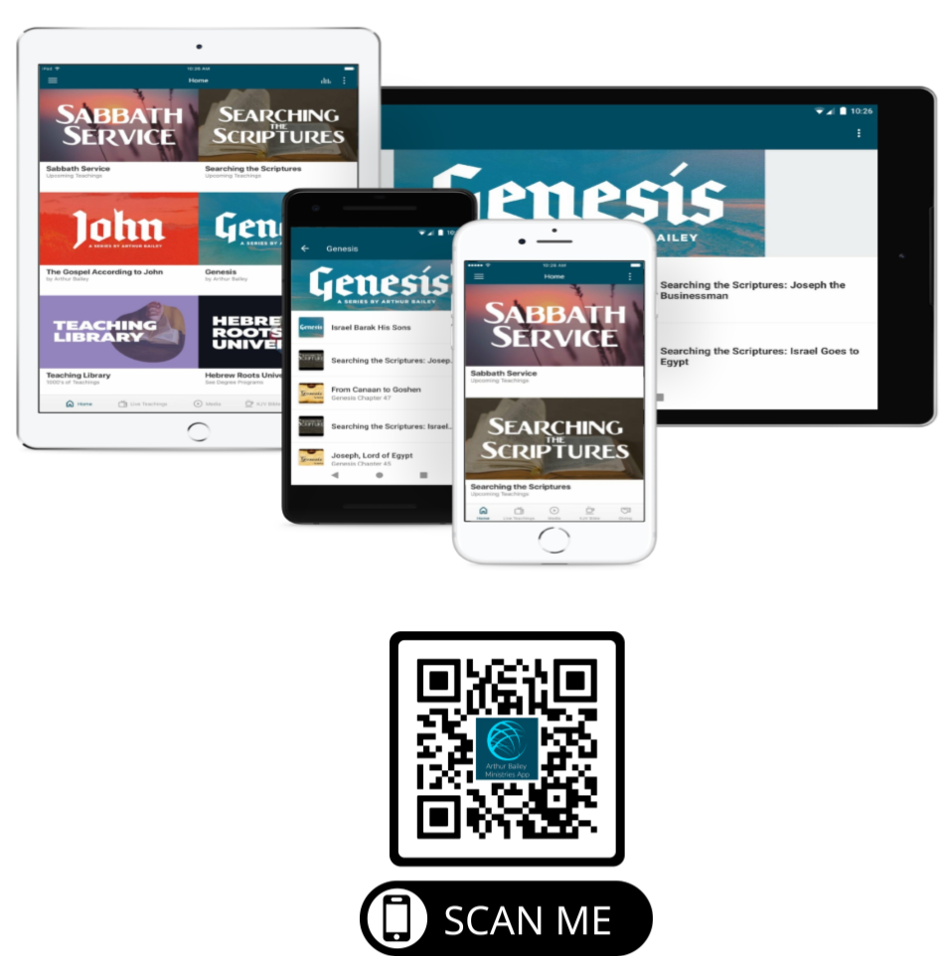

Slide 74
Mail in your support by check or money order.
Our Mailing Address:
P O Box 1182
Fort Mill, SC 29716

Slide 75
You can give by
Texting
Donate – Tithe - Offering
to
704-810-1579

Slide 76
