Slide 3
TODAY’S MESSAGE
Leviticus 27:1-34
Vows, Values and Redemption

Slide 4
Please Subscribe for Updates on our Website.
Watch us on YouTube.
Follow us on Facebook and the
other Social Media Networks.
Please Like and Share our Videos
and Posts.

Slide 5
At the end of today’s Teaching, you will be able to 1. Ask Questions 2. Receive Prayer 3. Give your Tithes and Offerings

Slide 6
The Vision of House of Israel is to be: 1. A Worshipping People (John 4:23-24) 2. An Evangelistic Community (Acts 2:42-47)

Slide 7
3. A Discipleship Center (Matthew 28:19) 4. An Equipping Network (Ephesians 4:12) 5. And a Worldwide Witness for Yeshua The Messiah
(Acts 1:8)

Slide 9
Prayer

Slide 10
TODAY’S MESSAGE
Leviticus 27:1-34
Vows, Values and Redemption

Slide 11
Vows were not commanded by the Law of YeHoVaH but were made by individuals who wanted to do something over and beyond what was required by YeHoVaH in exchange for something. Typically, vows were made to dedicate or devote someone or something of value to the service of YeHoVaH.

Slide 12
In this final Chapter of Leviticus, YeHoVaH gives Instructions for the vow being made, the value of the person or the thing that is vowed, and the process for redeeming that which had been vowed.

Slide 13
Things to Remember
Vows to God are voluntary.
Vows are not to be taken lightly.
God holds every man and woman accountable for their vows.
It is better not to make a vow than to make a vow and break it.

Slide 14
The final Chapter of Leviticus focuses on voluntary vows made by individuals unto YeHoVaH.
^{Lev 27:1} And the LORD spake unto Moses, saying,

Slide 15
^{Lev 27:2} Speak unto the children of Israel, and say unto them, When a man shall make a singular vow, the persons shall be for the LORD by thy estimation.
The verse in other Bible versions:

Slide 16
^{Lev 27:2} “Speak to the Israelites and say to them: ‘If anyone makes a special vow to dedicate persons to the LORD by giving equivalent values, (NIV)
^{LEV 27:2} “Speak to the sons of Israel and say to them, ‘ When a man makes a difficult vow, he shall be valued according to your valuation of persons belonging to the LORD (NASB)

Slide 17
^{LEV 27:2} “Speak unto the children of Israel and say unto them: When a man makes a difficult vow, he shall be valued in your value of persons belonging to Adonai (Jewish Masoretic Text)
^{LEV 27:2} “Speak to the sons of Yishraael and say to them, When a man shall make a difficult vow, in a value of persons before Shehmaa (Israelite Samaritan Text)

Slide 18
^{Lev 27:2} Speak unto the children of Israel and say unto them, When any one devoteth anything by a vow, the persons shall be for Jehovah according to thy valuation. (Darby)

Slide 19
Singular – 06381 פָּלָא pala' {paw-law'}
Meaning: 1) to be marvellous, be wonderful, be surpassing, be extraordinary, separate by distinguishing action 1a) (Niphal) 1a1) to be beyond one's power, be difficult to do 1a2) to be difficult to understand 1a3) to be wonderful, be extraordinary 1a3a) marvellous (participle) 1b) (Piel) to separate (an offering)

Slide 20
1c) (Hiphil) 1c1) to do extraordinary or hard or difficult thing 1c2) to make wonderful, do wondrously 1d) (Hithpael) to show oneself wonderful or marvellous
Usage: AV - (wondrous, marvellous...) work 18, wonders 9, marvellous 8, wonderful 8, ...things 6, hard 5, wondrous 3, wondrously 2, marvellously 2, performing 2, misc 8; 71

Slide 21
Vow – 05088 נֶדֶר neder {neh'-der} or נֵדֶר neder {nay'-der}
Meaning: 1) vow, votive offering
Usage: AV - vow 58, vowed 2; 60

Slide 22
Estimation – 06187 עֵרֶךְ `erek {eh'rek}
Meaning: 1) order, row, estimate, things that are set in order, layer, pile 1a) order, row 1b) estimate, valuation
Usage: AV - estimation 24, set at 1, equal 1, set in order 1, price 1, proportion 1, set 1, suit 1, taxation 1, valuest 1; 33

Slide 23
Hannah’s Vow - 1st Samuel 1:11
^{1Sa 1:11} And she vowed a vow, and said, O LORD of hosts, if thou wilt indeed look on the affliction of thine handmaid, and remember me, and not forget thine handmaid, but wilt give unto thine handmaid a man child, then I will give him unto the LORD all the days of his life, and there shall no razor come upon his head.

Slide 24
In Malachi 1, some people reneged on their vows.
^{Mal 1:14} But cursed be the deceiver, which hath in his flock a male, and voweth, and sacrificeth unto the Lord a corrupt thing: for I am a great King, saith the LORD of hosts, and my name is dreadful among the heathen.

Slide 25
No one is required to make a vow. If someone makes a vow unto YeHoVaH, they should honor it, or it would be sin in them.
^{Dt 23:21} When thou shalt vow a vow unto the LORD thy God, thou shalt not slack to pay it: for the LORD thy God will surely require it of thee; and it would be sin in thee.

Slide 26
If a person chooses not to vow, it will not be a sin to him/her.
^{Dt 23:22} But if thou shalt forbear to vow, it shall be no sin in thee.

Slide 27
YeHoVaH determined the value of the person based on age and gender.
^{Lev 27:3} And thy estimation shall be of the male from twenty years old even unto sixty years old, even thy estimation shall be fifty shekels of silver, after the shekel of the sanctuary.

Slide 28
Age: 20 to 60 Years
Male value: fifty shekels of silver
Female value: thirty shekels of silver
^{Lev 27:4} And if it be a female, then thy estimation shall be thirty shekels.

Slide 29
Age: 5 to 20 Years
Male value: twenty shekels
Female value: ten shekels
^{Lev 27:5} And if it be from five years old even unto twenty years old, then thy estimation shall be of the male twenty shekels, and for the female ten shekels.

Slide 30
Age: 1 Month to 5 Years
Male value: five shekels of silver
Female value: three shekels of silver
^{Lev 27:6} And if it be from a month old even unto five years old, then thy estimation shall be of the male five shekels of silver, and for the female thy estimation shall be three shekels of silver.

Slide 31
Age: Over 60 Years
Male value: fifteen shekels
Female value: ten shekels
^{Lev 27:7} And if it be from sixty years old and above; if it be a male, then thy estimation shall be fifteen shekels, and for the female ten shekels.

Slide 32
A poor person’s value was determined by the Priest.
^{Lev 27:8} But if he be poorer than thy estimation, then he shall present himself before the priest, and the priest shall value him; according to his ability that vowed shall the priest value him.

Slide 33
If the vow is a beast:
^{Lev 27:9} And if it be a beast, whereof men bring an offering unto the LORD, all that any man giveth of such unto the LORD shall be holy.

Slide 34
Beast – 0929 בְּהֵמָה behemah {be-hay-maw'}
Meaning: 1) beast, cattle, animal 1a) beasts (coll of all animals) 1b) cattle, livestock (of domestic animals) 1c) wild beasts
Usage: AV - beast 136, cattle 53; 189

Slide 35
Whatever is vowed becomes holy and is no longer to be used for any service besides that which is holy. Once it is offered, it cannot be changed. If a change is attempted, for whatever reason, both the offered beast and the beast used to change shall become holy.

Slide 36
^{Lev 27:10} He shall not alter it, nor change it, a good for a bad, or a bad for a good: and if he shall at all change beast for beast, then it and the exchange thereof shall be holy. ^{Lev 27:11} And if it be any unclean beast, of which they do not offer a sacrifice unto the LORD, then he shall present the beast before the priest:
^{Lev 27:12} And the priest shall value it, whether it be good or bad: as thou valuest it, who art the priest, so shall it be.

Slide 37
If there is any redemption of the beast offered as a vow, a fifth part was to be given in addition to its value.
^{Lev 27:13} But if he will at all redeem it, then he shall add a fifth part thereof unto thy estimation.

Slide 38
If the vow is a house:
^{Lev 27:14} And when a man shall sanctify his house to be holy unto the LORD, then the priest shall estimate it, whether it be good or bad: as the priest shall estimate it, so shall it stand.

Slide 39
If there is any redemption of the house that was sanctified, a fifth part was to be given in addition to its value.
^{Lev 27:15} And if he that sanctified it will redeem his house, then he shall add the fifth part of the money of thy estimation unto it, and it shall be his.

Slide 40
If the vow is a field:
^{Lev 27:16} And if a man shall sanctify unto the LORD some part of a field of his possession, then thy estimation shall be according to the seed thereof: an homer of barley seed shall be valued at fifty shekels of silver.

Slide 41
In the Jubilee, homes and land reverted back to the family based on Leviticus 25, with the exceptions of walled cities and Priests' lands.

Slide 42
The Jubilee year and redemptions of property that were sanctified:
^{Lev 27:17} If he sanctify his field from the year of jubilee, according to thy estimation it shall stand.
^{Lev 27:18} But if he sanctify his field after the jubilee, then the priest shall reckon unto him the money according to the years that remain, even unto the year of the jubilee, and it shall be abated from thy estimation.

Slide 43
The value was based on the harvesting years that remained unto the year of Jubilee, not counting the years the land was required to rest.
If there was any redemption of the field that was sanctified, a fifth part was to be given in addition to its value.

Slide 44
^{Lev 27:19} And if he that sanctified the field will in any wise redeem it, then he shall add the fifth part of the money of thy estimation unto it, and it shall be assured to him.

Slide 45
Once the field has been sanctified and is not redeemed or sold, it is no longer eligible for redemption.
^{Lev 27:20} And if he will not redeem the field, or if he have sold the field to another man, it shall not be redeemed any more.

Slide 46
Once the field has been sanctified and is not redeemed, it is no longer eligible for redemption and will belong to the Priests.
^{Lev 27:21} But the field, when it goeth out in the jubilee, shall be holy unto the LORD, as a field devoted; the possession thereof shall be the priest's.

Slide 47
If the person who bought the field sanctifies the land he is selling, the crops of the land, based on the estimation of the priest, and the land will revert back to the family in the Jubilee.

Slide 48
^{Lev 27:22} And if a man sanctify unto the LORD a field which he hath bought, which is not of the fields of his possession;
^{Lev 27:23} Then the priest shall reckon unto him the worth of thy estimation, even unto the year of the jubilee: and he shall give thine estimation in that day, as a holy thing unto the LORD.

Slide 49
^{Lev 27:24} In the year of the jubilee the field shall return unto him of whom it was bought, even to him to whom the possession of the land did belong.
^{Lev 27:25} And all thy estimations shall be according to the shekel of the sanctuary: twenty gerahs shall be the shekel.

Slide 50
That which is already declared holy by YeHoVaH, such as the firstling, cannot be used in a vow.
^{Lev 27:26} Only the firstling of the beasts, which should be the LORD'S firstling, no man shall sanctify it; whether it be ox, or sheep: it is the LORD'S.

Slide 51
Unclean animals could be redeemed.
^{Lev 27:27} And if it be of an unclean beast, then he shall redeem it according to thine estimation, and shall add a fifth part of it thereto: or if it be not redeemed, then it shall be sold according to thy estimation.

Slide 52
^{Lev 27:28} Notwithstanding no devoted thing, that a man shall devote unto the LORD of all that he hath, both of man and beast, and of the field of his possession, shall be sold or redeemed: every devoted thing is most holy unto the LORD.

Slide 53
Redeemed – 01350 גָּאַל ga'al {gaw-al'}
Meaning: 1) to redeem, act as kinsman-redeemer, avenge, revenge, ransom, do the part of a kinsman 1a) (Qal) 1a1) to act as kinsman, do the part of next of kin, act as kinsman-redeemer 1a1a) by marrying brother's widow to beget a child for him, to redeem from slavery, to redeem land, to exact vengeance

Slide 54
1a2) to redeem (by payment) 1a3) to redeem (with God as subject) 1a3a) individuals from death 1a3b) Israel from Egyptian bondage 1a3c) Israel from exile 1b) (Niphal) 1b1) to redeem oneself 1b2) to be redeemed
Usage: AV - redeem 50, redeemer 18, kinsman 13, revenger 7, avenger 6, ransom 2, at all 2, deliver 1, kinsfolks 1, kinsman's part 1, purchase 1, stain 1, wise 1; 104

Slide 55
Someone condemned to death cannot be redeemed.
^{Lev 27:29} None devoted, which shall be devoted of men, shall be redeemed; but shall surely be put to death.

Slide 56
Devoted – 02764 חֵרֶם cherem {khay'-rem} or )Zech. 14:11חֶרֶם ( cherem {kheh'-rem}
Meaning: 1) a thing devoted, thing dedicated, ban, devotion 2) a net, thing perforated 3) have been utterly destroyed, (appointed to) utter destruction

Slide 57
Usage: AV - net 9, accursed thing 9, accursed 4, curse 4, cursed thing 3, devoted 3, destruction 2, devoted thing 2, dedicated thing 1, destroyed 1; 38

Slide 58
Devoted – 02763 חָרָם charam {khaw-ram'}
Meaning: 1) to ban, devote, destroy utterly, completely destroy, dedicate for destruction, exterminate 1a) (Hiphil) 1a1) to prohibit (for common use), ban 1a2) to consecrate, devote, dedicate for destruction 1a3) to exterminate, completely destroy 1b) (Hophal)

Slide 59
1b1) to be put under the ban, be devoted to destruction 1b2) to be devoted, be forfeited 1b3) to be completely destroyed 2) to split, slit, mutilate (a part of the body) 2a) (Qal) to mutilate 2b) (Hiphil) to divide
Usage: AV - destroy 34, utterly 10, devote 2, accursed 1, consecrate 1, forfeited 1, flat nose 1, utterly to make away 1, slay 1; 52

Slide 60
Redeemed – 06299 פָּדָה padah {paw-daw'}
Meaning: 1) to ransom, redeem, rescue, deliver 1a) (Qal) to ransom 1b) (Niphal) to be ransomed 1c) (Hiphil) to allow one to be ransomed 1d) (Hophal) redeemed
Usage: AV - redeem 48, deliver 5, ransom 2, rescued 1, misc 3; 59

Slide 61
The Tithes belong to YeHoVaH.
^{Lev 27:30} And all the tithe of the land, whether of the seed of the land, or of the fruit of the tree, is the LORD'S: it is holy unto the LORD.

Slide 62
^{Lev 27:31} And if a man will at all redeem aught of his tithes, he shall add thereto the fifth part thereof.
^{Lev 27:32} And concerning the tithe of the herd, or of the flock, even of whatsoever passeth under the rod, the tenth shall be holy unto the LORD.

Slide 63
The tenth animal, male or female, belongs to YeHoVaH; good or bad, they belong to YeHoVaH automatically.

Slide 64
^{Lev 27:33} He shall not search whether it be good or bad, neither shall he change it: and if he change it at all, then both it and the change thereof shall be holy; it shall not be redeemed.

Slide 65
The New Testament speaks of vows twice.
The first, by Paul who had a vow on him.
^{Ac 18:18} And Paul after this tarried there yet a good while, and then took his leave of the brethren, and sailed thence into Syria, and with him Priscilla and Aquila; having shorn his head in Cenchrea: for he had a vow.

Slide 66
The second, by four men; Paul was asked by James to pay their vow to show the people that Paul honored the Law.
^{Ac 21:18} And the day following Paul went in with us unto James; and all the elders were present.
^{Ac 21:19} And when he had saluted them, he declared particularly what things God had wrought among the Gentiles by his ministry.

Slide 67
^{Ac 21:20} And when they heard it, they glorified the Lord, and said unto him, Thou seest, brother, how many thousands of Jews there are which believe; and they are all zealous of the law:
^{Ac 21:21} And they are informed of thee, that thou teachest all the Jews which are among the Gentiles to forsake Moses, saying that they ought not to circumcise their children, neither to walk after the customs.

Slide 68
^{Ac 21:22} What is it therefore? the multitude must needs come together: for they will hear that thou art come.
^{Ac 21:23} Do therefore this that we say to thee: We have four men which have a vow on them;

Slide 69
^{Ac 21:24} Them take, and purify thyself with them, and be at charges with them, that they may shave their heads: and all may know that those things, whereof they were informed concerning thee, are nothing; but that thou thyself also walkest orderly, and keepest the law.

Slide 70
^{Lev 27:34} These are the commandments, which the LORD commanded Moses for the children of Israel in mount Sinai.

Slide 72
Your support is greatly appreciated and needed.

Slide 74
Our Preferred
Donation Methods:

Slide 75
CashApp – $ABMHOI
Venmo – @Arthur-Bailey-10
Zelle – apostlea@gmail.com

Slide 76
Question and Answer
Period

Slide 77
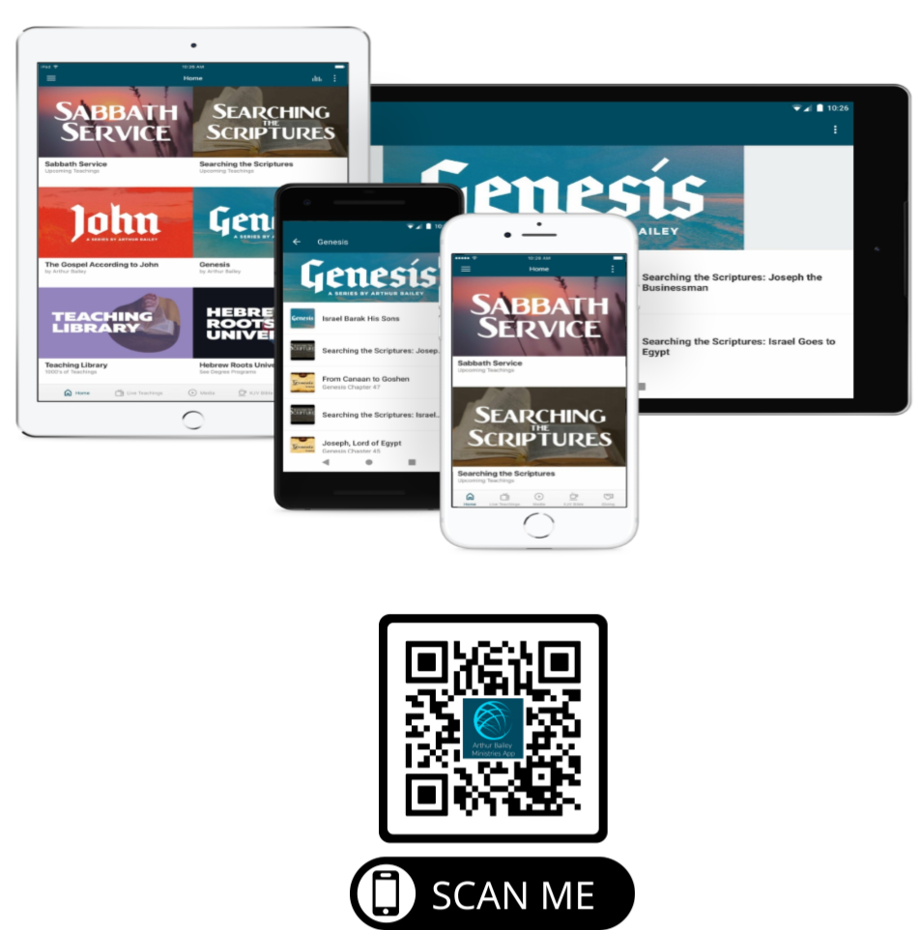

Slide 78
Mail in your support by check or money order.
Our Mailing Address:
P O Box 1182
Fort Mill, SC 29716

Slide 79
You can give by
Texting
Donate – Tithe - Offering
to
704-810-1579

Slide 80
