Slide 3
TODAY’S MESSAGE
Luke 19:1-27
Salvation and The Second Coming

Slide 4
Please Subscribe for Updates on our Website.
Watch us on YouTube.
Follow us on Facebook and the
other Social Media Networks.
Please Like and Share our Videos
and Posts.

Slide 5
At the end of today’s Teaching, you will be able to 1. Ask Questions 2. Receive Prayer 3. Give your Tithes and Offerings

Slide 6
The Vision of House of Israel is to be: 1. A Worshipping People (John 4:23-24) 2. An Evangelistic Community (Acts 2:42-47)

Slide 7
3. A Discipleship Center (Matthew 28:19) 4. An Equipping Network (Ephesians 4:12) 5. And a Worldwide Witness for Yeshua The Messiah
(Acts 1:8)

Slide 9
Prayer

Slide 10
TODAY’S MESSAGE
Luke 19:1-27
Salvation and The Second Coming

Slide 11
Yeshua’s journey up to Jerusalem leads Him through a city called Jericho. There He encounters a very rich man who goes through a great amount of difficulty to simply get a glimpse of Him. Yeshua used this man to communicate an understanding of salvation that people had in His day.

Slide 12
Yeshua also shared a parable to correct the misconception that had been developed in the minds of the people around Him from His teaching on the Kingdom’s immediate physical establishment.
^{Lk 19:1} And Yeshua entered and passed through Jericho.

Slide 13
In New Testament times Jericho stood some distance to the south-east of the ancient one, and near the opening of the valley of Achor. It was a rich and flourishing town, having a considerable trade, and celebrated for the palm trees which adorned the plain around. Yeshua visited Jericho on his last journey to Jerusalem where he gave sight to two blind men (Mat 20:29-34; Mar 10:46-52).

Slide 14
There were three different Jerichos, on three different sites, the Jericho of Joshua, the Jericho of Herod, and the Jericho of the Crusades.
Er-Riha, the modern Jericho, dates from the time of the Crusades.

Slide 15
^{Lk 19:2} And, behold, there was a man named Zacchaeus, which was the chief among the publicans, and he was rich.

Slide 16
In the previous Chapter we read about a rich ruler who asked Yeshua about inheriting eternal life. His response led Yeshua to say, “For it is easier for a camel to go through a needle's eye, than for a rich man to enter into the kingdom of God.”
In this passage, we read about salvation coming to a rich man’s house.

Slide 17
In Chapter 3, when the publicans came to John to be baptized, John told them:
^{Lk 3:12} Then came also publicans to be baptized, and said unto him, Master, what shall we do?
^{Lk 3:13} And he said unto them, Exact no more than that which is appointed you.

Slide 18
Publicans – 5057 τελώνης telones {tel-o'-nace}
Meaning: 1) a renter or farmer of taxes 1a) among the Romans, usually a man of equestrian rank 2) a tax gatherer, collector of taxes or tolls, one employed by a publican or farmer general in the collection of taxes.

Slide 19
The tax collectors were as a class, detested not only by the Jews, but by other nations also, both on account of their employment and of the harshness, greed, and deception, with which they did their job.
Usage: AV - publican 22; 22

Slide 20
In Chapter 5 of Luke, publicans were regarded in the same category as sinners.
^{Lk 5:29} And Levi made him a great feast in his own house: and there was a great company of publicans and of others that sat down with them.

Slide 21
^{Lk 5:30} But their scribes and Pharisees murmured against his disciples, saying, Why do ye eat and drink with publicans and sinners?
^{Lk 5:31} And Jesus answering said unto them, They that are whole need not a physician; but they that are sick.
^{Lk 5:32} I came not to call the righteous, but sinners to repentance.

Slide 22
In this Chapter, Zacchaeus is a chief publican.
Publican – 754 ἀρχιτελώνης architelones {ar-khee-tel-o'-nace}
Meaning: 1) a chief of tax collectors, chief publican
Usage: AV - chief among the publicans 1; 1

Slide 23
^{Lk 19:3} And he sought to see Yeshua who he was; and could not for the press, because he was little of stature.
^{Lk 19:4} And he ran before, and climbed up into a sycamore tree to see him: for he was to pass that way.

Slide 24
^{Lk 19:5} And when Yeshua came to the place, he looked up, and saw him, and said unto him, Zacchaeus, make haste, and come down; for today I must abide at thy house.
^{Lk 19:6} And he made haste, and came down, and received him joyfully.
^{Lk 19:7} And when they saw it, they all murmured, saying, That he was gone to be guest with a man that is a sinner.

Slide 25
Sinner – 268 ἁμαρτωλός hamartolos {ham-ar-to-los'}
Meaning: 1) devoted to sin, a sinner 1a) not free from sin 1b) pre-eminently sinful, especially wicked 1b1) all wicked men 1b2) specifically of men stained with certain definite vices or crimes 1b2a) tax collectors, heathen
Usage: AV - sinner 43, sinful 4; 47

Slide 26
Sin is defined in the New Testament Book of 1st John 3.
^{1Jn 3:4} Whosoever committeth sin transgresseth also the law: for sin is the transgression of the law.

Slide 27
Sin – 266 ἁμαρτία hamartia {ham-ar-tee'-ah}
Meaning: 1) equivalent to 264 1a) to be without a share in 1b) to miss the mark 1c) to err, be mistaken 1d) to miss or wander from the path of uprightness and honour, to do or go wrong 1e) to wander from the law of God, violate God's law, sin 2) that which is done wrong, sin, an offence, a violation of the divine law in thought or in act
Usage: AV - sin 172, sinful 1, offense 1; 174

Slide 28
Why was Zacchaeus considered a sinner by the Pharisees and others? His occupation.
He was a publican
What was a publican? He was a collector of taxes for the Roman government.
He worked for the Romans.
He became wealthy by exploitation.
He was chief among the publicans.

Slide 29
Zacchaeus knew how the people classified him as a sinner because of his occupation and how they thought about him and other publicans, but when he came into the company and presence of Yeshua, he wanted to make things right.

Slide 30
^{Lk 19:8} And Zacchaeus stood, and said unto the Lord; Behold, Lord, the half of my goods I give to the poor; and if I have taken any thing from any man by false accusation, I restore him fourfold.

Slide 31
In Yeshua’s presence, Zacchaeus is convicted to give half of his wealth to the poor, and anything taken from any man by false accusation, he would restore him fourfold.
Zacchaeus’s action was an act of repentance and restitution.

Slide 32
According to Torah/Law
^{Ex 22:1} If a man shall steal an ox, or a sheep, and kill it, or sell it; he shall restore five oxen for an ox, and four sheep for a sheep.

Slide 33
In 2nd Samuel 12, when David was confronted by YeHoVaH, via the prophet Nathan, because of what he had done by taking Uriah’s wife, Nathan told a story and concluded:

Slide 34
^{2Sa 12:5} And David's anger was greatly kindled against the man; and he said to Nathan, As the LORD liveth, the man that hath done this thing shall surely die: ^{2Sa 12:6} And he shall restore the lamb fourfold, because he did this thing, and because he had no pity. ^{2Sa 12:7} And Nathan said to David, Thou art the man. Thus saith the LORD God of Israel, I anointed thee king over Israel, and I delivered thee out of the hand of Saul;

Slide 35
^{Lk 19:9} And Yeshua said unto him, This day is salvation come to this house, forsomuch as he also is a son of Abraham.
Salvation is first mentioned in Genesis as Israel is prophesying to his sons.

Slide 36
^{Ge 49:18} I have waited for thy salvation, O LORD.

Slide 37
03444 יְשׁוּעָה yeshuw`ah {yesh-oo'-aw}
Meaning: 1) salvation, deliverance 1a) welfare, prosperity 1b) deliverance 1c) salvation (by God) 1d) victory
Usage: AV - salvation 65, help 4, deliverance 3, health 3, save 1, saving 1, welfare 1; 78

Slide 38
Salvation – 4991 σωτηρία soteria {so-tay-ree'-ah}
Meaning: 1) deliverance, preservation, safety, salvation 1a) deliverance from the molestation of enemies 1b) in an ethical sense, that which concludes to the souls safety or salvation 1b1) of Messianic salvation

Slide 39
2) salvation as the present possession of all true Christians 3) future salvation, the sum of benefits and blessings which the Christians, redeemed from all earthly ills, will enjoy after the visible return of Christ from heaven in the consummated and eternal kingdom of God.

Slide 40
The literature on salvation from church teaching is virtually the literature of theology.
In English Versions of the Bible the words "salvation" "save," are not technical theological terms, but denote simply "deliverance," in almost any sense the latter word can have. In systematic theology, however, "salvation" denotes the whole process by which man is delivered from all that would prevent his attaining to the highest good that God has prepared for him.

Slide 41
Or, by a transferred sense, "salvation" denotes the actual enjoyment of that good. So, while these technical senses are often associated with the Greek or Hebrew words translated "save," etc., yet they are still more often used in connection with other words or represented only by the general sense of a passage.

Slide 42
Salvation is both a present and a future matter for us. The full realization of all that God has in store will not be ours until the end of human history (if, indeed, there will not be opened infinite possibilities of eternal growth), but the enjoyment of these blessings depends on conditions fulfilled in us and by us now.

Slide 43
Salvation, then, means deliverance from all that interferes with the enjoyment of these blessings. So it takes countless forms-deliverance from natural plagues, from internal dissensions, from external enemies, or from the subjugation of conquerors (the exile, particularly). As far as enemies constitute the threatening danger, the prayer for deliverance is often based on their evil character.

Slide 44
But for the individual all these evils are summed up in the word "death," which was thought to terminate all relation to God and all possibility of enjoying His blessings (Ps 115:17; Isa 38:18, etc.). And so "death" became established as the antinomy to "salvation," and in this sense the word has persisted, although the equation "loss of salvation = physical death" has long been transcended.

Slide 45
But death and its attendant evils are worked by God's wrath, and so it is from this wrath that salvation is sought (Jos 7:26, etc.). And thus, naturally, salvation is from everything that raises that wrath, above all from sin (Eze 36:25,26, etc.).
Written by Burton Scott Easton

Slide 46
^{Lk 19:10} For the Son of man is come to seek and to save that which was lost.

Slide 47
Lost – 622 ἀπόλλυμι apollumi {ap-ol'-loo-mee}
Meaning: 1) to destroy 1a) to put out of the way entirely, abolish, put an end to ruin 1b) render useless 1c) to kill 1d) to declare that one must be put to death 1e) metaph. to devote or give over to eternal misery in hell 1f) to perish, to be lost, ruined, destroyed 2) to destroy 2a) to lose
Usage: AV - perish 33, destroy 26, lose 22, be lost 5, lost 4, misc 2; 92

Slide 48
The lost sheep of Israel or the tribes of Israel were not lost geographically, via location or exile or visually based on assimilation into other nations but lost in the sense of destruction or to perish because of violating divine Law based on the lifestyle lived.

Slide 49
^{Lk 19:11} And as they heard these things, he added and spake a parable, because he was nigh to Jerusalem, and because they thought that the kingdom of God should immediately appear.

Slide 50
The people thought that the Kingdom would appear immediately.
They must have derived this from Yeshua’s teachings, but remember Yeshua spoke to the people in parables!
Although they came to the conclusion based on parables, Yeshua spoke a parable.

Slide 51
^{Lk 19:12} He said therefore, A certain nobleman went into a far country to receive for himself a kingdom, and to return.
^{Lk 19:13} And he called his ten servants, and delivered them ten pounds, and said unto them, Occupy till I come.

Slide 52
4231 πραγματεύομαι pragmateuomai {prag-mat-yoo'-om-ahee}
Meaning: 1) to be occupied in anything 2) to carry on a business 3) to carry on the business of a banker or a trader
Origin: from 4229; TDNT - 6:641,927; v
Usage: AV - occupy 1; 1

Slide 53
^{Lk 19:14} But his citizens hated him, and sent a message after him, saying, We will not have this man to reign over us.

Slide 54
^{Lk 19:15} And it came to pass, that when he was returned, having received the kingdom, then he commanded these servants to be called unto him, to whom he had given the money, that he might know how much every man had gained by trading.
^{Lk 19:16} Then came the first, saying, Lord, thy pound hath gained ten pounds.

Slide 55
^{Lk 19:17} And he said unto him, Well, thou good servant: because thou hast been faithful in a very little, have thou authority over ten cities.
^{Lk 19:18} And the second came, saying, Lord, thy pound hath gained five pounds.
^{Lk 19:19} And he said likewise to him, Be thou also over five cities.

Slide 56
^{Lk 19:20} And another came, saying, Lord, behold, here is thy pound, which I have kept laid up in a napkin:
^{Lk 19:21} For I feared thee, because thou art an austere man: thou takest up that thou layedst not down, and reapest that thou didst not sow.

Slide 57
^{Lk 19:22} And he saith unto him, Out of thine own mouth will I judge thee, thou wicked servant. Thou knewest that I was an austere man, taking up that I laid not down, and reaping that I did not sow:
^{Lk 19:23} Wherefore then gavest not thou my money into the bank, that at my coming I might have required mine own with usury?

Slide 58
^{Lk 19:24} And he said unto them that stood by, Take from him the pound, and give it to him that hath ten pounds.
^{Lk 19:25} (And they said unto him, Lord, he hath ten pounds.)

Slide 59
^{Lk 19:26} For I say unto you, That unto every one which hath shall be given; and from him that hath not, even that he hath shall be taken away from him.
^{Lk 19:27} But those mine enemies, which would not that I should reign over them, bring hither, and slay them before me.

Slide 60
The lost sheep of Israel or the tribes of Israel were not lost geographically, via location or exile or visually based on assimilation into other nations but lost in the sense of destruction or to perish because of violating divine Law based on the lifestyle lived.

Slide 61
Yeshua came down from heaven to establish the Kingdom of Heaven in the earth, afterwards would return to Heaven, and then return a second time to earth to reign over His Kingdom.

Slide 62
^{Jn 3:13} And no man hath ascended up to heaven, but he that came down from heaven, even the Son of man which is in heaven.

Slide 63
Yeshua’s parable was letting it be known that His initial coming was not to reign, but to set in place those who were given the charge to prepare the people for His second coming.

Slide 64
John the Baptist was called to prepare the way for Yeshua’s first advent. The Apostles, Prophets, Evangelists, Pastors, and Teachers are to equip the Saints for the work of Ministry to prepare the way of Yeshua’s second advent or coming by preaching the Gospel of the Kingdom to the whole world!

Slide 65
No Excuses
There is judgment for those who do not submit or refuse to have Yeshua reign over them as Lord.

Slide 66
OCCUPY!

Slide 68
Our Preferred
Donation Methods:

Slide 69
CashApp – $ABMHOI
Venmo – @Arthur-Bailey-10
Zelle – apostlea@gmail.com

Slide 70
Question and Answer
Period

Slide 71
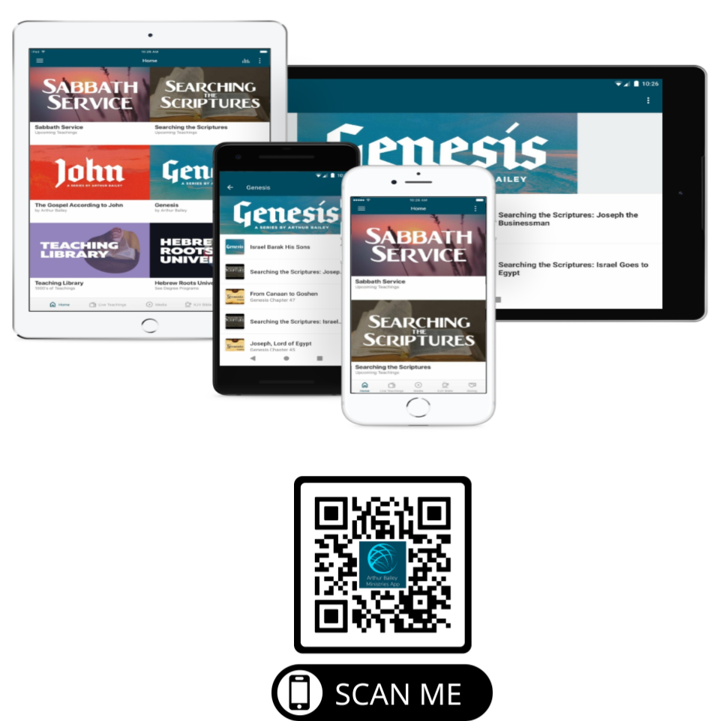

Slide 72
Mail in your support by check or money order.
Our Mailing Address:
P O Box 1182
Fort Mill, SC 29716

Slide 73
You can give by
Texting
Donate – Tithe - Offering
to
704-810-1579

