Slide 3
TODAY’S MESSAGE
Numbers
The Introduction

Slide 4
Please Subscribe for Updates on our Website.
Watch us on YouTube.
Follow us on Facebook and the
other Social Media Networks.
Please Like and Share our Videos
and Posts.

Slide 5
At the end of today’s Teaching, you will be able to 1. Ask Questions 2. Receive Prayer 3. Give your Tithes and Offerings

Slide 6
The Vision of House of Israel is to be: 1. A Worshipping People (John 4:23-24) 2. An Evangelistic Community (Acts 2:42-47)

Slide 7
3. A Discipleship Center (Matthew 28:19) 4. An Equipping Network (Ephesians 4:12) 5. And a Worldwide Witness for Yeshua The Messiah
(Acts 1:8)

Slide 9
Prayer

Slide 10
TODAY’S MESSAGE
Numbers
The Introduction

Slide 11
Numbers is the English name given to the 4th section of the Book of the Law. The Book of the Law was given by YeHoVaH to Moses for the purpose of governing the newly established Nation of Israel after their deliverance from bondage in Egypt.
Much of the information you are about to hear will not be taught in church services, Bible studies, or Torah portions.

Slide 12
What you are about to hear, and so much more, is taught in our Discipleship Program.
In Discipleship101 at Discipleship101.tv you will learn about the various denominations, theologians, and Jewish interpretations.

Slide 13
You will learn how the Bible was developed and how we got the Bible in its modern form.
You will learn about Hermeneutics.
Principles of interpretations.
Who the Church fathers were and their influences; none of whom are found in the Bible.

Slide 14
The denominations’ theological influence is quite clear to those who have eyes to see and ears to hear.
Much of what has been taught to the Protestant church from the English Bible has been produced by the Latin speaking Catholic Church theologians, Jewish sages, and Theological Seminaries.

Slide 15
A perfect undeniable proof of this is the naming of the segments of the Book of the Law.
Genesis is Greek in origin and comes from the word geneseos, which appears in the Greek translation (Septuagint).

Slide 16
The first phrase in the Hebrew text of Genesis 1:1 is bereshith ("in [the] beginning").
Exodus is a Latin word derived from Greek Exodos.
In Hebrew, Exodus is named after its first two words, weelleh shemoth ("These are the names of").

Slide 17
Leviticus receives its name from the Septuagint (the Greek translation of the OT) and means "relating to the Levites."
Its Hebrew title, vayikra/wayyiqra is the first word in the Hebrew text of Exodus and means "And he [i.e., the Lord] called."

Slide 18
Numbers, the English name of the book comes from the Septuagint (the Greek translation of the OT) and is based on the census lists found in Chapters 1-2 and 26.
The Hebrew title of Numbers is bemidbar ("in the desert")
Deuteronomy, we will discuss later.

Slide 19
Other proofs:
Religious Terminology not found in Scripture
Tanach
Talmud
Pentateuch
Tetragrammaton
Septuagint

Slide 20
Tanach – the three Jewish divisions of the Old Testament, comprising the Law or Torah, the Prophets or Neviim, and the Hagiographa or Ketuvim, taken as a whole. (Dictionary.com)

Slide 21
Talmud – The Talmud is a collection of writings that covers the full gamut of Jewish law and tradition, compiled and edited between the third and sixth centuries. Written in a mixture of Hebrew and Aramaic, it records the teachings and discussions of the great academies of the Holy Land and Babylonia.

Slide 22
Pentateuch – means simply "five books". In Greek, the Pentateuch (which Jews call the Torah) includes the books of Genesis, Exodus, Leviticus, Numbers, and Deuteronomy. (Merriam Webster)

Slide 23
Tetragrammaton – the four Hebrew letters usually transliterated YHWH or JHVH that form a biblical proper name of God. (Merriam Webster)
YeHoVaH’s Name is NOT
Yod Hey Vav Hey.

Slide 24
Septuagint – abbreviation LXX, the earliest extant Greek translation of the Old Testament from the original Hebrew. The Septuagint was presumably made for the Jewish community in Egypt when Greek was the common language throughout the region. (Britannica)

Slide 25
Words like those and many more force students of Scripture to go outside the Scriptures to find the meaning of these words and therefore subject themselves to theological persuasions further influenced by denominational interpretations of those words.

Slide 26
Greek translations changed Covenant to Testament creating and causing a separation between the New Covenant and Old Covenant.
The word Testament is not found in the Hebrew Scriptures.
The word Testament is found only in the English New Testament writings and is given the same definition as the word Covenant.

Slide 27
The translators made Jesus the mediator of the New Testament.
^{Mt 26:28} For this is my blood of the new testament, which is shed for many for the remission of sins.
^{Heb 9:15} And for this cause he is the mediator of the new testament, that by means of death, for the redemption of the transgressions that were under the first testament, they which are called might receive the promise of eternal inheritance.

Slide 28
Testament – 1242 διαθήκη diatheke {dee-ath-ay'-kay} Meaning: 1) a disposition, arrangement, of any sort, which one wishes to be valid, the last disposition which one makes of his earthly possessions after his death, a testament or will 2) a compact, a covenant, a testament 2a) God's covenant with Noah, etc.
Usage: AV - covenant 20, testament 13; 33

Slide 29
Covenant – 1242 διαθήκη diatheke {dee-ath-ay'-kay} Meaning: 1) a disposition, arrangement, of any sort, which one wishes to be valid, the last disposition which one makes of his earthly possessions after his death, a testament or will 2) a compact, a covenant, a testament 2a) God's covenant with Noah, etc. Usage: AV - covenant 20, testament 13; 33

Slide 30
Yeshua was the mediator of the New Covenant.
^{Heb 8:13} In that he saith, A new covenant, he hath made the first old. Now that which decayeth and waxeth old is ready to vanish away.

Slide 31
^{Heb 12:24} And to Yeshua the mediator of the new covenant, and to the blood of sprinkling, that speaketh better things than that of Abel.
One should ask why the translators used both Covenant and Testament in the New Testament. If Testament is the proper translation for Covenant, why not use Testament throughout the New Testament instead of Covenant?

Slide 32
Without searching the Scriptures for themselves, most people do not realize how much their understanding of Scripture is influenced by Jewish sages’, the Protestant Church’s influence in the English Bible that has been produced by the Catholic Church seminary theologians, Protestant Theological Seminaries, and the teachings of denominational religious leaders.

Slide 33
The word Bible is not found in the Bible.
The English word Bible comes from the English word book translated in the Greek as Biblos.
“Book” in the Hebrew Scriptures is Cepher.

Slide 34
Those of us who have sat under one denomination’s teaching will not see or hear what those who have sat under other denominational teachings which are under the “gos spel” or spell of their understandings and teachings of the Gospels.
Separation of the New Testament from the Old Testament gives denominational organizations great authority to teach their versions of the Gospels.

Slide 35
If we believe the Old Testament comes from YeHoVaH and the New Testament comes from YeHoVaH, then we have no choice but to agree that both the old and new are one continuous communication from the Most High God YeHoVaH!

Slide 36
Who wrote Numbers?
Numbers has traditionally been ascribed to Moses and it is assumed that the first five Books of the Bible, aka the Pentateuch, are one Book and come from one author.

Slide 37
When was it written?
The 40-year period of Israel's wanderings in the desert, which lasted from ​c. 1446 to 1406​ BC​, would have been the most likely time for Moses to write the bulk of what is today known as the Pentateuch or Book of the Law.

Slide 38
To Whom was it written?
Numbers relates the story of Israel's journey from Mount Sinai to the plains of Moab on the border of Canaan. Much of its legislation for people and Priests is similar to that in Exodus, Leviticus, and Deuteronomy.

Slide 39
Why was it written?
The Book tells of the murmuring and rebellion of God's people and of their subsequent judgment.

Slide 40
Numbers reveals that although YeHoVaH is a wrathful God, He is also:
God of Grace
God of Mercy
Covenant keeping God
Elohim who protects and provides for His Covenant people even when He is angry with them.

Slide 41
As discussed, Moses did not write five Books, Moses wrote one Book.
Scripturally, what is known as the Book of Moses, aka Mosaic Law, aka Torah, is called
The Book of the Law.
It is referred to in the Hebrew Writings as
The Book of the Law.

Slide 42
^{Dt 30:10} If thou shalt hearken unto the voice of the LORD thy God, to keep his commandments and his statutes which are written in this book of the law, and if thou turn unto the LORD thy God with all thine heart, and with all thy soul.

Slide 43
^{Jos 1:8} This book of the law shall not depart out of thy mouth; but thou shalt meditate therein day and night, that thou mayest observe to do according to all that is written therein: for then thou shalt make thy way prosperous, and then thou shalt have good success.

Slide 44
The Book of the Law of Moses
^{Jos 8:31} As Moses the servant of the LORD commanded the children of Israel, as it is written in the book of the law of Moses, an altar of whole stones, over which no man hath lift up any iron: and they offered thereon burnt offerings unto the LORD, and sacrificed peace offerings.

Slide 45
The Book of the Law of the Lord
^{2Ch 17:9} And they taught in Judah, and had the book of the law of the LORD with them, and went about throughout all the cities of Judah, and taught the people.

Slide 46
The Book of the Law of God
^{Jos 24:26} And Joshua wrote these words in the book of the law of God, and took a great stone, and set it up there under an oak, that was by the sanctuary of the LORD.

Slide 47
^{Ne 8:18} Also day by day, from the first day unto the last day, he read in the book of the law of God. And they kept the feast seven days; and on the eighth day was a solemn assembly, according unto the manner.

Slide 48
Numbers is the fourth part of the Torah (or, in Greek, the Pentateuch). In the Mishnah and in the Talmud, it is named Homesh ha-Pequdîm (i.e., the Fifth of the Mustered) because of the censuses recorded at the beginning of the Book and in Chapter 26.

Slide 49
The Septuagint names the part Arithmoi (Censuses or Numbers), while the Vulgate calls it Numeri (Numbers). Rashi (Rabbi Shelomo ben Yitzhak) referred to the book with its first words, “wa-yedabber” (i.e., “and he said”), but the traditional Hebrew name is Be-midbar (i.e., “in the wilderness” [of Sinai]).

Slide 50
In Christian Bibles, it is sometimes called the Fourth Book of Moses, presuming Moses’ authorship of the Pentateuch. As the first and last verses of the final composition of the Book indicate, the content was thought to contain the revelations Moses received from God during the wandering of the Israelites from the wilderness of Sinai to the “plains of Moab” at the border of the promised land.

Slide 51
The English name of the Book comes from the Septuagint (the Greek translation of the OT) and is based on the census lists found in chs. 1; 26. The Hebrew title of the book (bemidbar, "in the desert") is more descriptive of its contents. Numbers presents an account of the 38-year period of Israel's wandering in the desert following the establishment of the covenant of Sinai (compare 1:1 with Dt 1:1).

Slide 52
Numbers is broken down into 36 Chapters.
Numbers has three major divisions, based on Israel's geographical locations.
Each of the three divisions has two parts.

Slide 53
Israel at Sinai, preparing to depart for the land of promise
(1:1-10:10),
followed by the journey from Sinai to Kadesh
(10:11-12:16);

Slide 54
Israel at Kadesh, delayed as a result of rebellion
(13:1-20:13),
followed by the journey from Kadesh to the plains of Moab
(20:14-22:1);

Slide 55
Israel on the plains of Moab, anticipating the conquest of the land of promise
(22:2-32:42),
followed by Appendices dealing with various matters
(Chs. 33-36).

Slide 56
In Numbers, we are introduced to a prophet named Balaam who was employed by Balak, king of Moab, to curse Israel.
Balaam, who originally did not know YeHoVaH, was used by YeHoVaH to bless Israel and declare YeHoVaH’s name to the king.

Slide 57
There is much in Numbers that is written about in the New Testament writings that we will make the connections to as we proceed through the writing.

Slide 58
YeHoVaH, the God who had entered into Covenant with Abraham in Genesis 15 and 17;

Slide 59
YeHoVaH, who had delivered His people from bondage in the exodus (Exodus 14-15), and brought Israel into Covenant with Himself as His "treasured possession" in Exodus 19;

Slide 60
YeHoVaH, who had revealed His holiness and the gracious means of approaching Him (Leviticus 1-7)
was also a God of wrath.

Slide 61
His wrath extended to His rebellious children as well as to the enemy nations of Egypt and Canaan.

Slide 62
Even Moses, the great Prophet and servant of the Lord, was not exempt from God's wrath when he disobeyed God. Chapter 20, which records his error, begins with the notice of Miriam's death (20:1) and concludes with the record of Aaron's death (20:22-29).

Slide 63
Numbers reveals the passing of the old guard. Those whom YeHoVaH had used to establish the nation are dying before the nation has come into its own,
The Promised Land, or
The Land of Promise.

Slide 64
Your support is greatly appreciated and needed.

Slide 66
Our Preferred
Donation Methods:

Slide 67
CashApp – $ABMHOI
Venmo – @Arthur-Bailey-10
Zelle – apostlea@gmail.com

Slide 68
Question and Answer
Period

Slide 69
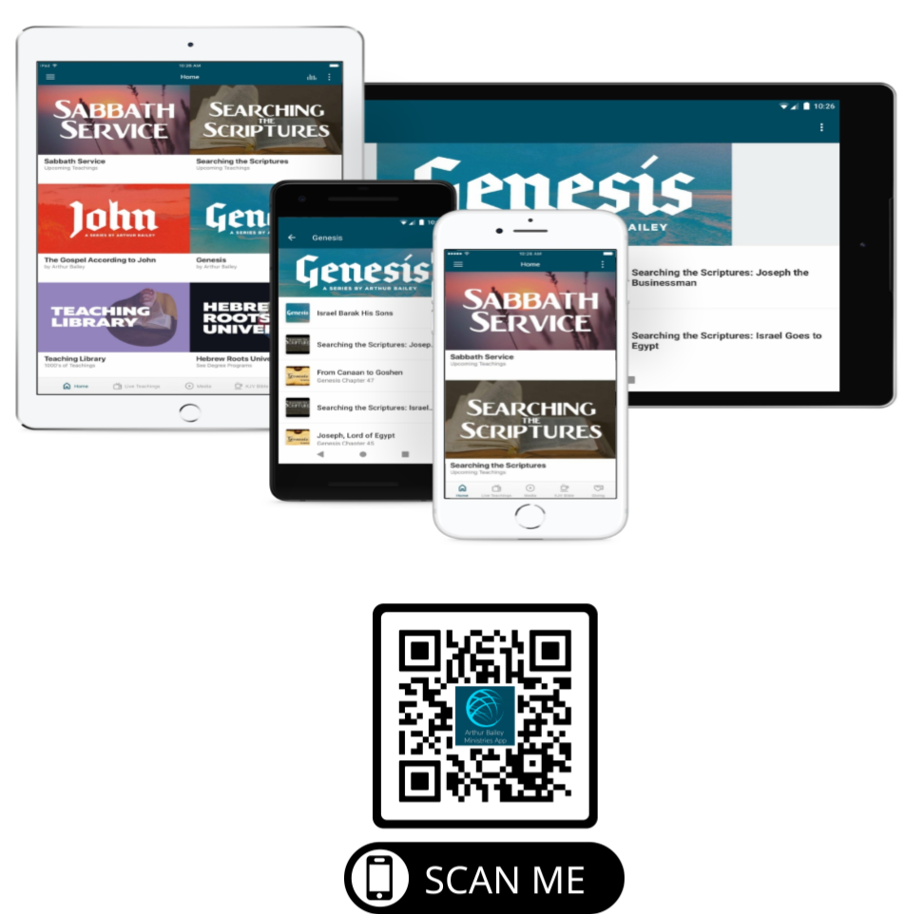

Slide 70
Mail in your support by check or money order.
Our Mailing Address:
P O Box 1182
Fort Mill, SC 29716

Slide 71
You can give by
Texting
Donate – Tithe - Offering
to
704-810-1579

Slide 72
