Slide 3
TODAY’S MESSAGE
Luke 20:27-47
The Resurrection and the Messiah

Slide 4
Please Subscribe for Updates on our Website.
Watch us on YouTube.
Follow us on Facebook and the
other Social Media Networks.
Please Like and Share our Videos
and Posts.

Slide 5
At the end of today’s Teaching, you will be able to 1. Ask Questions 2. Receive Prayer 3. Give your Tithes and Offerings

Slide 6
The Vision of House of Israel is to be: 1. A Worshipping People (John 4:23-24) 2. An Evangelistic Community (Acts 2:42-47)

Slide 7
3. A Discipleship Center (Matthew 28:19) 4. An Equipping Network (Ephesians 4:12) 5. And a Worldwide Witness for Yeshua The Messiah
(Acts 1:8)

Slide 9
Prayer

Slide 10
TODAY’S MESSAGE
Luke 20:27-47
The Resurrection and the Messiah

Slide 11
Yeshua’s teachings in the Temple Court put Him in direct conflict and confrontation with the Chief Priests, teachers, and elders. The Sadducees challenge Yeshua with a legal question about marriage and the resurrection. Yeshua’s response left them speechless as He further challenged the religious leaders about their own knowledge and understanding of the Scriptures that they taught about who they understood the Messiah to be.

Slide 12
^{Lk 20:27} Then came to him certain of the Sadducees, which deny that there is any resurrection; and they asked him,

Slide 13
Josephus states in his book, Antiquities, that the Sadducees were an aristocratic, politically minded group, willing to compromise with secular and pagan leaders. They controlled the High Priesthood at this time and held the majority of the seats in the Sanhedrin. They did not believe in the resurrection or an afterlife, and they rejected the oral tradition taught by the Pharisees.

Slide 14
The question is an attempt to pull Yeshua into a dispute between the Sadducees against the Pharisees and the Scribes who believe in the resurrection of the dead, angels and the spirit world.

Slide 15
^{Lk 20:28} Saying, Master, Moses wrote unto us, If any man's brother die, having a wife, and he die without children, that his brother should take his wife, and raise up seed unto his brother.
This practice is known as a levirate marriage. “Levir” is a Latin term meaning
“husband’s brother” or “brother-in-law”.

Slide 16
The practice dates back to the time of Judah in Genesis and is commanded in the
Book of the Law of YeHoVaH,
written in Deuteronomy.

Slide 17
^{Ge 38:6} Judah got a wife for Er, his firstborn, and her name was Tamar.
^{Ge 38:7} But Er, Judah’s firstborn, was wicked in the LORD'S sight; so the LORD put him to death.
^{Ge 38:8} Then Judah said to Onan, “Lie with your brother’s wife and fulfill your duty to her as a brother-in-law to produce offspring for your brother.”

Slide 18
^{Ge 38:9} But Onan knew that the offspring would not be his; so whenever he lay with his brother’s wife, he spilled his semen on the ground to keep from producing offspring for his brother.
^{Ge 38:10} What he did was wicked in the LORD'S sight; so he put him to death also.
^{Ge 38:11} Judah then said to his daughter-in-law Tamar, “Live as a widow in your father’s house until my son Shelah grows up.” For he thought, “He may die too, just like his brothers.” So Tamar went to live in her father’s house.

Slide 19
^{Dt 25:5} If brethren dwell together, and one of them die, and have no child, the wife of the dead shall not marry without unto a stranger: her husband's brother shall go in unto her, and take her to him to wife, and perform the duty of an husband's brother unto her.
^{Dt 25:6} And it shall be, that the firstborn which she beareth shall succeed in the name of his brother which is dead, that his name be not put out of Israel.

Slide 20
^{Dt 25:7} And if the man like not to take his brother's wife, then let his brother's wife go up to the gate unto the elders, and say, My husband's brother refuseth to raise up unto his brother a name in Israel, he will not perform the duty of my husband's brother.
^{Dt 25:8} Then the elders of his city shall call him, and speak unto him: and if he stand to it, and say, I like not to take her;

Slide 21
^{Dt 25:9} Then shall his brother's wife come unto him in the presence of the elders, and loose his shoe from off his foot, and spit in his face, and shall answer and say, So shall it be done unto that man that will not build up his brother's house.
^{Dt 25:10} And his name shall be called in Israel, The house of him that hath his shoe loosed.

Slide 22
^{Lk 20:29} There were therefore seven brethren: and the first took a wife, and died without children.
^{Lk 20:30} And the second took her to wife, and he died childless.
^{Lk 20:31} And the third took her; and in like manner the seven also: and they left no children, and died.

Slide 23
^{Lk 20:32} Last of all the woman died also.
^{Lk 20:33} Therefore in the resurrection whose wife of them is she? for seven had her to wife.

Slide 24
Yeshua’s answer, to the question of whose wife will she be, is neither.
^{Lk 20:34} And Yeshua answering said unto them, The children of this world marry, and are given in marriage:

Slide 25
World – 165 αἰών aion {ahee-ohn'}
Meaning: 1) for ever, an unbroken age, perpetuity of time, eternity 2) the worlds, universe 3) period of time, age
Usage: AV - ever 71, world 38, never + 3364 + 1519 + 3588 6, evermore 4, age 2, eternal 2, misc 5; 128

Slide 26
Yeshua makes it clear that the order of this world will not be the same as the order of the world to come. People in this world marry, but there will be no marriage in the new world to come.

Slide 27
^{Lk 20:35} But they which shall be accounted worthy to obtain that world, and the resurrection from the dead, neither marry, nor are given in marriage:

Slide 28
Account worthy – 2661 καταξιόω kataxioo {kat-ax-ee-o'-o}
Meaning: 1) to account worthy, judge worthy
Usage: AV - count worthy 2, account worthy 2; 4

Slide 29
^{Heb 9:27} And as it is appointed unto men once to die, but after this the judgment:

Slide 30
Obtain – 5177 τυγχάνω tugchano {toong-khan'-o}
Meaning: 1) to hit the mark 1a) of one discharging a javelin or arrow 2) to reach, attain, obtain, get, become master of 3) to happen, chance, fall out 3a) to specify, to take a case, as for example 4) to meet one
Usage: AV - obtain 5, be 1, chance 1, little 1, enjoy 1, may be 1, not tr 1, misc 2; 13

Slide 31
Sin
Sinned
Sinner
Defined:

Slide 32
Sin – 266 ἁμαρτία hamartia {ham-ar-tee'-ah}
Meaning: 1) equivalent to 264 1a) to be without a share in 1b) to miss the mark 1c) to err, be mistaken 1d) to miss or wander from the path of uprightness and honour, to do or go wrong 1e) to wander from the law of God, violate God's law, sin 2) that which is done wrong, sin, an offence, a violation of the divine law in thought or in act 3
Usage: AV - sin 172, sinful 1, offense 1; 174

Slide 33
^{Mt 12:31} Wherefore I say unto you, All manner of sin and blasphemy shall be forgiven unto men: but the blasphemy against the Holy Ghost shall not be forgiven unto men.

Slide 34
Sinned – 264 ἁμαρτάνω hamartano {ham-ar-tan'-o}
Meaning: 1) to be without a share in 2) to miss the mark 3) to err, be mistaken 4) to miss or wander from the path of uprightness and honour, to do or go wrong 5) to wander from the law of God, violate God's law, sin
Usage: AV - sin 38, trespass 3, offend 1, for your faults 1; 43

Slide 35
^{Mt 27:3} Then Judas, which had betrayed him, when he saw that he was condemned, repented himself, and brought again the thirty pieces of silver to the chief priests and elders,
^{Mt 27:4} Saying, I have sinned in that I have betrayed the innocent blood. And they said, What is that to us? see thou to that.

Slide 36
Sinner – 268 ἁμαρτωλός hamartolos {ham-ar-to-los'}
Meaning: 1) devoted to sin, a sinner 1a) not free from sin 1b) pre-eminently sinful, especially wicked 1b1) all wicked men 1b2) specifically of men stained with certain definite vices or crimes 1b2a) tax collectors, heathen
Usage: AV - sinner 43, sinful 4; 47

Slide 37
^{1Pe 4:17} For the time is come that judgment must begin at the house of God: and if it first begin at us, what shall the end be of them that obey not the gospel of God?
^{1Pe 4:18} And if the righteous scarcely be saved, where shall the ungodly and the sinner appear?

Slide 38
^{Lk 20:36} Neither can they die any more: for they are equal unto the angels; and are the children of God, being the children of the resurrection.

Slide 39
^{Heb 9:27} And as it is appointed unto men once to die, but after this the judgment:
^{Heb 9:28} So Messiah was once offered to bear the sins of many; and unto them that look for him shall he appear the second time without sin unto salvation.

Slide 40
Yeshua teaches on the resurrection from the dead via Moses' encounter with YeHoVaH at the bush when Moses declared that YeHoVaH was the God of Abraham, Isaac, and Jacob/Israel.

Slide 41
^{Lk 20:37} Now that the dead are raised, even Moses showed at the bush, when he calleth the Lord the God of Abraham, and the God of Isaac, and the God of Jacob.
^{Lk 20:38} For he is not a God of the dead, but of the living: for all live unto him.

Slide 42
A Scribe, who witnessed the conversation, commended Yeshua on His answer.
^{Lk 20:39} Then certain of the scribes answering said, Master, thou hast well said.

Slide 43
Scribes – 1122 γραμματεύς grammateus {gram-mat-yooce'} Meaning: 1) a clerk, scribe, esp.a public servant, secretary, recorder, whose office and influence differed in different states 2) in the Bible, a man learned in the Mosaic law and in the sacred writings, an interpreter, teacher. Scribes examined the more difficult and subtle questions of the law; added to the Mosaic law decisions of various kinds thought to elucidate its meaning and scope, and did this to the detriment of religion.

Slide 44
Since the advice of men skilled in the law was needed in the examination in the causes and the solution of the difficult questions, they were enrolled in the Sanhedrin; and are mentioned in connection with the priests and elders of the people. See a Bible Dictionary for more information on the scribes. 3) a religious teacher: so instructed that from his learning and ability to teach advantage may redound to the kingdom of heaven Usage: AV - scribe 66, townclerk 1; 67

Slide 45
Sanhedrin or council – 4892 συνέδριον sunedrion {soon-ed'-ree-on} Meaning: 1) any assembly (esp. of magistrates, judges, ambassadors), whether convened to deliberate or pass judgment 2) any session or assembly or people deliberating or adjudicating 2a) the Sanhedrin, the great council at Jerusalem, consisting of the seventy one members, viz. scribes, elders, prominent members of the high priestly families and the high priest, the president of the assembly.

Slide 46
The most important causes were brought before this tribunal, inasmuch as the Roman rulers of Judaea had left to it the power of trying such cases, and also of pronouncing sentence of death, with the limitation that a capital sentence pronounced by the Sanhedrin was not valid unless it was confirmed by the Roman procurator. 2b) a smaller tribunal or council which every Jewish town had for the decision of less important cases. Usage: AV - council 22; 22

Slide 47
When you read about the Letter of the Law:
Letter – 1121 γράμμα gramma {gram'-mah}
Meaning: 1) a letter 2) any writing, a document or record 2a) a note of hand, bill, bond, account, written acknowledgement of a debt 2b) a letter, an epistle 2c) the sacred writings (of the OT) 3) letters, i.e. learning 3a) of sacred learning
Usage: AV - letter 9, bill 2, writing 1, learning 1, scripture 1, written + 1722 1; 15

Slide 48
Scribes were lawyers that established, what we would call today, Case Law.

Slide 49
Case law, also used interchangeably with common law, is law that is based on precedents, that is the judicial decisions from previous cases, rather than law based on constitutions, statutes, or regulations. Case law uses the detailed facts of a legal case that have been resolved by courts or similar tribunals. These past decisions are called "case law", or precedent.

Slide 50
Yeshua’s response to the Sadducee shut them down and they asked no more questions of Him at that time.
^{Lk 20:40} And after that they durst not ask him any question at all.

Slide 51
Yeshua turns His attention to the Scribes and asked His own questions to challenge the knowledge of the Scribes in the presence of those who stood nearby.

Slide 52
^{Lk 20:41} And he said unto them, How say they that Messiah is David's son?
^{Lk 20:42} And David himself saith in the book of Psalms, The LORD said unto my Lord, Sit thou on my right hand,

Slide 53
In the Greek, it states kurios said to my kurios.
In Hebrew, YeHoVaH said unto my Adown.
^{Ps 110:1} The LORD said unto my Lord, Sit thou at my right hand, until I make thine enemies thy footstool.

Slide 54
Yeshua tried to get them to see from David’s words that David recognized that YeHoVaH was speaking to his Lord and that the Messiah was acknowledged by David in his day and time.

Slide 55
LORD – 03068 יְהֹוָה Yehovah {yeh-ho-vaw'}
Meaning: Jehovah = "the existing One" 1) the proper name of the one true God 1a) unpronounced except with the vowel pointings of 0136
Origin: from 01961; TWOT - 484a; n pr dei
Usage: AV - LORD 6510, GOD 4, JEHOVAH 4, variant 1; 6519

Slide 56
Lord – 0113 אָדוֹן 'adown {aw-done'} or )shortenedאָדֹן ( 'adon {aw-done'}
Meaning: 1) firm, strong, lord, master 1a) lord, master 1a1) reference to men 1a1a) superintendent of household,of affairs 1a1b) master 1a1c) king 1a2) reference to God 1a2a) the Lord God 1a2b) Lord of the whole earth 1b) lords, kings 1b1) reference to men 1b1a) proprietor of hill of Samaria 1b1b) master 1b1c) husband 1b1d) prophet

Slide 57
1b2a) Lord of lords (probably = "thy husband, Yahweh") 1c) my lord, my master 1c1) reference to men 1c1a) master 1c1b) husband 1c1c) prophet 1c1d) prince 1c1e) king 1c1f) father 1c1g) Moses 1c1h) priest Usage: AV - lord 197, master(s) 105, Lord 31, owner 1, sir 1; 335
Adown as lord/Lord used 228

Slide 58
YeHoVaH revealed Himself to Moses by the name YeHoVaH.
^{Ex 6:3} And I appeared unto Abraham, unto Isaac, and unto Jacob, by (the name of) God Almighty, but by my name JEHOVAH was I not known to them.

Slide 59
The LORD – 03068 יְהֹוָה Yehovah {yeh-ho-vaw'}
Meaning: Jehovah = "the existing One" 1) the proper name of the one true God 1a) unpronounced except with the vowel pointings of 0136
Usage: AV - LORD 6510, GOD 4, JEHOVAH 4, variant 1;
YeHoVaH as LORD Used 6519

Slide 60
Abraham referred to YeHoVaH as Adonay.
^{Ge 15:2} And Abram said, Lord GOD, what wilt thou give me, seeing I go childless, and the steward of my house is this Eliezer of Damascus?

Slide 61
Lord – 0136 אֲדֹנָי 'Adonay {ad-o-noy'}
Meaning: 1) my lord, lord 1a) of men 1b) of God 2) Lord - title, spoken in place of Yahweh in Jewish display of reverence
Usage: AV - Lord 431, lord 2, God 1;
Adonay as Lord/lord used 434

Slide 62
Sarah called Abraham Adown.
^{Ge 18:12} Therefore Sarah laughed within herself, saying, After I am waxed old shall I have pleasure, my lord being old also?

Slide 63
^{Lk 20:43} Till I make thine enemies thy footstool.
^{Lk 20:44} David therefore calleth him Lord, how is he then his son?
^{Lk 20:45} Then in the audience of all the people he said unto his disciples,

Slide 64
^{Lk 20:46} Beware of the scribes, which desire to walk in long robes, and love greetings in the markets, and the highest seats in the synagogues, and the chief rooms at feasts;
^{Lk 20:47} Which devour widows' houses, and for a show make long prayers: the same shall receive greater damnation.

Slide 65
Your support is greatly appreciated and needed.

Slide 67
Our Preferred
Donation Methods:

Slide 68
CashApp – $ABMHOI
Venmo – @Arthur-Bailey-10
Zelle – apostlea@gmail.com

Slide 69
Question and Answer
Period

Slide 70
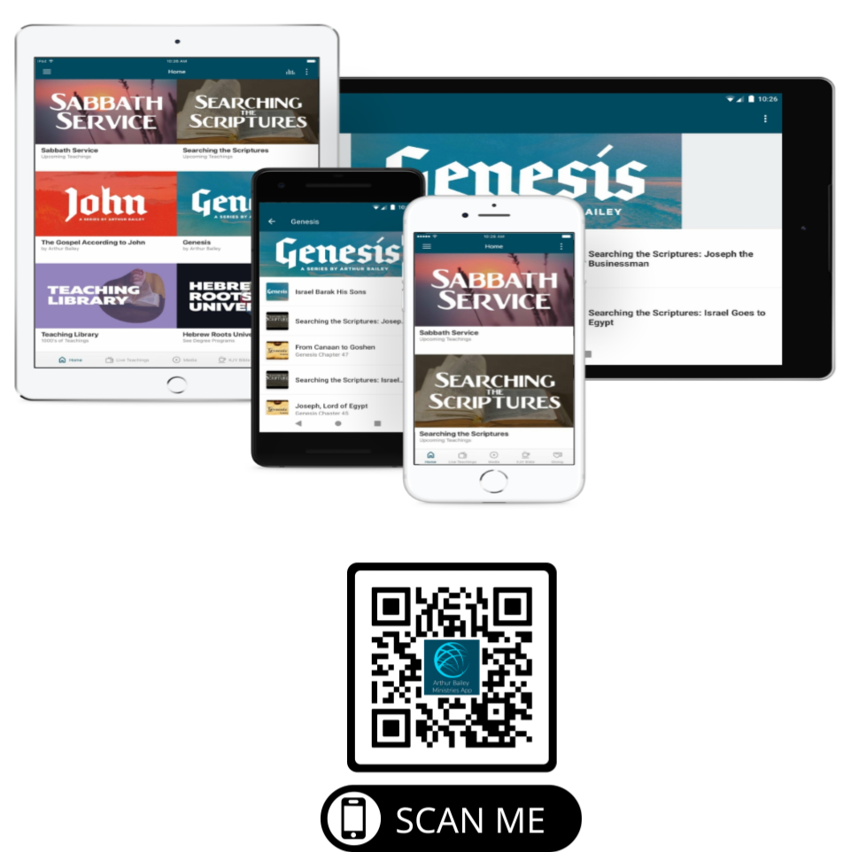

Slide 71
Mail in your support by check or money order.
Our Mailing Address:
P O Box 1182
Fort Mill, SC 29716

Slide 72
You can give by
Texting
Donate – Tithe - Offering
to
704-810-1579

