Slide 4
Welcome to the
1st Day of Unleavened Bread 2022

Slide 5
TODAY’S MESSAGE
Sanctifying The Firstborn

Slide 6
Please Subscribe for updates on our Website.
Watch us on YouTube.
Follow us on Facebook and the other Social Media networks.
Please Like and Share our videos and posts.

Slide 7
At the end of today’s Teaching, you will be able to 1. Ask Questions 2. Give your Tithes, Offerings, and Donations 3. Receive Prayer

Slide 8
The Vision of House of Israel is to be: 1. A Worshipping People (John 4:23-24) 2. An Evangelistic Community (Acts 2:42-47)

Slide 9
3. A Discipleship Center (Matthew 28:19) 4. An Equipping Network (Ephesians 4:12) 5. And a Worldwide Witness for Yeshua The Messiah
(Acts 1:8)

Slide 11
Prayer

Slide 12
TODAY’S MESSAGE
Sanctifying The Firstborn

Slide 13
^{Ex 13:1} And the LORD spake unto Moses, saying,
^{Ex 13:2} Sanctify unto me all the firstborn, whatsoever openeth the womb among the children of Israel, both of man and of beast: it is mine.

Slide 14
Sanctify – 06942 קָדַשׁ qadash {kaw-dash'}
Meaning: 1) to consecrate, sanctify, prepare, dedicate, be hallowed, be holy, be sanctified, be separate 1a) (Qal) 1a1) to be set apart, be consecrated 1a2) to be hallowed 1a3) consecrated, tabooed 1b) (Niphal) 1b1) to show oneself sacred or majestic 1b2) to be honoured, be treated as sacred

Slide 15
1b3) to be holy 1c) (Piel) 1c1) to set apart as sacred, consecrate, dedicate 1c2) to observe as holy, keep sacred 1c3) to honour as sacred, hallow 1c4) to consecrate 1d) (Pual) 1d1) to be consecrated 1d2) consecrated, dedicated 1e) (Hiphil) 1e1) to set apart, devote, consecrate 1e2) to regard or treat as sacred or hallow

Slide 16
1e3) to consecrate 1f) (Hithpael) 1f1) to keep oneself apart or separate 1f2) to cause Himself to be hallowed (of God) 1f3) to be observed as holy 1f4) to consecrate oneself
Usage: AV - sanctify 108, hallow 25, dedicate 10, holy 7, prepare 7, consecrate 5, appointed 1, bid 1, purified 1, misc 7; 172

Slide 17
To Sanctify is to set apart, to consecrate, to make holy, etc. By sanctifying the firstborn, man has been given the ability to hallow or make holy that which has been given to him by YeHoVaH.
YeHoVaH sanctified the seventh day.

Slide 18
To be holy, as YeHoVaH is Holy, requires observing those things that YeHoVaH made Holy.

Slide 19
YeHoVaH sanctified the seventh day.
YeHoVaH instructed Moses to Sanctify His people.
YeHoVaH instructed Moses to Sanctify His Priests.
YeHoVaH instructed Moses to Sanctify His Tabernacle.

Slide 20
YeHoVaH Sanctified the seventh day.
^{Ge 2:3} And God blessed the seventh day, and sanctified it: because that in it he had rested from all his work which God created and made.

Slide 21
YeHoVaH instructed Moses to Sanctify His people.
^{Ex 19:10} And the LORD said unto Moses, Go unto the people, and sanctify them today and tomorrow, and let them wash their clothes,

Slide 22
YeHoVaH instructed Moses to Sanctify His Priests.
^{Ex 28:41} And thou shalt put them upon Aaron thy brother, and his sons with him; and shalt anoint them, and consecrate them, and sanctify them, that they may minister unto me in the priest's office.

Slide 23
YeHoVaH instructed Moses to Sanctify His Tabernacle.
^{Ex 29:44} And I will sanctify the tabernacle of the congregation, and the altar: I will sanctify also both Aaron and his sons, to minister to me in the priest's office.

Slide 24
YeHoVaH commanded His people to Sanctify themselves.
^{Lev 20:7} Sanctify yourselves therefore, and be ye holy: for I am the LORD your God.

Slide 25
We are commanded to be Holy as YeHoVaH is Holy.
^{1Pe 1:15} But as he which hath called you is holy, so be ye holy in all manner of conversation;
^{1Pe 1:16} Because it is written, Be ye holy; for I am holy.

Slide 26
Everything in relationship with the Creator of Heaven and Earth is expected to be Holy,
for He is Holy!

Slide 27
YeHoVaH made Covenant with man, beast, and the earth.
^{Ge 9:9} And I, behold, I establish my covenant with you, and with your seed after you;

Slide 28
^{Ge 9:10} And with every living creature that is with you, of the fowl, of the cattle, and of every beast of the earth with you; from all that go out of the ark, to every beast of the earth. ^{Ge 9:11} And I will establish my covenant with you; neither shall all flesh be cut off any more by the waters of a flood; neither shall there any more be a flood to destroy the earth.

Slide 29
^{Ge 9:12} And God said, This is the token of the covenant which I make between me and you and every living creature that is with you, for perpetual generations:
^{Ge 9:13} I do set my bow in the cloud, and it shall be for a token of a covenant between me and the earth.

Slide 30
YeHoVaH instructed Israel to remember the Covenants He made from the beginning when He gave Israel the Sabbath Commandment.

Slide 31
^{Ex 20:9} Six days shalt thou labour, and do all thy work:
^{Ex 20:10} But the seventh day is the sabbath of the LORD thy God: in it thou shalt not do any work, thou, nor thy son, nor thy daughter, thy manservant, nor thy maidservant, nor thy cattle, nor thy stranger that is within thy gates:

Slide 32
^{Ex 20:11} For in six days the LORD made heaven and earth, the sea, and all that in them is, and rested the seventh day: wherefore the LORD blessed the sabbath day, and hallowed it.

Slide 33
He gave the Land a Sabbath rest called Shemitah.
^{Lev 25:1} And the LORD spake unto Moses in mount Sinai, saying,
^{Lev 25:2} Speak unto the children of Israel, and say unto them, When ye come into the land which I give you, then shall the land keep a sabbath unto the LORD.

Slide 34
^{Lev 25:3} Six years thou shalt sow thy field, and six years thou shalt prune thy vineyard, and gather in the fruit thereof;
^{Lev 25:4} But in the seventh year shall be a sabbath of rest unto the land, a sabbath for the LORD: thou shalt neither sow thy field, nor prune thy vineyard.

Slide 35
^{Ex 13:3} And Moses said unto the people, Remember this day, in which ye came out from Egypt, out of the house of bondage; for by strength of hand the LORD brought you out from this place: there shall no leavened bread be eaten.
^{Ex 13:4} This day came ye out in the month Abib.

Slide 36
^{Ex 13:5} And it shall be when the LORD shall bring thee into the land of the Canaanites, and the Hittites, and the Amorites, and the Hivites, and the Jebusites, which he sware unto thy fathers to give thee, a land flowing with milk and honey, that thou shalt keep this service in this month. ^{Ex 13:6} Seven days thou shalt eat unleavened bread, and in the seventh day shall be a feast to the LORD.

Slide 37
^{Ex 13:7} Unleavened bread shall be eaten seven days; and there shall no leavened bread be seen with thee, neither shall there be leaven seen with thee in all thy quarters.
^{Ex 13:8} And thou shalt show thy son in that day, saying, This is done because of that which the LORD did unto me when I came forth out of Egypt.

Slide 38
^{Ex 13:9} And it shall be for a sign unto thee upon thine hand, and for a memorial between thine eyes, that the LORD'S law may be in thy mouth: for with a strong hand hath the LORD brought thee out of Egypt.

Slide 39
Not Moses’ law or the law of Moses, but YeHoVaH’s Law.
^{Ex 13:10} Thou shalt therefore keep this ordinance in his season from year to year.
^{Ex 13:11} And it shall be when the LORD shall bring thee into the land of the Canaanites, as he sware unto thee and to thy fathers, and shall give it thee,

Slide 40
^{Ex 13:12} That thou shalt set apart unto the LORD all that openeth the matrix, and every firstling that cometh of a beast which thou hast; the males shall be the LORD'S.
^{Ex 13:13} And every firstling of an ass thou shalt redeem with a lamb; and if thou wilt not redeem it, then thou shalt break his neck: and all the firstborn of man among thy children shalt thou redeem.

Slide 41
^{Ex 13:14} And it shall be when thy son asketh thee in time to come, saying, What is this? that thou shalt say unto him, By strength of hand the LORD brought us out from Egypt, from the house of bondage:

Slide 42
The Teachings I have been doing are focused on keeping Scripture simple.
Father made Scripture to be understood by children. Father even anticipated the types of questions the children would ask and gave the parents the answers to the questions.
We don’t have to make stuff up.

Slide 43
Sometimes grownups make things so complicated and confusing.
YeHoVaH is not the author of confusion.

Slide 44
^{Ex 13:15} And it came to pass, when Pharaoh would hardly let us go, that the LORD slew all the firstborn in the land of Egypt, both the firstborn of man, and the firstborn of beast: therefore I sacrifice to the LORD all that openeth the matrix, being males; but all the firstborn of my children I redeem.

Slide 45
YeHoVaH said that Israel (the New Nation of Israel, not the man Israel) was His firstborn.
^{Ex 4:22} And thou shalt say unto Pharaoh, Thus saith the LORD, Israel is my son, even my firstborn:
^{Ex 4:23} And I say unto thee, Let my son go, that he may serve me: and if thou refuse to let him go, behold, I will slay thy son, even thy firstborn.

Slide 46
Matrix – 07358 רֶחֶם rechem {rekh'-em}
Meaning: 1) womb 1a) womb 1b) womb-man, woman-slave, woman, two women
Usage: AV - womb 21, matrix 5; 26

Slide 47
Redeem – 06299 פָּדָה padah {paw-daw'}
Meaning: 1) to ransom, redeem, rescue, deliver 1a) (Qal) to ransom 1b) (Niphal) to be ransomed 1c) (Hiphil) to allow one to be ransomed 1d) (Hophal) redeemed
Usage: AV - redeem 48, deliver 5, ransom 2, rescued 1, misc 3; 59

Slide 48
^{Ex 13:16} And it shall be for a token upon thine hand, and for frontlets between thine eyes: for by strength of hand the LORD brought us forth out of Egypt.

Slide 49
^{Ex 34:18} The feast of unleavened bread shalt thou keep. Seven days thou shalt eat unleavened bread, as I commanded thee, in the time of the month Abib: for in the month Abib thou camest out from Egypt.
^{Ex 34:19} All that openeth the matrix is mine; and every firstling among thy cattle, whether ox or sheep, that is male.

Slide 50
^{Ex 34:20} But the firstling of an ass thou shalt redeem with a lamb: and if thou redeem him not, then shalt thou break his neck. All the firstborn of thy sons thou shalt redeem. And none shall appear before me empty.

Slide 51
^{Dt 16:16} Three times in a year shall all thy males appear before the LORD thy God in the place which he shall choose; in the feast of unleavened bread, and in the feast of weeks, and in the feast of tabernacles: and they shall not appear before the LORD empty: ^{Dt 16:17} Every man shall give as he is able, according to the blessing of the LORD thy God which he hath given thee.

Slide 52
Your support is greatly appreciated and needed.

Slide 54
Our Preferred Donation Method
Cash App
$ABMHOI

Slide 55
Question and Answer
Period

Slide 56
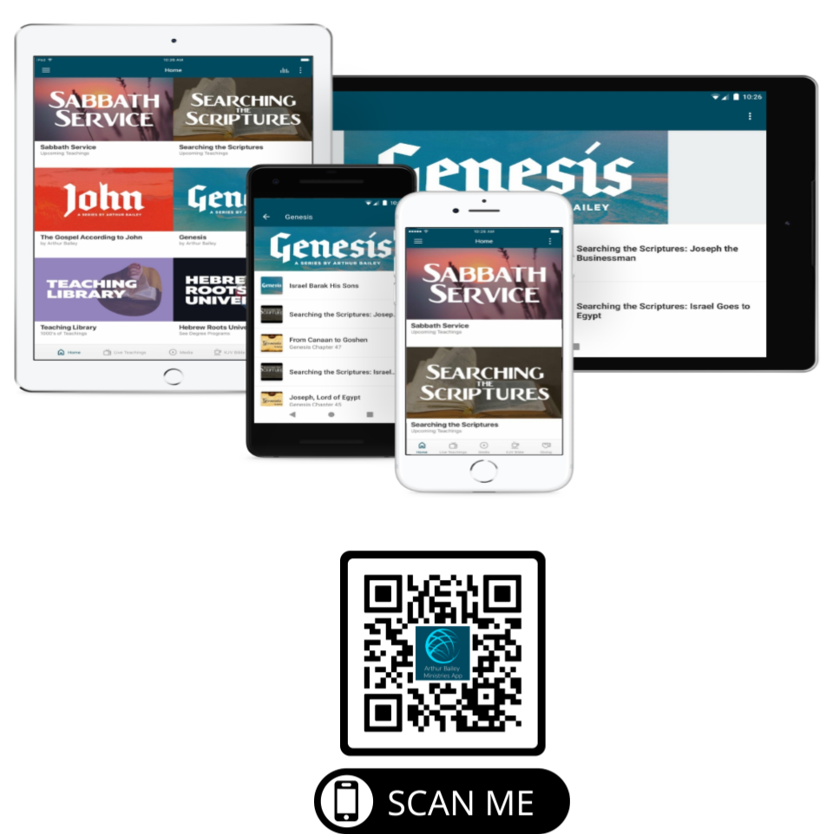

Slide 58
Mail in your support by check or money order.
Our Mailing Address:
P O Box 1182
Fort Mill, SC 29716

Slide 60
You can give by
Texting
Donate – Tithe - Offering
to
704-810-1579

