Slide 4
Welcome to
Passover 2022

Slide 5
TODAY’S MESSAGE
The LORD’s Passover

Slide 6
Please Subscribe for updates on our Website.
Watch us on YouTube.
Follow us on Facebook and the other Social Media networks.
Please Like and Share our videos and posts.

Slide 7
At the end of today’s Teaching, you will be able to 1. Ask Questions 2. Give your Tithes, Offerings, and Donations 3. Receive Prayer

Slide 8
The Vision of House of Israel is to be: 1. A Worshipping People (John 4:23-24) 2. An Evangelistic Community (Acts 2:42-47)

Slide 9
3. A Discipleship Center (Matthew 28:19) 4. An Equipping Network (Ephesians 4:12) 5. And a Worldwide Witness for Yeshua The Messiah
(Acts 1:8)

Slide 11
Prayer

Slide 12
TODAY’S MESSAGE
Passover 2022
The LORD’s Passover

Slide 13
The Passover and its meaning has evolved over the years. The stories and traditions added to the telling of the Passover story have also been embellished by the story tellers.

Slide 14
YeHoVaH made a promise to Abraham that He was going to bring his offspring out of bondage with great substance. On the first day of Unleavened Bread, He fulfilled that promise.

Slide 15
^{Ge 15:13} And he said unto Abram, Know of a surety that thy seed shall be a stranger in a land that is not theirs, and shall serve them; and they shall afflict them four hundred years;
^{Ge 15:14} And also that nation, whom they shall serve, will I judge: and afterward shall they come out with great substance.

Slide 16
The Biblical Passover is introduced to us by YeHoVaH’s Instructions to Moses to instruct His people how to prepare for the last and final plague that He would put on Egypt to force Pharaoh to let His people go.

Slide 17
^{Ex 11:1} And the LORD said unto Moses, Yet will I bring one plague more upon Pharaoh, and upon Egypt; afterwards he will let you go hence: when he shall let you go, he shall surely thrust you out hence altogether.

Slide 18
^{Ex 11:4} And Moses said, Thus saith the LORD, About midnight will I go out into the midst of Egypt:
^{Ex 11:5} And all the firstborn in the land of Egypt shall die, from the firstborn of Pharaoh that sitteth upon his throne, even unto the firstborn of the maidservant that is behind the mill; and all the firstborn of beasts.

Slide 19
The Passover Lamb/Goat is connected to the preservation of Israel’s firstborn from the plague and the death of the firstborn of Egypt’s man or beast at midnight during the 1st Day of Unleavened Bread.

Slide 20
^{Ex 12:1} And the LORD spake unto Moses and Aaron in the land of Egypt, saying,
^{Ex 12:2} This month shall be unto you the beginning of months: it shall be the first month of the year to you.

Slide 21
^{Ex 12:3} Speak ye unto all the congregation of Israel, saying, In the tenth day of this month they shall take to them every man a lamb, according to the house of their fathers, a lamb for an house:
^{Ex 12:4} And if the household be too little for the lamb, let him and his neighbour next unto his house take it according to the number of the souls; every man according to his eating shall make your count for the lamb.

Slide 22
Lamb – שֶׂה seh {seh} or שֵׂי sey {say}
Meaning: 1) one of a flock, lamb, sheep, goat, young sheep, young goat 1a) sheep, goat 1b) flock (collective)
Usage: AV - sheep 18, cattle 10, lamb 16, ewe 1, lamb + 03532 1; 46

Slide 23
^{Ex 12:5} Your lamb shall be without blemish, a male of the first year: ye shall take it out from the sheep, or from the goats:
Some people killed a sheep, some killed a goat, based on the Instructions given.

Slide 24
^{Ex 12:6} And ye shall keep it up until the fourteenth day of the same month: and the whole assembly of the congregation of Israel shall kill it in the evening.
^{Ex 12:7} And they shall take of the blood, and strike it on the two side posts and on the upper door post of the houses, wherein they shall eat it.
^{Ex 12:8} And they shall eat the flesh in that night, roast with fire, and unleavened bread; and with bitter herbs they shall eat it.

Slide 25
There are no cups associated with the Biblical Passover nor is wine or grape juice commanded or a requirement at Passover.

Slide 26
The four cups of the traditional Jewish Passover seder is just that: Tradition.
1. The Cup of Sanctification
2. The Cup of Judgment or Deliverance
3. The Cup of Redemption
4. The Cup of Praise or Consummation

Slide 27
^{Ex 12:9} Eat not of it raw, nor sodden at all with water, but roast with fire; his head with his legs, and with the purtenance thereof.
^{Ex 12:10} And ye shall let nothing of it remain until the morning; and that which remaineth of it until the morning ye shall burn with fire.

Slide 28
^{Ex 12:11} And thus shall ye eat it; with your loins girded, your shoes on your feet, and your staff in your hand; and ye shall eat it in haste: it is the LORD'S passover.

Slide 29
Passover – פֶּסַח pecach {peh'-sakh}
Meaning: 1) passover 1a) sacrifice of passover 1b) animal victim of the passover 1c) festival of the passover
Usage: AV - passover 46, passover offerings 3; 49

Slide 30
Pesach aka Passover
is a Sacrifice Not a Day.
Passover does not begin at sunset on the 13th of Abib.
The 14th of Abib begins at sunset on the 13th.

Slide 31
^{Ex 12:12} For I will pass through the land of Egypt this night, and will smite all the firstborn in the land of Egypt, both man and beast; and against all the gods of Egypt I will execute judgment: I am the LORD.
^{Ex 12:13} And the blood shall be to you for a token upon the houses where ye are: and when I see the blood, I will pass over you, and the plague shall not be upon you to destroy you, when I smite the land of Egypt.

Slide 32
^{Ex 12:14} And this day shall be unto you for a memorial; and ye shall keep it a feast to the LORD throughout your generations; ye shall keep it a feast by an ordinance for ever.

Slide 33
At its heart, Passover is a memorial established by YeHoVaH to remind Israel of what YeHoVaH did to Egypt’s firstborns and how He spared the Hebrews’ firstborns from the plague of death by the sign of the blood of a sheep or a goat on the doorposts of their houses.

Slide 34
Memorial – זִכָּרוֹן zikrown {zik-rone'}
Meaning: 1) memorial, reminder, remembrance
Usage: AV - memorial 17, remembrance 6, records 1; 24

Slide 35
Passover points backwards not forward.
No prophecy here.
Throughout the
Tanach (the Old Testament)
Passover is called by several titles:

Slide 36
The Lord’s Passover
The Passover of the LORD.
The Passover to the LORD
The Passover unto the LORD
It is NOT the Jewish Passover.

Slide 37
^{Ex 12:11} And thus shall ye eat it; with your loins girded, your shoes on your feet, and your staff in your hand; and ye shall eat it in haste: it is the LORD'S passover.

Slide 38
^{Ex 12:26} And it shall come to pass, when your children shall say unto you, What mean ye by this service?
^{Ex 12:27} That ye shall say, It is the sacrifice of
the LORD'S passover, who passed over the houses of the children of Israel in Egypt, when he smote the Egyptians, and delivered our houses. And the people bowed the head and worshipped.

Slide 39
^{Lev 23:5} In the fourteenth day of the first month at even is
the LORD'S passover.
It is NOT the Jewish Passover.

Slide 40
The Passover of the LORD.
^{Nu 28:16} And in the fourteenth day of the first month is
the passover of the LORD.

Slide 41
The Passover to the LORD
^{Ex 12:48} And when a stranger shall sojourn with thee, and will keep the passover to the LORD, let all his males be circumcised, and then let him come near and keep it; and he shall be as one that is born in the land: for no uncircumcised person shall eat thereof.

Slide 42
The Passover unto the LORD
^{Nu 9:10} Speak unto the children of Israel, saying, If any man of you or of your posterity shall be unclean by reason of a dead body, or be in a journey afar off, yet he shall keep
the passover unto the LORD.

Slide 43
^{Nu 9:14} And if a stranger shall sojourn among you, and will keep the passover unto the LORD; according to the ordinance of the passover, and according to the manner thereof, so shall he do: ye shall have one ordinance, both for the stranger, and for him that was born in the land.

Slide 44
^{Dt 16:1} Observe the month of Abib, and keep the passover unto the LORD thy God: for in the month of Abib the LORD thy God brought thee forth out of Egypt by night.
^{Dt 16:2} Thou shalt therefore sacrifice the passover unto the LORD thy God, of the flock and the herd, in the place which the LORD shall choose to place his name there.

Slide 45
^{2Ki 23:21} And the king commanded all the people, saying, Keep the passover unto the LORD your God, as it is written in the book of this covenant.
^{2Ch 30:1} And Hezekiah sent to all Israel and Judah, and wrote letters also to Ephraim and Manasseh, that they should come to the house of the LORD at Jerusalem, to keep the passover unto the LORD God of Israel.

Slide 46
^{2Ch 30:5} So they established a decree to make proclamation throughout all Israel, from Beer-sheba even to Dan, that they should come to keep the passover unto the LORD God of Israel at Jerusalem: for they had not done it of a long time in such sort as it was written.

Slide 47
^{2Ch 35:1} Moreover Josiah kept a passover unto the LORD in Jerusalem: and they killed the passover on the fourteenth day of the first month.

Slide 48
Do we celebrate Passover because Yeshua was crucified on Passover?
NO.
Yeshua celebrated Passover all of his earthly life except the last Passover when He was crucified.

Slide 49
Has Passover been fulfilled?
Some people associate a prophetic fulfillment to Passover AFTER Yeshua’s crucifixion.
BUT there is no known Biblical prophecy, prior to Yeshua’s crucifixion, that is associated with Passover which requires a fulfillment.

Slide 50
What is the significance of Yeshua and Passover?
Yeshua was crucified during Passover.

Slide 51
What did Paul mean when he said:
^{1Co 5:6} Your glorying is not good. Know ye not that a little leaven leaveneth the whole lump?

Slide 52
^{1Co 5:7} Purge out therefore the old leaven, that ye may be a new lump, as ye are unleavened. For even Messiah our passover is sacrificed for us:
^{1Co 5:8} Therefore let us keep the feast, not with old leaven, neither with the leaven of malice and wickedness; but with the unleavened bread of sincerity and truth.

Slide 53
First, Paul did not explain what he meant, therefore leaving any explanation to be private or of a personal interpretation.

Slide 54
Second, the context of Paul’s statement is not about Passover, but in reference to leaven in the context of dealing with the sin of an individual who was sleeping with his father’s wife meaning either his own mother or his stepmother.

Slide 55
It is clear from Paul’s several references to leaven and unleavened that the focus is more on leaven and not Passover.
At the time of Paul, Passover and the seven days of Unleavened Bread were all lumped together.

Slide 56
Therefore, we must conclude that Paul is speaking figuratively and symbolically about Passover and Unleavened Bread, not literal, in the encouragement of keeping the Feasts of Passover and Unleavened Bread in the right spirit and attitude.
Paul focuses more on the resurrection of Yeshua and the firstfruits from the dead or them that slept (1st Cor. 15:20) and its significance than the death at Passover.

Slide 57
As we gather to celebrate this Passover, like the thousands of Passovers that have been celebrated before, let us remember the awesome power of deliverance of YeHoVaH Almighty
our Most High,
the One True Elohim, and
The Only Wise and Living God!

Slide 58
Your support is greatly appreciated and needed.

Slide 60
Our Preferred Donation Method
Cash App
$ABMHOI

Slide 61
Question and Answer
Period

Slide 62
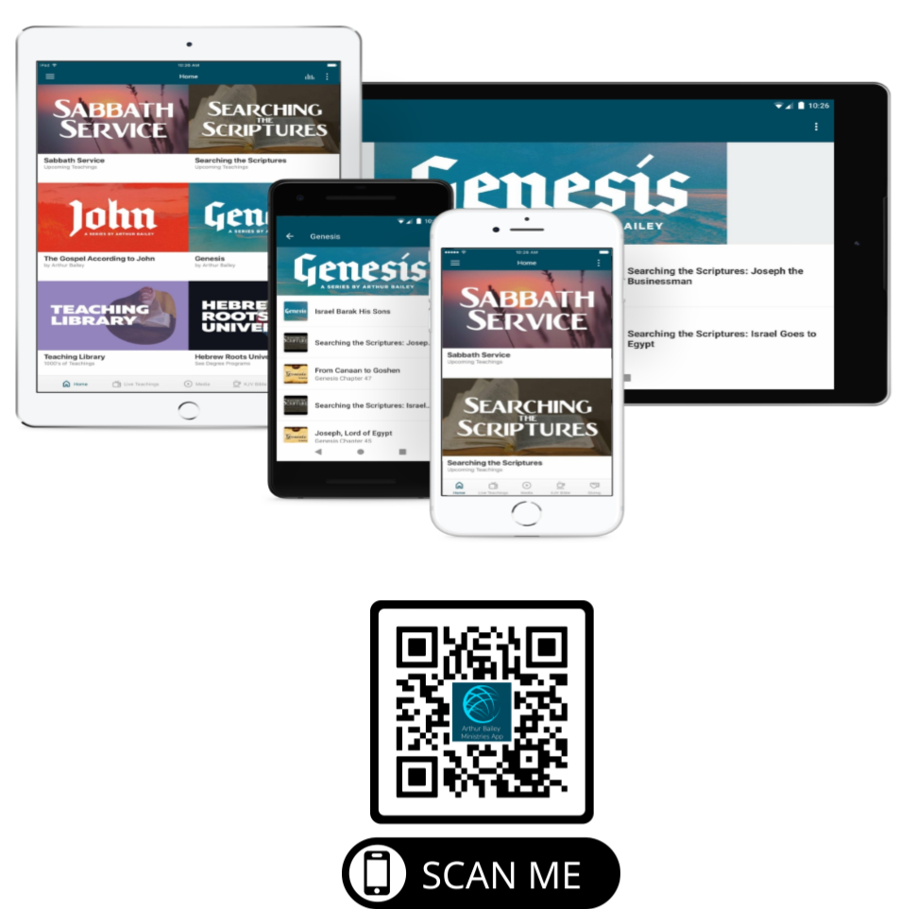

Slide 64
Mail in your support by check or money order.
Our Mailing Address:
P O Box 1182
Fort Mill, SC 29716

Slide 65
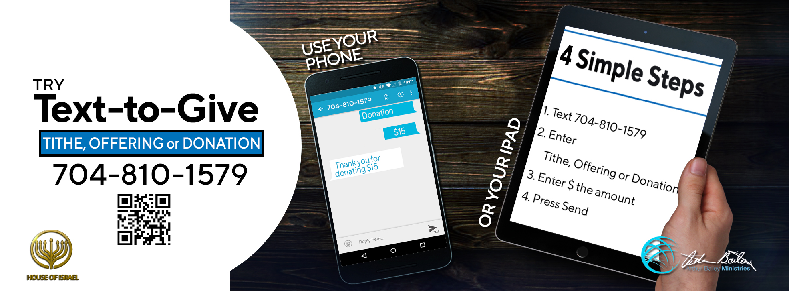

Slide 66
You can give by
Texting
Donate – Tithe - Offering
to
704-810-1579

