Slide 3
TODAY’S MESSAGE
Luke 24:36-53
Fear, Unbelief and the Promise

Slide 4
Please Subscribe for Updates on our Website.
Watch us on YouTube.
Follow us on Facebook and the
other Social Media Networks.
Please Like and Share our Videos
and Posts.

Slide 5
At the end of today’s Teaching, you will be able to 1. Ask Questions 2. Receive Prayer 3. Give your Tithes and Offerings

Slide 6
The Vision of House of Israel is to be: 1. A Worshipping People (John 4:23-24) 2. An Evangelistic Community (Acts 2:42-47)

Slide 7
3. A Discipleship Center (Matthew 28:19) 4. An Equipping Network (Ephesians 4:12) 5. And a Worldwide Witness for Yeshua The Messiah
(Acts 1:8)

Slide 9
Prayer

Slide 10
TODAY’S MESSAGE
Luke 24:36-53
Fear, Unbelief and the Promise

Slide 11
Fear and unbelief in the life of Believers result in strange and unusual behaviors. Fear causes Believers to question what YeHoVaH has said and compels them to operate contrary to what has been instructed in YeHoVaH’s Word.

Slide 12
The Promise of YeHoVaH’s Gift was given to enable Believers to stand on YeHoVaH’s Word. When Believers stand on YeHoVaH’s Word, they are empowered by His Spirit to walk according to YeHoVaH’s Instructions in full confidence and faith.

Slide 13
In the previous teaching “Unbelieving Believers”, I pointed out that unbelief among Believers is as common today as it was in the days of Yeshua amongst many of His Disciples. There is a huge difference in following Yeshua, the Man, and obeying Yeshua, the Word made flesh. Believers are not just followers and hearers of the Word. True believers are followers, hearers, and doers of the Word.

Slide 14
Unbelief among many of us who confess to be Believers is obvious in several ways.
The lack of miracles and the demonstration of power, as Yeshua said, is evidence.
The choice of words and things many allow their mouths to speak, often contradict what they say they believe.

Slide 15
Some Believers have lifestyles and practices of immoral behavior by engaging in those things the Bible clearly teaches that those who do such things would not inherit eternal life.
Much of the unbelief and immoral behavior could be due to the underlying disbelief in a Resurrection and Judgment after death.

Slide 16
A major part and purpose of Yeshua’s appearances was to assure His Disciples that the Resurrection, He spoke about, was factual and that He was proof of the Resurrection.
In the Gospel of John, Yeshua said He was the Resurrection and the Life.

Slide 17
^{Lk 24:36} And as they thus spake, Yeshua himself stood in the midst of them, and saith unto them, Peace be unto you.
^{Lk 24:37} But they were terrified and affrighted, and supposed that they had seen a spirit.

Slide 18
Terrified – 4422 πτοέω ptoeo {pto-eh'-o}
Meaning: 1) to terrify 2) be terrified
of causing to fly away);; v
Usage: AV - terrify 2; 2

Slide 19
Affrighted = two Greek words

Slide 20
Affrighted – 1719 ἔμφοβος emphobos {em'-fob-os}
Meaning: 1) thrown into fear, terrified, affrighted
Usage: AV - afraid 3, affrighted 2, tremble + 1096 1; 6
1096 γίνομαι ginomai {ghin'-om-ahee}
Meaning: 1) to become, i.e. to come into existence, begin to be, receive being 2) to become, i.e. to come to pass, happen 2a) of events 3) to arise, appear in history, come upon the stage 3a)

Slide 21
of men appearing in public 4) to be made, finished 4a) of miracles, to be performed, wrought 5) to become, be made
Usage: AV - be 255, come to pass 82, be made 69, be done 63, come 52, become 47, God forbid + 3361 15, arise 13, have 5, be fulfilled 3, be married to 3, be preferred 3, not tr 14, misc 4, vr done 2; 678

Slide 22
^{Lk 24:38} And he said unto them, Why are ye troubled? and why do thoughts arise in your hearts?

Slide 23
Troubled – 5015 ταράσσω tarasso {tar-as'-so}
Meaning: 1) to agitate, trouble (a thing, by the movement of its parts to and fro) 1a) to cause one inward commotion, take away his calmness of mind, disturb his equanimity 1b) to disquiet, make restless 1c) to stir up 1d) to trouble 1d1) to strike one's spirit with fear and dread 1e) to render anxious or distressed 1f) to perplex the mind of one by suggesting scruples or doubts
Usage: AV - trouble 17; 17

Slide 24
^{Lk 24:39} Behold my hands and my feet, that it is I myself: handle me, and see; for a spirit hath not flesh and bones, as ye see me have.
^{Lk 24:40} And when he had thus spoken, he showed them his hands and his feet.

Slide 25
Confused Emotions
^{Lk 24:41} And while they yet believed not for joy, and wondered, he said unto them, Have ye here any meat?

Slide 26
The Disciples experienced a range of emotions all at once:
Unbelieving
Joyful
Amazed
Unconvinced

Slide 27
Yeshua provided further proof.
^{Lk 24:42} And they gave him a piece of a broiled fish, and of an honeycomb.
^{Lk 24:43} And he took it, and did eat before them.

Slide 28
Yeshua reminded them of what He had spoken to them earlier.
^{Lk 24:44} And he said unto them, These are the words which I spake unto you, while I was yet with you, that all things must be fulfilled, which were written in the law of Moses, and in the prophets, and in the psalms, concerning me.

Slide 29
Yeshua reveals to the Disciples their biggest problem and exposes the church and many believers' problems today.
The Disciples did not remember the Words Yeshua spoke to them.

Slide 30
^{Lk 9:20} He said unto them, But whom say ye that I am? Peter answering said, The Christ of God.
^{Lk 9:21} And he straitly charged them, and commanded them to tell no man that thing;
^{Lk 9:22} Saying, The Son of man must suffer many things, and be rejected of the elders and chief priests and scribes, and be slain, and be raised the third day.

Slide 31
^{Lk 9:23} And he said to them all, If any man will come after me, let him deny himself, and take up his cross daily, and follow me.
^{Lk 9:24} For whosoever will save his life shall lose it: but whosoever will lose his life for my sake, the same shall save it.
^{Lk 9:25} For what is a man advantaged, if he gain the whole world, and lose himself, or be cast away?

Slide 32
^{Lk 9:26} For whosoever shall be ashamed of me and of my words, of him shall the Son of man be ashamed, when he shall come in his own glory, and in his Father's, and of the holy angels.
^{Lk 9:27} But I tell you of a truth, there be some standing here, which shall not taste of death, till they see the kingdom of God.

Slide 33
^{Lk 9:43} And they were all amazed at the mighty power of God. But while they wondered every one at all things which Jesus did, he said unto his disciples, ^{Lk 9:44} Let these sayings sink down into your ears: for the Son of man shall be delivered into the hands of men. ^{Lk 9:45} But they understood not this saying, and it was hid from them, that they perceived it not: and they feared to ask him of that saying.

Slide 34
^{Lk 18:31} Then he took unto him the twelve, and said unto them, Behold, we go up to Jerusalem, and all things that are written by the prophets concerning the Son of man shall be accomplished.
^{Lk 18:32} For he shall be delivered unto the Gentiles, and shall be mocked, and spitefully entreated, and spitted on:

Slide 35
^{Lk 18:33} And they shall scourge him, and put him to death: and the third day he shall rise again.
^{Lk 18:34} And they understood none of these things: and this saying was hid from them, neither knew they the things which were spoken.

Slide 36
^{Lk 22:37} For I say unto you, that this that is written must yet be accomplished in me, And he was reckoned among the transgressors: for the things concerning me have an end.

Slide 37
^{Lk 24:25} Then he said unto them, O fools, and slow of heart to believe all that the prophets have spoken:
^{Lk 24:26} Ought not Christ to have suffered these things, and to enter into his glory?
^{Lk 24:27} And beginning at Moses and all the prophets, he expounded unto them in all the scriptures the things concerning himself.

Slide 38
Yeshua had to reteach them.
Today, Believers have exchanged the Words of Yeshua, the Messiah, for the words of Paul.

Slide 39
Whenever people are reminded of what Yeshua said, they quote Paul.
We don’t need Paul to explain what Yeshua taught. Yeshua did a perfect job of that Himself.
The problem is Yeshua’s Disciples did not believe Him and this exposes our own unbelief of what Yeshua said.

Slide 40
Believers are not just followers and hearers of the Word.
True Believers are followers, hearers, and doers of the Word Yeshua taught!

Slide 41
^{Lk 24:45} Then opened he their understanding, that they might understand the scriptures,
How did He open their understanding that they might understand the Scriptures?
He explained. “Thus, it is written”.

Slide 42
Scriptures
^{Lk 24:46} And said unto them, Thus it is written, and thus it behooved Messiah to suffer, and to rise from the dead the third day:

Slide 43
The Psalmist Wrote
^{Ps 16:9} Therefore my heart is glad, and my glory rejoiceth: my flesh also shall rest in hope.
^{Ps 16:10} For thou wilt not leave my soul in hell; neither wilt thou suffer thine Holy One to see corruption. ^{Ps 16:11} Thou wilt show me the path of life: in thy presence is fulness of joy; at thy right hand there are pleasures for evermore.

Slide 44
The Prophet Isaiah Wrote
^{Isa 53:9} And he made his grave with the wicked, and with the rich in his death; because he had done no violence, neither was any deceit in his mouth. ^{Isa 53:10} Yet it pleased the LORD to bruise him; he hath put him to grief: when thou shalt make his soul an offering for sin, he shall see his seed, he shall prolong his days, and the pleasure of the LORD shall prosper in his hand.

Slide 45
^{Isa 53:11} He shall see of the travail of his soul, and shall be satisfied: by his knowledge shall my righteous servant justify many; for he shall bear their iniquities.
^{Isa 53:12} Therefore will I divide him a portion with the great, and he shall divide the spoil with the strong; because he hath poured out his soul unto death: and he was numbered with the transgressors; and he bare the sin of many, and made intercession for the transgressors.

Slide 46
^{Lk 24:47} And that repentance and remission of sins should be preached in his name among all nations, beginning at Jerusalem.
^{Lk 24:48} And ye are witnesses of these things.

Slide 47
Yeshua’s Disciples witnessed His sufferings.
Yeshua’s Disciples witnessed His appearances after His Resurrection.
Yeshua’s Disciples witnessed what He taught and what He did.
Yeshua’s Disciples where commanded to do what He did and taught.
Yeshua’s Disciples were instructed to tarry until they all received the Promised Holy Spirit that would endow them with Power.

Slide 48
^{Lk 24:49} And, behold, I send the promise of my Father upon you: but tarry ye in the city of Jerusalem, until ye be endued with power from on high.
^{Lk 24:50} And he led them out as far as to Bethany, and he lifted up his hands, and blessed them.

Slide 49
^{Lk 24:51} And it came to pass, while he blessed them, he was parted from them, and carried up into heaven.
^{Lk 24:52} And they worshipped him, and returned to Jerusalem with great joy:

Slide 50
Worshipped – 4352 προσκυνέω proskuneo {pros-koo-neh'-o}
Meaning: 1) to kiss the hand to (towards) one, in token of reverence 2) among the Orientals, esp. the Persians, to fall upon the knees and touch the ground with the forehead as an expression of profound reverence 3)

Slide 51
in the NT by kneeling or prostration to do homage (to one) or make obeisance, whether in order to express respect or to make supplication 3a) used of homage shown to men and beings of superior rank 3a1) to the Jewish high priests 3a2) to God 3a3) to Christ 3a4) to heavenly beings 3a5) to demons
Usage: AV - worship 60; 60

Slide 52
^{Ac 1:1} The former treatise have I made, O Theophilus, of all that Jesus began both to do and teach,
^{Ac 1:2} Until the day in which he was taken up, after that he through the Holy Ghost had given commandments unto the apostles whom he had chosen:

Slide 53
^{Ac 1:3} To whom also he showed himself alive after his passion by many infallible proofs, being seen of them forty days, and speaking of the things pertaining to the kingdom of God: ^{Ac 1:4} And, being assembled together with them, commanded them that they should not depart from Jerusalem, but wait for the promise of the Father, which, saith he, ye have heard of me.

Slide 54
^{Ac 1:5} For John truly baptized with water; but ye shall be baptized with the Holy Ghost not many days hence.
^{Ac 1:6} When they therefore were come together, they asked of him, saying, Lord, wilt thou at this time restore again the kingdom to Israel?
^{Ac 1:7} And he said unto them, It is not for you to know the times or the seasons, which the Father hath put in his own power.

Slide 55
^{Ac 1:8} But ye shall receive power, after that the Holy Ghost is come upon you: and ye shall be witnesses unto me both in Jerusalem, and in all Judaea, and in Samaria, and unto the uttermost part of the earth.
^{Ac 1:9} And when he had spoken these things, while they beheld, he was taken up; and a cloud received him out of their sight.

Slide 56
^{Ac 1:10} And while they looked stedfastly toward heaven as he went up, behold, two men stood by them in white apparel;
^{Ac 1:11} Which also said, Ye men of Galilee, why stand ye gazing up into heaven? this same Jesus, which is taken up from you into heaven, shall so come in like manner as ye have seen him go into heaven.

Slide 57
^{Ac 1:12} Then returned they unto Jerusalem from the mount called Olivet, which is from Jerusalem a sabbath day's journey.
When they returned to Jerusalem, they continued in the Temple …

Slide 58
^{Lk 24:53} And were continually in the temple, praising and blessing God. Amen.

Slide 59
Your support is greatly appreciated and needed.

Slide 61
Our Preferred
Donation Methods:

Slide 62
CashApp – $ABMHOI
Venmo – @Arthur-Bailey-10
Zelle – apostlea@gmail.com

Slide 63
Question and Answer
Period

Slide 64
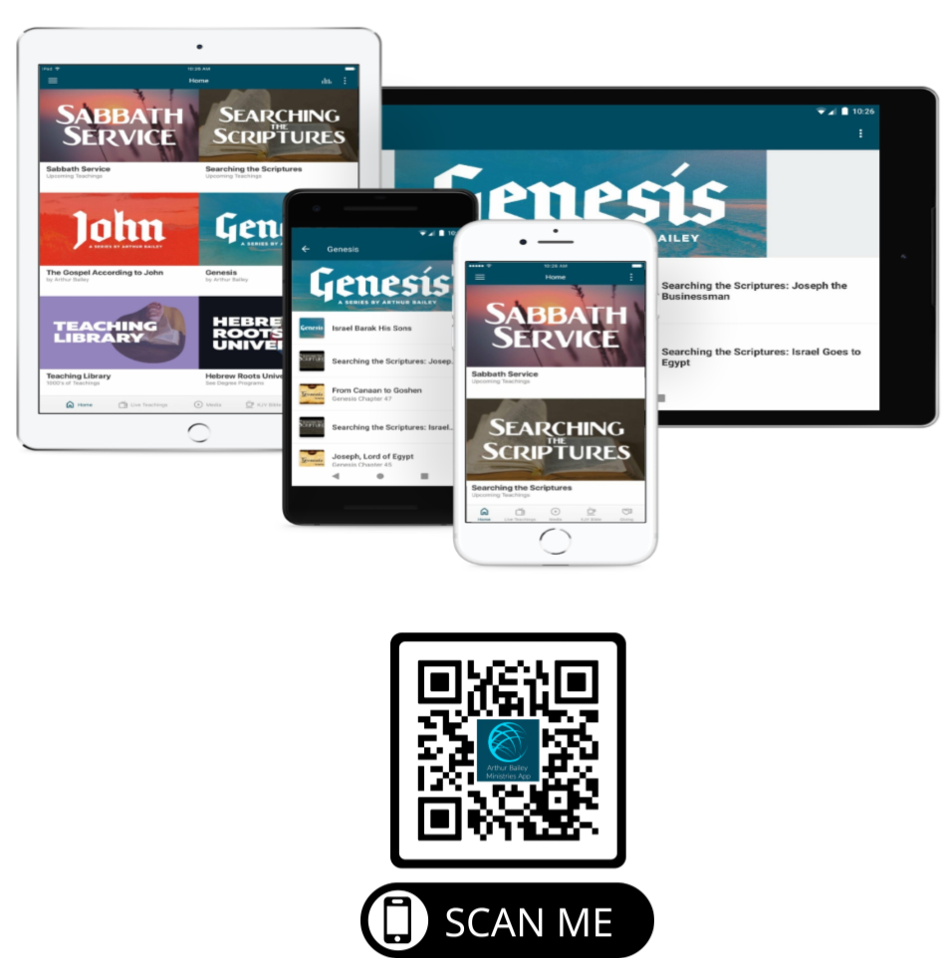

Slide 65
Mail in your support by check or money order.
Our Mailing Address:
P O Box 1182
Fort Mill, SC 29716

Slide 66
You can give by
Texting
Donate – Tithe - Offering
to
704-810-1579

