Slide 3
TODAY’S MESSAGE
Numbers 9:1-23
The Second Passover and the Cloud

Slide 4
Please Subscribe for Updates on our Website.
Watch us on YouTube.
Follow us on Facebook and the
other Social Media Networks.
Please Like and Share our Videos
and Posts.

Slide 5
At the end of today’s Teaching, you will be able to 1. Ask Questions 2. Receive Prayer 3. Give your Tithes and Offerings

Slide 6
The Vision of House of Israel is to be: 1. A Worshipping People (John 4:23-24) 2. An Evangelistic Community (Acts 2:42-47)

Slide 7
3. A Discipleship Center (Matthew 28:19) 4. An Equipping Network (Ephesians 4:12) 5. And a Worldwide Witness for Yeshua The Messiah
(Acts 1:8)

Slide 9
Prayer

Slide 10
TODAY’S MESSAGE
Numbers 9:1-23
The Second Passover and the Cloud

Slide 11
Passover set the stage for the killing of the firstborn sons of Egypt leading to the deliverance of Israel from bondage and slavery.
The Passover in Egypt birthed a Nation and established its independence to serve YeHoVaH as His firstborn.

Slide 12
Ironically, death defiled individuals and those who had been defiled were prohibited from keeping the Passover.
In this study, Instructions were given to those who had been defiled, for setting up the Tabernacle, and when to move the Camp.

Slide 13
^{Nu 9:1} And YeHoVaH spake unto Moses in the wilderness of Sinai, in the first month of the second year after they were come out of the land of Egypt, saying,
^{Nu 9:2} Let the children of Israel also keep the passover at his appointed season.

Slide 14
This is the 2nd Passover Israel celebrated unto YeHoVaH.
The 1st Passover was celebrated in Egypt. The 1st Passover sacrifices were killed by a family member because the Priest system had not been established.
Between the 1st and 2nd Passovers, the Priesthood system was instituted as a replacement for the firstborn son.

Slide 15
^{Nu 9:3} In the fourteenth day of this month, at even, ye shall keep it in his appointed season: according to all the rites of it, and according to all the ceremonies thereof, shall ye keep it.

Slide 16
Rites – 02708 חֻקָּה chuqqah {khook-kaw'}
Meaning: 1) statute, ordinance, limit, enactment, something prescribed 1a) statute
Usage: AV - statute 77, ordinance 22, custom 2, appointed 1, manners 1, rites 1; 104

Slide 17
Ceremonies – 04941 מִשְׁפָּט mishpat {mish-pawt'} Meaning: 1) judgment, justice, ordinance 1a) judgment 1a1) act of deciding a case 1a2) place, court, seat of judgment 1a3) process, procedure, litigation (before judges) 1a4) case, cause (presented for judgment) 1a5) sentence, decision (of judgment)

Slide 18
Usage: AV - judgment 296, manner 38, right 18, cause 12, ordinance 11, lawful 7, order 5, worthy 3, fashion 3, custom 2, discretion 2, law 2, measure 2, sentence 2, misc 18; 421
This is the only place this word “ceremonies” is used.

Slide 19
The rites of Passover were established by YeHoVaH because the Passover was His.
The Passover was YeHoVaH’s Passover.
^{Ex 12:11} And thus shall ye eat it; with your loins girded, your shoes on your feet, and your staff in your hand; and ye shall eat it in haste: it is YeHoVaH's passover.

Slide 20
^{Ex 12:3} Speak ye unto all the congregation of Israel, saying, In the tenth day of this month they shall take to them every man a lamb, according to the house of their fathers, a lamb for an house:
^{Ex 12:4} And if the household be too little for the lamb, let him and his neighbour next unto his house take it according to the number of the souls; every man according to his eating shall make your count for the lamb.

Slide 21
The Passover could come from the sheep or the goat.
^{Ex 12:5} Your lamb shall be without blemish, a male of the first year: ye shall take it out from the sheep, or from the goats:

Slide 22
As mentioned in our Passover Service, some people had sheep blood on their doorposts and others had goat blood on their doorposts.

Slide 23
Passover was a Sacrifice.
^{Ex 12:27} That ye shall say, It is the sacrifice of YeHoVaH'S passover, who passed over the houses of the children of Israel in Egypt, when he smote the Egyptians, and delivered our houses. And the people bowed the head and worshipped.

Slide 24
Passover was to be kept unto YeHoVaH.
^{Ex 12:48} And when a stranger shall sojourn with thee, and will keep the passover to YeHoVaH, let all his males be circumcised, and then let him come near and keep it; and he shall be as one that is born in the land: for no uncircumcised person shall eat thereof.

Slide 25
The rites of Passover established who could and who could not eat the Passover.
A stranger could not eat it.
^{Ex 12:43} And YeHoVaH said unto Moses and Aaron, This is the ordinance of the passover: There shall no stranger eat thereof:

Slide 26
Ordinance – 02708 חֻקָּה chuqqah {khook-kaw'}
Meaning: 1) statute, ordinance, limit, enactment, something prescribed 1a) statute
Usage: AV - statute 77, ordinance 22, custom 2, appointed 1, manners 1, rites 1; 104

Slide 27
A circumcised slave could eat the Passover.
^{Ex 12:44} But every man's servant that is bought for money, when thou hast circumcised him, then shall he eat thereof.

Slide 28
Servant – 05650 עֶבֶד `ebed {eh'-bed}
Meaning: 1) slave, servant 1a) slave, servant, man-servant 1b) subjects 1c) servants, worshippers (of God) 1d) servant (in special sense as prophets, Levites etc) 1e) servant (of Israel) 1f) servant (as form of address between equals) Usage: AV - servant 744, manservant 23, bondman 21, bondage 10, bondservant 1, on all sides 1; 800

Slide 29
A foreigner, an employee, or hired servant could not eat.
^{Ex 12:45} A foreigner and an hired servant shall not eat thereof.

Slide 30
Foreigner – 08453 תּוֹשָׁב towshab {to-shawb'} or תֹּשָׁב toshab Meaning:
1) sojourner, stranger
Usage: AV - sojourner 9, stranger 3, foreigner; 14

Slide 31
Hired Servant – 07916 שָׂכִיר sakiyr {saw-keer'}
Meaning: 1) hired 1a) hired (of animal) 1b) hireling, hired labourer (subst) 1b1) mercenary
Usage: AV - hired servant 8, hireling 6, hired 2, hired man 1, ;

Slide 32
Foreigners and hired servants are not subjected to the Law of YeHoVaH concerning the Passover.
They choose to work on the Sabbath and Feast Days, and you can hire them to work if you so choose.

Slide 33
However, the slaves, you own and care for, are to be treated the same as sons and daughters.
You cannot subject them to work on the Sabbath Day or the Feast Days.

Slide 34
^{Ex 20:10} But the seventh day is the sabbath of the LORD thy God: in it thou shalt not do any work, thou, nor thy son, nor thy daughter, thy manservant, nor thy maidservant, nor thy cattle, nor thy stranger that is within thy gates:

Slide 35
^{Ex 12:46} In one house shall it be eaten; thou shalt not carry forth aught of the flesh abroad out of the house; neither shall ye break a bone thereof.
^{Ex 12:47} All the congregation of Israel shall keep it.

Slide 36
A stranger who sojourned and was circumcised could eat.
^{Ex 12:48} And when a stranger shall sojourn with thee, and will keep the passover to YeHoVaH, let all his males be circumcised, and then let him come near and keep it; and he shall be as one that is born in the land: for no uncircumcised person shall eat thereof.

Slide 37
Circumcised – 04135 מוּל muwl {mool}
Meaning: 1) to circumcise, let oneself be circumcised, cut, be cut off 1a) (Qal) to circumcise 1b) (Niphal) to be circumcised, circumcise oneself 1c) (Hiphil) to cause to be circumcised 1c1) of destruction (fig.) 1d) (Hithpolel) to be cut off 1e) (Polel) cut down
Usage: AV - circumcise 30, destroy 3, cut down 1, needs 1, cut in pieces 1; 36

Slide 38
Uncircumcised – 06189 עָרֵל `arel {aw-rale'}
Meaning: 1) uncircumcised, having foreskin
Usage: AV - uncircumcised 34, uncircumcised person 1; 35

Slide 39
^{Ex 12:49} One law shall be to him that is homeborn, and unto the stranger that sojourneth among you.

Slide 40
Where the Passover was to be sacrificed:
^{Dt 16:5} Thou mayest not sacrifice the passover within any of thy gates, which YeHoVaH thy God giveth thee: ^{Dt 16:6} But at the place which YeHoVaH thy God shall choose to place his name in, there thou shalt sacrifice the passover at even, at the going down of the sun, at the season that thou camest forth out of Egypt.

Slide 41
^{Nu 9:4} And Moses spake unto the children of Israel, that they should keep the passover.
^{Nu 9:5} And they kept the passover on the fourteenth day of the first month at even in the wilderness of Sinai: according to all that YeHoVaH commanded Moses, so did the children of Israel.

Slide 42
^{Nu 9:6} And there were certain men, who were defiled by the dead body of a man, that they could not keep the passover on that day: and they came before Moses and before Aaron on that day:
According to Verse 7, the Israelites viewed the Passover as an Offering.

Slide 43
^{Nu 9:7} And those men said unto him, We are defiled by the dead body of a man: wherefore are we kept back, that we may not offer an offering of YeHoVaH in his appointed season among the children of Israel?

Slide 44
Offering – 07133 קֹרְבָּן qorban {kor-bawn'} or קֻרְבָּן qurban {koor-bawn'}
Meaning: 1) offering, oblation
Usage: AV - offering 68, oblation 12, offered 1, sacrifice 1; 82

Slide 45
The first time this word for Offering is used is in Leviticus 1.
^{Lev 1:1} YeHoVaH called to Moses and spoke to him from the Tent of Meeting. He said,
^{Lev 1:2} “Speak to the Israelites and say to them: ‘When any of you brings an offering to YeHoVaH, bring as your offering an animal from either the herd or the flock.

Slide 46
The men knew there was a problem and that they could not offer the Offering of Passover in their uncleanness.
The Passover was an Offering unto YeHoVaH that was allowed to be consumed by the presenter.
Offerings unto YeHoVaH involved the Priests.
Who was responsible for the sacrificing?

Slide 47
^{Lev 21:1} And YeHoVaH said unto Moses, Speak unto the priests the sons of Aaron, and say unto them, There shall none be defiled for the dead among his people: ^{Lev 21:2} But for his kin, that is near unto him, that is, for his mother, and for his father, and for his son, and for his daughter, and for his brother,
^{Lev 21:3} And for his sister a virgin, that is nigh unto him, which hath had no husband; for her may he be defiled.

Slide 48
^{Lev 21:4} But he shall not defile himself, being a chief man among his people, to profane himself. ^{Lev 21:5} They shall not make baldness upon their head, neither shall they shave off the corner of their beard, nor make any cuttings in their flesh. ^{Lev 21:6} They shall be holy unto their God, and not profane the name of their God: for the offerings of YeHoVaH made by fire, and the bread of their God, they do offer: therefore they shall be holy.

Slide 49
^{Nu 9:8} And Moses said unto them, Stand still, and I will hear what YeHoVaH will command concerning you.
^{Nu 9:9} And YeHoVaH spake unto Moses, saying,

Slide 50
^{Nu 9:10} Speak unto the children of Israel, saying, If any man of you or of your posterity shall be unclean by reason of a dead body, or be in a journey afar off, yet he shall keep the passover unto YeHoVaH.
^{Nu 9:11} The fourteenth day of the second month at even they shall keep it, and eat it with unleavened bread and bitter herbs.

Slide 51
Unclean – 02931 טָמֵא tame' {taw-may'}
Meaning: 1) unclean, impure 1a) ethically and religiously 1b) ritually 1c) of places
Usage: AV - unclean 79, defiled 5, infamous 1, polluted 1, pollution 1; 87

Slide 52
Coming in contact with a dead body renders one unclean.
Paul wrote:
^{2Co 6:17} Wherefore come out from among them, and be ye separate, saith the Lord, and touch not the unclean thing; and I will receive you,

Slide 53
^{2Co 6:18} And will be a Father unto you, and ye shall be my sons and daughters, saith the Lord Almighty.
^{2Co 7:1} Having therefore these promises, dearly beloved, let us cleanse ourselves from all filthiness of the flesh and spirit, perfecting holiness in the fear of God.

Slide 54
Unclean – 169 ἀκάθαρτος akathartos {ak-ath'-ar-tos}
Meaning: 1) not cleansed, unclean 1a) in a ceremonial sense: that which must be abstained from according to the levitical law 1b) in a moral sense: unclean in thought and life
Usage: AV - unclean 28, foul 2; 30

Slide 55
^{Nu 9:12} They shall leave none of it unto the morning, nor break any bone of it: according to all the ordinances of the passover they shall keep it. ^{Nu 9:13} But the man that is clean, and is not in a journey, and forbeareth to keep the passover, even the same soul shall be cut off from among his people: because he brought not the offering of YeHoVaH in his appointed season, that man shall bear his sin.

Slide 56
^{Nu 9:14} And if a stranger shall sojourn among you, and will keep the passover unto YeHoVaH; according to the ordinance of the passover, and according to the manner thereof, so shall he do: ye shall have one ordinance, both for the stranger, and for him that was born in the land.

Slide 57
What does this passage say about the 7 Days of Unleavened Bread?
Does the person who was unclean for Passover also not observe the 1st and 7th Day Sabbaths of Unleavened Bread?
Does the person who was unclean for the Passover celebration also wait until the 2nd month to keep the Feast of Unleavened Bread?

Slide 58
What about Firstfruits? Does the person who was unclean for the Passover celebration, also not observe Firstfruits?
Does being unclean for Passover change the count for the person concerning The Feast of Weeks/Pentecost?
Numbers 17 is the last recorded Passover in the Torah.
The next time Passover is mentioned is in Joshua.

Slide 59
^{Jos 5:2} At that time the LORD said unto Joshua, Make thee sharp knives, and circumcise again the children of Israel the second time.
^{Jos 5:3} And Joshua made him sharp knives, and circumcised the children of Israel at the hill of the foreskins.

Slide 60
^{Jos 5:4} And this is the cause why Joshua did circumcise: All the people that came out of Egypt, that were males, even all the men of war, died in the wilderness by the way, after they came out of Egypt. ^{Jos 5:5} Now all the people that came out were circumcised: but all the people that were born in the wilderness by the way as they came forth out of Egypt, them they had not circumcised.

Slide 61
^{Jos 5:6} For the children of Israel walked forty years in the wilderness, till all the people that were men of war, which came out of Egypt, were consumed, because they obeyed not the voice of the LORD: unto whom the LORD sware that he would not show them the land, which the LORD sware unto their fathers that he would give us, a land that floweth with milk and honey.

Slide 62
^{Jos 5:7} And their children, whom he raised up in their stead, them Joshua circumcised: for they were uncircumcised, because they had not circumcised them by the way.
^{Jos 5:8} And it came to pass, when they had done circumcising all the people, that they abode in their places in the camp, till they were whole.

Slide 63
^{Jos 5:9} And the LORD said unto Joshua, This day have I rolled away the reproach of Egypt from off you. Wherefore the name of the place is called Gilgal unto this day.
^{Jos 5:10} And the children of Israel encamped in Gilgal, and kept the passover on the fourteenth day of the month at even in the plains of Jericho.

Slide 64
The Cloud by Day and by Night
^{Nu 9:15} And on the day that the tabernacle was reared up the cloud covered the tabernacle, namely, the tent of the testimony: and at even there was upon the tabernacle as it were the appearance of fire, until the morning.

Slide 65
The Cloud has been used before as a sign, a promise, and the Presence of YeHoVaH.
^{Ge 9:13} I do set my bow in the cloud, and it shall be for a token of a covenant between me and the earth. ^{Ge 9:14} And it shall come to pass, when I bring a cloud over the earth, that the bow shall be seen in the cloud:

Slide 66
^{Ge 9:16} And the bow shall be in the cloud; and I will look upon it, that I may remember the everlasting covenant between God and every living creature of all flesh that is upon the earth.

Slide 67
^{Ex 13:21} And YeHoVaH went before them by day in a pillar of a cloud, to lead them the way; and by night in a pillar of fire, to give them light; to go by day and night:
^{Ex 13:22} He took not away the pillar of the cloud by day, nor the pillar of fire by night, from before the people.

Slide 68
^{Ex 14:19} And the angel of God, which went before the camp of Israel, removed and went behind them; and the pillar of the cloud went from before their face, and stood behind them:
^{Ex 14:20} And it came between the camp of the Egyptians and the camp of Israel; and it was a cloud and darkness to them, but it gave light by night to these: so that the one came not near the other all the night.

Slide 69
On one side of the Cloud was darkness.
On the other side of the Cloud was light.
How you see the clouds in your life will depend on your state of mind.
^{Ex 14:24} And it came to pass, that in the morning watch YeHoVaH looked unto the host of the Egyptians through the pillar of fire and of the cloud, and troubled the host of the Egyptians,

Slide 70
^{Ex 16:10} And it came to pass, as Aaron spake unto the whole congregation of the children of Israel, that they looked toward the wilderness, and, behold, the glory of YeHoVaH appeared in the cloud.
The Cloud showed up in Matthew, Mark, Luke, and Acts.

Slide 71
^{Mt 17:5} While he yet spake, behold, a bright cloud overshadowed them: and behold a voice out of the cloud, which said, This is my beloved Son, in whom I am well pleased; hear ye him.
^{Mk 9:7} And there was a cloud that overshadowed them: and a voice came out of the cloud, saying, This is my beloved Son: hear him.

Slide 72
^{Lk 9:34} While he thus spake, there came a cloud, and overshadowed them: and they feared as they entered into the cloud.
^{Lk 9:35} And there came a voice out of the cloud, saying, This is my beloved Son: hear him.

Slide 73
^{Lk 21:27} And then shall they see the Son of man coming in a cloud with power and great glory.
^{Ac 1:9} And when he had spoken these things, while they beheld, he was taken up; and a cloud received him out of their sight.

Slide 74
^{Ex 19:9} And YeHoVaH said unto Moses, Lo, I come unto thee in a thick cloud, that the people may hear when I speak with thee, and believe thee for ever. And Moses told the words of the people unto YeHoVaH. ^{Ex 19:16} And it came to pass on the third day in the morning, that there were thunders and lightnings, and a thick cloud upon the mount, and the voice of the trumpet exceeding loud; so that all the people that was in the camp trembled.

Slide 75
^{Nu 9:16} So it was always: the cloud covered it by day, and the appearance of fire by night.
^{Nu 9:17} And when the cloud was taken up from the tabernacle, then after that the children of Israel journeyed: and in the place where the cloud abode, there the children of Israel pitched their tents.

Slide 76
^{Nu 9:18} At the commandment of YeHoVaH the children of Israel journeyed, and at the commandment of YeHoVaH they pitched: as long as the cloud abode upon the tabernacle they rested in their tents.
^{Nu 9:19} And when the cloud tarried long upon the tabernacle many days, then the children of Israel kept the charge of YeHoVaH, and journeyed not.

Slide 77
^{Nu 9:20} And so it was, when the cloud was a few days upon the tabernacle; according to the commandment of YeHoVaH they abode in their tents, and according to the commandment of YeHoVaH they journeyed.
^{Nu 9:21} And so it was, when the cloud abode from even unto the morning, and that the cloud was taken up in the morning, then they journeyed: whether it was by day or by night that the cloud was taken up, they journeyed.

Slide 78
^{Nu 9:22} Or whether it were two days, or a month, or a year, that the cloud tarried upon the tabernacle, remaining thereon, the children of Israel abode in their tents, and journeyed not: but when it was taken up, they journeyed.
^{Nu 9:23} At the commandment of YeHoVaH they rested in the tents, and at the commandment of YeHoVaH they journeyed: they kept the charge of YeHoVaH, at the commandment of YeHoVaH by the hand of Moses.

Slide 79
Your support is greatly appreciated and needed.

Slide 81
Our Preferred
Donation Methods:

Slide 82
CashApp – $ABMHOI
Venmo – @Arthur-Bailey-10
Zelle – apostlea@gmail.com

Slide 83
Question and Answer
Period

Slide 84
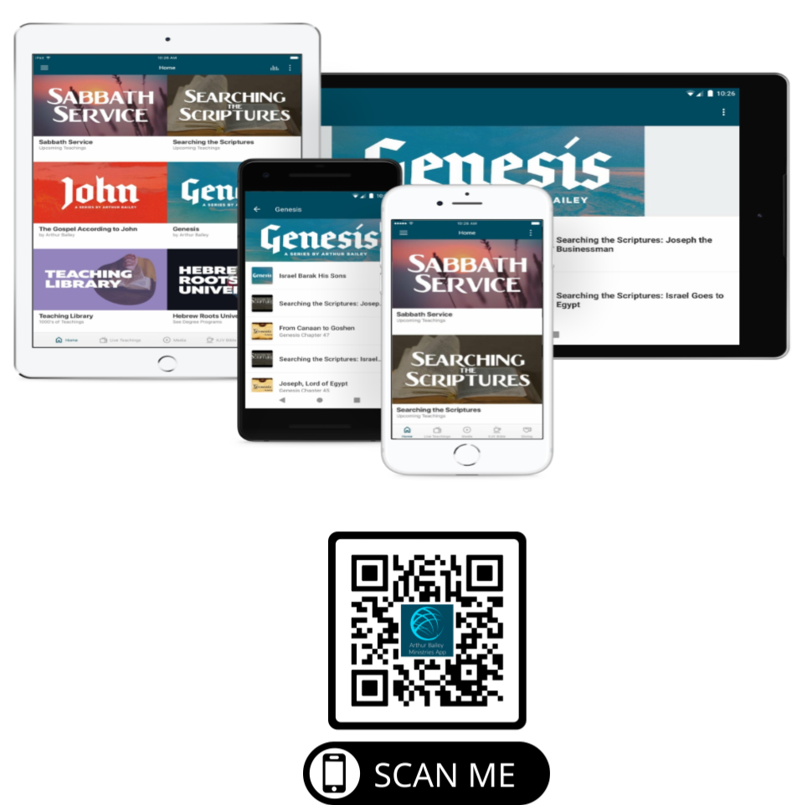

Slide 85
Mail in your support by check or money order.
Our Mailing Address:
P O Box 1182
Fort Mill, SC 29716

Slide 86
You can give by
Texting
Donate – Tithe - Offering
to
704-810-1579

Slide 87
