Slide 3
TODAY’S MESSAGE
Mark 1:1-13
Repentance, Confession and Forgiveness of Sin

Slide 4
Please Subscribe for Updates on our Website.
Watch us on YouTube.
Follow us on Facebook and the
other Social Media Networks.
Please Like and Share our Videos
and Posts.

Slide 5
At the end of today’s Teaching, you will be able to 1. Ask Questions 2. Receive Prayer 3. Give your Tithes and Offerings

Slide 6
The Vision of House of Israel is to be: 1. A Worshipping People (John 4:23-24) 2. An Evangelistic Community (Acts 2:42-47)

Slide 7
3. A Discipleship Center (Matthew 28:19) 4. An Equipping Network (Ephesians 4:12) 5. And a Worldwide Witness for Yeshua The Messiah
(Acts 1:8)

Slide 9
Prayer

Slide 10
TODAY’S MESSAGE
Mark 1:1-13
Repentance, Confession and Forgiveness of Sin

Slide 11
Repentance of sins and confession of sins are, and have always been, key components of receiving forgiveness of sins and activating the grace of God through Messiah Yeshua that brings salvation since the days of the Prophets and John the Baptist. The opening verses of the Gospel according to Mark lay the foundation for receiving YeHoVaH’s forgiveness of sins and receiving the Holy Spirit that empowers Believers to live a Godly life.

Slide 12
Mark informs us in his opening statement that the focus of his writing is the Gospel of Yeshua the Messiah and that He is the Son of Elohim. He will reveal that the Gospel of Yeshua is the good news that Yeshua preached and taught.
Yeshua’s preaching will reveal that what is written about Him is found in the Torah, the Writings, the Prophets, and found in the Bible from Genesis to Revelation.

Slide 13
^{Mk 1:1} The beginning of the gospel of Yeshua Messiah, the Son of God;

Slide 14
The word Gospel in the Greek is:
2098 εὐαγγέλιον euaggelion {yoo-ang-ghel'-ee-on} Meaning: 1) a reward for good tidings 2) good tidings 2a) the glad tidings of the kingdom of God soon to be set up, and subsequently also of Yeshua the Messiah, the founder of this kingdom. After the death of Messiah, the term comprises also the preaching of (concerning) Yeshua Messiah as having suffered death on the cross to…

Slide 15
…procure eternal salvation for the men in the kingdom of God, but as restored to life and exalted to the right hand of God in heaven, thence to return in majesty to consummate the kingdom of God 2b) the glad tidings of salvation through Messiah 2c) the proclamation of the grace of God manifest and pledged in Messiah 2d) the gospel

Slide 16
2e) as the messianic rank of Yeshua was proved by his words, his deeds, and his death, the narrative of the sayings, deeds, and death of Yeshua Messiah came to be called the gospel or glad tidings
Usage: AV - gospel 46, gospel of Messiah 11, gospel of God 7, gospel of the Kingdom 3, misc 10; 77

Slide 17
Throughout the New Testament, the Gospel is also referred to as:
“The Word of the Lord”
^{Ac 8:25} And they, when they had testified and preached the word of the Lord, returned to Jerusalem, and preached the gospel in many villages of the Samaritans.

Slide 18
"The Gospel of the Grace of God"
^{Ac 20:24} But none of these things move me, neither count I my life dear unto myself, so that I might finish my course with joy, and the ministry, which I have received of the Lord Yeshua, to testify the gospel of the grace of God.

Slide 19
"The Gospel of God,"
(Ro 1:1-2; 1Th 2:2, 9)
^{Ro 1:1} Paul, a servant of Yeshua Messiah, called to be an apostle, separated unto the gospel of God, ^{Ro 1:2} (Which he had promised afore by his prophets in the holy scriptures,)

Slide 20
^{1Th 2:2} But even after that we had suffered before, and were shamefully entreated, as ye know, at Philippi, we were bold in our God to speak unto you the gospel of God with much contention.
^{1Th 2:9} For ye remember, brethren, our labour and travail: for labouring night and day, because we would not be chargeable unto any of you, we preached unto you the gospel of God.

Slide 21
“The Word of God”
^{1Th 2:13} For this cause also thank we God without ceasing, because, when ye received the word of God which ye heard of us, ye received it not as the word of men, but as it is in truth, the word of God, which effectually worketh also in you that believe.

Slide 22
"The Glorious Gospel"
^{2Co 4:4} In whom the god of this world hath blinded the minds of them which believe not, lest the light of the glorious gospel of Messiah, who is the image of God, should shine unto them.
^{1Ti 1:11} According to the glorious gospel of the blessed God, which was committed to my trust.

Slide 23
"The Gospel of Your Salvation"
^{Eph 1:13} In whom ye also trusted, after that ye heard the word of truth, the gospel of your salvation: in whom also after that ye believed, ye were sealed with that holy Spirit of promise,

Slide 24
“The Gospel of Peace"
^{Eph 6:15} And your feet shod with the preparation of the gospel of peace;
“The Everlasting Gospel”
^{Rev 14:6} And I saw another angel fly in the midst of heaven, having the everlasting gospel to preach unto them that dwell on the earth, and to every nation, and kindred, and tongue, and people,

Slide 25
Mark also reveals that the beginning of the Gospel of Yeshua originated in the writings of the Prophets. In the first eight verses of Mark, he will quote and reference writings from several Prophets.
The Greek word for Gospel comes from the Hebrew word tidings, good tidings.

Slide 26
Good Tidings – 01319 בּשׂר basar {baw-sar'}
Meaning: 1) to bear news, bear tidings, publish, preach, show forth 1a) (Piel) 1a1) to gladden with good news 1a2) to bear news 1a3) to announce (salvation) as good news, preach 1b) (Hithpael) to receive good news
Usage: AV - tidings 16, show forth 3, publish 3, messenger 1, preached 1; 24

Slide 27
^{Isa 52:6} Therefore my people shall know my name: therefore they shall know in that day that I am he that doth speak: behold, it is I.
^{Isa 52:7} How beautiful upon the mountains are the feet of him that bringeth good tidings, that publisheth peace; that bringeth good tidings of good, that publisheth salvation; that saith unto Zion, Thy God reigneth!

Slide 28
^{Isa 61:1} The Spirit of YeHoVaH GOD is upon me; because YeHoVaH hath anointed me to preach good tidings unto the meek; he hath sent me to bind up the brokenhearted, to proclaim liberty to the captives, and the opening of the prison to them that are bound; ^{Isa 61:2} To proclaim the acceptable year of YeHoVaH, and the day of vengeance of our God; to comfort all that mourn;

Slide 29
Luke records that Yeshua read from the Prophet Isaiah:
^{Lk 4:17} And there was delivered unto him the book of the prophet Esaias. And when he had opened the book, he found the place where it was written,

Slide 30
^{Lk 4:18} The Spirit of YeHoVaH is upon me, because he hath anointed me to preach the gospel to the poor; he hath sent me to heal the brokenhearted, to preach deliverance to the captives, and recovering of sight to the blind, to set at liberty them that are bruised,
^{Lk 4:19} To preach the acceptable year of YeHoVaH.

Slide 31
^{Mk 1:2} As it is written in the prophets, Behold, I send my messenger before thy face, which shall prepare thy way before thee.

Slide 32
Some Bible versions say, as it is written in the Prophet Isaiah.
^{Isa 40:3} The voice of him that crieth in the wilderness, Prepare ye the way of YeHoVaH, make straight in the desert a highway for our God.

Slide 33
However, the KJV has “Prophets” because it is also written in Malachi who gives a fuller description of the messenger’s task and the One who will come after the messenger.

Slide 34
^{Mal 3:1} Behold, I will send my messenger, and he shall prepare the way before me: and YeHoVaH, whom ye seek, shall suddenly come to his temple, even the messenger of the covenant, whom ye delight in: behold, he shall come, saith YeHoVaH of hosts.

Slide 35
^{Mk 1:3} The voice of one crying in the wilderness, Prepare ye the way of YeHoVaH, make his paths straight.
^{Mk 1:4} John did baptize in the wilderness, and preach the baptism of repentance for the remission of sins.

Slide 36
Baptize – 907 βαπτίζω baptizo {bap-tid'-zo}
Meaning: 1) to dip repeatedly, to immerse, to submerge (of vessels sunk) 2) to cleanse by dipping or submerging, to wash, to make clean with water, to wash one's self, bathe 3) to overwhelm

Slide 37
Baptism – 908 βάπτισμα baptisma {bap'-tis-mah}
Meaning: 1) immersion, submersion 1a) of calamities and afflictions with which one is quite overwhelmed 1b) of John's baptism, that purification rite by which men on confessing their sins were bound to spiritual reformation, obtained the pardon of their past sins and became qualified for the benefits of the Messiah's kingdom soon to be set up.

Slide 38
Repentence – 3341 μετάνοια metanoia {met-an'-oy-ah}
Meaning: 1) a change of mind, as it appears to one who repents, of a purpose he has formed or of something he has done
Usage: AV - repentance 24; 24

Slide 39
Remission – 859 ἄφεσις aphesis {af'-es-is}
Meaning: 1) release from bondage or imprisonment 2) forgiveness or pardon, of sins (letting them go as if they had never been committed), remission of the penalty
Usage: AV - remission 9, forgiveness 6, deliverance 1, liberty 1; 17

Slide 40
Sins – 266 ἁμαρτία hamartia {ham-ar-tee'-ah}
Meaning: 1) equivalent to 264 1a) to be without a share in 1b) to miss the mark 1c) to err, be mistaken 1d) to miss or wander from the path of uprightness and honour, to do or go wrong 1e) to wander from the law of God, violate God's law, sin 2) that which is done wrong, sin, an offence, a violation of the divine law in thought or in act 3) collectively, the complex or aggregate of sins committed either by a single person or by many
Usage: AV - sin 172, sinful 1, offense 1; 174

Slide 41
1st John defines sin as:
^{1Jn 3:3} And every man that hath this hope in him purifieth himself, even as he is pure.
^{1Jn 3:4} Whosoever committeth sin transgresseth also the law: for sin is the transgression of the law.
^{1Jn 3:5} And ye know that he was manifested to take away our sins; and in him is no sin.

Slide 42
^{1Jn 3:6} Whosoever abideth in him sinneth not: whosoever sinneth hath not seen him, neither known him.
^{1Jn 3:7} Little children, let no man deceive you: he that doeth righteousness is righteous, even as he is righteous.
^{1Jn 3:8} He that committeth sin is of the devil; for the devil sinneth from the beginning. For this purpose the Son of God was manifested, that he might destroy the works of the devil.

Slide 43
^{1Jn 3:9} Whosoever is born of God doth not commit sin; for his seed remaineth in him: and he cannot sin, because he is born of God.
^{1Jn 3:10} In this the children of God are manifest, and the children of the devil: whosoever doeth not righteousness is not of God, neither he that loveth not his brother.

Slide 44
John did not mikvah, he baptized!
John preached and baptized a baptism of repentance for the remission of sin.
Mark gives us the geographical location of where John baptized and preached:

Slide 45
^{Mk 1:5} And there went out unto him all the land of Judaea, and they of Jerusalem, and were all baptized of him in the river of Jordan, confessing their sins.
^{Mk 1:6} And John was clothed with camel's hair, and with a girdle of a skin about his loins; and he did eat locusts and wild honey;

Slide 46
Mark describes how John dressed was also the way Elijah dressed.
^{2Ki 1:7} And he said unto them, What manner of man was he which came up to meet you, and told you these words?
^{2Ki 1:8} And they answered him, He was an hairy man, and girt with a girdle of leather about his loins. And he said, It is Elijah the Tishbite.

Slide 47
Other prophets dressed similarly.
^{ZEC 13:4} “Also it will come about in that day that the prophets will each be ashamed of his vision when he prophesies, and they will not put on a hairy robe in order to deceive; (NASB)

Slide 48
Yeshua called John a Prophet:
^{Mt 11:7} And as they departed, Yeshua began to say unto the multitudes concerning John, What went ye out into the wilderness to see? A reed shaken with the wind?

Slide 49
^{Mt 11:8} But what went ye out for to see? A man clothed in soft raiment? behold, they that wear soft clothing are in kings' houses. ^{Mt 11:9} But what went ye out for to see? A prophet? yea, I say unto you, and more than a prophet. ^{Mt 11:10} For this is he, of whom it is written, Behold, I send my messenger before thy face, which shall prepare thy way before thee.

Slide 50
^{Mk 1:7} And preached, saying, There cometh one mightier than I after me, the latchet of whose shoes I am not worthy to stoop down and unloose.
The Prophets prophesied about a Prophet who would prepare the way and preach about The Prophet.

Slide 51
^{Mk 1:8} I indeed have baptized you with water: but he shall baptize you with the Holy Ghost.
^{Mk 1:9} And it came to pass in those days, that Yeshua came from Nazareth of Galilee, and was baptized of John in Jordan.
^{Mk 1:10} And straightway coming up out of the water, he saw the heavens opened, and the Spirit like a dove descending upon him:

Slide 52
^{Mk 1:11} And there came a voice from heaven, saying, Thou art my beloved Son, in whom I am well pleased.
According to the Gospel of John, this was done to reveal to John the Baptist who Yeshua the Messiah, the Son of God, was.

Slide 53
^{Jn 1:29} The next day John seeth Yeshua coming unto him, and saith, Behold the Lamb of God, which taketh away the sin of the world.
^{Jn 1:30} This is he of whom I said, After me cometh a man which is preferred before me: for he was before me.
^{Jn 1:31} And I knew him not: but that he should be made manifest to Israel, therefore am I come baptizing with water.

Slide 54
^{Jn 1:32} And John bare record, saying, I saw the Spirit descending from heaven like a dove, and it abode upon him.
^{Jn 1:33} And I knew him not: but he that sent me to baptize with water, the same said unto me, Upon whom thou shalt see the Spirit descending, and remaining on him, the same is he which baptizeth with the Holy Ghost.

Slide 55
^{Mk 1:12} And immediately the Spirit driveth him into the wilderness.

Slide 56
Mark wrote that Yeshua was driven by the Spirit.
Luke wrote that Yeshua was led by the Spirit.

Slide 57
^{Lk 4:1} And Yeshua being full of the Holy Ghost returned from Jordan, and was led by the Spirit into the wilderness,
^{Lk 4:2} Being forty days tempted of the devil. And in those days he did eat nothing: and when they were ended, he afterward hungered.

Slide 58
^{Mk 1:13} And he was there in the wilderness forty days, tempted of Satan; and was with the wild beasts; and the angels ministered unto him.

Slide 59
Tempted – 3985 πειράζω peirazo {pi-rad'-zo} Meaning: 1) to try whether a thing can be done 1a) to attempt, endeavour 2) to try, make trial of, test: for the purpose of ascertaining his quantity, or what he thinks, or how he will behave himself 2a) in a good sense 2b) in a bad sense, to test one maliciously, craftily to put to the proof his feelings or judgments

Slide 60
2c) to try or test one's faith, virtue, character, by enticement to sin 2c1) to solicit to sin, to tempt 1c1a) of the temptations of the devil 2d) after the OT usage 2d1) of God: to inflict evils upon one in order to prove his character and the steadfastness of his faith 2d2) men are said to tempt God by exhibitions of distrust, as though they wished to try whether he is not justly distrusted Usage: AV - tempt 29, try 4, tempter 2, prove 1, assay 1, examine 1, go about 1; 39

Slide 61
Satan was used by YeHoVaH to inflict evil upon Him to prove Yeshua’s character.
YeHoVaH used Satan to test Job.

Slide 62
^{Job 1:7} And YeHoVaH said unto Satan, Whence comest thou? Then Satan answered YeHoVaH, and said, From going to and fro in the earth, and from walking up and down in it. ^{Job 1:8} And YeHoVaH said unto Satan, Hast thou considered my servant Job, that there is none like him in the earth, a perfect and an upright man, one that feareth God, and escheweth evil?

Slide 63
Perfect – 08535 תָּם tam {tawm}
Meaning: 1) perfect, complete 1a) complete, perfect 1a1) one who lacks nothing in physical strength, beauty, etc 1b) sound, wholesome 1b1) an ordinary, quiet sort of person 1c) complete, morally innocent, having integrity 1c1) one who is morally and ethically pure
Usage: AV - perfect 9, undefiled 2, plain 1, upright 1; 13

Slide 64
^{Job 1:9} Then Satan answered YeHoVaH, and said, Doth Job fear God for nought?
^{Job 1:10} Hast not thou made an hedge about him, and about his house, and about all that he hath on every side? thou hast blessed the work of his hands, and his substance is increased in the land.

Slide 65
^{Job 1:11} But put forth thine hand now, and touch all that he hath, and he will curse thee to thy face.
In the New Testament, the Gospel never means simply a Book, but rather the message which Messiah and His Apostles announced.
In some places it is called:

Slide 66
The Word of the Lord
The Gospel of the Grace of God
The Gospel of God
The Word of God
The Glorious Gospel
The Gospel of Your Salvation
The Gospel of Peace
The Everlasting Gospel

Slide 67
Your support is greatly appreciated and needed.

Slide 69
Our Preferred
Donation Methods:

Slide 70
CashApp – $ABMHOI
Venmo – @Arthur-Bailey-10
Zelle – apostlea@gmail.com

Slide 71
Question and Answer
Period

Slide 72
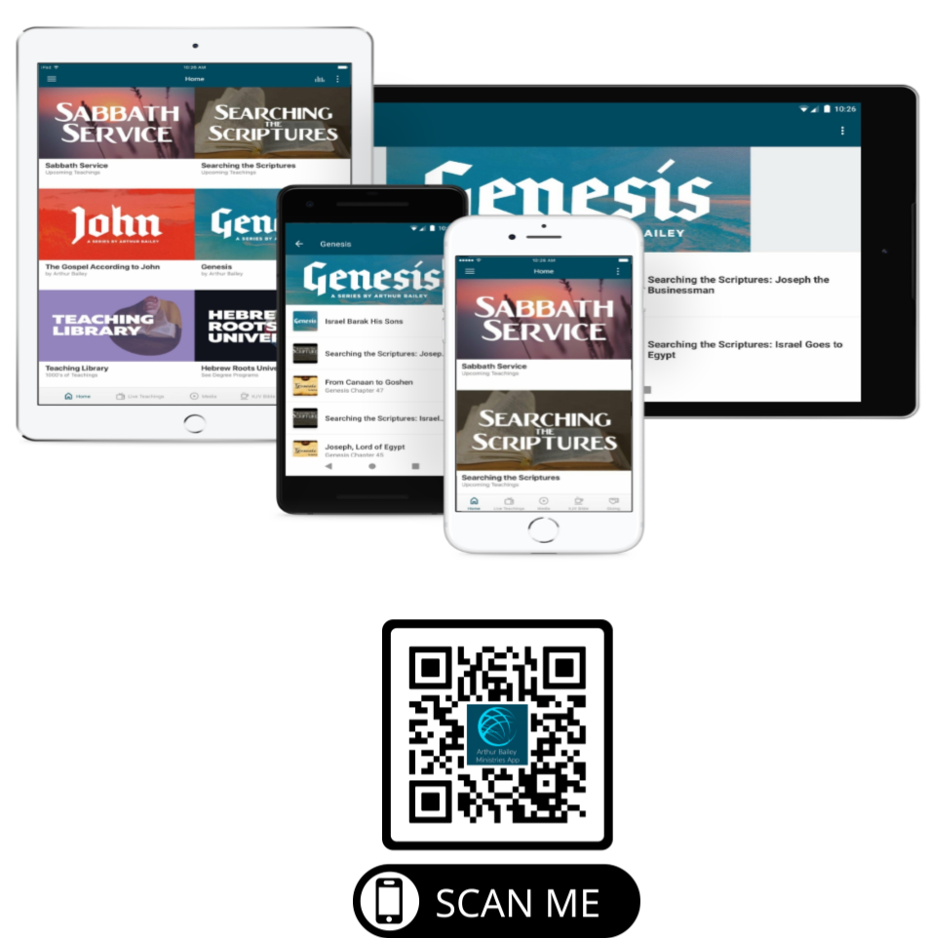

Slide 73
Mail in your support by check or money order.
Our Mailing Address:
P O Box 1182
Fort Mill, SC 29716

Slide 74
You can give by
Texting
Donate – Tithe - Offering
to
704-810-1579

