Slide 3
TODAY’S MESSAGE
Mark 1:14-28
Repent and Believe the Gospel

Slide 4
Please Subscribe for Updates on our Website.
Watch us on YouTube.
Follow us on Facebook and the
other Social Media Networks.
Please Like and Share our Videos
and Posts.

Slide 5
At the end of today’s Teaching, you will be able to 1. Ask Questions 2. Receive Prayer 3. Give your Tithes and Offerings

Slide 6
The Vision of House of Israel is to be: 1. A Worshipping People (John 4:23-24) 2. An Evangelistic Community (Acts 2:42-47)

Slide 7
3. A Discipleship Center (Matthew 28:19) 4. An Equipping Network (Ephesians 4:12) 5. And a Worldwide Witness for Yeshua The Messiah
(Acts 1:8)

Slide 9
Prayer

Slide 10
TODAY’S MESSAGE
Mark 1:14-28
Repent and Believe the Gospel

Slide 11
The opening of Mark’s Gospel narrative of Yeshua’s Ministry introduces John the Baptist. John came baptizing and preaching a water baptism of repentance for the forgiveness of sins as the forerunner to announce the coming of The Messiah. John’s message made a clear distinction between his baptism in water and Yeshua who would baptize with the Holy Spirit.

Slide 12
In this teaching, we will examine Yeshua’s opening message as He presents the Gospel of the Kingdom and the prerequisite for believing it.

Slide 13
^{Mk 1:4} John did baptize in the wilderness, and preach the baptism of repentance for the remission of sins.
^{Mk 1:8} I indeed have baptized you with water: but he shall baptize you with the Holy Ghost.

Slide 14
Most people when they hear the word, or think of baptizing, only think of water baptism.
The Gospels teach about three different baptisms.

Slide 15
Water Baptism
Holy Spirit Baptism
Yeshua speaks to His Disciples of another Baptism that He would be baptized with.
^{Lk 12:50} But I have a baptism to be baptized with; and how am I straitened till it be accomplished!

Slide 16
In the teaching series, The Foundations of our Faith which is an eight-part teaching, Baptisms (plural) are foundational teachings.

Slide 17
^{Mk 1:14} Now after that John was put in prison, Yeshua came into Galilee, preaching the gospel of the kingdom of God,

Slide 18
Why was the Prophet of God put in prison?
^{Lk 3:19} But Herod the tetrarch, being reproved by him for Herodias his brother Philip's wife, and for all the evils which Herod had done,
^{Lk 3:20} Added yet this above all, that he shut up John in prison.

Slide 19
The Torah teaches that a man may not take his brother’s wife while the brother is alive.
^{Lev 18:16} “ ‘Do not have sexual relations with your brother’s wife; that would dishonor your brother.
^{Lev 20:21} And if a man shall take his brother's wife, it is an unclean thing: he hath uncovered his brother's nakedness; they shall be childless.

Slide 20
^{Mt 14:3} For Herod had laid hold on John, and bound him, and put him in prison for Herodias' sake, his brother Philip's wife.
^{Mt 14:4} For John said unto him, It is not lawful for thee to have her.
^{Mt 14:5} And when he would have put him to death, he feared the multitude, because they counted him as a prophet.

Slide 21
^{Mt 14:6} But when Herod's birthday was kept, the daughter of Herodias danced before them, and pleased Herod.
^{Mt 14:7} Whereupon he promised with an oath to give her whatsoever she would ask.
^{Mt 14:8} And she, being before instructed of her mother, said, Give me here John Baptist's head in a charger.

Slide 22
^{Mt 14:9} And the king was sorry: nevertheless for the oath's sake, and them which sat with him at meat, he commanded it to be given her.
^{Mt 14:10} And he sent, and beheaded John in the prison.
^{Mt 14:11} And his head was brought in a charger, and given to the damsel: and she brought it to her mother.
^{Mt 14:12} And his disciples came, and took up the body, and buried it, and went and told Yeshua.

Slide 23
However:
^{Dt 25:5} If brethren dwell together, and one of them die, and have no child, the wife of the dead shall not marry without unto a stranger: her husband's brother shall go in unto her, and take her to him to wife, and perform the duty of an husband's brother unto her.

Slide 24
^{Dt 25:6} And it shall be, that the firstborn which she beareth shall succeed in the name of his brother which is dead, that his name be not put out of Israel.

Slide 25
Herodias wasn’t the first woman who went after the Prophets of God.
Jezebel slew the Prophets of YeHoVaH.
^{1Ki 18:13} Was it not told my lord what I did when Jezebel slew the prophets of the LORD, how I hid an hundred men of the LORD'S prophets by fifty in a cave, and fed them with bread and water?

Slide 26
Another Jezebel shows up in Revelation that will lead YeHoVaH’s people astray, claiming to be a Prophet herself.
^{Rev 2:18} And unto the angel of the church in Thyatira write; These things saith the Son of God, who hath his eyes like unto a flame of fire, and his feet are like fine brass;

Slide 27
^{Rev 2:19} I know thy works, and charity, and service, and faith, and thy patience, and thy works; and the last to be more than the first.
^{Rev 2:20} Notwithstanding I have a few things against thee, because thou sufferest that woman Jezebel, which calleth herself a prophetess, to teach and to seduce my servants to commit fornication, and to eat things sacrificed unto idols.

Slide 28
^{Rev 2:21} And I gave her space to repent of her fornication; and she repented not.
^{Rev 2:22} Behold, I will cast her into a bed, and them that commit adultery with her into great tribulation, except they repent of their deeds.

Slide 29
^{Rev 2:23} And I will kill her children with death; and all the churches shall know that I am he which searcheth the reins and hearts: and I will give unto every one of you according to your works.

Slide 30
Since the beginning of mankind, women have been instrumental in getting men to rebel against YeHoVaH, challenging the men of God, trying to influence, mislead, and even seducing men into doing their will to the detriment of themselves and their children.

Slide 31
Children tend to be more sensitive to their mothers; they watch and follow their mothers more so than their fathers, and even rise up against their fathers while siding with their mothers.
Sayings like:
“Happy wife, happy life.”
“Men are the head, but women are the necks that turn the heads.”

Slide 32
Many pastors and preachers tend to cater to the women in their ministries and rightly so because women are considered the weaker vessel.
However, they must not hesitate to call women out, just as they would call men out, when they are wrong and going against the Word of YeHoVaH!

Slide 33
Herod was a weak man.
It takes a strong man to stand with God.
John was an example of a strong man.

Slide 34
^{Mk 1:14} Now after that John was put in prison, Yeshua came into Galilee, preaching the gospel of the kingdom of God,
^{Mk 1:15} And saying, The time is fulfilled, and the kingdom of God is at hand: repent ye, and believe the gospel.

Slide 35
Repent – 3340 μετανοέω metanoeo {met-an-o-eh'-o}
Meaning: 1) to change one's mind, i.e. to repent 2) to change one's mind for better, heartily to amend with abhorrence of one's past sins
Usage: AV - repent 34; 34
Misc: For Synonyms see entry 5862

Slide 36
Believe – 4100 πιστεύω pisteuo {pist-yoo'-o}
Meaning: 1) to think to be true, to be persuaded of, to credit, place confidence in 1a) of the thing believed 1a1) to credit, have confidence 1b) in a moral or religious reference 1b1) used in the NT of the conviction and trust to which a man is impelled by a certain inner and higher prerogative and law of soul

Slide 37
1b2) to trust in Yeshua or God as able to aid either in obtaining or in doing something: saving faith 1bc) mere acknowledgment of some fact or event: intellectual faith 2) to entrust a thing to one, i.e. his fidelity 2a) to be intrusted with a thing
Usage: AV - believe 239, commit unto 4, commit to (one's) trust 1, be committed unto 1, be put in trust with 1, be commit to one's trust 1, believer 1; 248

Slide 38
For the people to believe the teachings Yeshua taught:
They had to change their minds about what they had believed based on what they had been taught by the Pharisees, Sadducees, Scribes, and Herod.
They had to believe, or put their trust in, and commit to the Gospel Yeshua taught.

Slide 39
The year Yeshua began His public Ministry, Israel had wandered off the path of righteousness and away from the Law of YeHoVaH.

Slide 40
Israel had become like the nations around them.
Israel was under Roman occupation.
The Priesthood was in disarray.
Israel had established a synagogue system that was established in Babylon.

Slide 41
The people feared the Roman government, Herod, the synagogue leaders, the Pharisees, and the Sadducees more than they feared YeHoVaH.
The people were following the teachings of the Pharisees, Sadducees, and the political systems of the day that had been sanctioned by Rome.

Slide 42
Yeshua would warn the people to beware of those doctrinal or systems of leaven.

Slide 43
^{Mt 16:11} How is it that ye do not understand that I spake it not to you concerning bread, that ye should beware of the leaven of the Pharisees and of the Sadducees?
^{Mt 16:12} Then understood they how that he bade them not beware of the leaven of bread, but of the doctrine of the Pharisees and of the Sadducees.

Slide 44
^{Mk 8:15} And he charged them, saying, Take heed, beware of the leaven of the Pharisees, and of the leaven of Herod.

Slide 45
^{Mk 1:16} Now as he walked by the sea of Galilee, he saw Simon and Andrew his brother casting a net into the sea: for they were fishers.
^{Mk 1:17} And Yeshua said unto them, Come ye after me, and I will make you to become fishers of men.

Slide 46
Something to consider:
Simon and Andrew did not use bait and hook to catch fish.

Slide 47
^{Mk 1:18} And straightway they forsook their nets, and followed him.
^{Mk 1:19} And when he had gone a little farther thence, he saw James the son of Zebedee, and John his brother, who also were in the ship mending their nets.

Slide 48
^{Mk 1:20} And straightway he called them: and they left their father Zebedee in the ship with the hired servants, and went after him.

Slide 49
They left their father, hired servants, and ship.
^{Mk 1:21} And they went into Capernaum; and straightway on the sabbath day he entered into the synagogue, and taught.

Slide 50
In the Gospel according to Luke, we read:
^{Lk 4:16} And he came to Nazareth, where he had been brought up: and, as his custom was, he went into the synagogue on the sabbath day, and stood up for to read.

Slide 51
^{Mk 1:22} And they were astonished at his doctrine: for he taught them as one that had authority, and not as the scribes.

Slide 52
Doctrine – 1322 διδαχή didache {did-akh-ay'}
Meaning: 1) teaching 1a) that which is taught 1b) doctrine, teaching, concerning something 2) the act of teaching, instruction 2a) in religious assemblies of the Christians, to speak in the way of teaching, in distinction from other modes of speaking in public
Usage: AV - doctrine 29, has been taught 1; 30

Slide 53
Authority – 1849 ἐξουσία exousia {ex-oo-see'-ah}
Meaning: 1) power of choice, liberty of doing as one pleases 1a) leave or permission 2) physical and mental power 2a) the ability or strength with which one is endued, which he either possesses or exercises 3) the power of authority (influence) and of right (privilege)

Slide 54
4) the power of rule or government (the power of him whose will and commands must be submitted to by others and obeyed) 4a) universally 4a1) authority over mankind 4b) specifically 4b1) the power of judicial decisions
Usage: AV - power 69, authority 29, right 2, liberty 1, jurisdiction 1, strength 1; 103

Slide 55
I’m amazed when so-called believers talk about the doctrine of free will. The people of the world may exercise free will, but Yeshua said that His mother and brothers are those that do the will of God.

Slide 56
^{Mk 3:33} And he answered them, saying, Who is my mother, or my brethren?
^{Mk 3:34} And he looked round about on them which sat about him, and said, Behold my mother and my brethren!
^{Mk 3:35} For whosoever shall do the will of God, the same is my brother, and my sister, and mother.

Slide 57
Scribes – 1122 γραμματεύς grammateus {gram-mat-yooce'}
Meaning: 1) a clerk, scribe, esp.a public servant, secretary, recorder, whose office and influence differed in different states 2) in the Bible, a man learned in the Mosaic law and in the sacred writings, an interpreter, teacher.

Slide 58
Scribes examined the more difficult and subtle questions of the law; added to the Mosaic law decisions of various kinds thought to elucidate its meaning and scope, and did this to the detriment of religion. Since the advice of men skilled in the law was needed in the examination in the causes and the solution of the difficult questions, they were enrolled in the Sanhedrin; and are mentioned in connection with the priests and elders of the people.

Slide 59
See a Bible Dictionary for more information on the scribes. 3) a religious teacher: so instructed that from his learning and ability to teach advantage may redound to the kingdom of heaven
Usage: AV - scribe 66, townclerk 1; 67

Slide 60
^{Mk 1:23} And there was in their synagogue a man with an unclean spirit; and he cried out,
^{Mk 1:24} Saying, Let us alone; what have we to do with thee, thou Yeshua of Nazareth? art thou come to destroy us? I know thee who thou art, the Holy One of God.

Slide 61
The unclean spirit spoke through the man. Yeshua rebuked the spirit and commanded it to leave the man.
^{Mk 1:25} And Yeshua rebuked him, saying, Hold thy peace, and come out of him.
^{Mk 1:26} And when the unclean spirit had torn him, and cried with a loud voice, he came out of him.

Slide 62
^{Mk 1:27} And they were all amazed, insomuch that they questioned among themselves, saying, What thing is this? what new doctrine is this? for with authority commandeth he even the unclean spirits, and they do obey him.
The people were amazed at what Yeshua did and taught but questioned amongst themselves instead of asking their questions to Yeshua.

Slide 63
^{Mk 1:28} And immediately his fame spread abroad throughout all the region round about Galilee.

Slide 64
Fame – 189 ἀκοή akoe {ak-o-ay'}
Meaning: 1) the sense of hearing 2) the organ of hearing, the ear 3) the thing heard 3a) instruction, namely oral 3a1) of preaching the gospel 3b) hearsay, report or rumour
Usage: AV - hearing 10, ears 4, fame 3, rumour 2, report 2, audience 1, misc 2; 24

Slide 65
People began to say things about Yeshua.
Luke wrote:

Slide 66
^{Lk 7:12} Now when he came nigh to the gate of the city, behold, there was a dead man carried out, the only son of his mother, and she was a widow: and much people of the city was with her.
^{Lk 7:13} And when the Lord saw her, he had compassion on her, and said unto her, Weep not.

Slide 67
^{Lk 7:14} And he came and touched the bier: and they that bare him stood still. And he said, Young man, I say unto thee, Arise.
^{Lk 7:15} And he that was dead sat up, and began to speak. And he delivered him to his mother.

Slide 68
^{Lk 7:16} And there came a fear on all: and they glorified God, saying, That a great prophet is risen up among us; and, That God hath visited his people.
^{Lk 7:17} And this rumour of him went forth throughout all Judaea, and throughout all the region round about.
^{Lk 7:18} And the disciples of John showed him of all these things.

Slide 69
Your support is greatly appreciated and needed.

Slide 71
Our Preferred
Donation Methods:

Slide 72
CashApp – $ABMHOI
Venmo – @Arthur-Bailey-10
Zelle – apostlea@gmail.com

Slide 73
Question and Answer
Period

Slide 74
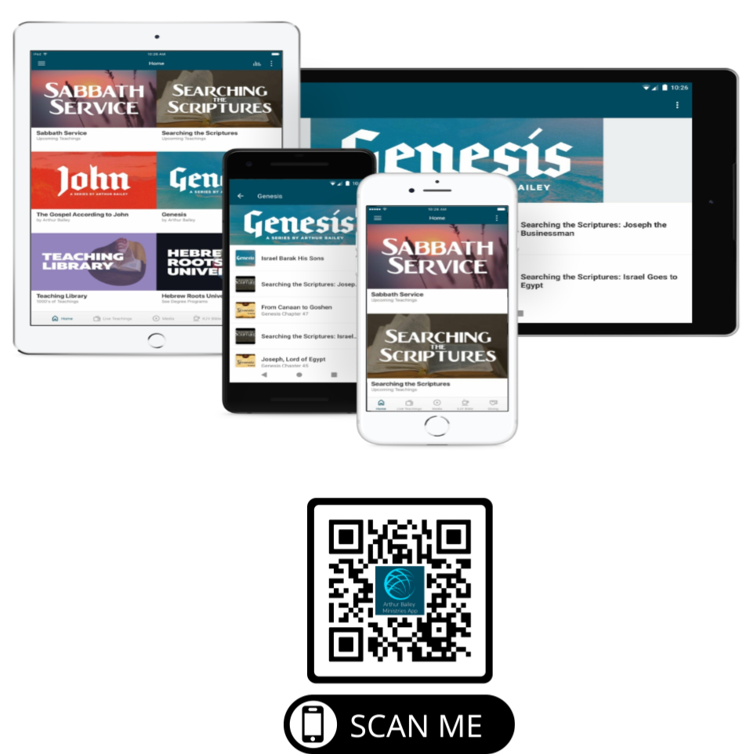

Slide 75
Mail in your support by check or money order.
Our Mailing Address:
P O Box 1182
Fort Mill, SC 29716

Slide 76
You can give by
Texting
Donate – Tithe - Offering
to
704-810-1579

