Slide 3
TODAY’S MESSAGE
Mark 1:29-45
Ministering Healing and Being Healed

Slide 4
Please Subscribe for Updates on our Website.
Watch us on YouTube.
Follow us on Facebook and the
other Social Media Networks.
Please Like and Share our Videos
and Posts.

Slide 5
At the end of today’s Teaching, you will be able to 1. Ask Questions 2. Receive Prayer 3. Give your Tithes and Offerings

Slide 6
The Vision of House of Israel is to be: 1. A Worshipping People (John 4:23-24) 2. An Evangelistic Community (Acts 2:42-47)

Slide 7
3. A Discipleship Center (Matthew 28:19) 4. An Equipping Network (Ephesians 4:12) 5. And a Worldwide Witness for Yeshua The Messiah
(Acts 1:8)

Slide 9
Prayer

Slide 10
TODAY’S MESSAGE
Mark 1:29-45
Ministering Healing and Being Healed

Slide 11
Trust YeHoVaH for your healing and deliverance today while the message goes forth.
Trust YeHoVaH to speak to you today and be filled with His Spirit!

Slide 12
When reading about the Ministry of Yeshua and the Gospel Yeshua taught, we must always keep in mind that Yeshua taught two ways.
Yeshua taught by what He did and by what He said.
Ministering Healing was a key aspect of Yeshua’s Ministry of Deeds as He taught and prepared His Disciples for Ministry.

Slide 13
Mark focused on Yeshua’s deeds and revealed several keys and motivations behind Yeshua’s Healing Ministry and what was required by those being healed by Him.
In this portion of Mark’s Gospel, we’re going to see several keys to Ministering Healing and being healed.

Slide 14
When Yeshua cast out demons, it was typically at the request of others.
In the case of the demon in the man in the synagogue in Verses 22-26, the demon called Yeshua out and exposed Him to others while putting itself on display. Yeshua’s response was to shut the demon up and cast it out.

Slide 15
Healing requires faith on behalf of both parties. Faith is required of the person being used to heal; and faith is required of the person being healed.
Yeshua did not go looking for people to heal. They were brought to Him, came to Him, or others inquired of Yeshua on their behalf. He did not go to the hospital, to mental institutions, or any place looking for people to heal. People were brought to him.

Slide 16
Yeshua’s prayer life was personal and private.
Often times when He prayed, He prayed alone, not in a group, and not with His Disciples until they asked Him to teach them how to pray.

Slide 17
When He took them with Him, He would have them wait in a certain place and He would go on a little further.
An active prayer life is an essential part of ministry: prayer to YeHoVaH/God for the power of His Spirit to operate and manifest in our lives.

Slide 18
Keys to Yeshua’s Ministry with Power and Authority
He was filled with the Holy Spirit.
He had knowledge of the Law and the Writings.
In His wilderness experience, He resisted the temptation of the devil using His knowledge of the Law and the Writings.
Yeshua worked in agreement with the Law and honored the Instructions given by His Father, who is in heaven.

Slide 19
Yeshua’s pattern is the example we will need to live our lives by if we are to walk in power and authority.
The devil tries to usurp our power and authority as he did with the first Adam in the garden who gave place to the devil and disobeyed YeHoVaH’s Instructions.

Slide 20
^{Romans 6:16} Know ye not, that to whom ye yield yourselves servants to obey, his servants ye are to whom ye obey; whether of sin unto death, or of obedience unto righteousness?
Our knowledge of the Word and the application of it is our greatest weapon as Spirit-filled Believers.

Slide 21
Just as Yeshua was filled with the Holy Spirit of YeHoVaH, it was His knowledge and use of the Word of YeHoVaH that made Him successful in defeating the devil.
Being Spirit-filled without the knowledge of the Word of YeHoVaH or the ability to use it, and without being obedient to the Word and Voice of YeHoVaH, as He leads us by His Spirit, will not bring us the kind of success Yeshua and His Disciples experienced.

Slide 22
^{Mk 1:29} And forthwith, when they were come out of the synagogue, they entered into the house of Simon and Andrew, with James and John.
^{Mk 1:30} But Simon's wife's mother lay sick of a fever, and anon they tell him of her.

Slide 23
Yeshua did not know Simon‘s wife’s mother was sick until somebody (“they tell Him of her”) came and told Him.
So, they brought her sickness to His attention, and He healed her.
Did He heal her without her consent?

Slide 24
^{Mk 1:31} And he came and took her by the hand, and lifted her up; and immediately the fever left her, and she ministered unto them.

Slide 25
Luke Wrote
^{Lk 4:38} And he arose out of the synagogue, and entered into Simon's house. And Simon's wife's mother was taken with a great fever; and they besought him for her.

Slide 26
Besought – 2065 ἐρωτάω erotao {er-o-tah'-o}
Meaning: 1) to question 2) to ask 2a) to request, entreat, beg, beseech
Usage: AV - ask 23, beseech 14, pray 14, desire 6, intreat 1; 58

Slide 27
^{Lk 4:39} And he stood over her, and rebuked the fever; and it left her: and immediately she arose and ministered unto them.

Slide 28
^{Mk 1:32} And at even, when the sun did set, they brought unto him all that were diseased, and them that were possessed with devils. ^{Mk 1:33} And all the city was gathered together at the door.
^{Mk 1:34} And he healed many that were sick of divers diseases, and cast out many devils; and suffered not the devils to speak, because they knew him.

Slide 29
Do the devils know you?
When you live and walk in the ordained power and authority as a Spirit-filled Believer, the devils know who you are, and they must obey.
You can’t fake it.

Slide 30
^{Ac 19:11} And God wrought special miracles by the hands of Paul: ^{Ac 19:12} So that from his body were brought unto the sick handkerchiefs or aprons, and the diseases departed from them, and the evil spirits went out of them. ^{Ac 19:13} Then certain of the vagabond Jews, exorcists, took upon them to call over them which had evil spirits the name of the Lord Yeshua, saying, We adjure you by Yeshua whom Paul preacheth.

Slide 31
You can’t just mimic what you see others do.
^{Ac 19:14} And there were seven sons of one Sceva, a Jew, and chief of the priests, which did so.
^{Ac 19:15} And the evil spirit answered and said, Yeshua I know, and Paul I know; but who are ye?

Slide 32
^{Ac 19:16} And the man in whom the evil spirit was leaped on them, and overcame them, and prevailed against them, so that they fled out of that house naked and wounded. ^{Ac 19:17} And this was known to all the Jews and Greeks also dwelling at Ephesus; and fear fell on them all, and the name of the Lord Yeshua was magnified.
^{Ac 19:18} And many that believed came, and confessed, and showed their deeds.

Slide 33
^{Mk 1:35} And in the morning, rising up a great while before day, he went out, and departed into a solitary place, and there prayed.
^{Mk 1:36} And Simon and they that were with him followed after him.
^{Mk 1:37} And when they had found him, they said unto him, All men seek for thee.

Slide 34
Found – 2147 εὑρίσκω heurisko {hyoo-ris'-ko}
Meaning: 1) to come upon, hit upon, to meet with 1a) after searching, to find a thing sought 1b) without previous search, to find (by chance), to fall in with 1c) those who come or return to a place 2) to find by enquiry, thought, examination, scrutiny, observation, to find out by practice and experience 2a) to see, learn, discover, understand 2b) to be found i.e. to be seen, be present Usage: AV - find 174, misc 4; 178

Slide 35
The Disciples went looking for Yeshua.
The Disciples told Yeshua, “All men seek for thee.”

Slide 36
Seek – 2212 ζητέω zeteo {dzay-teh'-o}
Meaning: 1) to seek in order to find 1a) to seek a thing 1b) to seek [in order to find out] by thinking, meditating, reasoning, to enquire into 1c) to seek after, seek for, aim at, strive after 2) to seek i.e. require, demand 2a) to crave, demand something from someone
Usage: AV - seek 100, seek for 5, go about 4, desire 3, misc 7; 119

Slide 37
^{Mk 1:38} And he said unto them, Let us go into the next towns, that I may preach there also: for therefore came I forth.

Slide 38
The Word of God is Powerful
^{Heb 4:12} For the word of God is quick, and powerful, and sharper than any twoedged sword, piercing even to the dividing asunder of soul and spirit, and of the joints and marrow, and is a discerner of the thoughts and intents of the heart.

Slide 39
The Gospel of the Kingdom was preached because of iniquity/lawlessness.
Yeshua worked in agreement with the Law and honored the Instructions given by His Father, who art in heaven.

Slide 40
^{Mt 24:12} And because iniquity shall abound, the love of many shall wax cold.

Slide 41
Iniquity – 458 ἀνομία anomia {an-om-ee'-ah}
Meaning: 1) the condition of without law 1a) because ignorant of it 1b) because of violating it 2) contempt and violation of law, iniquity, wickedness
Usage: AV - iniquity 12, unrighteousness 1, transgress the law + 4060 1, transgression of the law 1; 15

Slide 42
^{Mt 24:13} But he that shall endure unto the end, the same shall be saved.
^{Mt 24:14} And this gospel of the kingdom shall be preached in all the world for a witness unto all nations; and then shall the end come.

Slide 43
^{Mk 16:15} And he said unto them, Go ye into all the world, and preach the gospel to every creature.
^{Mk 16:16} He that believeth and is baptized shall be saved; but he that believeth not shall be damned.

Slide 44
^{Mk 16:17} And these signs shall follow them that believe; In my name shall they cast out devils; they shall speak with new tongues;
^{Mk 16:18} They shall take up serpents; and if they drink any deadly thing, it shall not hurt them; they shall lay hands on the sick, and they shall recover.

Slide 45
^{Mk 1:39} And he preached in their synagogues throughout all Galilee, and cast out devils.
^{Mk 1:40} And there came a leper to him, beseeching him, and kneeling down to him, and saying unto him, If thou wilt, thou canst make me clean.

Slide 46
Beseech – 3870 παρακαλέω parakaleo {par-ak-al-eh'-o}
Meaning: 1) to call to one's side, call for, summon 2) to address, speak to, (call to, call upon), which may be done in the way of exhortation, entreaty, comfort, instruction, etc. 2a) to admonish, exhort 2b) to beg, entreat, beseech 2b1) to strive to appease by entreaty 2c) to console, to encourage and strengthen by consolation, to comfort 2c1) to receive consolation, be comforted 2d) to encourage, strengthen 2e) exhorting and comforting and encouraging 2f) to instruct, teach
Usage: AV - beseech 43, comfort 23, exhort 21, desire 8, pray 6, intreat 3, misc 4, vr besought 1; 109

Slide 47
Cleansed – 2511 καθαρίζω katharizo {kath-ar-id'-zo}
Meaning: 1) to make clean, cleanse 1a) from physical stains and dirt 1a1) utensils, food 1a2) a leper, to cleanse by curing 1a3) to remove by cleansing 1b) in a moral sense 1b1) to free from defilement of sin and from faults 1b2) to purify from wickedness

Slide 48
1b3) to free from guilt of sin, to purify 1b4) to consecrate by cleansing or purifying 1b5) to consecrate, dedicate 2) to pronounce clean in a levitical sense
Usage: AV - cleanse 16, make clean 5, be clean 3, purge 3, purify 3; 30

Slide 49
^{Mk 1:41} And Yeshua, moved with compassion, put forth his hand, and touched him, and saith unto him, I will; be thou clean.
^{Mk 1:42} And as soon as he had spoken, immediately the leprosy departed from him, and he was cleansed.
^{Mk 1:43} And he straitly charged him, and forthwith sent him away;

Slide 50
^{Mk 1:44} And saith unto him, See thou say nothing to any man: but go thy way, show thyself to the priest, and offer for thy cleansing those things which Moses commanded,
for a testimony unto them.

Slide 51
Testimony – 3142 μαρτύριον marturion {mar-too'-ree-on}
Meaning: 1) testimony
Usage: AV - testimony 15, witness 4, to be testified 1; 20

Slide 52
Yeshua instructed the former leper:
“See thou say nothing to any man EXCEPT the Priest.”

Slide 53
^{Mk 1:45} But he went out, and began to publish it much, and to blaze abroad the matter, insomuch that Yeshua could no more openly enter into the city, but was without in desert places: and they came to him from every quarter.

Slide 54
Did the former leper follow Yeshua’s instructions?
No.
Some people believe that the former leper helped Yeshua’s Ministry by disobeying His instructions.
Did he?

Slide 55
Yeshua could no more openly enter into the city but was without in desert places: and they came to Him from every quarter.

Slide 56
Whatever was the outcome of the former leper’s actions, the fact remains that he disobeyed Yeshua’s instructions.

Slide 57
Like the former leper, many do not follow Yeshua’s instructions today.

Slide 58
Instead of following Yeshua’s instructions what did he do?
“… began to publish it much”

Slide 59
The former leper began to preach …

Slide 60
Publish – 2784 κηρύσσω kerusso {kay-roos'-so}
Meaning: 1) to be a herald, to officiate as a herald 1a) to proclaim after the manner of a herald 1b) always with the suggestion of formality, gravity and an authority which must be listened to and obeyed

Slide 61
2) to publish, proclaim openly: something which has been done 3) used of the public proclamation of the gospel and matters pertaining to it, made by John the Baptist, by Jesus, by the apostles and other Christian teachers
Usage: AV - preach 51, publish 5, proclaim 2, preached + 2258 2, preacher 1; 61

Slide 62
The former leper
blazed abroad …

Slide 63
Blaze abroad – 1310 διαφημίζω diaphemizo {dee-af-ay-mid'-zo}
Meaning: 1) to spread abroad, blaze abroad 2) to spread abroad his fame or renown
Usage: AV - spread abroad (one's) fame 1, be commonly reported 1, blaze abroad 1; 3

Slide 64
Your support is greatly appreciated and needed.

Slide 66
Our Preferred
Donation Methods:

Slide 67
CashApp – $ABMHOI
Venmo – @Arthur-Bailey-10
Zelle – apostlea@gmail.com

Slide 68
Question and Answer
Period

Slide 69
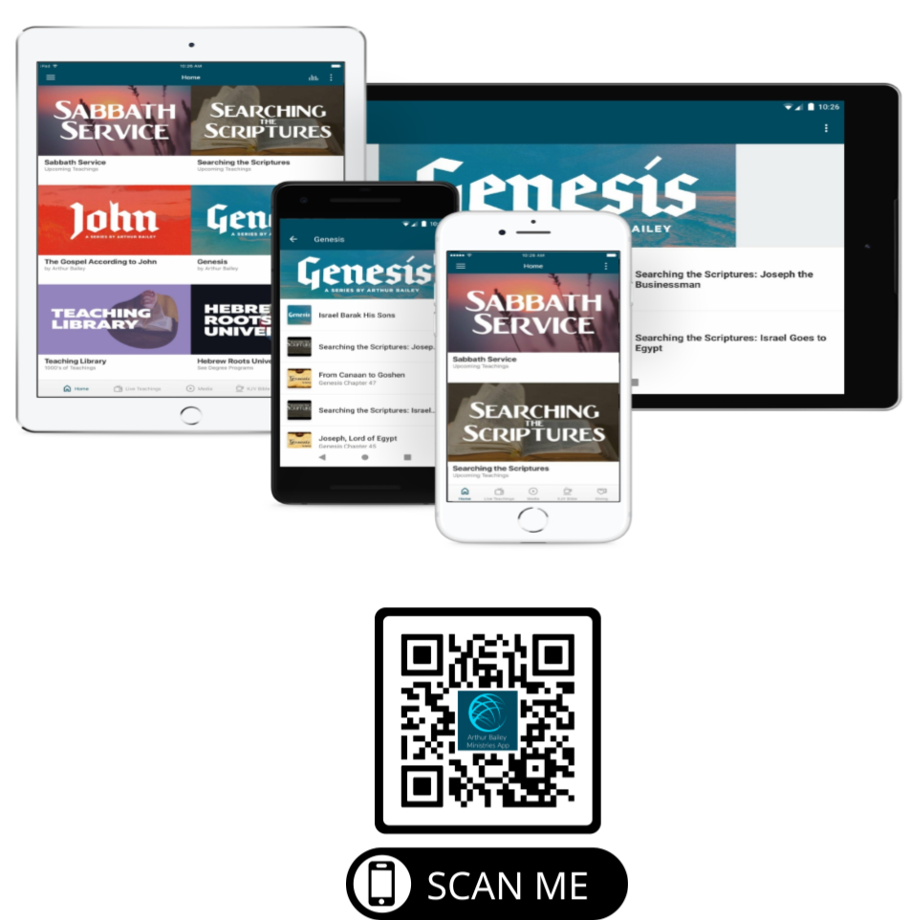

Slide 70
Mail in your support by check or money order.
Our Mailing Address:
P O Box 1182
Fort Mill, SC 29716

Slide 71
You can give by
Texting
Donate – Tithe - Offering
to
704-810-1579

