Slide 3
TODAY’S MESSAGE
Numbers 11:1-35
How to Make God Angry

Slide 4
Please Subscribe for Updates on our Website.
Watch us on YouTube.
Follow us on Facebook and the
other Social Media Networks.
Please Like and Share our Videos
and Posts.

Slide 5
At the end of today’s Teaching, you will be able to 1. Ask Questions 2. Receive Prayer 3. Give your Tithes and Offerings

Slide 6
The Vision of House of Israel is to be: 1. A Worshipping People (John 4:23-24) 2. An Evangelistic Community (Acts 2:42-47)

Slide 7
3. A Discipleship Center (Matthew 28:19) 4. An Equipping Network (Ephesians 4:12) 5. And a Worldwide Witness for Yeshua The Messiah
(Acts 1:8)

Slide 9
Prayer

Slide 10
TODAY’S MESSAGE
Numbers 11:1-35
How to Make God Angry

Slide 11
Making God angry should be the last thing a confessing child of God should want to do. However, during Israel’s time in the wilderness with God, after He delivered them from their bondage in Egypt, Israel managed to anger God often.

Slide 12
The complaints of Israel and the mixed multitudes demonstrated and displayed a total lack of faith and trust in Moses' leadership and YeHoVaH’s ability to provide for them what they wanted. This caused great frustration for Moses and Aaron. Frustrated, Moses demanded help from YeHoVaH; His response brought great calamity to the people and addressed Moses' request for help.

Slide 13
Three days after Israel left Egypt, they began to complain.
They complained about water in Exodus 15.
They complained about the manna in Exodus 16.
They complained about water again in Exodus 17.
They made idols in Exodus 32 while Moses was on the mountain.

Slide 14
In Exodus 5, before they ever left Egypt, the people complained about how Moses and Aaron made them look in the eyes of Pharaoh.

Slide 15
The people of Israel complained and angered YeHoVaH.
The fire of YeHoVaH consumed some of them.

Slide 16
^{Nu 11:1} And when the people complained, it displeased the LORD: and the LORD heard it; and his anger was kindled; and the fire of the LORD burnt among them, and consumed them that were in the uttermost parts of the camp.
^{Nu 11:2} And the people cried unto Moses; and when Moses prayed unto the LORD, the fire was quenched.

Slide 17
Moses’ prayer to YeHoVaH appeased YeHoVaH’s anger.
^{Nu 11:3} And he called the name of the place Taberah: because the fire of the LORD burnt among them.

Slide 18
Taberah – 08404 תַּבְעֵרָה Tab`erah {tab-ay-raw'}
Meaning: Taberah = "burning" 1) a place in the wilderness of Paran
Usage: AV - Taberah 2; 2

Slide 19
The mixed multitude fell a-lusting.
^{Nu 11:4} And the mixed multitude that was among them fell a-lusting: and the children of Israel also wept again, and said, Who shall give us flesh to eat?

Slide 20
Mixed multitude – 0628 אֲסַפְסֻף 'acpecuph {as-pes-oof'}
Meaning: 1) collection, rabble, collected multitude
Usage: AV - mixt multitude 1; 1

Slide 21
^{Ex 12:38} And a mixed multitude went up also with them; and flocks, and herds, even very much cattle.

Slide 22
Looking back to Egypt.
^{Nu 11:5} We remember the fish, which we did eat in Egypt freely; the cucumbers, and the melons, and the leeks, and the onions, and the garlic:
^{Nu 11:6} But now our soul is dried away: there is nothing at all, beside this manna, before our eyes.

Slide 23
The people craved flesh to eat.
YeHoVaH had provided manna, and once quail, for them.
The appetite of the people spoke.
The people complained because they were tired of the manna. They desired variety in their diet.

Slide 24
If it was simply hunger, they would have a legitimate request. However, YeHoVaH had provided manna for them.
They complained about what YeHoVaH had provided for them.
They displayed cravings or lust for something they did not have based on the name that was given to the place where it happened.

Slide 25
^{Nu 11:7} And the manna was as coriander seed, and the colour thereof as the colour of bdellium. ^{Nu 11:8} And the people went about, and gathered it, and ground it in mills, or beat it in a mortar, and baked it in pans, and made cakes of it: and the taste of it was as the taste of fresh oil.
^{Nu 11:9} And when the dew fell upon the camp in the night, the manna fell upon it.

Slide 26
The cries of the people angered YeHoVaH and Moses. This led to Moses' complaints and questioning YeHoVaH.

Slide 27
^{Nu 11:10} Then Moses heard the people weep throughout their families, every man in the door of his tent: and the anger of the LORD was kindled greatly; Moses also was displeased.

Slide 28
Moses asked questions of YeHoVaH. Moses wanted to know what he did to deserve this type of treatment.
^{Nu 11:11} And Moses said unto the LORD, Wherefore hast thou afflicted thy servant? and wherefore have I not found favour in thy sight, that thou layest the burden of all this people upon me?

Slide 29
^{Nu 11:12} Have I conceived all this people? have I begotten them, that thou shouldest say unto me, Carry them in thy bosom, as a nursing father beareth the sucking child, unto the land which thou swarest unto their fathers?

Slide 30
Moses felt he needed to remind YeHoVaH that these were His people.

Slide 31
Conceived – 02029 הָרָה harah {haw-raw'}
Meaning: 1) to conceive, become pregnant, bear, be with child, be conceived, progenitor 1a) (Qal) to conceive, become pregnant 1b) (Pual) to be conceived 1c) (Poel) to conceive, contrive, devise
Usage: AV - conceive 38, woman with child 2, with child 2, again 1, bare 1, progenitors 1; 43

Slide 32
Begotten – 03205 יָלַד yalad {yaw-lad'}
Meaning: 1) to bear, bring forth, beget, gender, travail 1a) (Qal) 1a1) to bear, bring forth 1a1a) of child birth 1a1b) of distress (simile) 1a1c) of wicked (behaviour) 1a2) to beget 1b) (Niphal) to be born 1c) (Piel) 1c1) to cause or help to bring forth 1c2) to assist or tend as a midwife 1c3) midwife (participle) 1d)

Slide 33
(Pual) to be born 1e) (Hiphil) 1e1) to beget (a child) 1e2) to bear (fig. - of wicked bringing forth iniquity) 1f) (Hophal) day of birth, birthday (infinitive) 1g) (Hithpael) to declare one's birth (pedigree)
Usage: AV - beget 201, bare 110, born 79, bring forth 25, bear 23, travail 16, midwife 10, child 8, delivered 5, borne 3, birth 2, labour 2, brought up 2, misc 12; 498

Slide 34
^{Nu 11:13} Whence should I have flesh to give unto all this people? for they weep unto me, saying, Give us flesh, that we may eat.
^{Nu 11:14} I am not able to bear all this people alone, because it is too heavy for me.

Slide 35
^{Ex 12:37} And the children of Israel journeyed from Rameses to Succoth, about six hundred thousand on foot that were men, beside children.
^{Ex 12:38} And a mixed multitude went up also with them; and flocks, and herds, even very much cattle.

Slide 36
Moses would have rather died at the hand of YeHoVaH than continued to be in the position he was in amongst a dissatisfied and complaining people.

Slide 37
^{Nu 11:15} And if thou deal thus with me, kill me, I pray thee, out of hand, if I have found favour in thy sight; and let me not see my wretchedness.

Slide 38
Moses was commanded to select seventy elders to assist him.
^{Nu 11:16} And the LORD said unto Moses, Gather unto me seventy men of the elders of Israel, whom thou knowest to be the elders of the people, and officers over them; and bring them unto the tabernacle of the congregation, that they may stand there with thee.

Slide 39
Remember
^{Ex 12:37} …about six hundred thousand on foot that were men, beside children.
^{Ex 12:38} And a mixed multitude went up also with them; and flocks, and herds, even very much cattle.

Slide 40
It was estimated that there were more than two million people that Moses was leading.

Slide 41
600,000 divided by 70 = 8,571 meaning equally divided, each elder would carry the burden of 8,571 people.
2,000,000 divided by 70 = 28,571 meaning equally divided, each elder would carry the burden of 28,571 people.

Slide 42
^{Nu 11:17} And I will come down and talk with thee there: and I will take of the spirit which is upon thee, and will put it upon them; and they shall bear the burden of the people with thee, that thou bear it not thyself alone.

Slide 43
^{Nu 11:18} And say thou unto the people, Sanctify yourselves against tomorrow, and ye shall eat flesh: for ye have wept in the ears of the LORD, saying, Who shall give us flesh to eat? for it was well with us in Egypt: therefore the LORD will give you flesh, and ye shall eat.

Slide 44
YeHoVaH took the people’s complaints personally and gave them what they complained about, at a cost to the people.
Be careful what you ask for.

Slide 45
^{Nu 11:19} Ye shall not eat one day, nor two days, nor five days, neither ten days, nor twenty days;
^{Nu 11:20} But even a whole month, until it come out at your nostrils, and it be loathsome unto you: because that ye have despised the LORD which is among you, and have wept before him, saying, Why came we forth out of Egypt?

Slide 46
Despised – 03988 מָאַס ma'ac {maw-as'}
Meaning: 1) to reject, despise, refuse 1a) (Qal) 1a1) to reject, refuse 1a2) to despise 1b) (Niphal) to be rejected 2) (Niphal) to flow, run
Usage: AV - despise 25, refuse 9, reject 19, abhor 4, become loathsome 1, melt away 1, misc 17; 76

Slide 47
^{Nu 11:21} And Moses said, The people, among whom I am, are six hundred thousand footmen; and thou hast said, I will give them flesh, that they may eat a whole month.

Slide 48
Footmen – 07273 רַגְלִי ragliy {rag-lee'}
Meaning: 1) on foot 1a) man on foot, footman, foot soldier
Usage: AV - footman 7, footman + 0376 4, foot 1; 12

Slide 49
Moses, in his own mind and calculations knew that what YeHoVaH was proposing was practically impossible.

Slide 50
^{Nu 11:22} Shall the flocks and the herds be slain for them, to suffice them? or shall all the fish of the sea be gathered together for them, to suffice them?
^{Nu 11:23} And the LORD said unto Moses, Is the LORD'S hand waxed short? thou shalt see now whether my word shall come to pass unto thee or not.

Slide 51
It is those words that YeHoVaH has spoken that should put the fear of going against Him in our hearts and minds.

Slide 52
^{Nu 23:19} God is not a man, that he should lie; neither the son of man, that he should repent: hath he said, and shall he not do it? or hath he spoken, and shall he not make it good?
People for generations have questioned what YeHoVaH can and cannot do or what He will or will not do.

Slide 53
Trusting Him at His Word is not the easiest thing to do because we are a people who are fleshly, carnal, emotional, selfish, and walk mostly by sight than by faith.

Slide 54
Trusting YeHoVaH requires walking by faith and not by sight.
Trusting YeHoVaH means denying ourselves.
Trusting YeHoVaH means putting our fleshly carnal nature under.
Trusting YeHoVaH means renewing our minds.
Trusting YeHoVaH means taking Him at His Word.

Slide 55
Moses has numbered the Children of Israel by Tribes.
Moses has set in place the Priests to serve in the Tabernacle.
Moses has set in place the Levites to serve the Priests in the Tabernacle.
Moses is given Instructions for the Elders to help him carry the burden of the people.

Slide 56
^{Nu 11:24} And Moses went out, and told the people the words of the LORD, and gathered the seventy men of the elders of the people, and set them round about the tabernacle.
^{Nu 11:25} And the LORD came down in a cloud, and spake unto him, and took of the spirit that was upon him, and gave it unto the seventy elders: and it came to pass, that, when the spirit rested upon them, they prophesied, and did not cease.

Slide 57
Prophesied – 05012 נָבָא naba' {naw-baw'}
Meaning: 1) to prophesy 1a) (Niphal) 1a1) to prophesy 1a1a) under influence of divine spirit 1a1b) of false prophets 1b) (Hithpael) 1b1) to prophesy 1b1a) under influence of divine spirit 1b1b) of false prophets
Usage: AV - prophesy 111, prophesying 2, prophet 2; 115

Slide 58
^{Nu 11:26} But there remained two of the men in the camp, the name of the one was Eldad, and the name of the other Medad: and the spirit rested upon them; and they were of them that were written, but went not out unto the tabernacle: and they prophesied in the camp. ^{Nu 11:27} And there ran a young man, and told Moses, and said, Eldad and Medad do prophesy in the camp.

Slide 59
^{Nu 11:28} And Joshua the son of Nun, the servant of Moses, one of his young men, answered and said, My lord Moses, forbid them. ^{Nu 11:29} And Moses said unto him, Enviest thou for my sake? would God that all the LORD'S people were prophets, and that the LORD would put his spirit upon them!

Slide 60
YeHoVaH heard Moses and incorporated Moses’ desires in a prophecy given to Joel.
^{Joel 2:28} And it shall come to pass afterward, that I will pour out my spirit upon all flesh; and your sons and your daughters shall prophesy, your old men shall dream dreams, your young men shall see visions: ^{Joel 2:29} And also upon the servants and upon the handmaids in those days will I pour out my spirit.

Slide 61
Joel’s prophecy began to come to pass on Pentecost.
^{Ac 2:16} But this is that which was spoken by the prophet Joel;

Slide 62
^{Ac 2:17} And it shall come to pass in the last days, saith God, I will pour out of my Spirit upon all flesh: and your sons and your daughters shall prophesy, and your young men shall see visions, and your old men shall dream dreams:
^{Ac 2:18} And on my servants and on my handmaidens I will pour out in those days of my Spirit; and they shall prophesy:

Slide 63
^{Nu 11:30} And Moses gat him into the camp, he and the elders of Israel.
^{Nu 11:31} And there went forth a wind from the LORD, and brought quails from the sea, and let them fall by the camp, as it were a day's journey on this side, and as it were a day's journey on the other side, round about the camp, and as it were two cubits high upon the face of the earth.

Slide 64
^{Nu 11:32} And the people stood up all that day, and all that night, and all the next day, and they gathered the quails: he that gathered least gathered ten homers: and they spread them all abroad for themselves round about the camp.

Slide 65
2 days and a night, the Children of Israel gathered quail.
A homer is not to be confused with an omer.

Slide 66
Omer – 06016 עֹמֶר `omer {o'-mer}
Meaning: 1) omer 1a) a dry measure of 1/10 ephah (about 2 litres) 2) sheaf
Usage: AV - sheaf 8, omer 6; 14

Slide 67
Homer – 02563 חֹמֶר chomer {kho'mer}
Meaning: 1) cement, mortar, clay 1a) mortar, cement 1b) clay 1c) mire 2) heap 2a) swelling, surging (of water) 3) homer - a unit of dry measure about 65 imperial gallons (300 l)
Usage: AV - clay 11, homer 11, morter 4, mire 2, heap 2; 30

Slide 68
Ten homers is equivalent to about fifty bushels.

Slide 69
^{Nu 11:33} And while the flesh was yet between their teeth, ere it was chewed, the wrath of the LORD was kindled against the people, and the LORD smote the people with a very great plague.

Slide 70
The Children of Israel lacked faith.
Psalms 78 captured it like this:
^{Ps 78:21} Therefore the LORD heard this, and was wroth: so a fire was kindled against Jacob, and anger also came up against Israel;
^{Ps 78:22} Because they believed not in God, and trusted not in his salvation:

Slide 71
^{Ps 78:23} Though he had commanded the clouds from above, and opened the doors of heaven,
^{Ps 78:24} And had rained down manna upon them to eat, and had given them of the corn of heaven.
^{Ps 78:25} Man did eat angels' food: he sent them meat to the full.

Slide 72
^{Ps 78:26} He caused an east wind to blow in the heaven: and by his power he brought in the south wind.
^{Ps 78:27} He rained flesh also upon them as dust, and feathered fowls like as the sand of the sea:
^{Ps 78:28} And he let it fall in the midst of their camp, round about their habitations.

Slide 73
^{Ps 78:29} So they did eat, and were well filled: for he gave them their own desire;
^{Ps 78:30} They were not estranged from their lust. But while their meat was yet in their mouths,
^{Ps 78:31} The wrath of God came upon them, and slew the fattest of them, and smote down the chosen men of Israel.

Slide 74
^{Ps 78:32} For all this they sinned still, and believed not for his wondrous works.
It is written in Psalms 106 :

Slide 75
^{Ps 106:13} They soon forgat his works; they waited not for his counsel:
^{Ps 106:14} But lusted exceedingly in the wilderness, and tempted God in the desert.
^{Ps 106:15} And he gave them their request; but sent leanness into their soul.

Slide 76
07332 רָזוֹן razown {raw-zone'}
Meaning: 1) leanness, scantness, wasting 1a) leanness 1b) wasting (of disease) 1c) scantness (of measure)
Usage: AV - leanness 2, scant 1; 3

Slide 77
^{Nu 11:34} And he called the name of that place Kibroth-hattaavah: because there they buried the people that lusted.

Slide 78
Kibroth-hattaavah – 06914 קִבְרוֹת הַתַּאֲוָה Qibrowth hat-Ta'avah {kib-roth' hat-tah-av-aw'}
Meaning: Kibroth-hattaavah = "graves of lust" 1) a station of Israel in the wilderness 3 campsites away from Sinai near the gulf of Akabah
Usage: AV - Kibrothhattaavah 5; 5

Slide 79
^{Nu 11:35} And the people journeyed from Kibroth-hattaavah unto Hazeroth; and abode at Hazeroth.

Slide 80
First Fire
Then Flesh
Then the curse of a Plague

Slide 81
YeHoVaH did not want Israel to experience plague; He had warned them.
Numbers 8:19
Leviticus 26:21

Slide 82
Just as YeHoVaH sent plagues on Egypt and the Israelites, in the last days, YeHoVaH will send plagues on the nations of the world according to the Book of Revelation,
starting in Chapter 9.

Slide 83
Your support is greatly appreciated and needed.

Slide 85
Our Preferred
Donation Methods:

Slide 86
CashApp – $ABMHOI
Venmo – @Arthur-Bailey-10
Zelle – apostlea@gmail.com

Slide 87
Question and Answer
Period

Slide 88
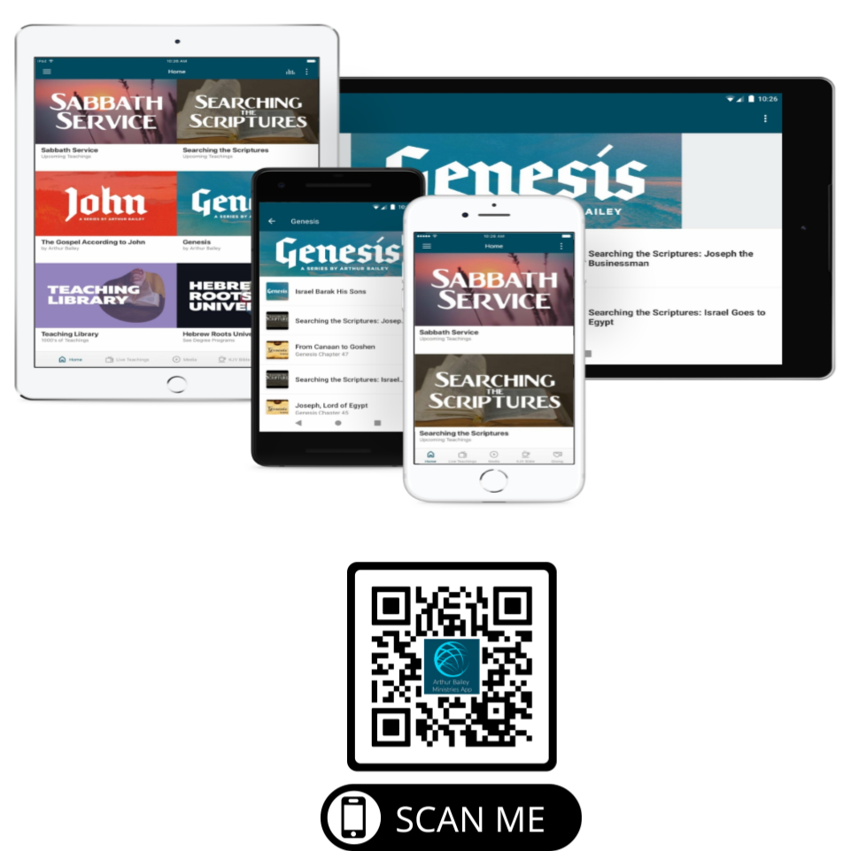

Slide 89
Mail in your support by check or money order.
Our Mailing Address:
P O Box 1182
Fort Mill, SC 29716

Slide 90
You can give by
Texting
Donate – Tithe - Offering
to
704-810-1579

