Slide 3
TODAY’S MESSAGE
Mark 2:18-28
Fasting and The Sabbath

Slide 4
Please Subscribe for Updates on our Website.
Watch us on YouTube.
Follow us on Facebook and the
other Social Media Networks.
Please Like and Share our Videos
and Posts.

Slide 5
At the end of today’s Teaching, you will be able to 1. Ask Questions 2. Receive Prayer 3. Give your Tithes and Offerings

Slide 6
The Vision of House of Israel is to be: 1. A Worshipping People (John 4:23-24) 2. An Evangelistic Community (Acts 2:42-47)

Slide 7
3. A Discipleship Center (Matthew 28:19) 4. An Equipping Network (Ephesians 4:12) 5. And a Worldwide Witness for Yeshua The Messiah
(Acts 1:8)

Slide 9
Prayer

Slide 10
TODAY’S MESSAGE
Mark 2:18-28
Fasting and The Sabbath

Slide 11
Fasting was a common practice for the people of faith who followed the Pharisees and the disciples of John the Baptist. The practice of fasting can be traced back to the time of David and the Law.
When questioned about fasting, Yeshua's response was classic.

Slide 12
When questioned about what He was doing on the Sabbath Day, Yeshua left those who questioned Him dumbfounded with His response.
His response has also dumbfounded some in this present day who teach others.

Slide 13
Two sets of disciples came to Yeshua, disciples of John and disciples of the Pharisees.
They had witnessed Yeshua and His Disciples eating at Matthew’s house with publicans and sinners in Verses 16 and 17.

Slide 14
^{Mk 2:16} And when the scribes and Pharisees saw him eat with publicans and sinners, they said unto his disciples, How is it that he eateth and drinketh with publicans and sinners? ^{Mk 2:17} When Yeshua heard it, he saith unto them, They that are whole have no need of the physician, but they that are sick: I came not to call the righteous, but sinners to repentance.

Slide 15
^{Mk 2:18} And the disciples of John and of the Pharisees used to fast: and they come and say unto him, Why do the disciples of John and of the Pharisees fast, but thy disciples fast not?

Slide 16
Used – 2258 ἦν en {ane}
Meaning: 1) I was, etc.
Usage: AV - was 266, were 115, had been 12, had 11, taught + 1321 4, stood + 2476 4, misc 41, vr was 1; 455

Slide 17
Fast – 3522 νηστεύω nesteuo
{nace-tyoo'-o}
Meaning: 1) to abstain as a religious exercise from food and drink: either entirely, if the fast lasted but a single day, or from customary and choice nourishment, if it continued several days
Usage: AV - fast 21; 21

Slide 18
Fasting was commonly practiced amongst the Hebrew people.
Fasting can be traced directly back to David who fasted and prayed for his son to live,
2nd Samuel 12.

Slide 19
There are no direct Commands to fast in the Torah.
Fasting is the traditional interpretation of afflicting one's soul on the Day of Atonement.
Fasting can become a ritual,
Zachariah 7:5 and 8:19.

Slide 20
Fasting can be corporate as a community or personal.
Fasting is never to be done to be seen of men.
Prior to the coming of Messiah, fasting was expected, by the religious, to be done for all to see.

Slide 21
Some Pharisees fasted twice a week according to Luke 18:12.
Yeshua connected fasting unto YeHoVaH as to praying; this was in in contrast to fasting religiously,
Matthew 6.

Slide 22
^{Mt 6:12} And forgive us our debts, as we forgive our debtors.
^{Mt 6:13} And lead us not into temptation, but deliver us from evil: For thine is the kingdom, and the power, and the glory, for ever. Amen.

Slide 23
^{Mt 6:14} For if ye forgive men their trespasses, your heavenly Father will also forgive you:
^{Mt 6:15} But if ye forgive not men their trespasses, neither will your Father forgive your trespasses.

Slide 24
^{Mt 6:16} Moreover when ye fast, be not, as the hypocrites, of a sad countenance: for they disfigure their faces, that they may appear unto men to fast. Verily I say unto you, They have their reward.

Slide 25
^{Mt 6:17} But thou, when thou fastest, anoint thine head, and wash thy face;
^{Mt 6:18} That thou appear not unto men to fast, but unto thy Father which is in secret: and thy Father, which seeth in secret, shall reward thee openly.

Slide 26
^{Mk 2:19} And Yeshua said unto them, Can the children of the bridechamber fast, while the bridegroom is with them? as long as they have the bridegroom with them, they cannot fast.

Slide 27
Yeshua’s reference to the Bridechamber and the Bridegroom is a reference to Himself and His Disciples.

Slide 28
Bridechamber – 3567 νυμφών numphon {noom-fohn'} Meaning: 1) the chamber containing the bridal bed, the bridal chamber 1a) of the friends of the bridegroom whose duty it was to provide and care for whatever pertained to the bridal chamber, i.e. whatever was needed for the due celebration of the nuptials 1b) the room in which the marriage ceremonies are held Usage: AV - bridechamber 3; 3

Slide 29
Remember, Yeshua spoke parables to the people.
^{Mt 13:34} All these things spake Yeshua unto the multitude in parables; and without a parable spake he not unto them:
^{Mt 13:35} That it might be fulfilled which was spoken by the prophet, saying, I will open my mouth in parables; I will utter things which have been kept secret from the foundation of the world.

Slide 30
Although what Yeshua is saying is not referenced as a parable, He is speaking parabolic.
Yeshua is the Bridegroom.
Those whose names are written in the Lamb’s Book of Life are the Bride, Revelation 21.
The friends of the Bridegroom are those in the wedding party (speaking of the Disciples).

Slide 31
The bridechamber and bridegroom terms are synonymous with a marriage or a wedding feast.
Yeshua, the Bridegroom, is speaking of the New Covenant of which He is the mediator, where YeHoVaH who divorced Israel will remarry via a New Covenant.

Slide 32
In the New Testament writings, those terms are used only in the Gospels and in the Book of Revelation.
To understand Yeshua’s teachings, you must view them through the eyes of the Law and the Prophets.
To understand the Law and the Prophets, you must view them through the teachings of Yeshua.

Slide 33
^{Mk 2:20} But the days will come, when the bridegroom shall be taken away from them, and then shall they fast in those days.

Slide 34
Yeshua reveals His purpose by giving parabolic illustrations using garments and wineskins/bottles.

Slide 35
^{Mk 2:21} No man also seweth a piece of new cloth on an old garment: else the new piece that filled it up taketh away from the old, and the rent is made worse.
^{Mk 2:22} And no man putteth new wine into old bottles: else the new wine doth burst the bottles, and the wine is spilled, and the bottles will be marred: but new wine must be put into new bottles.

Slide 36
Yeshua makes it clear that His teaching is not to be sewn together with the teachings of Judaism, mixed with Judaism, or poured into old bottles or wineskins.
You can’t add Yeshua’s teachings to Judaism or try to interpret Yeshua’s teachings through Jewish traditions.

Slide 37
Jews and Messianics try to force Yeshua to comply with their understanding of the teaching of the Law and the Prophets instead of viewing the teachings of the Law and the Prophets through Yeshua’s teachings.

Slide 38
The Sabbath
^{Mk 2:23} And it came to pass, that he went through the corn fields on the sabbath day; and his disciples began, as they went, to pluck the ears of corn.

Slide 39
Ears of corn – 4719 Στάχυς stachus {stakh'-oos}
Meaning: 1) an ear of corn or of growing grain
Usage: AV - ear of corn 3, ear 2; 5

Slide 40
Matthew and Luke inform us that Yeshua and His Disciples plucked the corn to eat.
^{Mt 12:1} At that time Yeshua went on the sabbath day through the corn; and his disciples were an hungered, and began to pluck the ears of corn, and to eat.

Slide 41
^{Lk 6:1} And it came to pass on the second sabbath after the first, that he went through the corn fields; and his disciples plucked the ears of corn, and did eat, rubbing them in their hands.

Slide 42
^{Mk 2:24} And the Pharisees said unto him, Behold, why do they on the sabbath day that which is not lawful?

Slide 43
To the Christian who practices Christianity, they may say that is an example of Yeshua breaking the Sabbath Law to teach them we can worship on any day and that they don’t have to keep the Sabbath.
To the Jew that practices Judaism, they can say that is an example that Yeshua was not the Mashiach because He violated the Sabbath Commandment.

Slide 44
Yeshua may have violated Jewish law, but He did not violate the Sabbath Law according to YeHoVaH’s Commandment.
If He violated the Law of YeHoVaH, He could not be the Messiah of YeHoVaH.
Here is what the Law actually says concerning what Yeshua and His Disciples were doing.

Slide 45
^{Dt 23:24} When thou comest into thy neighbour's vineyard, then thou mayest eat grapes thy fill at thine own pleasure; but thou shalt not put any in thy vessel.
^{Dt 23:25} When thou comest into the standing corn of thy neighbour, then thou mayest pluck the ears with thine hand; but thou shalt not move a sickle unto thy neighbour's standing corn.

Slide 46
Ears – 04425 מְלִילָה meliylah {mel-ee-law'}
Meaning: 1) ear (of wheat), head (of wheat)
Usage: AV - ears 1; 1

Slide 47
Yeshua was not harvesting or putting the sickle to the grain, He and His Disciples were eating.
It is NOT a violation of the Sabbath Law to eat on the Sabbath!

Slide 48
^{Mk 2:25} And he said unto them, Have ye never read what David did, when he had need, and was an hungered, he, and they that were with him?
^{Mk 2:26} How he went into the house of God in the days of Abiathar the high priest, and did eat the showbread, which is not lawful to eat but for the priests, and gave also to them which were with him?

Slide 49
^{1Sa 21:1} Then came David to Nob to Ahimelech the priest: and Ahimelech was afraid at the meeting of David, and said unto him, Why art thou alone, and no man with thee?
^{1Sa 21:2} And David said unto Ahimelech the priest, The king hath commanded me a business, and hath said unto me, Let no man know any thing of the business whereabout I send thee, and what I have commanded thee: and I have appointed my servants to such and such a place.

Slide 50
^{1Sa 21:3} Now therefore what is under thine hand? give me five loaves of bread in mine hand, or what there is present.
^{1Sa 21:4} And the priest answered David, and said, There is no common bread under mine hand, but there is hallowed bread; if the young men have kept themselves at least from women.

Slide 51
^{1Sa 21:5} And David answered the priest, and said unto him, Of a truth women have been kept from us about these three days, since I came out, and the vessels of the young men are holy, and the bread is in a manner common, yea, though it were sanctified this day in the vessel.
^{1Sa 21:6} So the priest gave him hallowed bread: for there was no bread there but the showbread, that was taken from before the LORD, to put hot bread in the day when it was taken away.

Slide 52
^{Mk 2:27} And he said unto them, The sabbath was made for man, and not man for the sabbath:

Slide 53
The Sabbath was made for man.
YeHoVaH made an entire day for man as a gift and a day to rest and worship. He then commanded man to rest, as He did, and keep the day Holy.

Slide 54
^{Ge 2:2} And on the seventh day God ended his work which he had made; and he rested on the seventh day from all his work which he had made.
^{Ge 2:3} And God blessed the seventh day, and sanctified it: because that in it he had rested from all his work which God created and made.

Slide 55
^{Mk 2:28} Therefore the Son of man is Lord also of the sabbath.

Slide 56
Yeshua is Lord of the Sabbath.
The Sabbath is not Lord of Yeshua or to be lorded over us with a bunch of rules and regulations not commanded by YeHoVaH.

Slide 57
The Pharisees and religious leaders had concocted a bunch of rules and regulations, do’s and don’ts, and connected them to the Sabbath.

Slide 58
^{Lev 23:1} And the LORD spake unto Moses, saying,
^{Lev 23:2} Speak unto the children of Israel, and say unto them, Concerning the feasts of the LORD, which ye shall proclaim to be holy convocations, even these are my feasts.

Slide 59
^{Lev 23:3} Six days shall work be done: but the seventh day is the sabbath of rest, an holy convocation; ye shall do no work therein: it is the sabbath of the LORD in all your dwellings.
^{Lev 23:4} These are the feasts of the LORD, even holy convocations, which ye shall proclaim in their seasons.

Slide 60
Your support is greatly appreciated and needed.

Slide 62
Our Preferred
Donation Methods:

Slide 63
CashApp – $ABMHOI
Venmo – @Arthur-Bailey-10
Zelle – apostlea@gmail.com

Slide 64
Question and Answer
Period

Slide 65
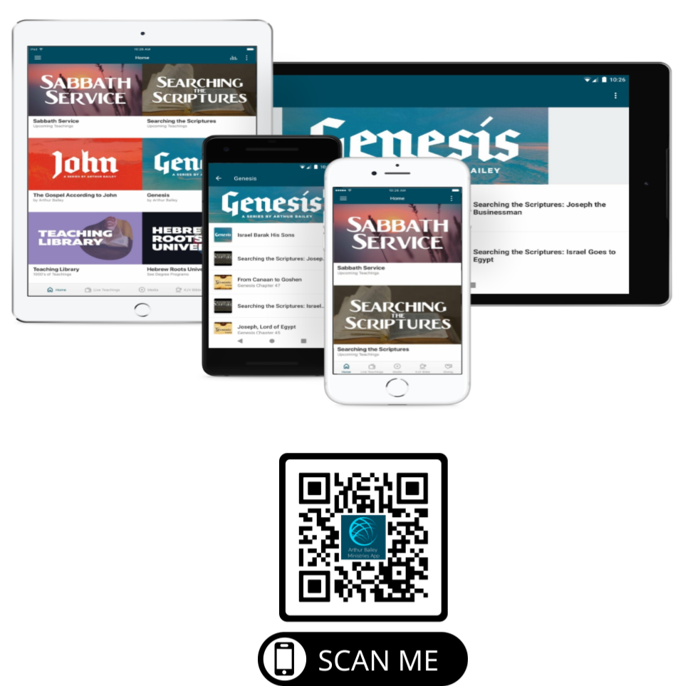

Slide 66
Mail in your support by check or money order.
Our Mailing Address:
P O Box 1182
Fort Mill, SC 29716

Slide 67
You can give by
Texting
Donate – Tithe - Offering
to
704-810-1579

