Slide 3
TODAY’S MESSAGE
Numbers 15:1-41
Remember and Do My Commandments

Slide 4
Please Subscribe for Updates on our Website.
Watch us on YouTube.
Follow us on Facebook and the
other Social Media Networks.
Please Like and Share our Videos
and Posts.

Slide 5
At the end of today’s Teaching, you will be able to 1. Ask Questions 2. Receive Prayer 3. Give your Tithes and Offerings

Slide 6
The Vision of House of Israel is to be: 1. A Worshipping People (John 4:23-24) 2. An Evangelistic Community (Acts 2:42-47)

Slide 7
3. A Discipleship Center (Matthew 28:19) 4. An Equipping Network (Ephesians 4:12) 5. And a Worldwide Witness for Yeshua The Messiah
(Acts 1:8)

Slide 9
Prayer

Slide 10
TODAY’S MESSAGE
Numbers 15:1-41
Remember and Do My Commandments

Slide 11
YeHoVaH established Israel as a nation of people that would be governed by the Laws and Commandments He gave. Israel’s livelihood, protection, and their very lives depended on them submitting by faith to obey the Commandments given to them.
The same Laws applied to both the native born and the strangers living amongst Israel.

Slide 12
In this portion of Numbers, we will glean lessons that were implemented in the wilderness that are applicable and still binding on YeHoVaH’s people today.

Slide 13
Numbers 15 is a record of the Instructions for Israel to implement:
Once the Israelites live in The Land as a habitation;
Another set of Instructions for when they enter The Land;
And further Instructions that were to be implemented immediately after the stoning of a man who violated the Sabbath Command.

Slide 14
The first set of Instructions are found in Verses 1-16.
The second set of Instructions are found in Verses 17-31.
A man is found violating the Sabbath Command in Verses 32-36 that lead to the final set of Instructions about wearing Fringes.

Slide 15
^{Nu 15:1} And YeHoVaH spake unto Moses, saying,
YeHoVaH spoke.
Moses wrote.

Slide 16
YeHoVaH gives Instructions for the future when Israel will inhabit the land.
^{Nu 15:2} Speak unto the children of Israel, and say unto them, When ye be come into the land of your habitations, which I give unto you,

Slide 17
In the previous Chapter, YeHoVaH made it clear that those who rebelled against Him would not enter The Land.
But His grace and mercy are on display in this Chapter because He is letting the people know that the Promised Land was still a Promise that would be fulfilled.
When they entered The Land and made an Offering to Him, they were to follow certain Instructions. These were not required, but voluntary Offerings.

Slide 18
^{Nu 15:3} And will make an offering by fire unto YeHoVaH, a burnt offering, or a sacrifice in performing a vow, or in a freewill offering, or in your solemn feasts, to make a sweet savour unto YeHoVaH, of the herd, or of the flock: ^{Nu 15:4} Then shall he that offereth his offering unto YeHoVaH bring a meat offering of a tenth deal of flour mingled with the fourth part of an hin of oil.

Slide 19
^{Nu 15:5} And the fourth part of an hin of wine for a drink offering shalt thou prepare with the burnt offering or sacrifice, for one lamb.
^{Nu 15:6} Or for a ram, thou shalt prepare for a meat offering two tenth deals of flour mingled with the third part of an hin of oil.
^{Nu 15:7} And for a drink offering thou shalt offer the third part of an hin of wine, for a sweet savour unto YeHoVaH.

Slide 20
^{Nu 15:8} And when thou preparest a bullock for a burnt offering, or for a sacrifice in performing a vow, or peace offerings unto YeHoVaH: ^{Nu 15:9} Then shall he bring with a bullock a meat offering of three tenth deals of flour mingled with half an hin of oil. ^{Nu 15:10} And thou shalt bring for a drink offering half an hin of wine, for an offering made by fire, of a sweet savour unto YeHoVaH.

Slide 21
^{Nu 15:11} Thus shall it be done for one bullock, or for one ram, or for a lamb, or a kid.
^{Nu 15:12} According to the number that ye shall prepare, so shall ye do to every one according to their number.
^{Nu 15:13} All that are born of the country shall do these things after this manner, in offering an offering made by fire, of a sweet savour unto YeHoVaH.

Slide 22
^{Nu 15:14} And if a stranger sojourn with you, or whosoever be among you in your generations, and will offer an offering made by fire, of a sweet savour unto YeHoVaH; as ye do, so he shall do.
^{Nu 15:15} One ordinance shall be both for you of the congregation, and also for the stranger that sojourneth with you, an ordinance for ever in your generations: as ye are, so shall the stranger be before YeHoVaH.

Slide 23
Ordinance – 02708 חֻקָּה chuqqah {khook-kaw'}
Meaning: 1) statute, ordinance, limit, enactment, something prescribed 1a) statute
Usage: AV - statute 77, ordinance 22, custom 2, appointed 1, manners 1, rites 1; 104

Slide 24
Stranger – 01616 גֵּר ger {gare} or (fully) גֵּיר geyr (gare)
Meaning: 1) sojourner 1a) a temporary inhabitant, a newcomer lacking inherited rights 1b) of foreigners in Israel, though conceded rights
Usage: AV - stranger 87, alien 1, sojourner 1, stranger + 0376 1, stranger + 04480 1, strangers + 0582 1; 92

Slide 25
^{Nu 15:16} One law and one manner shall be for you, and for the stranger that sojourneth with you.

Slide 26
Law – 08451 תּוֹרָה towrah {to-raw'} or תֹּרָה torah {to-raw'}
Meaning: 1) law, direction, instruction 1a) instruction, direction (human or divine) 1a1) body of prophetic teaching 1a2) instruction in Messianic age 1a3) body of priestly direction or instruction

Slide 27
1a4) body of legal directives 1b) law 1b1) law of the burnt offering 1b2) of special law, codes of law 1c) custom, manner 1d) the Deuteronomic or Mosaic Law
Usage: AV - law 219; 219

Slide 28
Manner – 04941 מִשְׁפָּט mishpat {mish-pawt'}
Meaning: 1) judgment, justice, ordinance 1a) judgment 1a1) act of deciding a case 1a2) place, court, seat of judgment 1a3) process, procedure, litigation (before judges) 1a4) case, cause (presented for judgment) 1a5) sentence, decision (of judgment) 1a6) execution (of judgment) 1a7) time (of judgment)

Slide 29
1b) justice, right, rectitude (attributes of God or man) 1c) ordinance 1d) decision (in law) 1e) right, privilege, due (legal) 1f) proper, fitting, measure, fitness, custom, manner, plan
Usage: AV - judgment 296, manner 38, right 18, cause 12, ordinance 11, lawful 7, order 5, worthy 3, fashion 3, custom 2, discretion 2, law 2, measure 2, sentence 2, misc 18; 421

Slide 30
^{Nu 15:17} And YeHoVaH spake unto Moses, saying,
^{Nu 15:18} Speak unto the children of Israel, and say unto them, When ye come into the land whither I bring you,
^{Nu 15:19} Then it shall be, that, when ye eat of the bread of the land, ye shall offer up an heave offering unto YeHoVaH.

Slide 31
^{Nu 15:20} Ye shall offer up a cake of the first of your dough for an heave offering: as ye do the heave offering of the threshingfloor, so shall ye heave it.
^{Nu 15:21} Of the first of your dough ye shall give unto YeHoVaH an heave offering in your generations.

Slide 32
Before Israel ate the bread of The Land, Israel was to offer a Heave Offering of the dough.

Slide 33
^{Nu 15:22} And if ye have erred, and not observed all these commandments, which YeHoVaH hath spoken unto Moses,

Slide 34
Erred – 07686 שָׁגָה shagah {shaw-gaw'} Meaning: 1) to go astray, stray, err 1a) (Qal) 1a1) to err, stray 1a2) to swerve, meander, reel, roll, be intoxicated, err (in drunkenness) 1a3) to go astray (morally) 1a4) to commit sin of ignorance or inadvertence, err (ignorantly) 1b) (Hiphil) 1b1) to lead astray 1b2) to lead astray, mislead (mentally) 1b3) to lead astray (morally) Usage: AV - err 11, ravished 2, wander 3, deceiver 1, cause to go astray 1, sin through ignorance 1, go astray 1, deceived 1; 21

Slide 35
^{Nu 15:23} Even all that YeHoVaH hath commanded you by the hand of Moses, from the day that YeHoVaH commanded Moses, and henceforward among your generations;

Slide 36
These commandments were to be kept in future generations long after Moses’ death. The Law was not contingent on Moses or on that generation.
YeHoVaH spoke to Israel’s past, their present, and their future.
He speaks to our past, our present, and our future.

Slide 37
Sin in Error or Ignorance
^{Nu 15:24} Then it shall be, if aught be committed by ignorance without the knowledge of the congregation, that all the congregation shall offer one young bullock for a burnt offering, for a sweet savour unto YeHoVaH, with his meat offering, and his drink offering, according to the manner, and one kid of the goats for a sin offering.

Slide 38
Ignorance – 07684 שְׁגָגָה shegagah {sheg-aw-gaw'}
Meaning: 1) sin, sin of error or inadvertence, inadvertent sin 1a) error
Usage: AV - (through, in...) ignorance 12, unawares 4, error 2, unwittingly 1; 19

Slide 39
^{Nu 15:25} And the priest shall make an atonement for all the congregation of the children of Israel, and it shall be forgiven them; for it is ignorance: and they shall bring their offering, a sacrifice made by fire unto YeHoVaH, and their sin offering before YeHoVaH, for their ignorance:
^{Nu 15:26} And it shall be forgiven all the congregation of the children of Israel, and the stranger that sojourneth among them; seeing all the people were in ignorance.

Slide 40
^{Nu 15:27} And if any soul sin through ignorance, then he shall bring a she goat of the first year for a sin offering.
^{Nu 15:28} And the priest shall make an atonement for the soul that sinneth ignorantly, when he sinneth by ignorance before YeHoVaH, to make an atonement for him; and it shall be forgiven him.

Slide 41
^{Nu 15:29} Ye shall have one law for him that sinneth through ignorance, both for him that is born among the children of Israel, and for the stranger that sojourneth among them.

Slide 42
Sin Intentionally
^{Nu 15:30} But the soul that doeth aught presumptuously, whether he be born in the land, or a stranger, the same reproacheth YeHoVaH; and that soul shall be cut off from among his people.
^{Nu 15:31} Because he hath despised the word of YeHoVaH, and hath broken his commandment, that soul shall utterly be cut off; his iniquity shall be upon him.

Slide 43
Cut off – 03772 כָּרַת karath {kaw-rath'}
Meaning: 1) to cut, cut off, cut down, cut off a body part, cut out, eliminate, kill, cut a covenant 1a) (Qal) 1a1) to cut off 1a1a) to cut off a body part, behead 1a2) to cut down 1a3) to hew 1a4) to cut or make a covenant 1b) (Niphal) 1b1) to be cut off 1b2) to be cut down 1b3) to be chewed 1b4) to be cut off, fail

Slide 44
1c) (Pual) 1c1) to be cut off 1c2) to be cut down 1d) (Hiphil) 1d1) to cut off 1d2) to cut off, destroy 1d3) to cut down, destroy 1d4) to take away 1d5) to permit to perish 1e) (Hophal) cut off
Usage: AV - cut off 145, make 85, cut down 23, cut 9, fail 6, destroy 4, want 3, covenanted 2, hew 2, misc 9; 288

Slide 45
To be cut off could mean to be put to death based on the Verses that follow.

Slide 46
^{Nu 15:32} And while the children of Israel were in the wilderness, they found a man that gathered sticks upon the sabbath day.
^{Nu 15:33} And they that found him gathering sticks brought him unto Moses and Aaron, and unto all the congregation.
^{Nu 15:34} And they put him in ward, because it was not declared what should be done to him.

Slide 47
^{Nu 15:35} And YeHoVaH said unto Moses, The man shall be surely put to death: all the congregation shall stone him with stones without the camp.
^{Nu 15:36} And all the congregation brought him without the camp, and stoned him with stones, and he died; as YeHoVaH commanded Moses.

Slide 48
^{Nu 15:37} And YeHoVaH spake unto Moses, saying,
^{Nu 15:38} Speak unto the children of Israel, and bid them that they make them fringes in the borders of their garments throughout their generations, and that they put upon the fringe of the borders a ribband of blue:

Slide 49
Fringes – 06734 צִיצִת tsiytsith {tsee-tseeth'}
Meaning: 1) fringe, tassel, lock
Usage: AV - fringe 3, lock 1; 4

Slide 50
Borders – 03671 כָּנָף kanaph {kaw-nawf'}
Meaning: 1) wing, extremity, edge, winged, border, corner, shirt 1a) wing 1b) extremity 1b1) skirt, corner (of garment)
Usage: AV - wing 74, skirt 14, borders 2, corners 2, ends 2, feathered 2, sort 2, winged 2, misc 8; 108

Slide 51
The Prophet Malachi prophesied about the fringe on the border of the garment of the Sun of Righteousness, aka Yeshua.
^{Mal 4:2} But unto you that fear my name shall the Sun of righteousness arise with healing in his wings; and ye shall go forth, and grow up as calves of the stall.

Slide 52
Wings - 03671 כָּנָף kanaph {kaw-nawf'}
Meaning: 1) wing, extremity, edge, winged, border, corner, shirt 1a) wing 1b) extremity 1b1) skirt, corner (of garment)
Usage: AV - wing 74, skirt 14, borders 2, corners 2, ends 2, feathered 2, sort 2, winged 2, misc 8; 108

Slide 53
Yeshua wore fringes on the borders of His garments.
Remember, Yeshua taught by what He said and by what He did.

Slide 54
^{Mt 9:20} And, behold, a woman, which was diseased with an issue of blood twelve years, came behind him, and touched the hem of his garment:
^{Mt 14:36} And besought him that they might only touch the hem of his garment: and as many as touched were made perfectly whole.

Slide 55
Hem – 2899 κράσπεδον kraspedon {kras'-ped-on}
Meaning: 1) the extremity or prominent part of a thing, edge, skirt, margin 1a) the fringe of a garment 1b) in the NT a little appendage hanging down from the edge of the mantle or cloak, made of twisted wool 1c) a tassel, tuft: the Jews had such appendages attached to their mantles to remind them of the law
Usage: AV - border 3, hem 2; 5

Slide 56
^{Nu 15:39} And it shall be unto you for a fringe, that ye may look upon it, and remember all the commandments of YeHoVaH, and do them; and that ye seek not after your own heart and your own eyes, after which ye use to go a-whoring:

Slide 57
Our eyes and our hearts can lead us astray to go after the things we desire.

Slide 58
^{Nu 15:40} That ye may remember, and do all my commandments, and be holy unto your God.
^{Nu 15:41} I am YeHoVaH your God, which brought you out of the land of Egypt, to be your God: I am YeHoVaH your God.

Slide 59
YeHoVaH’s Commandments are for our benefit.
Obeying His Commandments brings life and blessings!

Slide 60
Your support is greatly appreciated and needed.

Slide 62
Our Preferred
Donation Methods:

Slide 63
CashApp – $ABMHOI
Venmo – @Arthur-Bailey-10
Zelle – apostlea@gmail.com

Slide 64
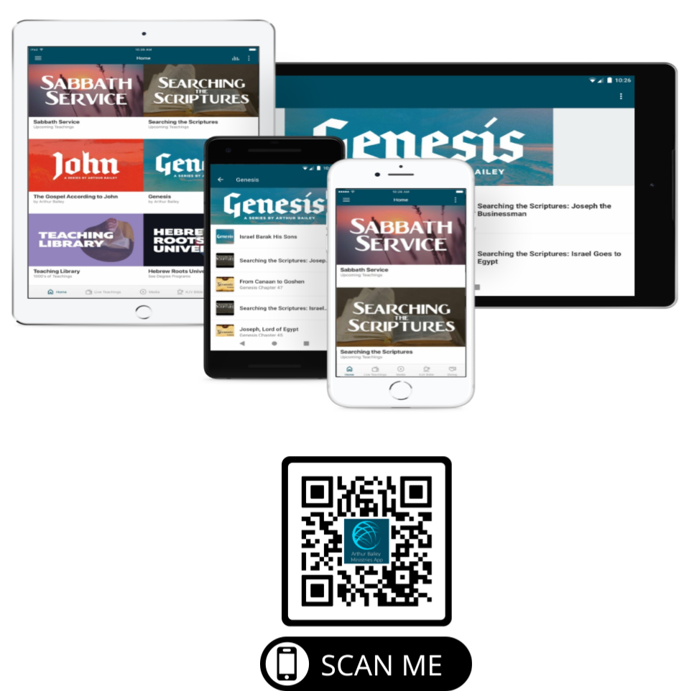

Slide 65
Mail in your support by check or money order.
Our Mailing Address:
P O Box 1182
Fort Mill, SC 29716

Slide 66
You can give by
Texting
Donate – Tithe - Offering
to
704-810-1579

