Slide 3
TODAY’S MESSAGE
Numbers 16:1-50
When Leaders Rebel

Slide 4
Please Subscribe for Updates on our Website.
Watch us on YouTube.
Follow us on Facebook and the
other Social Media Networks.
Please Like and Share our Videos
and Posts.

Slide 5
At the end of today’s Teaching, you will be able to 1. Ask Questions 2. Receive Prayer 3. Give your Tithes and Offerings

Slide 6
The Vision of House of Israel is to be: 1. A Worshipping People (John 4:23-24) 2. An Evangelistic Community (Acts 2:42-47)

Slide 7
3. A Discipleship Center (Matthew 28:19) 4. An Equipping Network (Ephesians 4:12) 5. And a Worldwide Witness for Yeshua The Messiah
(Acts 1:8)

Slide 9
Prayer

Slide 10
TODAY’S MESSAGE
Numbers 16:1-50
When Leaders Rebel

Slide 11
Leadership amongst the Israelite Tribes was established with the Instructions that YeHoVaH gave to Moses as recorded in the early Chapters of Numbers.
Apparently, some of the leaders were not satisfied with their leadership positions and desired more authority than had been allotted them.

Slide 12
The sentence of wandering in the wilderness for forty years and not being able to enter the Promised Land presented an opportune time for several of the leaders to confront Moses.
They did not expect what would come next.

Slide 13
Leaders are individuals that people look to for a variety of reasons.
Leaders can be formal or informal.
Leaders can be ordained or not ordained.
Leaders can be placed in a position of authority or not.
Leaders are influential people that influence the decisions of those who look to them as examples to follow.

Slide 14
When leaders follow their leaders, they set a good example for the people who look to them.
When leaders rebel against their leaders, they set a bad example for the people who look to them.

Slide 15
Remember, Moses went up into the mountain to receive the Torah alone. The people had to accept what Moses said as if YeHoVaH said it because they did not hear the words from YeHoVaH’s mouth but from Moses' mouth.

Slide 16
Those who rose up against Moses assumed and accused Moses of setting himself over them as a ruler.
Korah was one of the Kohathites in charge of carrying the Ark of the Covenant and the Tabernacle furnishings.
Korah took the lead, based on the language of this Chapter, and instigated a rebellion against Moses and Aaron.

Slide 17
^{Nu 16:1} Now Korah, the son of Izhar, the son of Kohath, the son of Levi, and Dathan and Abiram, the sons of Eliab, and On, the son of Peleth, sons of Reuben, took men:
^{Nu 16:2} And they rose up before Moses, with certain of the children of Israel, two hundred and fifty princes of the assembly, famous in the congregation, men of renown:

Slide 18
^{Nu 16:3} And they gathered themselves together against Moses and against Aaron, and said unto them, Ye take too much upon you, seeing all the congregation are holy, every one of them, and YeHoVaH is among them: wherefore then lift ye up yourselves above the congregation of YeHoVaH?

Slide 19
They accused Moses and Aaron of lifting themselves over the congregation.

Slide 20
^{Nu 16:4} And when Moses heard it, he fell upon his face:
^{Nu 16:5} And he spake unto Korah and unto all his company, saying, Even tomorrow YeHoVaH will show who are his, and who is holy; and will cause him to come near unto him: even him whom he hath chosen will he cause to come near unto him.

Slide 21
^{Nu 16:6} This do; Take you censers, Korah, and all his company;
^{Nu 16:7} And put fire therein, and put incense in them before YeHoVaH tomorrow: and it shall be that the man whom YeHoVaH doth choose, he shall be holy: ye take too much upon you, ye sons of Levi.

Slide 22
Korah appeared to have rallied other Levites to stand with him based on how Moses' addressed them, “You sons of Levi …”

Slide 23
^{Nu 16:8} And Moses said unto Korah, Hear, I pray you, ye sons of Levi:
^{Nu 16:9} Seemeth it but a small thing unto you, that the God of Israel hath separated you from the congregation of Israel, to bring you near to himself to do the service of the tabernacle of YeHoVaH, and to stand before the congregation to minister unto them?

Slide 24
Numbers 16:10 reveals their desire for the Priesthood. Korah and the other Levites he rallied were not satisfied being a servant of the Priests but wanted to be a Priest.

Slide 25
^{Nu 16:10} And he hath brought thee near to him, and all thy brethren the sons of Levi with thee: and seek ye the priesthood also?
^{Nu 16:11} For which cause both thou and all thy company are gathered together against YeHoVaH: and what is Aaron, that ye murmur against him?

Slide 26
Moses informed them that they were gathering against YeHoVaH.
The sons of Reuben rejected Moses' invitation to come up.

Slide 27
^{Nu 16:12} And Moses sent to call Dathan and Abiram, the sons of Eliab: which said, We will not come up:
^{Nu 16:13} Is it a small thing that thou hast brought us up out of a land that floweth with milk and honey, to kill us in the wilderness, except thou make thyself altogether a prince over us?

Slide 28
Dathan and Abiram, the sons of Eliab, accused Moses of
Taking them out of the land of milk and honey: Egypt
Desiring to blind them by gouging out their eyes
Making himself a ruler over them
Not bringing them into the land of milk and honey

Slide 29
Their former slavery was, at the moment, being viewed as a land of milk and honey compared to their present conditions.

Slide 30
^{Nu 16:14} Moreover thou hast not brought us into a land that floweth with milk and honey, or given us inheritance of fields and vineyards: wilt thou put out the eyes of these men? we will not come up.
Moses asked YeHoVaH to not respect their offerings.

Slide 31
^{Nu 16:15} And Moses was very wroth, and said unto YeHoVaH, Respect not thou their offering: I have not taken one ass from them, neither have I hurt one of them.

Slide 32
A Reminder of Numbers 12:3
^{Nu 12:3} (Now the man Moses was very meek, above all the men which were upon the face of the earth.)
Moses, a very meek man became very wroth.

Slide 33
A Trial by Censer, Fire, and Incense
^{Nu 16:16} And Moses said unto Korah, Be thou and all thy company before YeHoVaH, thou, and they, and Aaron, tomorrow:
^{Nu 16:17} And take every man his censer, and put incense in them, and bring ye before YeHoVaH every man his censer, two hundred and fifty censers; thou also, and Aaron, each of you his censer.

Slide 34
^{Nu 16:18} And they took every man his censer, and put fire in them, and laid incense thereon, and stood in the door of the tabernacle of the congregation with Moses and Aaron. ^{Nu 16:19} And Korah gathered all the congregation against them unto the door of the tabernacle of the congregation: and the glory of YeHoVaH appeared unto all the congregation.

Slide 35
^{Nu 16:20} And YeHoVaH spake unto Moses and unto Aaron, saying,
^{Nu 16:21} Separate yourselves from among this congregation, that I may consume them in a moment.
^{Nu 16:22} And they fell upon their faces, and said, O God, the God of the spirits of all flesh, shall one man sin, and wilt thou be wroth with all the congregation?

Slide 36
^{Nu 16:23} And YeHoVaH spake unto Moses, saying,
^{Nu 16:24} Speak unto the congregation, saying, Get you up from about the tabernacle of Korah, Dathan, and Abiram.

Slide 37
Dathan and Abiram would not come to Moses, so Moses went to them.
The elders of Israel followed Moses.

Slide 38
^{Nu 16:25} And Moses rose up and went unto Dathan and Abiram; and the elders of Israel followed him.
Remove yourself from wicked people.

Slide 39
^{Nu 16:26} And he spake unto the congregation, saying, Depart, I pray you, from the tents of these wicked men, and touch nothing of theirs, lest ye be consumed in all their sins.

Slide 40
Depart – 05493 סוּר cuwr {soor} or שּׂוּר suwr )Hos 9:12( {soor}
Meaning: 1) to turn aside, depart 1a) (Qal) 1a1) to turn aside, turn in unto 1a2) to depart, depart from way, avoid 1a3) to be removed 1a4) to come to an end 1b) (Polel) to turn aside 1c) (Hiphil) 1c1) to cause to turn aside, cause to depart, remove, take away, put away, depose

Slide 41
1c2) to put aside, leave undone, retract, reject, abolish 1d) (Hophal) to be taken away, be removed
Usage: AV - (put, take,...) away 97, depart 76, remove 35, aside 29, take 14, turn 12, turn in 9, take off 6, go 3, put 3, eschewed 3, misc 14; 301

Slide 42
^{Nu 16:27} So they gat up from the tabernacle of Korah, Dathan, and Abiram, on every side: and Dathan and Abiram came out, and stood in the door of their tents, and their wives, and their sons, and their little children. ^{Nu 16:28} And Moses said, Hereby ye shall know that YeHoVaH hath sent me to do all these works; for I have not done them of mine own mind.

Slide 43
^{Nu 16:29} If these men die the common death of all men, or if they be visited after the visitation of all men; then YeHoVaH hath not sent me. ^{Nu 16:30} But if YeHoVaH make a new thing, and the earth open her mouth, and swallow them up, with all that appertain unto them, and they go down quick into the pit; then ye shall understand that these men have provoked YeHoVaH.

Slide 44
^{Nu 16:31} And it came to pass, as he had made an end of speaking all these words, that the ground clave asunder that was under them:
YeHoVaH does a new thing as specified by Moses.
^{Nu 16:32} And the earth opened her mouth, and swallowed them up, and their houses, and all the men that appertained unto Korah, and all their goods.

Slide 45
Houses – 01004 בַּיִת bayith {bah'-yith}
Meaning: 1) house 1a) house, dwelling habitation 1b) shelter or abode of animals 1c) human bodies (fig.) 1d) of Sheol 1e) of abode of light and darkness 1f) of land of Ephraim 2) place 3) receptacle 4) home, house as containing a family 5) household, family 5a) those belonging to the same household

Slide 46
5b) family of descendants, descendants as organized body 6) household affairs 7) inwards (metaph.) 8) (TWOT) temple adv 9) on the inside prep 10) within Usage: AV - house 1881, household 54, home 25, within 22, temple 11, prison 16, place 16, family 3, families + 01 2, dungeon 2, misc 23; 2055

Slide 47
Buried Alive
^{Nu 16:33} They, and all that appertained to them, went down alive into the pit, and the earth closed upon them: and they perished from among the congregation.

Slide 48
Pit – 07585 שְׁאוֹל she'owl {sheh-ole'} or שְׁאֹל sheol {sheh-ole'}
Meaning: 1) sheol, underworld, grave, hell, pit 1a) the underworld 1b) Sheol - the OT designation for the abode of the dead 1b1) place of no return 1b2) without praise of God 1b3) wicked sent there for punishment 1b4) righteous not abandoned to it 1b5) of the place of exile (fig) 1b6) of extreme degradation in sin
Usage: AV - grave 31, hell 31, pit 3; 65

Slide 49
^{Nu 16:34} And all Israel that were round about them fled at the cry of them: for they said, Lest the earth swallow us up also.

Slide 50
All of Israel feared that the earth that swallowed Dathan, Abiram, Korah, and their families would also swallow them.
A fire consumed the 250 princes.
^{Nu 16:35} And there came out a fire from YeHoVaH, and consumed the two hundred and fifty men that offered incense.

Slide 51
Imagine seeing whole families with their little ones swallowed up.
Some who were swallowed up were probably good friends, possibly betrothed, to some who remained.
Feelings and emotions of pity, sorrow, anger, and bitterness developed as a result of what the people had experienced.

Slide 52
They, for whatever reason, did not see the hand of God responding to the rebellion of the wicked. They most likely did not consider those who rebelled as wicked at all, simply individuals who were addressing their grievances with leadership.
Justification of one’s behavior does not make their behavior righteous or excuse away their behavior.

Slide 53
People are responsible for their words and deeds regardless of who they blame for THEIR words and deeds, or the situation they find themselves in because of the actions of others.
YeHoVaH’s Word doesn’t change because of your situations or circumstances.
The decision these men made cost them their lives and the lives of their wives, sons, and little ones. All their possessions were buried with them.

Slide 54
It is important for wives and children to encourage their husbands and fathers to obey YeHoVaH’s Commandments.
It is equally important that wives and children submit to and honor the husbands and fathers that obey YeHoVaH’s Commandments!

Slide 55
^{Nu 16:36} And YeHoVaH spake unto Moses, saying,
The censers of the wicked were made a covering of the altar as a sign to the people.

Slide 56
^{Nu 16:37} Speak unto Eleazar the son of Aaron the priest, that he take up the censers out of the burning, and scatter thou the fire yonder; for they are hallowed.
^{Nu 16:38} The censers of these sinners against their own souls, let them make them broad plates for a covering of the altar: for they offered them before YeHoVaH, therefore they are hallowed: and they shall be a sign unto the children of Israel.

Slide 57
^{Nu 16:39} And Eleazar the priest took the brasen censers, wherewith they that were burnt had offered; and they were made broad plates for a covering of the altar:

Slide 58
Brasen – 05178 נְחֹשֶׁת nechosheth {nekh-o'-sheth}
Meaning: 1) copper, bronze 1a) copper (ore), bronze (as copper alloy) 1b) fetters (of copper or bronze) 1c) copper (as value) 2) lust, harlotry 2a) meaning dubious
Usage: AV - brass 103, brasen 28, fetters 4, chain 3, copper 1, filthiness 1, steel 1; 141

Slide 59
^{Nu 16:40} To be a memorial unto the children of Israel, that no stranger, which is not of the seed of Aaron, come near to offer incense before YeHoVaH; that he be not as Korah, and as his company: as YeHoVaH said to him by the hand of Moses.

Slide 60
The memorial was for those who aspired to be Priests but were not of the seed of Aaron.
You would think that those who were not destroyed would have learned the lesson from those who had been destroyed for murmuring against Moses and Aaron and thus would stop murmuring.

Slide 61
^{Nu 16:41} But on the morrow all the congregation of the children of Israel murmured against Moses and against Aaron, saying, Ye have killed the people of YeHoVaH.
The people accused Moses of killing the people.

Slide 62
Did the people think Moses had power to open the earth and swallow all those families?
Did the people actually think Moses sent fire and destroyed the 250 princes?
If they thought Moses had that kind of Power, why do the same thing again?

Slide 63
^{Nu 16:42} And it came to pass, when the congregation was gathered against Moses and against Aaron, that they looked toward the tabernacle of the congregation: and, behold, the cloud covered it, and the glory of YeHoVaH appeared.
^{Nu 16:43} And Moses and Aaron came before the tabernacle of the congregation.

Slide 64
^{Nu 16:44} And YeHoVaH spake unto Moses, saying,
^{Nu 16:45} Get you up from among this congregation, that I may consume them as in a moment. And they fell upon their faces.

Slide 65
YeHoVaH sent a plague amongst the people before Moses could talk Him out of it.
All Moses could do was try to stop the plague from spreading by having Aaron make an atonement for the people.

Slide 66
Moses instructs Aaron to atone for the sins of the people by putting fire and incense in a censer.
^{Nu 16:46} And Moses said unto Aaron, Take a censer, and put fire therein from off the altar, and put on incense, and go quickly unto the congregation, and make an atonement for them: for there is wrath gone out from YeHoVaH; the plague is begun.

Slide 67
^{Nu 16:47} And Aaron took as Moses commanded, and ran into the midst of the congregation; and, behold, the plague was begun among the people: and he put on incense, and made an atonement for the people.
^{Nu 16:48} And he stood between the dead and the living; and the plague was stayed.

Slide 68
^{Nu 16:49} Now they that died in the plague were fourteen thousand and seven hundred, beside them that died about the matter of Korah.

Slide 69
Fourteen thousand and seven hundred people died in the plague, besides the 250 princes who were killed by fire, in addition to the families of Korah, Dathan, and Abiram, who went down to the pit.

Slide 70
^{Nu 16:50} And Aaron returned unto Moses unto the door of the tabernacle of the congregation: and the plague was stayed.

Slide 71
The people rebelled against Moses, but ultimately rebelled against the ONE who called Moses: YeHoVaH.

Slide 72
Your support is greatly appreciated and needed.

Slide 74
Our Preferred
Donation Methods:

Slide 75
CashApp – $ABMHOI
Venmo – @Arthur-Bailey-10
Zelle – apostlea@gmail.com

Slide 76
Question and Answer
Period

Slide 77
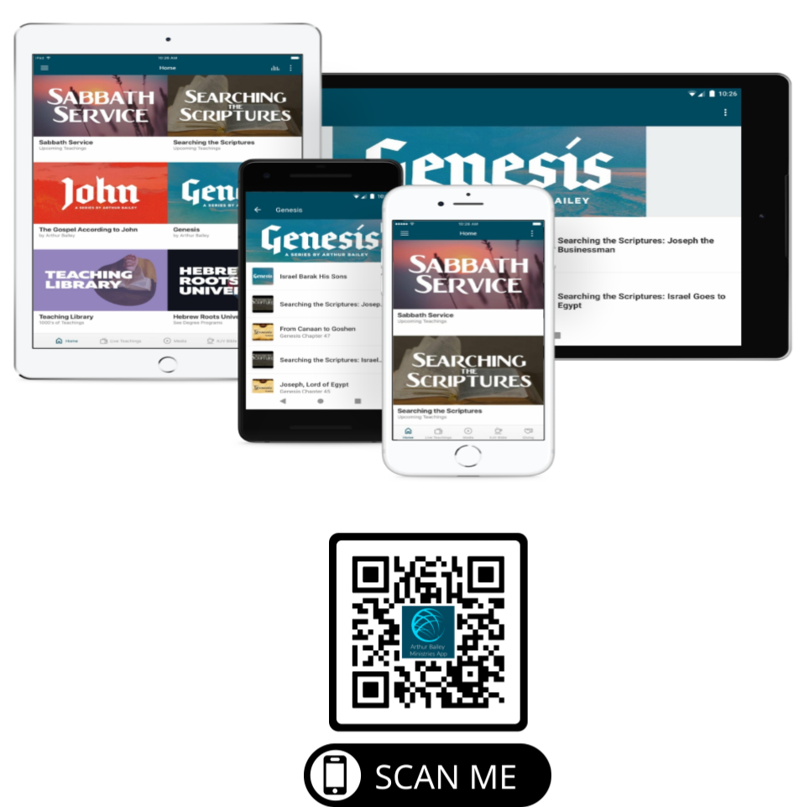

Slide 78
Mail in your support by check or money order.
Our Mailing Address:
P O Box 1182
Fort Mill, SC 29716

Slide 79
You can give by
Texting
Donate – Tithe - Offering
to
704-810-1579

