Slide 3
TODAY’S MESSAGE
Numbers 19:1-22
The Red Heifer

Slide 4
Please Subscribe for Updates on our Website.
Watch us on YouTube.
Follow us on Facebook and the
other Social Media Networks.
Please Like and Share our Videos
and Posts.

Slide 5
At the end of today’s Teaching, you will be able to 1. Ask Questions 2. Receive Prayer 3. Give your Tithes and Offerings

Slide 6
The Vision of House of Israel is to be: 1. A Worshipping People (John 4:23-24) 2. An Evangelistic Community (Acts 2:42-47)

Slide 7
3. A Discipleship Center (Matthew 28:19) 4. An Equipping Network (Ephesians 4:12) 5. And a Worldwide Witness for Yeshua The Messiah
(Acts 1:8)

Slide 9
Prayer

Slide 10
TODAY’S MESSAGE
Numbers 19:1-22
The Red Heifer

Slide 11
The desire of YeHoVaH, the Holy One of Israel, to dwell among His people required the people to be holy as He is Holy. The potential of becoming unclean existed from a variety of sources.
The Red Heifer Instructions were given to Moses to give to the Priests, for the people who became unclean under certain conditions to be rendered clean again, so as not to defile the Tabernacle of YeHoVaH.

Slide 12
In this study, we will delve into the Instructions surrounding the Red Heifer and what is the significance of the Red Heifer today.
There are various ways for people to become unclean and various Instructions for each way a person becomes unclean to become clean again.
This Chapter deals with becoming unclean by coming in contact with the dead.

Slide 13
^{Nu 19:1} And the LORD spake unto Moses and unto Aaron, saying,
YeHoVaH Spoke, Moses wrote.

Slide 14
The Mosaic law is a theological term not a Biblical term.

Slide 15
^{Nu 19:2} This is the ordinance of the law which the LORD hath commanded, saying, Speak unto the children of Israel, that they bring thee a red heifer without spot, wherein is no blemish, and upon which never came yoke:

Slide 16
YeHoVaH commanded Moses to speak to the Children of Israel. Moses wrote what YeHoVaH said, so as not to add or diminish from what YeHoVaH Spoke.
Moses did not rely on his memory when YeHoVaH Spoke. Moses wrote it down; Moses transcribed YeHoVaH’s Words.

Slide 17
The red heifer is a red female cow.

Slide 18
The responsibility of this Command was given to the Priest’s Office. Eleazar, the Priest, was given the task to carry out because he was the Priest in the Office at the time.
This responsibility was given to other Priests after the death of Eleazar and most likely to the descendants of Eleazar’s house.

Slide 19
^{Nu 19:3} And ye shall give her unto Eleazar the priest, that he may bring her forth without the camp, and one shall slay her before his face:

Slide 22
Most likely the person assisting the Priest was a Levite since they were given to the Priests as a gift to serve them.

Slide 23
Notice: The red heifer was not a Sacrifice or Offering and was not put on the Brazen Altar but was to be killed outside the Camp.

Slide 24
^{Nu 19:4} And Eleazar the priest shall take of her blood with his finger, and sprinkle of her blood directly before the tabernacle of the congregation seven times:

Slide 25
Eleazar, the Priest in office at the time, was to take of the blood of the red heifer and sprinkle it before the Tabernacle.
The connection between the red heifer ashes, in the water that cleanses from impurities to the Tabernacle, and to God is made by the sprinkling of the blood by the Priest in front of the Tabernacle.

Slide 26
^{Nu 19:5} And one shall burn the heifer in his sight; her skin, and her flesh, and her blood, with her dung, shall he burn:
^{Nu 19:6} And the priest shall take cedar wood, and hyssop, and scarlet, and cast it into the midst of the burning of the heifer.

Slide 27
^{Nu 19:7} Then the priest shall wash his clothes, and he shall bathe his flesh in water, and afterward he shall come into the camp, and the priest shall be unclean until the even.
^{Nu 19:8} And he that burneth her shall wash his clothes in water, and bathe his flesh in water, and shall be unclean until the even.

Slide 28
^{Nu 19:9} And a man that is clean shall gather up the ashes of the heifer, and lay them up without the camp in a clean place, and it shall be kept for the congregation of the children of Israel for a water of separation: it is a purification for sin.

Slide 29
Separation – 05079 נִדָּה niddah {nid-daw'}
Meaning: 1) impurity, filthiness, menstruous, set apart 1a) impurity 1a1) of ceremonial impurity 1a2) of menstruation 1b) impure thing (fig.) 1b1) of idolatry, immorality
Usage: AV - separation 14, put apart 2, filthiness 2, flowers 2, far 1, set apart 1, menstruous 1, removed 1, unclean thing 1, unclean 1, uncleanness 1, menstruous woman

Slide 30
Although the word translates as niddah, it has nothing to do with a woman that is niddah or menstruous.

Slide 31
^{Nu 19:9} And a man who is clean shall collect the ashes of the heifer and put them outside the camp in a clean place, and they shall be kept for the congregation of the Israelites for the water for impurity; it is a sin offering. AMP

Slide 32
^{NU 19:9} ‘Now a man who is clean shall gather up the ashes of the heifer and deposit them outside the camp in a clean place, and the congregation of the sons of Israel shall keep it as water to remove impurity; it is purification from sin.
NASB

Slide 33
^{Nu 19:9} And a man that is clean shall gather up the ashes of the heifer, and lay them up without the camp in a clean place; and it shall be kept for the congregation of the children of Israel for a water for impurity: it is a sin-offering.
ASV

Slide 34
^{Nu 19:9} And a man that is clean shall gather up the ashes of the heifer, and lay them up without the camp in a clean place; and it shall be kept for the congregation of the children of Israel for a water for impurity: it is a sin-offering.
IST - Israelite Samaritan Text

Slide 35
Everyone involved in the process of preparing the water of impurity from the ashes of the red heifer becomes unclean until evening after washing their clothes and themselves. The ashes are to be kept outside the Camp.

Slide 36
^{Nu 19:10} And he that gathereth the ashes of the heifer shall wash his clothes, and be unclean until the even: and it shall be unto the children of Israel, and unto the stranger that sojourneth among them, for a statute for ever.

Slide 37
The purpose of the water is to remove impurities from those who come in contact with the dead and, according to
Numbers 31:21-24, for the purifying of booty from war.

Slide 38
^{Nu 31:21} And Eleazar the priest said unto the men of war which went to the battle, This is the ordinance of the law which the LORD commanded Moses;
^{Nu 31:22} Only the gold, and the silver, the brass, the iron, the tin, and the lead,

Slide 39
^{Nu 31:23} Every thing that may abide the fire, ye shall make it go through the fire, and it shall be clean: nevertheless it shall be purified with the water of separation: and all that abideth not the fire ye shall make go through the water.
^{Nu 31:24} And ye shall wash your clothes on the seventh day, and ye shall be clean, and afterward ye shall come into the camp.

Slide 40
Those who had gone to war/battle most likely were in the vicinity of those who had been slain or came in contact with the dead.

Slide 41
^{Nu 19:11} He that toucheth the dead body of any man shall be unclean seven days.

Slide 42
The unclean period of the person who comes in contact with a dead body is seven days.
The process of purification is two stages:
Stage One: Purification on the third day
Stage Two: Clean on the seventh day.

Slide 43
^{Nu 19:12} He shall purify himself with it on the third day, and on the seventh day he shall be clean: but if he purify not himself the third day, then the seventh day he shall not be clean.

Slide 44
Purify not – 02398 חטא chata' {khaw-taw'}
Meaning: 1) to sin, miss, miss the way, go wrong, incur guilt, forfeit, purify from uncleanness 1a) (Qal) 1a1) to miss 1a2) to sin, miss the goal or path of right and duty 1a3) to incur guilt, incur penalty by sin, forfeit 1b) (Piel) 1b1) to bear loss 1b2) to make a sin-offering 1b3) to purify from sin 1b4) to purify from uncleanness 1c) (Hiphil)

Slide 45
1c1) to miss the mark 1c2) to induce to sin, cause to sin 1c3) to bring into guilt or condemnation or punishment 1d) (Hithpael) 1d1) to miss oneself, lose oneself, wander from the way 1d2) to purify oneself from uncleanness
Usage: AV - sin 188, purify 11, cleanse 8, sinner 8, committed 6, offended 4, blame 2, done 2, fault 1, harm 1, loss 1, miss 1, offender 1, purge 1, reconciliation 1, sinful 1, trespass 1; 238

Slide 46
There are two time periods of uncleanliness for those were rendered unclean because of the dead.
Until evening, when the day ends, and the new day begins;
Not until morning as some believe that is when the new day starts.

Slide 47
Seven days of evening and mornings, not seven days from sunrise to sunset.
For seven days they are to be outside the Camp.

Slide 48
What cleanses the man who is unclean, is following the Instructions given by YeHoVaH.

Slide 49
^{Nu 19:13} Whosoever toucheth the dead body of any man that is dead, and purifieth not himself, defileth the tabernacle of the LORD; and that soul shall be cut off from Israel: because the water of separation was not sprinkled upon him, he shall be unclean; his uncleanness is yet upon him.

Slide 50
Some would argue that because there is no water of cleansing from impurity from a red heifer today, that it is impossible for people who have come in contact with the dead to be cleansed. We will deal with at the end of this teaching.

Slide 51
^{Nu 19:14} This is the law, when a man dieth in a tent: all that come into the tent, and all that is in the tent, shall be unclean seven days.
^{Nu 19:15} And every open vessel, which hath no covering bound upon it, is unclean.

Slide 52
The open vessel that was open when the death took place is unclean.

Slide 53
^{Nu 19:16} And whosoever toucheth one that is slain with a sword in the open fields, or a dead body, or a bone of a man, or a grave, shall be unclean seven days.

Slide 54
The Water of Impurity

Slide 55
^{Nu 19:17} And for an unclean person they shall take of the ashes of the burnt heifer of purification for sin, and running water shall be put thereto in a vessel:

Slide 56
^{Nu 19:18} And a clean person shall take hyssop, and dip it in the water, and sprinkle it upon the tent, and upon all the vessels, and upon the persons that were there, and upon him that touched a bone, or one slain, or one dead, or a grave:

Slide 57
^{Nu 19:19} And the clean person shall sprinkle upon the unclean on the third day, and on the seventh day: and on the seventh day he shall purify himself, and wash his clothes, and bathe himself in water, and shall be clean at even.

Slide 58
^{Nu 19:20} But the man that shall be unclean, and shall not purify himself, that soul shall be cut off from among the congregation, because he hath defiled the sanctuary of the LORD: the water of separation hath not been sprinkled upon him; he is unclean.

Slide 59
Everyone who comes in contact with the water of cleansing from impurity becomes unclean.

Slide 60
^{Nu 19:21} And it shall be a perpetual statute unto them, that he that sprinkleth the water of separation shall wash his clothes; and he that toucheth the water of separation shall be unclean until even.
^{Nu 19:22} And whatsoever the unclean person toucheth shall be unclean; and the soul that toucheth it shall be unclean until even.

Slide 61
The Significance of the Red Heifer Today
Jews of Judaism
Messianic Judaism
Christian Jews
Christian Zionists

Slide 62
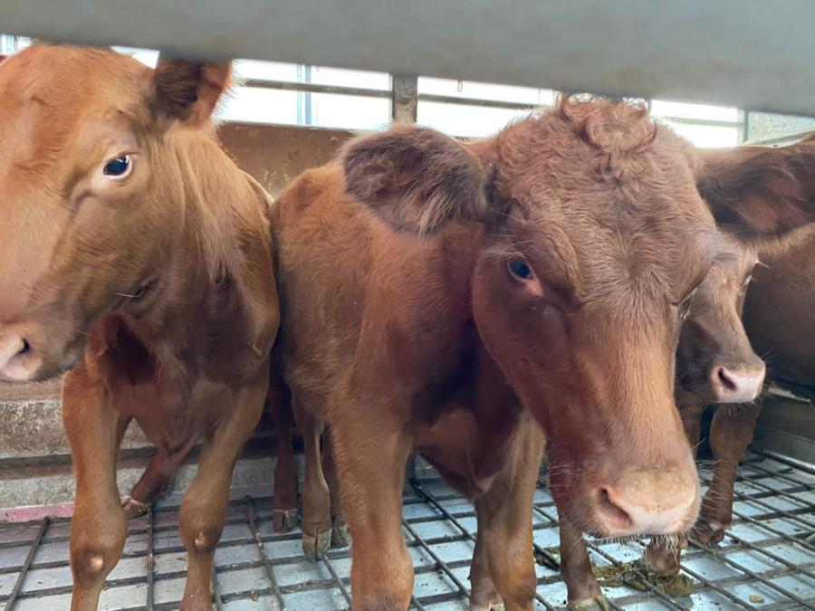
5 Red Heifers sent from Texas to Israel on Sept 15, 2022

Slide 65
Five rabbi-approved red heifers arrived from Texas on Thursday to a ceremonious welcome at Ben-Gurion Airport – and touched off a whirlwind of speculation as to the prophetic significance of their presence in Israel and whether we are barreling toward a third-temple period or the "last days."

Slide 66
The cows have been inspected by rabbis and were found to be red and unblemished, which means they are ritually pure for sacrifice as stipulated under the law of Moses. In order for someone following Mosaic law to become ritually pure, the ashes of a red heifer are required, according to the Book of Numbers.

Slide 67
“This is a requirement of the law that the Lord has commanded: Tell the Israelites to bring you a red heifer without defect or blemish and that has never been under a yoke." Numbers 19:2
The farmers, in Texas, knew enough of the requirements and did not tag the ears of these cows leaving them unblemished.

Slide 68
The presence of these heifers in Israel means that if the temple were to be rebuilt – or if it comes down from the sky, as some believe – sacrifices could already begin and temple service could be restored.
This signifies to many Jews that redemption is now possible. Jews believe that the ashes of a red heifer are needed for purification. Christians believe that Jesus became the once-and-for-all sacrifice needed for salvation.

Slide 69
The Christian organization, Boneh Israel, located the cattle and, along with the Temple Institute, was responsible for getting them to Israel. Earlier in the year, rabbis from the Temple Institute went to Texas to inspect the cows.
While Christians and Jews believe that the third temple signals the End Times or a Messianic era, the third temple is also associated in the New Testament with the "man of perdition," or the anti-Christ, who will be manifested at that time and help build the temple. (2 Thessalonians 2:4)

Slide 70
Followers of the Biblical Messiah Yeshua,
the Son of Elohim,
Messianic Hebrew Roots followers of Yeshua
^{Heb 9:11} But Messiah being come an high priest of good things to come, by a greater and more perfect tabernacle, not made with hands, that is to say, not of this building;

Slide 71
^{Heb 9:12} Neither by the blood of goats and calves, but by his own blood he entered in once into the holy place, having obtained eternal redemption for us. ^{Heb 9:13} For if the blood of bulls and of goats, and the ashes of an heifer sprinkling the unclean, sanctifieth to the purifying of the flesh: ^{Heb 9:14} How much more shall the blood of Messiah, who through the eternal Spirit offered himself without spot to God, purge your conscience from dead works to serve the living God?

Slide 72
Purge – 2511 καθαρίζω katharizo {kath-ar-id'-zo}
Meaning: 1) to make clean, cleanse 1a) from physical stains and dirt 1a1) utensils, food 1a2) a leper, to cleanse by curing 1a3) to remove by cleansing 1b) in a moral sense 1b1) to free from defilement of sin and from faults

Slide 73
1b2) to purify from wickedness 1b3) to free from guilt of sin, to purify 1b4) to consecrate by cleansing or purifying 1b5) to consecrate, dedicate 2) to pronounce clean in a levitical sense
Usage: AV - cleanse 16, make clean 5, be clean 3, purge 3, purify 3; 30

Slide 74
^{Heb 9:15} And for this cause he is the mediator of the new testament, that by means of death, for the redemption of the transgressions that were under the first testament, they which are called might receive the promise of eternal inheritance.

Slide 75
Ashes and Urns

Slide 76
Your support is greatly appreciated and needed.

Slide 78
Our Preferred
Donation Methods:

Slide 79
CashApp – $ABMHOI
Venmo – @Arthur-Bailey-10
Zelle – apostlea@gmail.com

Slide 80
Question and Answer
Period

Slide 82
Mail in your support by check or money order.
Our Mailing Address:
P O Box 1182
Fort Mill, SC 29716

Slide 83
You can give by
Texting
Donate – Tithe - Offering
to
704-810-1579

