Slide 3
TODAY’S MESSAGE
Mark 3:20-35
Was Yeshua demon Possessed?

Slide 4
Please Subscribe for Updates on our Website.
Watch us on YouTube.
Follow us on Facebook and the
other Social Media Networks.
Please Like and Share our Videos
and Posts.

Slide 5
At the end of today’s Teaching, you will be able to 1. Ask Questions 2. Receive Prayer 3. Give your Tithes and Offerings

Slide 6
The Vision of House of Israel is to be: 1. A Worshipping People (John 4:23-24) 2. An Evangelistic Community (Acts 2:42-47)

Slide 7
3. A Discipleship Center (Matthew 28:19) 4. An Equipping Network (Ephesians 4:12) 5. And a Worldwide Witness for Yeshua The Messiah
(Acts 1:8)

Slide 9
Prayer

Slide 10
TODAY’S MESSAGE
Mark 3:20-35
Was Yeshua demon Possessed?

Slide 11
Modern day followers of the Biblical Messiah may wonder why a Kingdom message would be titled “Was Yeshua demon Possessed?”
The prevalent accusations by the religious leaders concerning the origin of Yeshua’s power, that enabled Him to do the miracles He was doing, was believed to have come from beelzebub, prince of the devils.

Slide 12
The accusations of the religious leaders not only caused Yeshua’s own friends, brethren, and mother to question His sanity in His day, but is still circulated and believed by some to this very day.
In our Introduction to the Gospel of Mark, we identified that Mark was written somewhere between AD 50 and AD 70.

Slide 14
We must keep in mind that although the Word is as relevant today as it was when it was written, Mark is an ancient text written over 1,900 years ago. We must look at the Gospel of Mark as best we can through the lens of the people of that generation.

Slide 15
Yeshua’s Ministry was unlike anything the people of His day had ever seen.
People saw Yeshua’s Ministry through their belief systems and what they had been taught and brought up believing.

Slide 16
The supernatural powers Yeshua operated in, manifested in a number of ways from healing the sick, feeding the multitudes, turning water to wine, raising the dead, disputing with the authoritative religious leaders, casting out demons, etc. They were mind blowing to say the least.
How could He operate in such power?
To the religious leaders there was one of two explanations for the source of Yeshua’s powers.

Slide 17
1. His power was from YeHoVaH.
OR
2. His power was from satan.

Slide 18
The Pharisee, Nicodemus, concluded His powers were from YeHoVaH!

Slide 19
^{Jn 3:1} There was a man of the Pharisees, named Nicodemus, a ruler of the Jews:
^{Jn 3:2} The same came to Yeshua by night, and said unto him, Rabbi, we know that thou art a teacher come from God: for no man can do these miracles that thou doest, except God be with him.

Slide 20
The Scribes chose the latter, concluding Yeshua’s power came from satan.
As teachers and so-called legal experts, they influenced the thinking and religious beliefs of the people.

Slide 21
^{Mk 3:20} And the multitude cometh together again, so that they could not so much as eat bread.
^{Mk 3:21} And when his friends heard of it, they went out to lay hold on him: for they said, He is beside himself.

Slide 22
Who were Yeshua’s friends?
Friends – 3844 παρά para {par-ah'}
Meaning: 1) from, of at, by, besides, near
Usage: AV - of 51, with 42, from 24, by ... side 15, at 12, than 11, misc 45; 200
Notes:
¹ friends: or, kinsmen

Slide 23
^{Mk 3:21} And when those who belonged to Him ( His kinsmen) heard it, they went out to take Him by force, for they kept saying, He is out of His mind (beside Himself, deranged)! AMP
^{MK 3:21} When His own people heard of this, they went out to take custody of Him; for they were saying, “ He has lost His senses.” NASB

Slide 24
^{Mk 3:21} And his relatives having heard of it went out to lay hold on him, for they said, He is out of his mind. Darby
^{Mk 3:21} When his family heard what was happening, they tried to take him home with them. “He’s out of his mind,” they said. NLT

Slide 25
²¹ When his family heard it, they went out to restrain him, for people were saying, "He has gone out of his mind." RSV
What is meant by Yeshua’s friends/family saying He was being beside Himself?

Slide 26
Beside himself – 1839 ἐξίστημι existemi {ex-is'-tay-mee} Meaning: 1) to throw out of position, displace 1a) to amaze, to astonish, throw into wonderment 1b) to be amazed, astounded 1c) to be out of one's mind, besides one's self, insane
Usage: AV - be amazed 6, be astonished 5, bewitch 2, be beside (one's) self 2, make astonished 1, wonder 1; 17

Slide 27
Used concerning Simon the sorcerer
^{Ac 8:9} But there was a certain man, called Simon, which beforetime in the same city used sorcery, and bewitched the people of Samaria, giving out that himself was some great one:

Slide 28
^{Ac 8:10} To whom they all gave heed, from the least to the greatest, saying, This man is the great power of God.
^{Ac 8:11} And to him they had regard, because that of long time he had bewitched them with sorceries.

Slide 29
^{Mk 3:22} And the scribes which came down from Jerusalem said, He hath Beelzebub, and by the prince of the devils casteth he out devils.

Slide 30
Scribes – 1122 γραμματεύς grammateus {gram-mat-yooce'} Meaning: 1) a clerk, scribe, esp.a public servant, secretary, recorder, whose office and influence differed in different states 2) in the Bible, a man learned in the Mosaic law and in the sacred writings, an interpreter, teacher. Scribes examined the more difficult and subtle questions of the law; added to the Mosaic law decisions of various kinds thought to elucidate its meaning and scope, and did this to the detriment of religion.

Slide 31
Since the advice of men skilled in the law was needed in the examination in the causes and the solution of the difficult questions, they were enrolled in the Sanhedrin; and are mentioned in connection with the priests and elders of the people. See a Bible Dictionary for more information on the scribes. 3) a religious teacher: so instructed that from his learning and ability to teach advantage may redound to the kingdom of heaven Usage: AV - scribe 66, townclerk 1; 67

Slide 32
Why would the Scribes accuse Yeshua of casting out demons by the prince of devils, indicating He was demon possessed?

Slide 33
^{Mk 3:23} And he called them unto him, and said unto them in parables, How can satan cast out satan?
^{Mk 3:24} And if a kingdom be divided against itself, that kingdom cannot stand.
^{Mk 3:25} And if a house be divided against itself, that house cannot stand.

Slide 34
The same is true with an individual.
If a person is divided within themselves, they are double minded, unstable.

Slide 35
^{Mk 3:26} And if Satan rise up against himself, and be divided, he cannot stand, but hath an end.
^{Mk 3:27} No man can enter into a strong man's house, and spoil his goods, except he will first bind the strong man; and then he will spoil his house.

Slide 36
A person not operating by the power of YeHoVaH might possibly be bound by something or someone stronger than he/she.

Slide 37
^{Mk 3:28} Verily I say unto you, All sins shall be forgiven unto the sons of men, and blasphemies wherewith soever they shall blaspheme:

Slide 38
Blaspheme – 987 βλασφημέω blasphemeo {blas-fay-meh'-o}
Meaning: 1) to speak reproachfully, rail at, revile, calumniate, blaspheme 2) to be evil spoken of, reviled, railed at
Usage: AV - blaspheme 17, speak evil of 10, rail on 2, blasphemer 1, speak blasphemy 1, blasphemously 1, misc 3; 35

Slide 39
^{Mk 3:29} But he that shall blaspheme against the Holy Ghost hath never forgiveness, but is in danger of eternal damnation:

Slide 40
Yeshua was speaking to an audience that understood that blaspheming of the Spirit of God was to blaspheme the Name of God.
To blaspheme the Holy Ghost is to blaspheme YeHoVaH for YeHoVaH is the Holy Ghost.

Slide 41
^{Jn 4:21} Yeshua saith unto her, Woman, believe me, the hour cometh, when ye shall neither in this mountain, nor yet at Jerusalem, worship the Father.
^{Jn 4:22} Ye worship ye know not what: we know what we worship: for salvation is of the Jews.

Slide 42
^{Jn 4:23} But the hour cometh, and now is, when the true worshippers shall worship the Father in spirit and in truth: for the Father seeketh such to worship him.
^{Jn 4:24} God is a Spirit: and they that worship him must worship him in spirit and in truth.

Slide 43
A blasphemer was put to death in the Torah.

Slide 44
^{Lev 24:10} And the son of an Israelitish woman, whose father was an Egyptian, went out among the children of Israel: and this son of the Israelitish woman and a man of Israel strove together in the camp;
^{Lev 24:11} And the Israelitish woman's son blasphemed the name of the LORD, and cursed. And they brought him unto Moses: (and his mother's name was Shelomith, the daughter of Dibri, of the tribe of Dan:)

Slide 45
^{Lev 24:12} And they put him in ward, that the mind of the LORD might be shown them.
^{Lev 24:13} And the LORD spake unto Moses, saying,
^{Lev 24:14} Bring forth him that hath cursed without the camp; and let all that heard him lay their hands upon his head, and let all the congregation stone him.

Slide 46
^{Lev 24:15} And thou shalt speak unto the children of Israel, saying, Whosoever curseth his God shall bear his sin.
^{Lev 24:16} And he that blasphemeth the name of the LORD, he shall surely be put to death, and all the congregation shall certainly stone him: as well the stranger, as he that is born in the land, when he blasphemeth the name of the LORD, shall be put to death.

Slide 47
^{Mk 3:30} Because they said, He hath an unclean spirit.

Slide 48
^{Lk 11:18} If Satan also be divided against himself, how shall his kingdom stand? because ye say that I cast out devils through Beelzebub. ^{Lk 11:19} And if I by Beelzebub cast out devils, by whom do your sons cast them out? therefore shall they be your judges.
^{Lk 11:20} But if I with the finger of God cast out devils, no doubt the kingdom of God is come upon you.

Slide 49
The finger of God

Slide 50
^{Ex 8:19} Then the magicians said unto Pharaoh, This is the finger of God: and Pharaoh's heart was hardened, and he hearkened not unto them; as the LORD had said.

Slide 51
^{Ex 31:18} And he gave unto Moses, when he had made an end of communing with him upon mount Sinai, two tables of testimony, tables of stone, written with the finger of God.

Slide 52
^{Dt 9:10} And the LORD delivered unto me two tables of stone written with the finger of God; and on them was written according to all the words, which the LORD spake with you in the mount out of the midst of the fire in the day of the assembly.

Slide 53
^{Lk 11:20} But if I with the finger of God cast out devils, no doubt the kingdom of God is come upon you.
^{Lk 11:21} When a strong man armed keepeth his palace, his goods are in peace:

Slide 54
^{Lk 11:22} But when a stronger than he shall come upon him, and overcome him, he taketh from him all his armour wherein he trusted, and divideth his spoils.
^{Lk 11:23} He that is not with me is against me: and he that gathereth not with me scattereth.

Slide 55
^{Lk 11:24} When the unclean spirit is gone out of a man, he walketh through dry places, seeking rest; and finding none, he saith, I will return unto my house whence I came out.
^{Lk 11:25} And when he cometh, he findeth it swept and garnished.

Slide 56
^{Lk 11:26} Then goeth he, and taketh to him seven other spirits more wicked than himself; and they enter in, and dwell there: and the last state of that man is worse than the first.
^{Lk 11:27} And it came to pass, as he spake these things, a certain woman of the company lifted up her voice, and said unto him, Blessed is the womb that bare thee, and the paps which thou hast sucked.

Slide 57
^{Lk 11:28} But he said, Yea rather, blessed are they that hear the word of God, and keep it.

Slide 58
^{Mk 3:31} There came then his brethren and his mother, and, standing without, sent unto him, calling him.

Slide 59
Why did Yeshua’s mother and brethren come?

Slide 60
Based on verse 2, the word was spread and reached them that Yeshua was beside Himself, possibly bewitched.

Slide 61
^{Mk 3:32} And the multitude sat about him, and they said unto him, Behold, thy mother and thy brethren without seek for thee.
^{Mk 3:33} And he answered them, saying, Who is my mother, or my brethren?

Slide 62
This response gave credence to them and those who heard Yeshua that maybe what they were saying about Yeshua was true.
The reply seems to imply that Yeshua denounced His perceived biological family for the family of YeHoVaH, those who did the will of His Father.

Slide 63
^{Mk 3:34} And he looked round about on them which sat about him, and said, Behold my mother and my brethren!
^{Mk 3:35} For whosoever shall do the will of God, the same is my brother, and my sister, and mother.

Slide 64
Question and Answer
Period

Slide 65
Your support is greatly appreciated and needed.

Slide 67
Our Preferred
Donation Methods:

Slide 68
CashApp – $ABMHOI
Venmo – @Arthur-Bailey-10
Zelle – apostlea@gmail.com

Slide 69
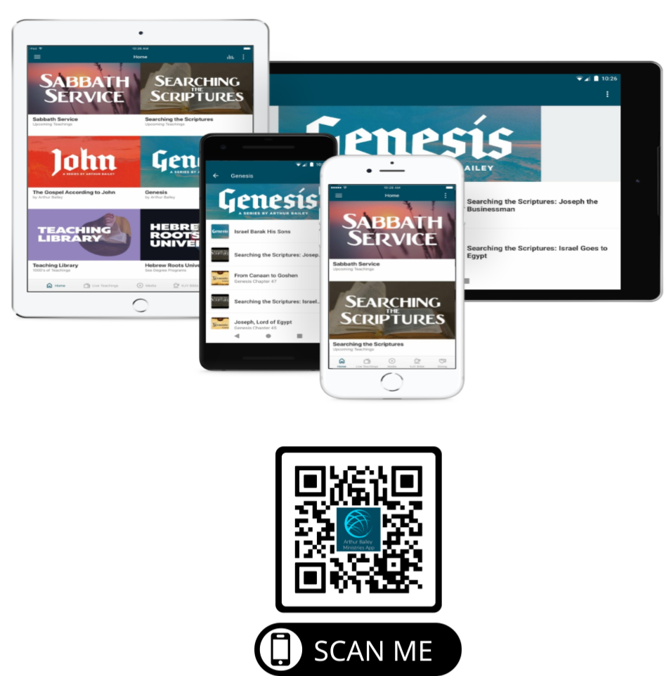

Slide 70
Mail in your support by check or money order.
Our Mailing Address:
P O Box 1182
Fort Mill, SC 29716

Slide 71
You can give by
Texting
Donate – Tithe - Offering
to
704-810-1579

