Slide 3
TODAY’S MESSAGE
Mark 4:26-41
The Power of the Gospel

Slide 4
Please Subscribe for Updates on our Website.
Watch us on YouTube.
Follow us on Facebook and the
other Social Media Networks.
Please Like and Share our Videos
and Posts.

Slide 5
At the end of today’s Teaching, you will be able to 1. Ask Questions 2. Receive Prayer 3. Give your Tithes and Offerings

Slide 6
The Vision of House of Israel is to be: 1. A Worshipping People (John 4:23-24) 2. An Evangelistic Community (Acts 2:42-47)

Slide 7
3. A Discipleship Center (Matthew 28:19) 4. An Equipping Network (Ephesians 4:12) 5. And a Worldwide Witness for Yeshua The Messiah
(Acts 1:8)

Slide 9
Prayer

Slide 10
TODAY’S MESSAGE
Mark 4:26-41
The Power of the Gospel

Slide 11
The Kingdom of God and the Gospel of the Kingdom are inseparable. Yeshua came, the first time, to usher in the invisible Kingdom of the Almighty, All-Powerful God of Abraham, Isaac, and Israel to earth and man, by the Power of the Gospel. His teachings were not fully understood by the people of His day and are still not fully understood by the people of our day.

Slide 12
In this teaching, we will examine the impact of the Power of the Gospel in the lives of those who have ears to hear and its transformative power as taught by Yeshua.

Slide 13
Gospel – 2098 εὐαγγέλιον euaggelion {yoo-ang-ghel'-ee-on} Meaning: 1) a reward for good tidings 2) good tidings 2a) the glad tidings of the kingdom of God soon to be set up, and subsequently also of Yeshua the Messiah, the founder of this kingdom. After the death of Messiah, the term comprises also the preaching of (concerning) Yeshua Messiah as having suffered death on the cross to procure eternal salvation for the men in the kingdom of God, but as restored to life and exalted to the right hand of God in heaven, thence to return in majesty to consummate the kingdom of God

Slide 14
2b) the glad tidings of salvation through Messiah 2c) the proclamation of the grace of God manifest and pledged in Messiah 2d) the gospel 2e) as the messianic rank of Yeshua was proved by his words, his deeds, and his death, the narrative of the sayings, deeds, and death of Yeshua Messiah came to be called the gospel or glad tidings Usage: AV - gospel 46, gospel of Messiah 11, gospel of God 7, gospel of the Kingdom 3, misc 10; 77

Slide 15
It is not the Name Jesus, or Yeshua, or Yahshua, or Yehoshua that saves us.
It is the power of God in the Name Jesus, or Yeshua, or Yahshua, or Yehoshua that saves us.
It is the Power in the Word of God made flesh and called by the name Yeshua.

Slide 16
It is the Word of God that saves us.
You cannot separate the Name from the WORD!
It is the Engrafted Word that is able to save the soul.

Slide 17
People can get so caught up in the Name that they miss, or ignore, that He is the Word of God that is given a human Name.

Slide 18
The Gospel is the Good News.
The Good News is the Word of God.
The Word of God was made flesh and given a human Name (John 1:14).
His Name is called the Word of God.

Slide 19
^{Rev 19:13} And he was clothed with a vesture dipped in blood: and his name is called The Word of God.

Slide 20
When we are baptized/immersed in the Name of Yeshua, we should be being baptized/immersed in the Word.
When we call upon the Name, we are calling on the Word of God.

Slide 21
^{Jn 1:1} In the beginning was the Word, and the Word was with God, and the Word was God.

Slide 22
He sent His Word.
^{Ps 107:19} Then they cry unto the LORD in their trouble, and he saveth them out of their distresses.
^{Ps 107:20} He sent his word, and healed them, and delivered them from their destructions.
^{Ps 107:21} Oh that men would praise the LORD for his goodness, and for his wonderful works to the children of men!

Slide 23
He Sent His Son
^{Jn 3:16} For God so loved the world, that he gave his only begotten Son, that whosoever believeth in him should not perish, but have everlasting life.

Slide 24
^{Jn 3:17} For God sent not his Son into the world to condemn the world; but that the world through him might be saved.
^{Jn 3:18} He that believeth on him is not condemned: but he that believeth not is condemned already, because he hath not believed in the name of the only begotten Son of God.

Slide 25
The Word of God came in human form (Yeshua)
preaching in Parables.

Slide 26
Parables – 3850 παραβολή parabole {par-ab-ol-ay'}
Meaning: 1) a placing of one thing by the side of another, juxtaposition, as of ships in battle 2) metaph. 2a) a comparing, comparison of one thing with another, likeness, similitude 2b) an example by which a doctrine or precept is illustrated

Slide 27
2c) a narrative, fictitious but agreeable to the laws and usages of human life, by which either the duties of men or the things of God, particularly the nature and history of God's kingdom are figuratively portrayed 2d) a parable: an earthly story with a heavenly meaning 3) a pithy and instructive saying, involving some likeness or comparison and having preceptive or admonitory force

Slide 28
3a) an aphorism, a maxim 4) a proverb 5) an act by which one exposes himself or his possessions to danger, a venture, a risk
Usage: AV - parable 46, figure 2, comparison 1, proverb 1; 50

Slide 29
The Parables are illustrations to tell a story.
Understanding the Parable of the Sower is the key to understanding all Parables.
Yeshua is the sower.
The seed is the Word.
The ground is the person that the seed/Word has been sown into.

Slide 30
In this portion of Mark, Yeshua taught two Parables and demonstrated the power of the Word over the storm.

Slide 31
^{Mk 4:26} And he said, So is the kingdom of God, as if a man should cast seed into the ground;

Slide 32
Remember, we discussed last week that the seed is the Word of God.
Yeshua came to preach the Gospel of the Kingdom.
When the seed/word is planted in the soil of men it is designed to produce fruit (fruit of the Spirit), which grows in a man from the inside out like a seed in the ground.
The seed sown is going to eventually show some signs of growth.

Slide 33
^{Mk 4:27} And should sleep, and rise night and day, and the seed should spring and grow up, he knoweth not how.
^{Mk 4:28} For the earth bringeth forth fruit of herself; first the blade, then the ear, after that the full corn in the ear.
^{Mk 4:29} But when the fruit is brought forth, immediately he putteth in the sickle, because the harvest is come.

Slide 34
The Word produces the change in man.
The way the Word works in man is unexplainable like the seed in the ground. But the seed, like the Word, is designed by YeHoVaH to produce fruit unto a harvest .
Yeshua makes a comparison between the Kingdom of YeHoVaH and a grain of mustard seed.

Slide 35
^{Mk 4:30} And he said, Whereunto shall we liken the kingdom of God? or with what comparison shall we compare it?
^{Mk 4:31} It is like a grain of mustard seed, which, when it is sown in the earth, is less than all the seeds that be in the earth:

Slide 36
The Power of the Gospel is its ability to transform the lives of those who receive it and transform them into a powerful figure.
Paul wrote, He was not ashamed of the Gospel for it is the power of God.

Slide 37
^{Ro 1:16} For I am not ashamed of the gospel of Messiah: for it is the power of God unto salvation to every one that believeth; to the Jew first, and also to the Greek.
^{Ro 1:17} For therein is the righteousness of God revealed from faith to faith: as it is written, The just shall live by faith.;

Slide 38
^{Ro 1:18} For the wrath of God is revealed from heaven against all ungodliness and unrighteousness of men, who hold the truth in unrighteousness;

Slide 39
The Gospel, The Word of God, is the Power of God.

Slide 40
^{Mk 4:32} But when it is sown, it groweth up, and becometh greater than all herbs, and shooteth out great branches; so that the fowls of the air may lodge under the shadow of it.
^{Mk 4:33} And with many such parables spake he the word unto them, as they were able to hear it.

Slide 41
The mustard seed is the Word.
The earth is the ground which is man.
The smallest seed/ Word is able to produce a great tree.
The Word of God is truth.
The Word/Truth will make you free.
The Word/Truth of God is quick and powerful.

Slide 42
Hebrews 4:12 (KJV)
For the word of God [is] quick, and powerful, and sharper than any twoedged sword, piercing even to the dividing asunder of soul and spirit, and of the joints and marrow, and [is] a discerner of the thoughts and intents of the heart.

Slide 43
The Word is light.
The Word is a lamp.
The engrafted Word is able to save.

Slide 44
James 1:21 (KJV)
Wherefore lay apart all filthiness and superfluity of naughtiness, and receive with meekness the engrafted word, which is able to save your souls.

Slide 45
Engrafted – 1721 ἔμφυτος emphutos {em'-foo-tos}
Meaning: 1) inborn, implanted by nature, implanted by others instruction
Usage: AV - engrafted 1; 1

Slide 46
In All these Parables, Yeshua spake/preached.

Slide 47
Spake – 2980 λαλέω laleo {lal-eh'-o}
Meaning: 1) to utter a voice or emit a sound 2) to speak 2a) to use the tongue or the faculty of speech 2b) to utter articulate sounds 3) to talk 4) to utter, tell 5) to use words in order to declare one's mind and disclose one's thoughts 5a) to speak
Usage: AV - speak 244, say 15, tell 12, talk 11, preach 6, utter 4, misc 3, vr speak 1; 296

Slide 48
^{Mk 4:34} But without a parable spake he not unto them: and when they were alone, he expounded all things to his disciples.
Yeshua explained the Parables to the Disciples so that they could understand His teachings.

Slide 49
^{Mk 4:35} And the same day, when the even was come, he saith unto them, Let us pass over unto the other side.
^{Mk 4:36} And when they had sent away the multitude, they took him even as he was in the ship. And there were also with him other little ships.

Slide 50
Who was in those ships is not known, but we know that there were many who followed Yeshua.
^{Mk 4:37} And there arose a great storm of wind, and the waves beat into the ship, so that it was now full.

Slide 51
The Disciples were afraid even though Yeshua was in the boat with them.
Some are afraid to step out of the boat, but these Disciples were afraid while being in the boat with Yeshua during a storm.

Slide 52
^{Mk 4:38} And he was in the hinder part of the ship, asleep on a pillow: and they awake him, and say unto him, Master, carest thou not that we perish?
^{Mk 4:39} And he arose, and rebuked the wind, and said unto the sea, Peace, be still. And the wind ceased, and there was a great calm.

Slide 53
Elijah was a man just like us and yet he prayed.
James 5
^{Jas 5:17} Elias was a man subject to like passions as we are, and he prayed earnestly that it might not rain: and it rained not on the earth by the space of three years and six months.
^{Jas 5:18} And he prayed again, and the heaven gave rain, and the earth brought forth her fruit.

Slide 54
Fear is the absence of Faith.
^{Mk 4:40} And he said unto them, Why are ye so fearful? how is it that ye have no faith?

Slide 55
Fearful – 1169 δειλός deilos {di-los'}
Meaning: 1) timid, fearful
Usage: AV - fearful 3; 3

Slide 56
Faith – 4102 πίστις pistis {pis'-tis}
Meaning: 1) conviction of the truth of anything, belief; in the NT of a conviction or belief respecting man's relationship to God and divine things, generally with the included idea of trust and holy fervour born of faith and joined with it 1a) relating to God 1a1) the conviction that God exists and is the creator and ruler of all things, the provider and bestower of eternal salvation through Messiah 1b) relating to Messiah

Slide 57
1b1) a strong and welcome conviction or belief that Yeshua is the Messiah, through whom we obtain eternal salvation in the kingdom of God 1c) the religious beliefs of Messiahians 1d) belief with the predominate idea of trust (or confidence) whether in God or in Messiah, springing from faith in the same 2) fidelity, faithfulness 2a) the character of one who can be relied on Usage: AV - faith 239, assurance 1, believe + 1537 1, belief 1, them that believe 1, fidelity 1; 244

Slide 58
Fear is the absence of Faith.
^{Mk 4:41} And they feared exceedingly, and said one to another, What manner of man is this, that even the wind and the sea obey him?

Slide 59
Fear – 5399 φοβέω (φοβέομαι) phobeo {fob-eh'-o}
Meaning: 1) to put to flight by terrifying (to scare away) 1a) to put to flight, to flee 1b) to fear, be afraid 1b1) to be struck with fear, to be seized with alarm 1b1a) of those startled by strange sights or occurrences

Slide 60
1b1b) of those struck with amazement 1b2) to fear, be afraid of one 1b3) to fear (i.e. hesitate) to do something (for fear of harm) 1c) to reverence, venerate, to treat with deference or reverential obedience
Usage: AV - fear 62, be afraid 23, be afraid of 5, reverence 1, misc 2; 93

Slide 61
Faith in God is
faith in His Word made flesh,
Named Yeshua.
When we abide, remain, continue in His Word we are His Disciples indeed.

Slide 62
^{Jn 8:30} As he spake these words, many believed on him.
^{Jn 8:31} Then said Yeshua to those Jews which believed on him, If ye continue in my word, then are ye my disciples indeed;
^{Jn 8:32} And ye shall know the truth, and the truth shall make you free.

Slide 63
Question and Answer
Period

Slide 64
Your support is greatly appreciated and needed.

Slide 66
Our Preferred
Donation Methods:

Slide 67
CashApp – $ABMHOI
Venmo – @Arthur-Bailey-10
Zelle – apostlea@gmail.com

Slide 68
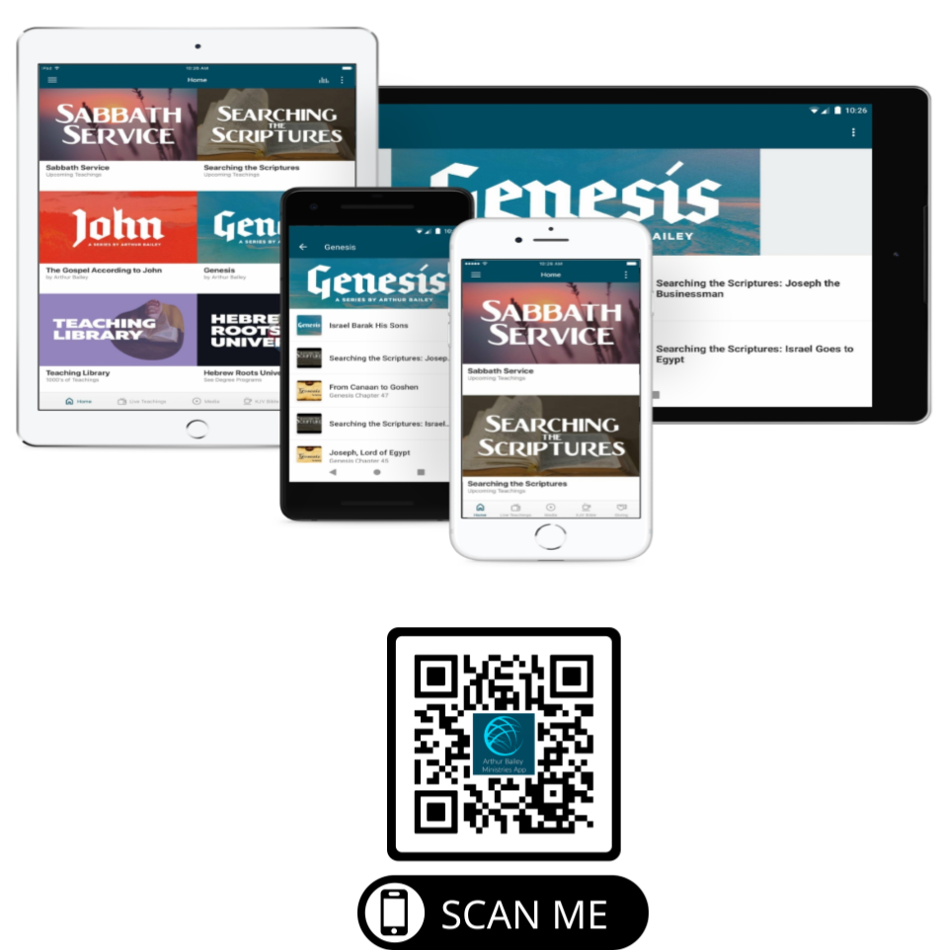

Slide 69
Mail in your support by check or money order.
Our Mailing Address:
P O Box 1182
Fort Mill, SC 29716

Slide 70
You can give by
Texting
Donate – Tithe - Offering
to
704-810-1579

