Slide 3
TODAY’S MESSAGE
Dealing with demons …
Mark 5:1-20

Slide 4
Please Subscribe for Updates on our Website.
Watch us on YouTube
Check out our Shorts and Videos
@ApostleArthurBailey1
Instagram Reels
@ ApostleArthurBailey

Slide 5
Follow us on our
Social Media Networks
Facebook @ ApostleArthurBailey
Instagram @ ApostleArthurBailey
TikTok @ ApostleArthurBailey
And Others

Slide 6
Please Like and Share our Videos
and Posts.

Slide 7
At the end of today’s Teaching, you will be able to 1. Ask Questions 2. Receive Prayer 3. Give your Tithes and Offerings

Slide 8
The Vision of House of Israel is to be: 1. A Worshipping People (John 4:23-24) 2. An Evangelistic Community (Acts 2:42-47)

Slide 9
3. A Discipleship Center (Matthew 28:19) 4. An Equipping Network (Ephesians 4:12) 5. And a Worldwide Witness for Yeshua The Messiah
(Acts 1:8)

Slide 11
Prayer

Slide 12
TODAY’S MESSAGE
Dealing with demons …
Mark 5:1-20

Slide 13
Demonic influences and forces are running rampant in the world around us.
This teaching will offer practical instructions on how to deal with demonic forces and influences.

Slide 14
To deal with demons you must know your authority.
You must walk in that authority.
If you are not prepared to complete the work, don’t start.
You cannot be afraid - Fear cannot cast out fear.

Slide 15
^{Rev 21:7} He that overcometh shall inherit all things; and I will be his God, and he shall be my son.
^{Rev 21:8} But the fearful, and unbelieving, and the abominable, and murderers, and whoremongers, and sorcerers, and idolaters, and all liars, shall have their part in the lake which burneth with fire and brimstone: which is the second death.

Slide 16
Yeshua said to His Disciples in the previous Chapter:
^{Mk 4:35} And the same day, when the even was come, he saith unto them, Let us pass over unto the other side.

Slide 17
^{Mk 5:1} And they came over unto the other side of the sea, into the country of the Gadarenes.

Slide 18
Gadarenes – 1046 Γαδαρηνός Gadarenos {gad-ar-ay-nos'}
Meaning: Gadarenes = "reward at the end" 1) also called Gergesenes, was the capital of Peraea, situated opposite the south extremity of the Lake of Gennesaret to the south-east, but at some distance from the lake on the banks of the river Hieromax
Origin: from Gadara (a town east of the Jordan); Usage: AV - Gadarenes 3; 3

Slide 19
^{Mk 5:2} And when he was come out of the ship, immediately there met him out of the tombs a man with an unclean spirit,

Slide 20
The text tells us that the man had an unclean spirit, indicating one.
We later are informed in the story that the unclean spirit was a multitude of at least two thousand based on the number of swine that were drowned.
However, each swine could have been inhabited by more than one demon as the man who had a multitude of demons inhabiting him all at one time.

Slide 21
^{Mk 5:3} Who had his dwelling among the tombs; and no man could bind him, no, not with chains:
The man dwelt among the tombs, but he moved about freely between the tombs and the mountains.

Slide 22
^{Mk 5:4} Because that he had been often bound with fetters and chains, and the chains had been plucked asunder by him, and the fetters broken in pieces: neither could any man tame him.

Slide 23
The people of the region had dealt with the man, not the unclean spirit.
The people did not know what to do or how to handle legion, so they tried to lock the man away amongst the dead.
The demon possessed man manifested supernatural strength that enabled him to break chains and fetters.

Slide 24
^{Mk 5:5} And always, night and day, he was in the mountains, and in the tombs, crying, and cutting himself with stones.

Slide 25
The man was tormented. He cried out in the mountains and the tombs, night and day, hurting himself.

Slide 26
^{Mk 5:6} But when he saw Yeshua afar off, he ran and worshipped him,

Slide 27
The man ran to Yeshua. The man’s action was an indication that he wanted to be free.
This was the duality of the man’s reality.
Although the man was inhabited by an unclean spirit, the man still had the capacity to recognize Yeshua, run to Him, and worship.

Slide 28
Worshipped – {pros-koo-neh'-o}
Meaning: 1) to kiss the hand to (towards) one, in token of reverence 2) among the Orientals, esp. the Persians, to fall upon the knees and touch the ground with the forehead as an expression of profound reverence

Slide 29
3) in the NT by kneeling or prostration to do homage (to one) or make obeisance, whether in order to express respect or to make supplication 3a) used of homage shown to men and beings of superior rank 3a1) to the Jewish high priests 3a2) to God 3a3) to Messiah 3a4) to heavenly beings 3a5) to demons
Usage: AV - worship 60; 60

Slide 30
The demon speaks.
^{Mk 5:7} And cried with a loud voice, and said, What have I to do with thee, Yeshua, thou Son of the most high God? I adjure thee by God, that thou torment me not.
The spirit spoke in the singular, using the man’s voice.

Slide 31
^{Mk 5:8} For he said unto him, Come out of the man, thou unclean spirit.
Yeshua had commanded the spirit to come out.

Slide 32
Manifestations of the unclean spirit
The demons had the man living amongst the tombs, but the man had a home.
Recognition of the Savior
Extraordinary strength
Violent behavior

Slide 33
Tormented day and night
Inability to sleep – restlessness
Crying out – uncontrollable outbursts
Cutting himself with stones
Fearful of destruction

Slide 34
^{Mk 5:9} And he asked him, What is thy name? And he answered, saying, My name is Legion: for we are many.

Slide 35
Legion – 3003 λεγιών legion {leg-i-ohn'}
Meaning: 1) a legion, a body of soldiers whose number differed at different times, and in the time of Augustus seems to have consisted of 6826 men (i.e. 6100 foot soldiers, and 726 horsemen)
Usage: AV - legion 4; 4

Slide 36
Legion was a unit of multiple spirits.
Yeshua had to deal with the unclean spirit in order to free the man.
This demonic activity was difficult to pinpoint exactly what unclean spirit was in operation because there were many.
Yeshua had said come out, but the unclean spirit remained and entered into negotiations with Yeshua.

Slide 37
Yeshua’s encounter led Him to identify the unclean spirit He was dealing with.
Legion knew he had to abandon the man, but wanted to have some say in staying in the region.
Legion, wanting to stay in the country, indicated it was a regional cluster of spirits familiar with its environments and the people.

Slide 38
^{Mk 5:10} And he besought him much that he would not send them away out of the country.
First, legion speaks for the group of devils.

Slide 39
^{Mk 5:11} Now there was there nigh unto the mountains a great herd of swine feeding.

Slide 40
Next, the devils began speaking for themselves.
^{Mk 5:12} And all the devils besought him, saying, Send us into the swine, that we may enter into them.

Slide 41
Devils – 1142 δαίμων daimon {dah'-ee-mown}
Meaning: 1) a god, a goddess 1a) an inferior deity, whether good or bad 2) in the NT, an evil spirit
Usage: AV - devils 4, devil 1; 5

Slide 42
Besought – 3870 παρακαλέω parakaleo {par-ak-al-eh'-o}
Meaning: 1) to call to one's side, call for, summon 2) to address, speak to, (call to, call upon), which may be done in the way of exhortation, entreaty, comfort, instruction, etc. 2a) to admonish, exhort 2b) to beg, entreat, beseech 2b1) to strive to appease by entreaty

Slide 43
2c) to console, to encourage and strengthen by consolation, to comfort 2c1) to receive consolation, be comforted 2d) to encourage, strengthen 2e) exhorting and comforting and encouraging 2f) to instruct, teach
Usage: AV - beseech 43, comfort 23, exhort 21, desire 8, pray 6, intreat 3, misc 4, vr besought 1; 109

Slide 44
I can only imagine what this conversation sounded like when all the demons spoke and besought Yeshua in agreement.
All the devils were in agreement.

Slide 45
^{Mk 5:13} And forthwith Yeshua gave them leave. And the unclean spirits went out, and entered into the swine: and the herd ran violently down a steep place into the sea, (they were about two thousand;) and were choked in the sea.

Slide 46
Observations
Unclean spirits can enter animals.
The swine were fine until the unclean spirits entered them.
The demons drove two thousand swine into the lake, and they drowned.

Slide 47
With all those demons, the man only cut himself.
The devils harmed the man but did not drive the man into the lake to drown.

Slide 48
^{Mk 5:14} And they that fed the swine fled, and told it in the city, and in the country. And they went out to see what it was that was done.
^{Mk 5:15} And they come to Yeshua, and see him that was possessed with the devil, and had the legion, sitting, and clothed, and in his right mind: and they were afraid.

Slide 49
Possessed – 1139 δαιμονίζομαι daimonizomai {dahee-mon-id'-zom-ahee}
Meaning: 1) to be under the power of a demon.
Usage: AV - possessed with devils 4, possessed with the devil 3, of the devils 2, vexed with a devil 1, possessed with a devil 1, have a devil 1; 13

Slide 50
Misc: In the NT, these are persons, afflicted with especially severe diseases, either bodily or mentally, (such as paralysis, blindness, deafness, loss of speech, epilepsy, melancholy, insanity, etc.) whose bodies in the opinion of the Jews demons had entered, and so held possession of them as not only to afflict them with ills, but also to dethrone the reason and take its place themselves; accordingly the possessed were wont to express the mind and consciousness of the demons dwelling in them; and their cure was thought to require the expulsion of the demon.

Slide 51
Why were they afraid?
^{Mk 5:16} And they that saw it told them how it befell to him that was possessed with the devil, and also concerning the swine.

Slide 52
The keepers of the swine, who witnessed the event, told them, that came out to see, what had happened to the man and the swine.

Slide 53
^{Mk 5:17} And they began to pray him to depart out of their coasts.
^{Mk 5:18} And when he was come into the ship, he that had been possessed with the devil prayed him that he might be with him.

Slide 54
Yeshua instructed the man to go home and tell his friends of the great things that had been done for him.
^{Mk 5:19} Howbeit Yeshua suffered him not, but saith unto him, Go home to thy friends, and tell them how great things the Lord hath done for thee, and hath had compassion on thee.

Slide 55
Tell – 312 ἀναγγέλλω anaggello {an-ang-el'-lo}
Meaning: 1) to announce, make known 2) to report, bring back tidings, rehearse
Usage: AV - tell 6, show 6, declare 3, rehearse 1, speak 1, report 1; 18

Slide 56
The man had a home and friends or people who knew him.
^{Mk 5:20} And he departed, and began to publish in Decapolis how great things Yeshua had done for him: and all men did marvel.

Slide 57
Publish – 2784 κηρύσσω kerusso {kay-roos'-so}
Meaning: 1) to be a herald, to officiate as a herald 1a) to proclaim after the manner of a herald 1b) always with the suggestion of formality, gravity and an authority which must be listened to and obeyed 2) to publish, proclaim openly: something which has been done

Slide 58
3) used of the public proclamation of the gospel and matters pertaining to it, made by John the Baptist, by Yeshua, by the apostles and other Messianic teachers
Usage: AV - preach 51, publish 5, proclaim 2, preached + 2258 2, preacher 1; 61

Slide 59
From demon possessed to Evangelizing
At the end of this event, Yeshua and His Disciples passed back over to the side of the Galilee from whence they came.
It appears from the event that Yeshua had only one purpose for going to the other side because He only ministered to one person on the other side.

Slide 60
However, that one person, Yeshua ministered to, ministered to so many.
Never underestimate or take for granted the person you minister to, deliver, or heal. You never know the extent of the ministry that will come from that one person, and in this case, from someone who had been discarded by the people of the region.

Slide 61
On the surface, it seems Yeshua ministered to only one person, but the conclusion of the matter shows that Yeshua was ministering to a multitude simply by ministering to the one man.
One person being set free can minister to so many.
The unclean spirit recognized Yeshua as the Son of Elohim and wanted Yeshua to swear before YeHoVaH that He would not torment it.

Slide 62
In this case, all the unclean spirits inhabited one person.
Regional or country spirits and/or familiar spirits operate in areas, places, and ways that seem natural to the people in those regions or country.

Slide 63
Cultural norms
Superstitious
Slang
Sayings
Old wives’ tales
Religious manifestations of dance, shaking, running, laughter, etc.
Voodoo, witchcraft, sorcery

Slide 64
In some cases, these unclean spirits inhabit certain people who can make themselves seem important to the people of the region as wise; and people of the region consult them for guidance, direction, and advice on the future and decisions they need to make.

Slide 65
The world today is filled with people manifesting
unclean spirits.

Slide 66
The natural world only knows how to deal with natural people in a natural way.
Jails and prisons
Mental institutions
Treatment centers
Conversion therapy
Doctors and therapists that treat symptoms not the spirit.

Slide 67
Yeshua, the great therapist, identified the spirit, casted the spirit out of the man, and went back to the other side.
Before He left, He commanded the man or commissioned the man to evangelize his friends and tell them what had happened to him.

Slide 68
Your support is greatly appreciated and needed.

Slide 70
Our Preferred
Donation Methods:

Slide 71
CashApp – $ABMHOI
Venmo – @Arthur-Bailey-10
Zelle – apostlea@gmail.com

Slide 72
Question and Answer
Period

Slide 73
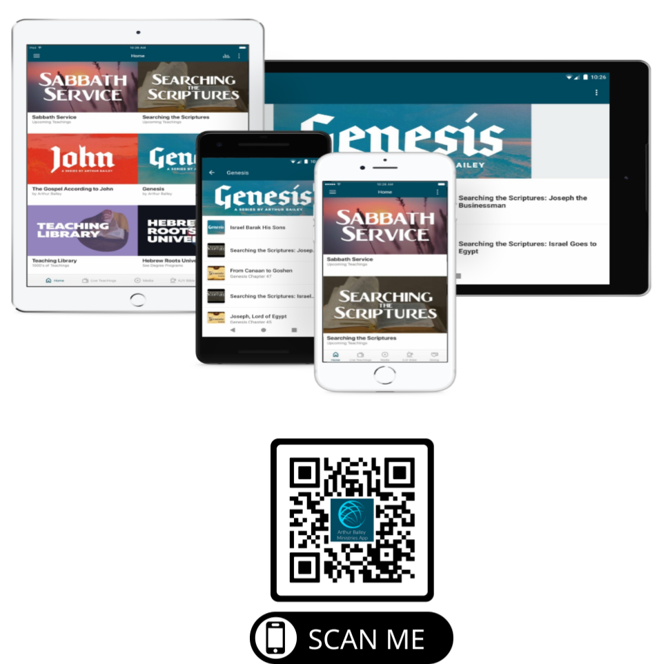

Slide 74
Mail in your support by check or money order.
Our Mailing Address:
P O Box 1182
Fort Mill, SC 29716

Slide 75
You can give by
Texting
Donate – Tithe - Offering
to
704-810-1579

