Slide 3
TODAY’S MESSAGE
Numbers 20:1-29
Moses’ and Aaron’s Rebellion

Slide 4
Please Subscribe for Updates on our Website.
Watch us on YouTube.
Follow us on Facebook and the
other Social Media Networks.
Please Like and Share our Videos
and Posts.

Slide 5
At the end of today’s Teaching, you will be able to 1. Ask Questions 2. Receive Prayer 3. Give your Tithes and Offerings

Slide 6
The Vision of House of Israel is to be: 1. A Worshipping People (John 4:23-24) 2. An Evangelistic Community (Acts 2:42-47)

Slide 7
3. A Discipleship Center (Matthew 28:19) 4. An Equipping Network (Ephesians 4:12) 5. And a Worldwide Witness for Yeshua The Messiah
(Acts 1:8)

Slide 9
Prayer

Slide 10
TODAY’S MESSAGE
Numbers 20:1-29
Moses’ and Aaron’s Rebellion

Slide 11
Rebellion against YeHoVaH ignites His wrath and the wrath of YeHoVaH is directed at those who rebel.
Such was the case of the Israelites in the wilderness and with Aaron and Moses after they rebelled against YeHoVaH’s Instructions.

Slide 12
After the death of Aaron’s and Moses’ sister, Miriam, the people rose up against Moses and Aaron again.
This time, the rebellion of the Children of Israel led to Moses and Aaron rebelling against YeHoVaH by adding to the Instructions of YeHoVaH.
This resulted in catastrophic consequences.

Slide 13
For me, as a leader, this is one of the most important passages in the Bible.

Slide 14
^{Nu 20:1} Then came the children of Israel, even the whole congregation, into the desert of Zin in the first month: and the people abode in Kadesh; and Miriam died there, and was buried there.

Slide 15
Very little is said about Miriam in the Bible.
Was she married?
Did she have children?
How old was she?
However, she was a significant person of influence amongst the Children of Israel.

Slide 16
Micah wrote:
^{Mic 6:4} For I brought thee up out of the land of Egypt, and redeemed thee out of the house of servants; and I sent before thee Moses, Aaron, and Miriam.

Slide 17
Israel rebels against Moses and Aaron again.

Slide 18
^{Nu 20:2} And there was no water for the congregation: and they gathered themselves together against Moses and against Aaron.
^{Nu 20:3} And the people chode with Moses, and spake, saying, Would God that we had died when our brethren died before YeHoVaH!

Slide 19
^{Nu 20:4} And why have ye brought up the congregation of YeHoVaH into this wilderness, that we and our cattle should die there?
^{Nu 20:5} And wherefore have ye made us to come up out of Egypt, to bring us in unto this evil place? it is no place of seed, or of figs, or of vines, or of pomegranates; neither is there any water to drink.

Slide 20
YeHoVaH knew the people needed food and drink. He provided them what He wanted them to have.
When they wanted something, they murmured and complained instead of simply asking.
Matthew 6:8 Be not ye therefore like unto them: for your Father knoweth what things ye have need of, before ye ask him.

Slide 21
^{Nu 20:6} And Moses and Aaron went from the presence of the assembly unto the door of the tabernacle of the congregation, and they fell upon their faces: and the glory of YeHoVaH appeared unto them.

Slide 22
YeHoVaH Spoke to Moses and gave specific Instructions for Aaron and him to follow.

Slide 23
^{Nu 20:7} And YeHoVaH spake unto Moses, saying,
^{Nu 20:8} Take the rod, and gather thou the assembly together, thou, and Aaron thy brother, and speak ye unto the rock before their eyes; and it shall give forth his water, and thou shalt bring forth to them water out of the rock: so thou shalt give the congregation and their beasts drink.

Slide 24
^{Nu 20:9} And Moses took the rod from before YeHoVaH, as he commanded him.
Moses was angered by the rebellion of the people.

Slide 25
^{Nu 20:10} And Moses and Aaron gathered the congregation together before the rock, and he said unto them, Hear now, ye rebels; must we fetch you water out of this rock?
“Must we” was referring to Aaron and himself.

Slide 26
Moses’ actions added to, or changed, the Instructions YeHoVaH gave him.
YeHoVaH said speak to the rock, Moses hit the rock.
YeHoVaH had told Moses to hit the rock forty years earlier, but this time, He instructed Moses to speak to the rock.

Slide 27
^{Ex 16:1} And they took their journey from Elim, and all the congregation of the children of Israel came unto the wilderness of Sin, which is between Elim and Sinai, on the fifteenth day of the second month after their departing out of the land of Egypt.

Slide 28
^{Ex 17:6} Behold, I will stand before thee there upon the rock in Horeb; and thou shalt smite the rock, and there shall come water out of it, that the people may drink. And Moses did so in the sight of the elders of Israel.
^{Ex 17:7} And he called the name of the place Massah, and Meribah, because of the chiding of the children of Israel, and because they tempted YeHoVaH, saying, Is YeHoVaH among us, or not?

Slide 29
^{Ex 19:1} In the third month, when the children of Israel were gone forth out of the land of Egypt, the same day came they into the wilderness of Sinai.

Slide 30
^{Nu 20:11} And Moses lifted up his hand, and with his rod he smote the rock twice: and the water came out abundantly, and the congregation drank, and their beasts also.

Slide 31
Moses heard the Word but did not do the Word he heard. He was a hearer only and not a doer in this event.
^{Ro 2:13} (For not the hearers of the law are just before God, but the doers of the law shall be justified.

Slide 32
^{Jas 1:21} Wherefore lay apart all filthiness and superfluity of naughtiness, and receive with meekness the engrafted word, which is able to save your souls.
^{Jas 1:22} But be ye doers of the word, and not hearers only, deceiving your own selves.

Slide 33
^{Jas 1:23} For if any be a hearer of the word, and not a doer, he is like unto a man beholding his natural face in a glass:
^{Jas 1:24} For he beholdeth himself, and goeth his way, and straightway forgetteth what manner of man he was.

Slide 34
^{Jas 1:25} But whoso looketh into the perfect law of liberty, and continueth therein, he being not a forgetful hearer, but a doer of the work, this man shall be blessed in his deed.

Slide 35
When James wrote these words, the New Testament did not exist.

Slide 36
^{Nu 20:12} And YeHoVaH spake unto Moses and Aaron, Because ye believed me not, to sanctify me in the eyes of the children of Israel, therefore ye shall not bring this congregation into the land which I have given them.

Slide 37
Moses and Aaron did not believe and did not sanctify YeHoVaH in the eyes of the people.

Slide 38
Believed – 0539 אָמַן ‘aman {aw-man'}
Meaning: 1) to support, confirm, be faithful 1a) (Qal) 1a1) to support, confirm, be faithful, uphold, nourish 1a1a) foster-father (subst.) 1a1b) foster-mother, nurse 1a1c) pillars, supporters of the door 1b) (Niphal) 1b1) to be established, be faithful, be carried, make firm 1b1a) to be carried by a nurse 1b1b) made firm, sure, lasting 1b1c) confirmed, established, sure 1b1d) verified, confirmed 1b1e) reliable, faithful, trusty

Slide 39
1c) (Hiphil) 1c1) to stand firm, to trust, to be certain, to believe in 1c1a) stand firm 1c1b) trust, believe
Usage: AV - believe 44, assurance 1, faithful 20, sure 11, established 7, trust 5, verified 3, stedfast 2, continuance 2, father 2, bring up 4, nurse 2, be nursed 1, surely be 1, stand fast 1, fail 1, trusty 1; 108

Slide 40
Sanctify – 06942 קָדַשׁ qadash {kaw-dash'} Meaning: 1) to consecrate, sanctify, prepare, dedicate, be hallowed, be holy, be sanctified, be separate 1a) (Qal) 1a1) to be set apart, be consecrated 1a2) to be hallowed 1a3) consecrated, tabooed 1b) (Niphal) 1b1) to show oneself sacred or majestic 1b2) to be honoured, be treated as sacred 1b3) to be holy 1c) (Piel) 1c1) to set apart as sacred, consecrate, dedicate 1c2) to observe as holy, keep sacred 1c3) to honour as sacred, hallow 1c4) to consecrate 1d)

Slide 41
(Pual) 1d1) to be consecrated 1d2) consecrated, dedicated 1e) (Hiphil) 1e1) to set apart, devote, consecrate 1e2) to regard or treat as sacred or hallow 1e3) to consecrate 1f) (Hithpael) 1f1) to keep oneself apart or separate 1f2) to cause Himself to be hallowed (of God) 1f3) to be observed as holy 1f4) to consecrate oneself
Usage: AV - sanctify 108, hallow 25, dedicate 10, holy 7, prepare 7, consecrate 5, appointed 1, bid 1, purified 1, misc 7; 172

Slide 42
Moses’ and Aaron’s actions caused the people to look to them as the provider and not to YeHoVaH.
Had Moses followed YeHoVaH’s Instructions, YeHoVaH would have been sanctified in the eyes of the people.

Slide 43
^{Nu 20:13} This is the water of Meribah; because the children of Israel strove with YeHoVaH, and he was sanctified in them.

Slide 44
Both the Psalmist and the Hebrew writer reminded the people of YeHoVaH of this event as an example.

Slide 45
^{Ps 106:32} They angered him also at the waters of strife, so that it went ill with Moses for their sakes:
^{Ps 106:33} Because they provoked his spirit, so that he spake unadvisedly with his lips.

Slide 46
^{Heb 3:7} Wherefore (as the Holy Ghost saith, Today if ye will hear his voice,
^{Heb 3:8} Harden not your hearts, as in the provocation, in the day of temptation in the wilderness:
^{Heb 3:9} When your fathers tempted me, proved me, and saw my works forty years.

Slide 47
^{Heb 3:10} Wherefore I was grieved with that generation, and said, They do always err in their heart; and they have not known my ways.
^{Heb 3:11} So I sware in my wrath, They shall not enter into my rest.)
^{Heb 3:12} Take heed, brethren, lest there be in any of you an evil heart of unbelief, in departing from the living God.

Slide 48
^{Heb 3:13} But exhort one another daily, while it is called Today; lest any of you be hardened through the deceitfulness of sin.
^{Heb 3:14} For we are made partakers of Messiah, if we hold the beginning of our confidence stedfast unto the end;
^{Heb 3:15} While it is said, Today if ye will hear his voice, harden not your hearts, as in the provocation.

Slide 49
^{Heb 3:16} For some, when they had heard, did provoke: howbeit not all that came out of Egypt by Moses.
^{Heb 3:17} But with whom was he grieved forty years? was it not with them that had sinned, whose carcases fell in the wilderness?

Slide 50
^{Heb 3:18} And to whom sware he that they should not enter into his rest, but to them that believed not?
^{Heb 3:19} So we see that they could not enter in because of unbelief.

Slide 51
^{Nu 20:14} And Moses sent messengers from Kadesh unto the king of Edom, Thus saith thy brother Israel, Thou knowest all the travail that hath befallen us:

Slide 52
The people of Edom, the Edomites, were the brothers of Israel, the Israelites.

Slide 53
Edom – 0123 אֱדֹם 'Edom {ed-ome'} or (fully) אֱדוֹם 'Edowm {ed-ome'}
Meaning: Edom = "red" 1) Edom 2) Edomite, Idumean - descendants of Esau 3) land of Edom, Idumea - land south and south east of Palestine
Usage: AV - Edom 87, Edomites 9, Idumea 4; 100

Slide 54
^{Nu 20:15} How our fathers went down into Egypt, and we have dwelt in Egypt a long time; and the Egyptians vexed us, and our fathers:
^{Nu 20:16} And when we cried unto YeHoVaH, he heard our voice, and sent an angel, and hath brought us forth out of Egypt: and, behold, we are in Kadesh, a city in the uttermost of thy border:

Slide 55
^{Nu 20:17} Let us pass, I pray thee, through thy country: we will not pass through the fields, or through the vineyards, neither will we drink of the water of the wells: we will go by the king's high way, we will not turn to the right hand nor to the left, until we have passed thy borders. ^{Nu 20:18} And Edom said unto him, Thou shalt not pass by me, lest I come out against thee with the sword.

Slide 56
^{Nu 20:19} And the children of Israel said unto him, We will go by the high way: and if I and my cattle drink of thy water, then I will pay for it: I will only, without doing any thing else, go through on my feet.
^{Nu 20:20} And he said, Thou shalt not go through. And Edom came out against him with much people, and with a strong hand.

Slide 57
^{Nu 20:21} Thus Edom refused to give Israel passage through his border: wherefore Israel turned away from him.
^{Nu 20:22} And the children of Israel, even the whole congregation, journeyed from Kadesh, and came unto mount Hor.

Slide 58
^{Nu 20:23} And YeHoVaH spake unto Moses and Aaron in mount Hor, by the coast of the land of Edom, saying,
The death of Aaron was because of his rebellion.

Slide 59
^{Nu 20:24} Aaron shall be gathered unto his people: for he shall not enter into the land which I have given unto the children of Israel, because ye rebelled against my word at the water of Meribah.
^{Nu 20:25} Take Aaron and Eleazar his son, and bring them up unto mount Hor:

Slide 60
Aaron was stripped of his garments; basically, fired from the Priesthood because of his rebellion against YeHoVaH.
How can you serve YeHoVaH and rebel against Him, by not following His Instructions, and He be OK with that?

Slide 61
^{Nu 20:26} And strip Aaron of his garments, and put them upon Eleazar his son: and Aaron shall be gathered unto his people, and shall die there.
^{Nu 20:27} And Moses did as YeHoVaH commanded: and they went up into mount Hor in the sight of all the congregation.

Slide 62
^{Nu 20:28} And Moses stripped Aaron of his garments, and put them upon Eleazar his son; and Aaron died there in the top of the mount: and Moses and Eleazar came down from the mount.

Slide 63
Aaron went up into the mountain with Moses and Eleazar but did not return with them. The people saw that as the indication that Aaron was dead.

Slide 64
^{Nu 20:29} And when all the congregation saw that Aaron was dead, they mourned for Aaron thirty days, even all the house of Israel.

Slide 65
It seems Miriam, Aaron, and Moses all died the same year.
Miriam died at the beginning of the Chapter.
Aaron dies at the end of the Chapter.
Moses would have died shortly afterwards based on his age when he died.

Slide 66
According to:
^{Nu 33:39} And Aaron was an hundred and twenty and three years old when he died in mount Hor.

Slide 67
^{Ex 7:7} Moses was eighty years old and Aaron eighty-three when they spoke to Pharaoh.
Aaron was three years older than Moses.

Slide 68
According to:
^{Dt 34:7} And Moses was an hundred and twenty years old when he died: his eye was not dim, nor his natural force abated.

Slide 69
The people who resisted Aaron, rose up against Aaron, rebelled against him, and virtually were the catalyst for his death, mourned his death for thirty days.
Some people will give you more respect when you are dead than they give you when you are alive.

Slide 70
Question and Answer
Period

Slide 71
Your support is greatly appreciated and needed.

Slide 73
Our Preferred
Donation Methods:

Slide 74
CashApp – $ABMHOI
Venmo – @Arthur-Bailey-10
Zelle – apostlea@gmail.com

Slide 75
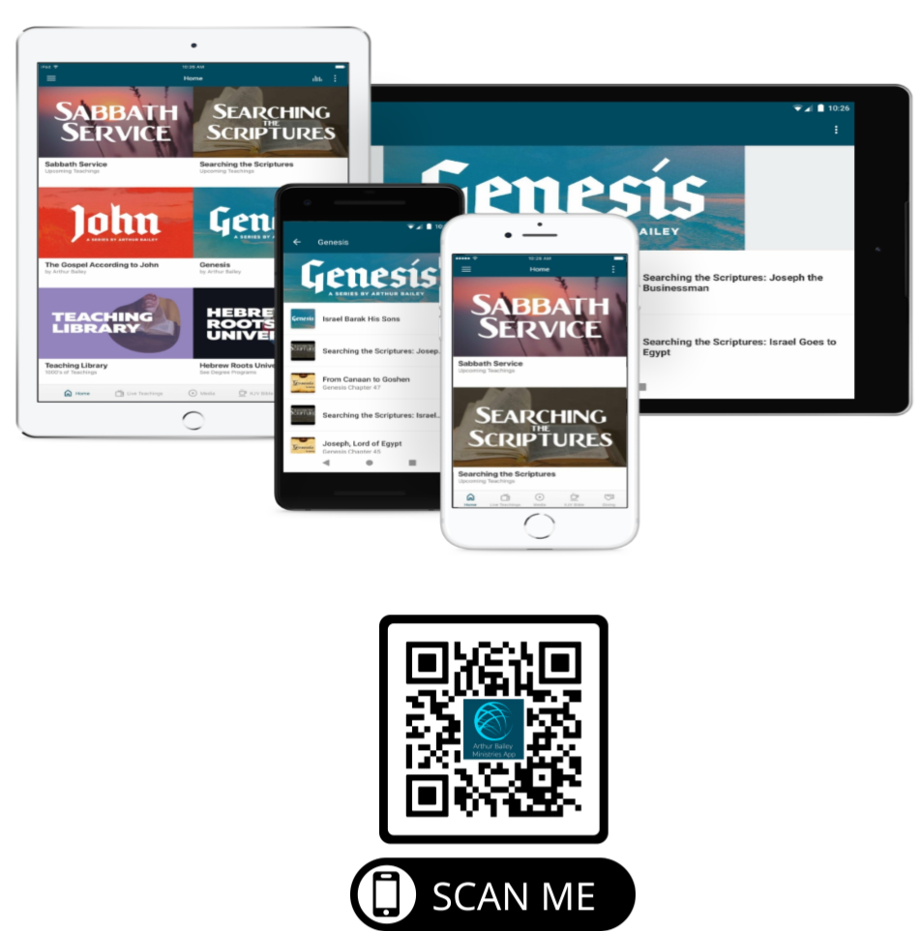

Slide 76
Mail in your support by check or money order.
Our Mailing Address:
P O Box 1182
Fort Mill, SC 29716

Slide 77
You can give by
Texting
Donate – Tithe - Offering
to
704-810-1579

