Slide 4
TODAY’S MESSAGE
The Evolution of the American Gospel
Part 5
The Separation of the Testaments and Its Impact
Part 2

Slide 5
Please Subscribe for Updates on our Website.
Watch us on YouTube.
Follow us on Facebook and the
other Social Media Networks.
Please Like and Share our Videos
and Posts.

Slide 6
At the end of today’s Teaching, you will be able to 1. Ask Questions 2. Receive Prayer 3. Give your Tithes and Offerings

Slide 7
The Vision of House of Israel is to be: 1. A Worshipping People (John 4:23-24) 2. An Evangelistic Community (Acts 2:42-47)

Slide 8
3. A Discipleship Center (Matthew 28:19) 4. An Equipping Network (Ephesians 4:12) 5. And a Worldwide Witness for Yeshua The Messiah
(Acts 1:8)

Slide 10
Prayer

Slide 11
TODAY’S MESSAGE
The Evolution of the American Gospel
Part 5
The Separation of the Testaments and Its Impact
Part 2

Slide 12
The Separation of the Testaments and Its Impact
Part 2

Slide 13
BCE = Before Common Era
BC = Before Christ
CE = Common Era
AD = Anni Domini (in the year of Our Lord)
After the Birth of Yeshua

Slide 14
The Languages Divided

Slide 15
^{Joh 19:19} And Pilate wrote a title, and put it on the cross. And the writing was, JESUS OF NAZARETH THE KING OF THE JEWS.
²⁰ This title then read many of the Jews: for the place where Jesus was crucified was nigh to the city: and it was written in Hebrew, and Greek, and Latin.

Slide 16
The languages spoken during the time of Yeshua’s earthly Ministry were
Hebrew (Aramaic)
Greek (Koine) and
Latin.

Slide 17
Hebrews – 1445 Ἑβραῖος Hebraios {heb-rah'-yos}
Meaning: 1) Hebrew 1a) any one of the Jewish or Israelitish nations 2) in a narrower sense, those who live in Palestine and use the language of the country 3) all Jewish Christians, whether they spoke Aramaic or Greek
Usage: AV - Hebrew 5; 5

Slide 18
1676 Ἑλληνιστί Hellenisti {hel-lay-nis-tee'}
Meaning: 1) in Greek, the Greek language
Origin: from the same as 1675; TDNT - 2:504,227; adv
Usage: AV - Greek 2; 2

Slide 19
Latin – 4515 Ῥωμαϊστί Rhomaisti {hro-mah-is-tee'}
Meaning: Latin = "of Rome's strength" 1) the language spoken by the Romans
Usage: AV - Latin 1; 1

Slide 20
At the time of Yeshua, the Apostles, and throughout the Acts of the Apostles, the New Testament had not been written.
And, before there was a New Testament there was the Old Testament known as the Tanakh.

Slide 21
According to the Talmud, much of the Tanakh was compiled by the men of the Great Assembly, a task completed in 450 BCE, and it has remained unchanged ever since.

Slide 22
The Tanakh consists of twenty-four books.
Counted as one Book each are:
1 & 2 Samuel
1 & 2 Kings
1 & 2 Chronicles
Ezra & Nehemiah
The Twelve Minor Prophets
(תרי עשר‎)

Slide 23
Rabbinic Judaism recognizes the 24 books of the Masoretic Text, commonly called the Old Testament, the Tanakh or Hebrew Bible, as authoritative.

Slide 24
Modern scholarship suggests that the most recently written are the Books of Jonah, Lamentations, and Daniel, all of which may have been composed as late as the Second Century BCE.

Slide 25
The Tanakh was translated from Hebrew to Greek and is known as the Septuagint (from the Latin septuaginta, "seventy").

Slide 26
The Septuagint is a Koine Greek translation of a Hebraic textual tradition that included certain texts which were later included in the canonical Hebrew Bible and other related texts which were not. As the primary Greek translation of the Old Testament, it is also called the Greek Old Testament.

Slide 27
Once Gentiles dominated the Messianic Faith, the attempt to separate it from the Old Testament was to separate the Gentiles from the Jews/Israel.

Slide 28
The New Covenant presented a huge problem for those who were powerful men and instrumental in developing the New Testament collection of writings; especially those who were non-Hebrew or not of the House of Israel or the House of Judah.

Slide 29
The Problem:
How do you incorporate into this New Covenant those who are of non-Israelite origin?

Slide 30
It was obvious to the scholars, engaged in translations of the Hebrew texts into Greek, Latin, and other languages, that the New Covenant was uniquely and specifically Hebrew in origin and needed to be expanded to include all people, especially them.

Slide 31
This task was much easier when the Bible was closely guarded by those who could read the language, as the masses of people looked to those who could interpret the language and teach.

Slide 32
The more the Assemblies, and later Churches, took on a more Gentile look, feel, and practice, the less Hebrew the Scriptures became until the transformation and evolution was complete.

Slide 33
The congregations, which were uniquely Hebrew and Greek speaking Jews/Hebrews in the First Century, have evolved into a predominately Gentile institution today.

Slide 34
In the First Century, the Hebrew Scriptures had to be translated into Greek for the Grecians mentioned in Acts 6.

Slide 35
Acts 6:1 And in those days, when the number of the disciples was multiplied, there arose a murmuring of the Grecians against the Hebrews, because their widows were neglected in the daily ministration.

Slide 36
Grecians – 1675 Ἑλληνιστής Hellenistes {hel-lay-nis-tace'}
Meaning: 1) a Hellenist 1a) one who imitates the manners and customs or the worship of the Greeks, and use the Greek tongue 1b) used in the NT of Jews born in foreign lands and speaking Greek
Usage: AV - Grecians 3; 3

Slide 37
Logically, the Greek culture began to be incorporated into the practice of the faith and eventually won out. The first translations of the Hebrew Scriptures were into the Greek language to accommodate the Greek speaking Hebrews.

Slide 38
The more the Greek speaking Hebrews accepted the good news of the faith, the more the congregations took on a Greek culture.
The expansion of the gospel was predominately into Greek speaking lands.

Slide 39
The New Testament, by use of the Greek word, diatheke, transformed covenant into testament; diatheke referring to a binding will a person made to ensure proper disposal of goods upon the death of the person making the will.

Slide 40
Still, the New Testament followed the Septuagint, the earliest Greek translation, in using diatheke to translate the Hebrew berith or covenant. New Testament language is thus Greek with a strong Hebrew flavoring.—Holman Bible Dictionary

Slide 41
The New Testament uses the terms Testament and Covenant interchangeably giving both words the same definition.

Slide 42
^{Mat 26:28} For this is my blood of the new testament, which is shed for many for the remission of sins.

Slide 43
^{Heb 8:10} For this is the covenant that I will make with the house of Israel after those days, saith the Lord; I will put my laws into their mind, and write them in their hearts: and I will be to them a God, and they shall be to me a people:

Slide 44
Testament/Covenant – 1242 διαθήκη diatheke {dee-ath-ay'-kay} Meaning: 1) a disposition, arrangement, of any sort, which one wishes to be valid, the last disposition which one makes of his earthly possessions after his death, a testament or will 2) a compact, a covenant, a testament 2a) God's covenant with Noah, etc.
Usage: AV - covenant 20, testament 13; 33

Slide 45
Covenant –01285 בְּרִית beriyth {ber-eeth'}
Meaning: 1) covenant, alliance, pledge 1a) between men 1a1) treaty, alliance, league (man to man) 1a2) constitution, ordinance (monarch to subjects) 1a3) agreement, pledge (man to man) 1a4) alliance (of friendship)

Slide 46
1a5) alliance (of marriage) 1b) between God and man 1b1) alliance (of friendship) 1b2) covenant (divine ordinance with signs or pledges) 2) (phrases) 2a) covenant making 2b) covenant keeping 2c) covenant violation Usage: AV - covenant 264, league 17, confederacy 1, confederate 1, confederate + 01167 1; 284

Slide 47
The primary difference between Covenant and Testament is definition.

Slide 48
A Covenant is an alliance, treaty, agreement between two parties.
A Testament is like a will that a person writes and becomes valid after their death.

Slide 49
Yeshua lives.
YeHoVaH is eternal.
Yeshua was not the New Covenant, but the Mediator of the Covenant between YeHoVaH and Israel.

Slide 50
A covenant, and more precisely the New Covenant, is made by YeHoVaH with a specific people, Israel.

Slide 51
^{Jer 31:33} But this shall be the covenant that I will make with the house of Israel; After those days, saith the LORD, I will put my law in their inward parts, and write it in their hearts; and will be their God, and they shall be my people.

Slide 52
³⁴ And they shall teach no more every man his neighbour, and every man his brother, saying, Know the LORD: for they shall all know me, from the least of them unto the greatest of them, saith the LORD: for I will forgive their iniquity, and I will remember their sin no more.
(Jer 31:33-34 KJV)

Slide 53
¹⁰ For this is the covenant that I will make with the house of Israel after those days, saith the Lord; I will put my laws into their mind, and write them in their hearts: and I will be to them a God, and they shall be to me a people:

Slide 54
¹¹ And they shall not teach every man his neighbour, and every man his brother, saying, Know the Lord: for all shall know me, from the least to the greatest. ¹² For I will be merciful to their unrighteousness, and their sins and their iniquities will I remember no more.
(Heb 8:10-12 KJV)

Slide 55
The New Testament is a collection of writings that embodies and expounds on the New Covenant.
It is NOT the New Covenant.

Slide 56
The New Testament is a collection of 27 books of 4 different genres of Christian literature (Gospels, one account of the Acts of the Apostles, Epistles, and an Apocalypse).

Slide 57
The first compilation of the New Testament letters or writings only contained a few writings.
Marcion was the first to develop what we know today as a New Testament around 140 – 144 AD.

Slide 58
Marcion was Catholic, his father was the Bishop of Sinope in Pontus. Marcion most likely spoke Latin and Greek because he was born in a Greek province and was part of the Roman Catholic Church.

Slide 59
180 A.D. Early translations of the New Testament from Greek into Latin, Syriac, and Coptic versions began about 180 A.D.
195 A.D. The name of the first translation of the combined Old and New Testaments into Latin was termed
Old Latin.

Slide 60
Vetus Latina ("Old Latin" in Latin), also known as Vetus Itala ("Old Italian"), Itala ("Italian") and Old Italic, is the collective name given to the Latin translations of biblical texts (both Old Testament and New Testament) that existed before the Vulgate, the Latin translation produced by Jerome in the late 4th-century.

Slide 61
There is no single "Vetus Latina" Bible. Instead, Vetus Latina is a collection of Biblical manuscript texts that are Latin translations of Septuagint passages that preceded it.

Slide 62
NOTE: Since the Scriptures were translated from the Hebrew Tanakh into the Greek Septuagint and used to make the Scriptures readable for a Greek audience, should not both the Old and New Testament be handed down to us in Greek or Latin? Why is a Hebrew Old Testament now being taught instead of a Greek Old Testament?

Slide 63
This was done to separate the Hebrew speakers from the Greek speakers and to formalize the separation from Hebrew to Greek. Thus, the blank page between the Testaments.

Slide 64
In 380 A.D. The Latin Vulgate was translated by St. Jerome. He translated into Latin the Old Testament from the Hebrew and the New Testament from Greek.
The Latin Vulgate became the Bible of the Western Church until the Protestant Reformation in the 1500's.

Slide 65
The Latin Vulgate continues to be the authoritative translation of the Roman Catholic Church to this day.
The Protestant Reformation saw an increase in translations of the Bible into the common languages of the people.

Slide 66
It is maintained by recent scholars that the Apostle's Creed was drawn up in the Roman Church in opposition to Marcionism
(cf. F. Kattenbusch, "Das Apost. Symbol.", Leipzig, 1900; A.C. McGiffert, "The Apostle's Creed", New York, 1902).

Slide 67
At one point in America’s history when a person confessed faith in Yeshua, they were given a Pocket Bible containing the New Testament and Psalms.
Later the Pocket Bible was reduced to only the Gospel of John.

Slide 68
Christians, from the very offset of their introduction to church, are taught to only focus on the New Testament teachings and that the Old Testament is for the Jews and not for the Gentiles.

Slide 69
The Teaching
What Do We Do With Those Gentiles?

Slide 70
Next Week:
The Evolution Completed

Slide 71
Your support is greatly appreciated and needed.

Slide 73
Our Preferred
Donation Methods:

Slide 74
CashApp – $ABMHOI
Venmo – @Arthur-Bailey-10
Zelle – apostlea@gmail.com

Slide 75
Question and Answer
Period

Slide 76
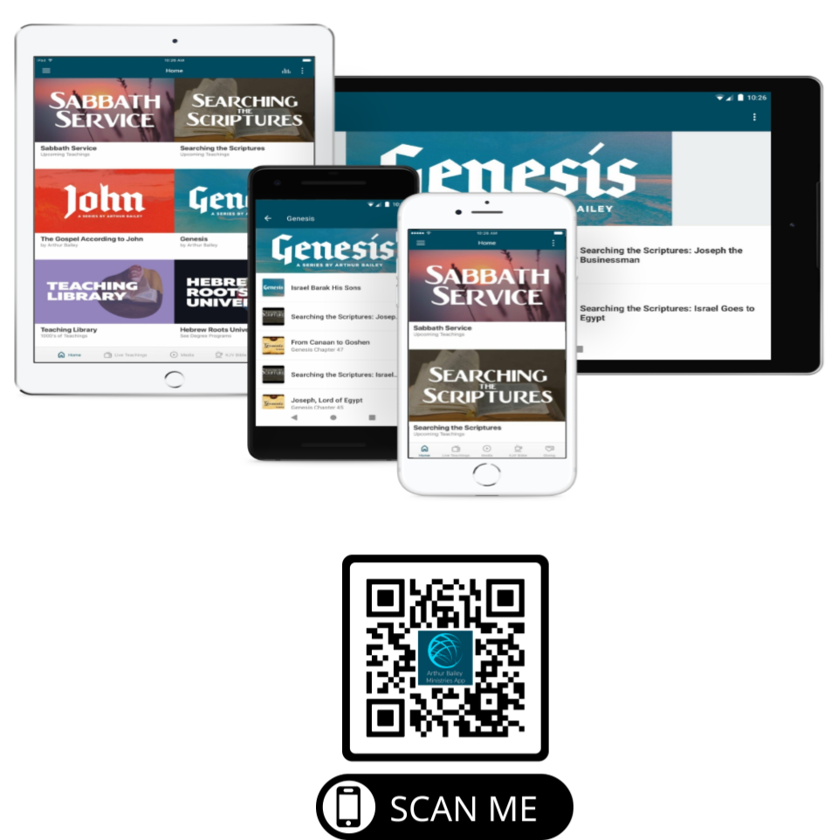

Slide 77
Mail in your support by check or money order.
Our Mailing Address:
P O Box 1182
Fort Mill, SC 29716

Slide 78
You can give by
Texting
Donate – Tithe - Offering
to
704-810-1579

