Slide 4
TODAY’S MESSAGE
You Must be Born Again!
Part 1

Slide 5
Please Subscribe for Updates on our Website.
Watch us on YouTube.
Follow us on Facebook and the
other Social Media Networks.
Please Like and Share our Videos
and Posts.

Slide 6
At the end of today’s Teaching, you will be able to 1. Ask Questions 2. Receive Prayer 3. Give your Tithes and Offerings

Slide 7
The Vision of House of Israel is to be: 1. A Worshipping People (John 4:23-24) 2. An Evangelistic Community (Acts 2:42-47)

Slide 8
3. A Discipleship Center (Matthew 28:19) 4. An Equipping Network (Ephesians 4:12) 5. And a Worldwide Witness for Yeshua The Messiah
(Acts 1:8)

Slide 10
Prayer

Slide 11
TODAY’S MESSAGE
You Must be Born Again!
Part 1

Slide 12
The Church world has taken a conversation Yeshua had with a Pharisee at night and built powerhouse ministries teaching a gospel message of salvation.
Much has been said about being born again and what it means. Billy Graham and the like have built multimillion dollar ministries from John 3:16.

Slide 13
But what does John 3:16 really teach us in the context in which it is given?
In this Message, “You Must Be Born Again”, we will explore this topic and this Bible passage in context.

Slide 14
^{Jn 3:1} There was a man of the Pharisees, named Nicodemus, a ruler of the Jews:

Slide 15
^{Jn 3:2} The same came to Yeshua by night, and said unto him, Rabbi, we know that thou art a teacher come from YeHoVaH: for no man can do these miracles that thou doest, except G-d be with him.

Slide 16
G-D, L-rd, the LORD, HASHEM
These are all representative of the ban on using the Name YeHoVaH.
YHVH: Yud Hey Vav Hey

Slide 17
The context of Yeshua’s encounter with Nicodemus is found in
John Chapter 2.

Slide 18
^{Jn 2:13} And the Jews' passover was at hand, and Yeshua went up to Jerusalem,
^{Jn 2:14} And found in the temple those that sold oxen and sheep and doves, and the changers of money sitting:

Slide 19
^{Dt 14:22} Thou shalt truly tithe all the increase of thy seed, that the field bringeth forth year by year.

Slide 20
^{Dt 14:23} And thou shalt eat before the LORD thy God, in the place which he shall choose to place his name there, the tithe of thy corn, of thy wine, and of thine oil, and the firstlings of thy herds and of thy flocks; that thou mayest learn to fear the LORD thy God always.

Slide 21
^{Dt 14:24} And if the way be too long for thee, so that thou art not able to carry it (the tithe); or if the place be too far from thee, which the LORD thy God shall choose to set his name there, when the LORD thy God hath blessed thee:

Slide 22
^{Dt 14:25} Then shalt thou turn it (the tithe) into money, and bind up the (the tithe) money in thine hand, and shalt go unto the place which the LORD thy God shall choose.

Slide 23
^{Dt 14:26} And thou shalt bestow that money (the tithe); for whatsoever thy soul lusteth after, for oxen, or for sheep, or for wine, or for strong drink, or for whatsoever thy soul desireth: and thou shalt eat there before the LORD thy God, and thou shalt rejoice, thou, and thine household,

Slide 24
^{Jn 2:15} And when he (Yeshua) had made a scourge of small cords, he drove them all out of the temple (court), and the sheep, and the oxen; and poured out the changers' money, and overthrew the tables;

Slide 25
^{Jn 2:16} And said unto them that sold doves, Take these things hence; make not my Father's house an house of merchandise.

Slide 26
^{Jn 2:17} And his disciples remembered that it was written, The zeal of thine house hath eaten me up.
(Psalms 69:9)

Slide 27
^{Ps 69:9} For the zeal of thine house hath eaten me up; and the reproaches of them that reproached thee are fallen upon me.

Slide 28
^{Jn 2:18} Then answered the Jews and said unto him, What sign showest thou unto us, seeing that thou doest these things?
^{Jn 2:19} Yeshua answered and said unto them, Destroy this temple, and in three days I will raise it up.

Slide 29
^{Jn 2:20} Then said the Jews, Forty and six years was this temple in building, and wilt thou rear it up in three days?
^{Jn 2:21} But he spake of the temple of his body.

Slide 30
^{Jn 2:22} When therefore he was risen from the dead, his disciples remembered that he had said this unto them; and they believed the scripture, and the word which Yeshua had said.

Slide 31
^{Ps 16:10} because you will not abandon me to the grave,
nor will you let your Holy One see decay.

Slide 32
^{Jn 2:23} Now when he was in Jerusalem at the passover, in the feast day, many believed in his name, when they saw the miracles which he did.

Slide 33
^{Jn 2:24} But Yeshua did not commit himself unto them, because he knew all men,
^{Jn 2:25} And needed not that any should testify of man: for he knew what was in man.

Slide 34
^{Jn 3:1} There was a man of the Pharisees, named Nicodemus, a ruler of the Jews:

Slide 35
This passage tells us three things about Nicodemus
He was searching for Truth.
He was a Pharisee.
He was a ruler of the Jews.

Slide 36
(758)— ar’-khone; present participle of (757) (ar’-kho); a first (in rank or power): — chief (ruler), magistrate, prince, ruler.

Slide 37
SANHEDRIN (Talmudic Heb. transcription of the Gr. synedrion, a council). The highest Jewish tribunal during the Greek and Roman periods (KJV "council"). During the reign of the Hellenistic kings Israel was practically under home rule and was governed by an aristocratic council of elders, which was presided over by the hereditary high priest.

Slide 38
The council was called gerousia, which always signifies an aristocratic body. This later developed into the Sanhedrin. During most of the Roman period the internal government of the country was practically in its hands, and its influence was recognized even in the Diaspora.

Slide 39
After the death of Herod the Great, however, during the reign of Archelaus and the Roman procurators, the civil authority of the Sanhedrin was probably restricted to Judea, and this is very likely the reason why it had no judicial authority over Yeshua so long as He remained in Galilee.

Slide 40
The Sanhedrin was abolished after the destruction of Jerusalem.

Slide 41
The members of the Sanhedrin were drawn from the three classes named in Matthew 16:21; 27:41; Mark 8:31; 11:27; 14:43, 53; 15:1; and Luke 9:22; 22:66:
"the elders, the chief priests and the teachers of the law“.

Slide 42
By the Chief Priests, it is meant the acting High Priest, those who had been High Priests, and members of the privileged families from which the High Priests were taken.

Slide 43
The priestly aristocracy was comprised of the leading persons in the community, and they were the chief members of the Sanhedrin.

Slide 44
The teachers of the Law (KJV Scribes) formed the Pharisaic element in the Sanhedrin, though not all Pharisees were professional Scribes.

Slide 45
The elders were the Tribal and Family Heads of the people and Priesthood, mostly the secular nobility of Jerusalem.

Slide 46
The president bore the honorable title of "prince." Besides the president, there were subordinate officials
(Matthew 5:25; 26:51;
Mark 14:47; John 18:10).

Slide 47
According to Josephus, in the time of Messiah, the Sanhedrin was formally led by the Sadducean High Priests, but practically ruled by the Pharisees, who were immensely popular with the people
(Antiq. 18.1.4).

Slide 48
^{Jn 3:2} The same came to Yeshua by night, and said unto him, Rabbi, we know that thou art a teacher come from YeHoVaH: for no man can do these miracles that thou doest, except YeHoVaH be with him.

Slide 49
(4461)— hrab-bee’; of Hebrew origin [Hebrew {7227} (rab)
with pronoun suffix]; my master, i.e. Rabbi, as an official title of
honor: — Master, Rabbi.

Slide 50
(1320)— did-as’-kal-os; from (1321) (did-as’-ko); an
instructor (genitive or special): — doctor, master, teacher.

Slide 51
^{Jn 3:3} Yeshua answered and said unto him, Verily, verily, I say unto thee, Except a man be born again, he cannot see the kingdom of YeHoVaH.

Slide 52
^{Jn 3:4} Nicodemus saith unto him, How can a man be born when he is old? can he enter the second time into his mother's womb, and be born?

Slide 56
^{Jn 3:5} Yeshua answered, Verily, verily, I say unto thee, Except a man be born of water and of the Spirit, he cannot enter into the kingdom of God.

Slide 57
^{Jn 3:6} That which is born of the flesh is flesh; and that which is born of the Spirit is spirit.
^{Jn 3:7} Marvel not that I said unto thee, Ye must be born again.

Slide 58
^{Jn 3:8} The wind bloweth where it listeth, and thou hearest the sound thereof, but canst not tell whence it cometh, and whither it goeth: so is every one that is born of the Spirit.

Slide 59
^{Jn 3:9} Nicodemus answered and said unto him, How can these things be?

Slide 60
Nicodemus asked a question.
Yeshua responds with a question.

Slide 61
^{Jn 3:10} Yeshua answered and said unto him, Art thou a master of Israel, and knowest not these things?

Slide 62
Here is where the conversation gets interesting.
Yeshua’s question implies Nicodemus should have known what He was saying about this born-again process.

Slide 63
The phrase born again is used in three places in the
New Testament;
twice in John Chapter 3 and the other in
1st Peter.

Slide 64
Later we will take a look at how Peter interprets the born-again phrase.

Slide 65
Today, “You Must be Born Again” is interpreted:
You must get saved.
Give your heart to Jesus.
Make a decision for Christ.

Slide 66
But what did Yeshua mean and how should we interpret this conversation in the context in which it is given?

Slide 67
If Yeshua expected Nicodemus to know this, why?
How would Nicodemus know what Yeshua is talking about if he is hearing this for the very first time?

Slide 68
Nicodemus is a teacher/ruler/Pharisee of Israel.

Slide 69
^{Jn 3:10} Yeshua answered and said unto him, Art thou a master (teacher) of Israel, and knowest not these things?

Slide 70
Nicodemus is a teacher, but He does not know about being born again, although Yeshua implied that he should have known these things. How?

Slide 71
The Prophet Ezekiel prophesied.

Slide 72
^{Eze 36:16} Moreover the word of the LORD came unto me, saying,

Slide 73
^{Eze 36:17} Son of man, when the house of Israel dwelt in their own land, they defiled it by their own way and by their doings: their way was before me as the uncleanness of a removed woman.

Slide 74
^{Eze 36:18} Wherefore I poured my fury upon them for the blood that they had shed upon the land, and for their idols wherewith they had polluted it:

Slide 75
^{Eze 36:19} And I scattered them among the heathen, and they were dispersed through the countries: according to their way and according to their doings I judged them.

Slide 76
^{Eze 36:20} And when they entered unto the heathen, whither they went, they profaned my holy name, when they said to them, These are the people of the LORD, and are gone forth out of his land.

Slide 77
^{Eze 36:21} But I had pity for mine holy name, which the house of Israel had profaned among the heathen, whither they went.

Slide 78
^{Eze 36:22} Therefore say unto the house of Israel, Thus saith the Lord GOD; I do not this for your sakes, O house of Israel, but for mine holy name's sake, which ye have profaned among the heathen, whither ye went.

Slide 79
^{Eze 36:23} And I will sanctify my great name, which was profaned among the heathen, which ye have profaned in the midst of them; and the heathen shall know that I am the LORD, saith the Lord GOD, when I shall be sanctified in you before their eyes.

Slide 80
^{Eze 36:24} For I will take you from among the heathen, and gather you out of all countries, and will bring you into your own land.

Slide 81
^{Eze 36:25} Then will I sprinkle clean water upon you, and ye shall be clean: from all your filthiness, and from all your idols, will I cleanse you.

Slide 82
^{Eze 36:26} A new heart also will I give you, and a new spirit will I put within you: and I will take away the stony heart out of your flesh, and I will give you an heart of flesh.

Slide 83
^{Eze 36:27} And I will put my spirit within you, and cause you to walk in my statutes, and ye shall keep my judgments, and do them.

Slide 84
^{Eze 36:28} And ye shall dwell in the land that I gave to your fathers; and ye shall be my people, and I will be your God.

Slide 85
^{Eze 36:29} I will also save you from all your uncleannesses: and I will call for the corn, and will increase it, and lay no famine upon you.

Slide 86
^{Eze 36:30} And I will multiply the fruit of the tree, and the increase of the field, that ye shall receive no more reproach of famine among the heathen.

Slide 87
^{Eze 36:31} Then shall ye remember your own evil ways, and your doings that were not good, and shall loathe yourselves in your own sight for your iniquities and for your abominations.

Slide 88
^{Eze 36:32} Not for your sakes do I this, saith the Lord GOD, be it known unto you: be ashamed and confounded for your own ways, O house of Israel.

Slide 89
^{Eze 36:33} Thus saith the Lord GOD; In the day that I shall have cleansed you from all your iniquities I will also cause you to dwell in the cities, and the wastes shall be builded.

Slide 90
^{Eze 36:34} And the desolate land shall be tilled, whereas it lay desolate in the sight of all that passed by.

Slide 91
^{Eze 36:35} And they shall say, This land that was desolate is become like the garden of Eden; and the waste and desolate and ruined cities are become fenced, and are inhabited.

Slide 92
^{Eze 36:36} Then the heathen that are left round about you shall know that I the LORD build the ruined places, and plant that that was desolate: I the LORD have spoken it, and I will do it.

Slide 93
^{Eze 36:37} Thus saith the Lord GOD; I will yet for this be inquired of by the house of Israel, to do it for them; I will increase them with men like a flock.

Slide 94
^{Eze 36:38} As the holy flock, as the flock of Jerusalem in her solemn feasts; so shall the waste cities be filled with flocks of men: and they shall know that I am the LORD.

Slide 95
If Nicodemus does not know these things, then what is he teaching the people of Israel?
The traditions of the elders.

Slide 96
How did Peter interpret the
You Must be Born Again phrase,
1st Peter 1:1-25.

Slide 97
Question and Answer
Period

Slide 98
Your support is greatly appreciated and needed.

Slide 100
Our Preferred
Donation Methods:

Slide 101
CashApp – $ABMHOI
Venmo – @Arthur-Bailey-10
Zelle – apostlea@gmail.com

Slide 102
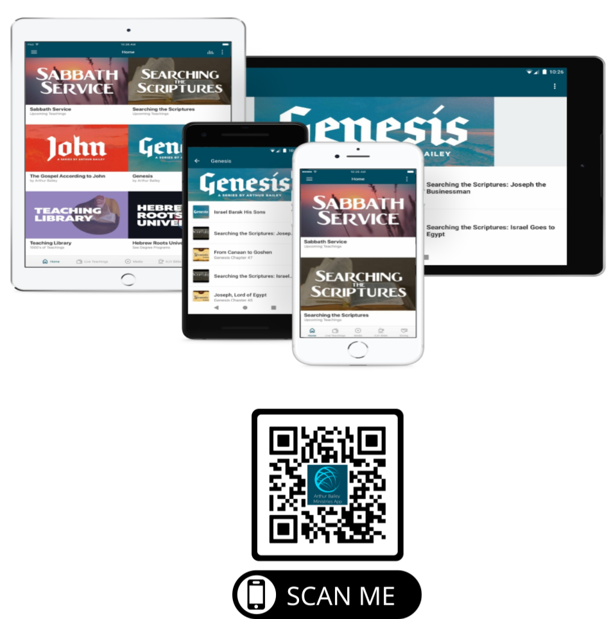

Slide 103
Mail in your support by check or money order.
Our Mailing Address:
P O Box 1182
Fort Mill, SC 29716

Slide 104
You can give by
Texting
Donate – Tithe - Offering
to
704-810-1579

