Slide 4
TODAY’S MESSAGE
You Must be Born Again!
Part 2

Slide 5
Please Subscribe for Updates on our Website.
Watch us on YouTube.
Follow us on Facebook and the
other Social Media Networks.
Please Like and Share our Videos
and Posts.

Slide 6
At the end of today’s Teaching, you will be able to 1. Ask Questions 2. Receive Prayer 3. Give your Tithes and Offerings

Slide 7
The Vision of House of Israel is to be: 1. A Worshipping People (John 4:23-24) 2. An Evangelistic Community (Acts 2:42-47)

Slide 8
3. A Discipleship Center (Matthew 28:19) 4. An Equipping Network (Ephesians 4:12) 5. And a Worldwide Witness for Yeshua The Messiah
(Acts 1:8)

Slide 10
Prayer

Slide 11
TODAY’S MESSAGE
You Must be Born Again!
Part 2

Slide 12
The phrase born again is used in three places in the
New Testament;
twice in John Chapter 3 and the other in 1st Peter.

Slide 13
Today, the “You Must be Born Again” phrase is interpreted as:
You must get saved.
Give your heart to Jesus.
Make a decision for Christ.

Slide 14
But what did Yeshua mean and how should we interpret this conversation in the context in which it is given?

Slide 15
The Church world has taken a conversation Yeshua had with a Pharisee at night and built powerhouse ministries teaching a gospel message of salvation.
Much has been said about being born again and what it means. Billy Graham, and the like, have built multimillion dollar ministries from John 3:16.

Slide 16
But what does John 3:16 really teach us in the context in which it is given?

Slide 17
^{Jn 3:1} There was a man of the Pharisees, named Nicodemus, a ruler of the Jews:

Slide 18
^{Jn 3:2} The same came to Yeshua by night, and said unto him, Rabbi, we know that thou art a teacher come from YeHoVaH: for no man can do these miracles that thou doest, except G-d be with him.

Slide 19
^{Jn 3:1} There was a man of the Pharisees, named Nicodemus, a ruler of the Jews:

Slide 20
We learned several things about Nicodemus:
He was searching for Truth.
He was a Pharisee.
He was a ruler of the Jews.

Slide 21
^{Jn 3:2} The same came to Yeshua by night, and said unto him, Rabbi, we know that thou art a teacher come from YeHoVaH: for no man can do these miracles that thou doest, except YeHoVaH be with him.

Slide 22
^{Jn 3:3} Yeshua answered and said unto him, Verily, verily, I say unto thee, Except a man be born again, he cannot see the kingdom of YeHoVaH.

Slide 23
^{Jn 3:4} Nicodemus saith unto him, How can a man be born when he is old? can he enter the second time into his mother's womb, and be born?

Slide 24
^{Jn 3:5} Yeshua answered, Verily, verily, I say unto thee, Except a man be born of water and of the Spirit, he cannot enter into the kingdom of God.

Slide 25
^{Jn 3:6} That which is born of the flesh is flesh; and that which is born of the Spirit is spirit.
^{Jn 3:7} Marvel not that I said unto thee, Ye must be born again.

Slide 26
^{Jn 3:8} The wind bloweth where it listeth, and thou hearest the sound thereof, but canst not tell whence it cometh, and whither it goeth: so is every one that is born of the Spirit.

Slide 27
^{Jn 3:9} Nicodemus answered and said unto him, How can these things be?

Slide 28
Nicodemus asked a question.
Yeshua responds with a question.

Slide 29
^{Jn 3:10} Yeshua answered and said unto him, Art thou a master of Israel, and knowest not these things?

Slide 30
Here is where the conversation gets interesting. Yeshua’s question implies Nicodemus should have known what He was saying about this born-again process.

Slide 31
If Yeshua expected Nicodemus to know this, why?
How would Nicodemus know what Yeshua is talking about if he is hearing this for the very first time?

Slide 32
Nicodemus is a teacher/ruler/Pharisee of Israel.

Slide 33
^{Jn 3:10} Yeshua answered and said unto him, Art thou a master (teacher) of Israel, and knowest not these things

Slide 34
Nicodemus is a teacher, but He does not know about being born again although Yeshua implied that he should have known these things. How?

Slide 35
If Nicodemus does not know these things, then what is he teaching the people of Israel?
The traditions of the elders.

Slide 36
How did Peter interpret the
You Must be Born Again phrase?
1st Peter 1:1-25

Slide 37
^{1Pe 1:1} Peter, an apostle of Jesus Christ, to the strangers scattered throughout Pontus, Galatia, Cappadocia, Asia, and Bithynia,

Slide 38
^{1Pe 1:2} Elect according to the foreknowledge of God the Father, through sanctification of the Spirit, unto obedience and sprinkling of the blood of Jesus Christ: Grace unto you, and peace, be multiplied.

Slide 39
^{1Pe 1:3} Blessed be the God and Father of our Lord Jesus Christ, which according to his abundant mercy hath begotten us again unto a lively hope by the resurrection of Jesus Christ from the dead,

Slide 40
This statement Peter makes, “begotten us again”,
is powerful.

Slide 41
Yeshua was the Only Begotten at the first and then He is referred to as the First Begotten after the Resurrection.
But, according to the Almighty, He was the First Begotten from the beginning.

Slide 42
^{Heb 1:6} And again, when he bringeth in the first begotten into the world, he saith, And let all the angels of God worship him.

Slide 43
^{Rev 1:5} And from Jesus Christ, who is the faithful witness, and the first begotten of the dead, and the prince of the kings of the earth. Unto him that loved us, and washed us from our sins in his own blood,

Slide 44
^{1Pe 1:4} To an inheritance incorruptible, and undefiled, and that fadeth not away, reserved in heaven for you,
^{1Pe 1:5} Who are kept by the power of God through faith unto salvation ready to be revealed in the last time.

Slide 45
^{1Pe 1:6} Wherein ye greatly rejoice, though now for a season, if need be, ye are in heaviness through manifold temptations:

Slide 46
^{1Pe 1:7} That the trial of your faith, being much more precious than of gold that perisheth, though it be tried with fire, might be found unto praise and honour and glory at the appearing of Jesus Christ:

Slide 47
^{1Pe 1:8} Whom having not seen, ye love; in whom, though now ye see him not, yet believing, ye rejoice with joy unspeakable and full of glory:
^{1Pe 1:9} Receiving the end of your faith, even the salvation of your souls.

Slide 48
^{1Pe 1:10} Of which salvation the prophets have inquired and searched diligently, who prophesied of the grace that should come unto you:

Slide 49
^{1Pe 1:11} Searching what, or what manner of time the Spirit of Christ which was in them did signify, when it testified beforehand the sufferings of Christ, and the glory that should follow.

Slide 50
^{1Pe 1:12} Unto whom it was revealed, that not unto themselves, but unto us they did minister the things, which are now reported unto you by them that have preached the gospel unto you with the Holy Ghost sent down from heaven; which things the angels desire to look into.

Slide 51
^{1Pe 1:13} Wherefore gird up the loins of your mind, be sober, and hope to the end for the grace that is to be brought unto you at the revelation of Jesus Christ;
^{1Pe 1:14} As obedient children, not fashioning yourselves according to the former lusts in your ignorance:

Slide 52
^{1Pe 1:15} But as he which hath called you is holy, so be ye holy in all manner of conversation;
^{1Pe 1:16} Because it is written, Be ye holy; for I am holy.

Slide 53
Peter quotes directly from the Torah/Law.

Slide 54
^{Lev 11:44} For I am the LORD your God: ye shall therefore sanctify yourselves, and ye shall be holy; for I am holy: neither shall ye defile yourselves with any manner of creeping thing that creepeth upon the earth.

Slide 55
^{Lev 11:45} For I am the LORD that bringeth you up out of the land of Egypt, to be your God: ye shall therefore be holy, for I am holy.

Slide 56
^{Lev 19:2} Speak unto all the congregation of the children of Israel, and say unto them, Ye shall be holy: for I the LORD your God am holy.

Slide 57
^{Lev 20:7} Sanctify yourselves therefore, and be ye holy: for I am the LORD your God.
^{Lev 20:8} And ye shall keep my statutes, and do them: I am the LORD which sanctify you.

Slide 58
^{1Pe 1:17} And if ye call on the Father, who without respect of persons judgeth according to every man's work, pass the time of your sojourning here in fear:

Slide 59
^{1Pe 1:18} Forasmuch as ye know that ye were not redeemed with corruptible things, as silver and gold, from your vain conversation received by tradition from your fathers;

Slide 60
^{1Pe 1:19} But with the precious blood of Christ, as of a lamb without blemish and without spot:
^{1Pe 1:20} Who verily was foreordained before the foundation of the world, but was manifest in these last times for you,

Slide 61
^{1Pe 1:21} Who by him do believe in God, that raised him up from the dead, and gave him glory; that your faith and hope might be in God.

Slide 62
^{1Pe 1:22} Seeing ye have purified your souls in obeying the truth through the Spirit unto unfeigned love of the brethren, see that ye love one another with a pure heart fervently:

Slide 63
^{1Pe 1:23} Being born again, not of corruptible seed, but of incorruptible, by the word of God, which liveth and abideth for ever.

Slide 64
Peter uses a direct quote from the Prophet Isaiah found in Isaiah 40.

Slide 65
^{1Pe 1:24} For all flesh is as grass, and all the glory of man as the flower of grass. The grass withereth, and the flower thereof falleth away:

Slide 66
^{1Pe 1:25} But the word of the Lord endureth for ever. And this is the word which by the gospel is preached unto you.

Slide 67
^{Isa 40:5} And the glory of the LORD shall be revealed, and all flesh shall see it together: for the mouth of the LORD hath spoken it.
^{Isa 40:6} The voice said, Cry. And he said, What shall I cry? All flesh is grass, and all the goodliness thereof is as the flower of the field:

Slide 68
^{Isa 40:7} The grass withereth, the flower fadeth: because the spirit of the LORD bloweth upon it: surely the people is grass.
^{Isa 40:8} The grass withereth, the flower fadeth: but the word of our God shall stand for ever.

Slide 69
^{Isa 40:9} O Zion, that bringest good tidings, get thee up into the high mountain; O Jerusalem, that bringest good tidings, lift up thy voice with strength; lift it up, be not afraid; say unto the cities of Judah, Behold your God!

Slide 70
The Prophet Isaiah prophesied that the Law and The Gospel had to go forth from Jerusalem.

Slide 71
The Law and the Gospel shall go forth from Jerusalem.
Yeshua had to die in Jerusalem.
The Great Commission was given in Jerusalem.
The Holy Spirit was given in Jerusalem.

Slide 72
The first Born Again Saints were born again in Jerusalem.
The message was to be preached from Jerusalem, to Judea, to Samaria, and to the uttermost parts of the world.

Slide 73
^{Isa 2:3} And many people shall go and say, Come ye, and let us go up to the mountain of the LORD, to the house of the God of Jacob; and he will teach us of his ways, and we will walk in his paths: for out of Zion shall go forth the law, and the word of the LORD from Jerusalem.

Slide 74
James, the Brother of Yeshua, took it a step further.

Slide 75
^{Jas 1:19} Wherefore, my beloved brethren, let every man be swift to hear, slow to speak, slow to wrath:
^{Jas 1:20} For the wrath of man worketh not the righteousness of God.

Slide 76
^{Jas 1:21} Wherefore lay apart all filthiness and superfluity of naughtiness, and receive with meekness the engrafted word, which is able to save your souls.

Slide 77
^{Jas 1:22} But be ye doers of the word, and not hearers only, deceiving your own selves.
^{Jas 1:23} For if any be a hearer of the word, and not a doer, he is like unto a man beholding his natural face in a glass:

Slide 78
^{Jas 1:24} For he beholdeth himself, and goeth his way, and straightway forgetteth what manner of man he was.

Slide 79
^{Jas 1:25} But whoso looketh into the perfect law of liberty, and continueth therein, he being not a forgetful hearer, but a doer of the work, this man shall be blessed in his deed.

Slide 80
John, the writer of the Book of Revelation, puts it this way.

Slide 81
^{Rev 12:17} And the dragon was wroth with the woman, and went to make war with the remnant of her seed, which keep the commandments of God, (Law) and have the testimony of Jesus Christ. (Gospel)

Slide 82
^{Rev 14:12} Here is the patience of the saints: here are they that keep the commandments of God, (Law) and .
the faith of Jesus. (Gospel)

Slide 83
Examples from the Bible

Slide 84
^{Ac 2:41} Then they that gladly received his word were baptized: and the same day there were added unto them about three thousand souls.

Slide 85
^{Ac 4:4} Howbeit many of them which heard the word believed; and the number of the men was about five thousand.

Slide 86
^{Ac 10:34} Then Peter opened his mouth, and said, Of a truth I perceive that God is no respecter of persons:
^{Ac 10:35} But in every nation he that feareth him, and worketh righteousness, is accepted with him.

Slide 87
^{Ac 10:36} The word which God sent unto the children of Israel, preaching peace by Jesus Christ: (he is Lord of all:)

Slide 88
^{Ac 10:37} That word, I say, ye know, which was published throughout all Judaea, and began from Galilee, after the baptism which John preached;

Slide 89
^{Ac 7:38} This is he, that was in the church in the wilderness with the angel which spake to him in the mount Sina, and with our fathers: who received the lively oracles to give unto us:

Slide 90
^{Heb 3:7} Wherefore (as the Holy Ghost saith, Today if ye will hear his voice,
^{Heb 3:8} Harden not your hearts, as in the provocation, in the day of temptation in the wilderness:

Slide 91
^{Heb 3:9} When your fathers tempted me, proved me, and saw my works forty years.
^{Heb 3:10} Wherefore I was grieved with that generation, and said, They do always err in their heart; and they have not known my ways.

Slide 92
^{Heb 3:11} So I sware in my wrath, They shall not enter into my rest.)
^{Heb 3:12} Take heed, brethren, lest there be in any of you an evil heart of unbelief, in departing from the living God.

Slide 93
^{Heb 3:13} But exhort one another daily, while it is called Today; lest any of you be hardened through the deceitfulness of sin.
^{Heb 3:14} For we are made partakers of Christ, if we hold the beginning of our confidence stedfast unto the end;

Slide 94
^{Heb 3:15} While it is said, Today if ye will hear his voice, harden not your hearts, as in the provocation.
^{Heb 3:16} For some, when they had heard, did provoke: howbeit not all that came out of Egypt by Moses.

Slide 95
^{Heb 3:17} But with whom was he grieved forty years? was it not with them that had sinned, whose carcases fell in the wilderness?
^{Heb 3:18} And to whom sware he that they should not enter into his rest, but to them that believed not?

Slide 96
^{Heb 3:19} So we see that they could not enter in because of unbelief.
^{Heb 4:1} Let us therefore fear, lest, a promise being left us of entering into his rest, any of you should seem to come short of it.

Slide 97
^{Heb 4:2} For unto us was the gospel preached, as well as unto them: but the word preached did not profit them, not being mixed with faith in them that heard it.

Slide 98
^{Heb 4:3} For we which have believed do enter into rest, as he said, As I have sworn in my wrath, if they shall enter into my rest: although the works were finished from the foundation of the world.

Slide 99
^{Heb 4:4} For he spake in a certain place of the seventh day on this wise, And God did rest the seventh day from all his works.

Slide 100
Question and Answer
Period

Slide 101
Your support is greatly appreciated and needed.

Slide 103
Our Preferred
Donation Methods:

Slide 104
CashApp – $ABMHOI
Venmo – @Arthur-Bailey-10
Zelle – apostlea@gmail.com

Slide 105
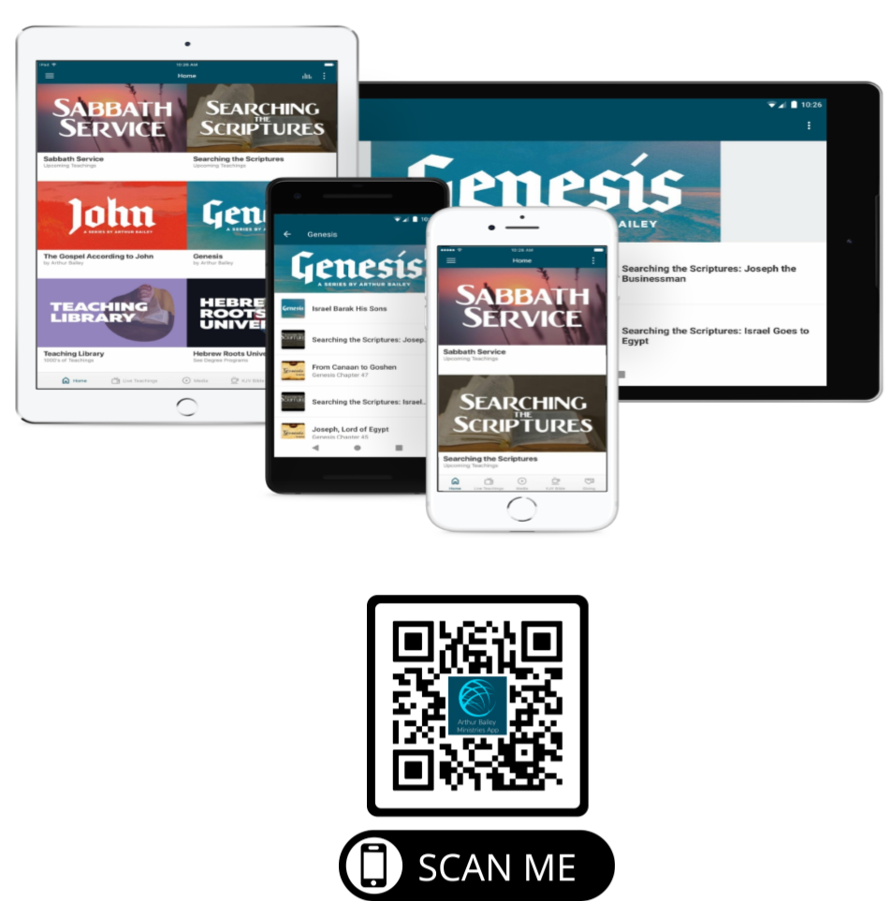

Slide 106
Mail in your support by check or money order.
Our Mailing Address:
P O Box 1182
Fort Mill, SC 29716

Slide 107
You can give by
Texting
Donate – Tithe - Offering
to
704-810-1579

