Slide 3
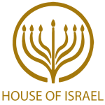
Todays Message:
The Day of Thanksgiving
and The Bible

Slide 4
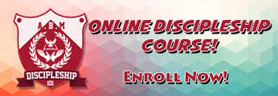
Discipleship101.TV

Slide 5
Leadership101.TV

Slide 6
Please subscribe for updates on our Website.
Watch us on YouTube.
Follow us on Facebook and the other Social Media networks.
Please Like and Share our videos and posts.

Slide 7
At the end of today’s Teaching, you will be able to 1. Ask Questions 2. Receive Prayer 3. Give your Tithes and Offerings

Slide 8
The Vision of House of Israel is to be: 1. A Worshipping People (John 4:23-24) 2. An Evangelistic Community (Acts 2:42-47)

Slide 9
3. A Discipleship Center (Matthew 28:19) 4. An Equipping Network (Ephesians 4:12) 5. And a Worldwide Witness for Yeshua The Messiah
(Acts 1:8)

Slide 11
Worship in Prayer

Slide 12
Todays Message:
The Day of Thanksgiving
and The Bible

Slide 13
This morning I was on the phone speaking to a utility company representative and before she hung up, she said, “Happy Thanksgiving” and I said, “Have a blessed day”. I told my wife about the conversation, and she indicated it was a fitting segue into the Teaching tonight. Although Thanksgiving is a week away, I was surprised by the representative's salutation. The Day of Thanksgiving is a religious conundrum. Is it a religious holiday or a secular holiday?

Slide 14
As believers, giving thanks is something we do, or should do, on a regular basis because of all the wonderful works of the Almighty and what He does in our lives.
As believers who look to the Scriptures for our way of life, giving thanks and examples of thanksgiving by men and women of the Book abounds.
The psalmist David wrote extensively on the subject of giving thanks.

Slide 15
^{Ps 92:1} It is a good thing to give thanks unto the LORD, and to sing praises unto thy name, O most High:
^{Ps 30:4} Sing unto the LORD, O ye saints of his, and give thanks at the remembrance of his holiness.
^{Ps 106:1} Praise ye the LORD. O give thanks unto the LORD; for he is good: for his mercy endureth for ever.

Slide 16
^{Ps 100:4} Enter into his gates with thanksgiving, and into his courts with praise: be thankful unto him, and bless his name.
^{Ps 116:17} I will offer to thee the sacrifice of thanksgiving, and will call upon the name of the LORD.

Slide 17
The Day of Thanksgiving is another matter altogether. Thanksgiving by its very name implies a religious response of giving thanks.
The name of the day, the Day of Thanksgiving, implies religious connotations. By default, the name of the day invokes giving thanks, which raises two questions.

Slide 18
Give thanks for What?
Give thanks to Who?
Both the religious communities and
non- religious communities alike celebrate the Day of Thanksgiving which generates debate over its religious associations.

Slide 19
Whenever the secular community and the religious community celebrate the same holi-day, the day becomes holi instead of holy. Consequently,
there is a “holi” day celebration.

Slide 20
Holi ( /ˈhoʊliː/; Sanskrit: होली Holī) is a Hindu spring festival, originating from India, celebrated predominantly in India but has also spread to Nepal and many other Western countries, also known as the "festival of colours" or the "festival of love". The festival signifies the victory of good over evil, the arrival of spring, end of winter, and for many a festive day to meet others, play and laugh, forget and forgive, and repair broken relationships. It is also celebrated as a thanksgiving for a good harvest.

Slide 21
The Origin and Controversy surrounding Thanksgiving
For many Americans, Thanksgiving is a special, beloved holiday for eating turkey - or a vegetarian main course option - and spending time with friends and family.

Slide 22
However, for others, the celebration is deeply controversial - as Thanksgiving has a contentious history that goes far beyond when the first feast was held. In addition to a holiday steeped with cultural appropriation, the period of history in America is frequently white-washed - which leads many Americans to ignore the holiday.

Slide 23
Thanksgiving is considered by some to be a "national day of mourning“.
Like Columbus Day, the holiday is viewed by many to be a celebration of the conquest of Native Americans by colonists.
Many Native Americans see Thanksgiving as an embellished narrative of “Pilgrims and Natives looking past their differences” to break bread.

Slide 24
Professor Robert Jensen of the University of Texas at Austin said: “One indication of moral progress in the United States would be the replacement of Thanksgiving Day and its self-indulgent family feasting with a National Day of Atonement accompanied by a self-reflective collective fasting.”

Slide 25
Americans are frequently guilty of cultural appropriation in their celebrations.
Young children are taught about Thanksgiving in school, where they often learn of the first feast through crafts and drawings. In addition to depictions of turkeys, the Mayflower and the Pilgrims, many children decorate Native American headdresses - which frequently bare no resemblance to the headdresses, clothes and feathers worn by the Wampanoag Indians.

Slide 26
These inaccurate historical references are perpetrated each year, making the battle for equality and accurate representation an ongoing one for Native Americans in America.

Slide 27
People disagree about when the first Thanksgiving happened
Most Americans think the three-day celebration between the Pilgrims and the Wampanoag Indians in 1621 in Plymouth, Massachusetts was the first Thanksgiving. The Pilgrims and their Native American neighbours had signed a mutual protection treaty the spring before and the feast was in honour of a successful first harvest.

Slide 28
But from the Pilgrims’ point of view, the first Thanksgiving - meant to be a day set aside for prayer and worship - took place in July 1623. Governor William Bradford declared a day of Thanksgiving to give thanks for the rain that had ended a drought and saved their harvest.

Slide 29
Others insist the first Thanksgiving took place a few years before in 1619 in Virginia.
In 1962, a Virginia state senator disputed President John F Kennedy’s assertion that Plymouth was the site of the First Thanksgiving.

Slide 30
“America’s First Thanksgiving was actually celebrated in Virginia in 1619,” the Virginian wrote the president, referring to a religious ceremony that English settlers held when they arrived in Berkeley Plantation near Richmond. “Please issue an appropriate correction.” “You are quite right,” came the reply from Mr Kennedy’s special assistant, the historian Arthur Schlesinger Jr. “I can only plead unconquerable New England bias on the part of the White House staff.”

Slide 31
Not everyone liked the idea of a national Thanksgiving holiday
In 1789, President George Washington proclaimed a National Day of Thanksgiving, asking Americans to gather on the last Thursday of November to give thanks for the establishment of “a form of government for their safety and happiness.”

Slide 32
But some members of Congress objected, asserting that the authority to designate a day of thanksgiving belonged to individual state governors, not the president.

Slide 33
Others argued that Thanksgiving was a “religious matter.” Therefore, the government’s establishment of a national thanksgiving was forbidden by the First Amendment.
Mr Washington proclaimed a second day of Thanksgiving in 1795, and presidents John Adams, James Madison and others did the same in subsequent years.

Slide 34
But many presidents, particularly Thomas Jefferson, still opposed doing this.
It was not until 1863 that President Abraham Lincoln established the regular tradition of observing days of national thanksgiving.

Slide 35
Article taken from https://www.independent.co.uk
Thanksgiving: Why many Americans don't celebrate it
Alexandra Wilts,
Chelsea Ritschel
Thursday 23 November 2017 00:45

Slide 36
A Biblical Perspective
The controversy surrounding Thanksgiving is not the believer’s argument.
Biblically, we have mandated Holy days that are to be observed that were handed down to us, through Moses, by YeHoVaH, Himself! If we are adamant about walking upright according to Scripture, we do not engage in these worldly affairs or skirmishes.

Slide 37
Thanksgiving is just another example of how the church and the world celebrate the same
holi - days that are not Holy days.

Slide 38
The church and the world celebrate Easter: holi - day or Holy day?
The church and the world celebrate Christmas: holi - day or Holy day?
The church and the world celebrate New Year: holi - day or Holy day?

Slide 39
The world does not celebrate any of the YAH’s Commanded Biblical Holy days and neither does the church. The world rebels against YeHoVaH’s Commands and Holy days and so does the church.

Slide 40
Thanksgiving is not a Holy day it is a secular holi - day. Thanksgiving, like Christmas, New Year, Hanukkah, and Purim, are manmade, man instituted, secular Holidays with no Holy components or Biblical requirements.

Slide 41
At least there are references to Purim and Hanukkah in the Bible, even though they are
man-made instituted holidays.

Slide 42
Thanksgiving was established by the US government at a time when the Biblical Holy days were ignored by the same government.

Slide 43
Neither the federal government, nor state governments, at any time in American history, inaugurated or declared any Biblical Holy day a national holiday. In fact, the framers of the constitution tied future politician’s hands from doing so, without a constitutional amendment, by separating state and church.

Slide 44
Although states could enact Biblical Holy days, no state in the continental US has ever done so. Thanksgiving is a secular US Holiday, no different than Christmas, New Year, 4th of July, Labor Day, Presidents Day, or any other secular holiday.

Slide 45
Thanksgiving is associated with the fall harvest in America. The Biblical harvest celebration at that time of the year is one of the latter Feasts of YeHoVaH, the Feast of Tabernacles or the Feast of Harvest.
Those who celebrate Tabernacles have already celebrated the Feast of Harvest and there would be no need to celebrate an additional harvest.
The people of the world, who would celebrate the secular holiday of Thanksgiving, they more than likely would not be celebrating the Biblical Feast of Tabernacles.

Slide 46
As a family, my wife and I, have decided that we will not celebrate Thanksgiving for the following reasons:

Slide 47
1. There is no real clear reason to do so 2. It is a secular holiday with religious intent 3. Native American heritage 4. Because of the origin of Thanksgiving and its roots 5. African American heritage 6. Because I celebrate the Biblical Holy days

Slide 48
Let us celebrate the Feasts recognized in Scripture and give honor and glory to our
Father who is in Heaven.

Slide 49
If one chooses to celebrate Thanksgiving, do so knowing it is not Biblically mandated or required by YeHoVaH, but mandated and expected by the world and America as an American patriotic citizen.

Slide 50
Citizens and countries that recognize Thanksgiving as a national holiday, may construe not celebrating the Day of Thanksgiving as being unpatriotic, un-American or un-National, but it is certainly not un-Biblical.

Slide 51
Your support is greatly appreciated and needed.

Slide 53
Our Preferred Donation Method
CashAPP
$ABMHOI

Slide 54
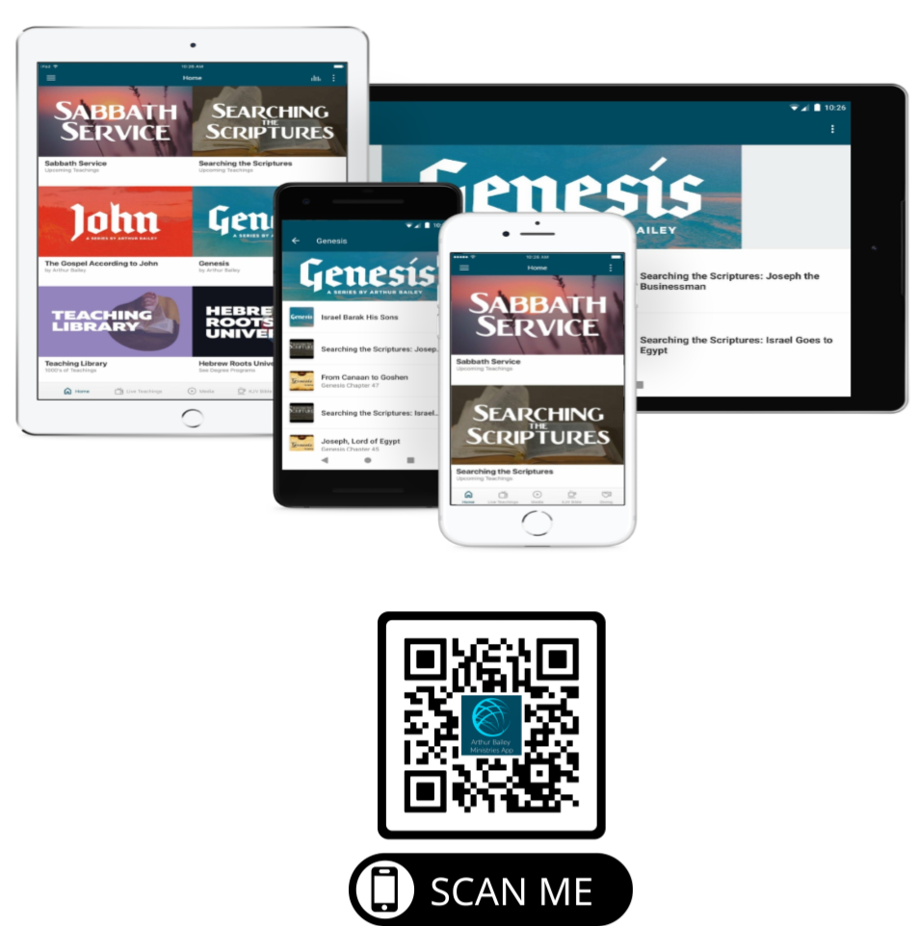

Slide 56
Mail in your support by check or money order.
Our Mailing Address:
P O Box 1182
Fort Mill, SC 29716

Slide 57
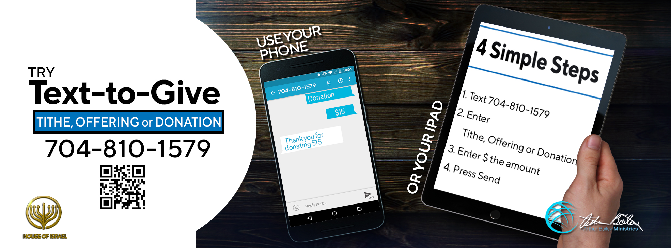

Slide 58
You can give by
Texting
Donate – Tithe - Offering
to
704-810-1579

